Slide 1


Slide 2
SeedEx
We aim to solve logistical challenges faced by seed companies within Kenya.
Challenges:
Top Up Delivery
Delays:
Ordering
Processing
Distribution

Slide 3
How?
Technology:
Immediately aggregating top-up orders from Agrodealers.
Calculate optimum truck inventories and routes.
Distributed Networks
Using a distributed ledger (IOTA), agrodealers act as transaction issuers in The Tangle to ensure the truthfulness and integrity of our data.

Slide 4

Problem
Losses incurred by seed companies due to inefficient logistic and distribution systems.
Market 3%
500-1000MT sales
Up to 40% loss
Losses due Inefficient logistics systems
.03
/sec
2.3K
/day
800K
/year
Source:Freshco

Slide 5
Value Proposition
Activities | Current Situation | Proposed Solution
Order Processing | 1 | Real Time
Planning & Logistics | 5 | 1
Dispatch & Delivery | 1 | 1
Total Days | 7 | 2

Slide 6
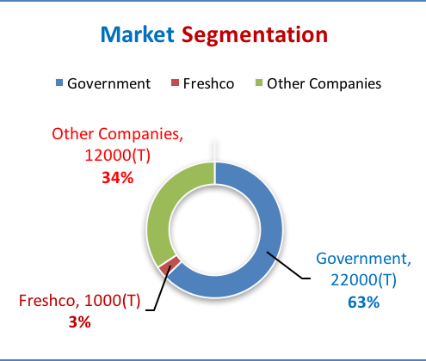




Business Model
Subscription
Data Sale

Slide 7




Marketing Plan
Referrals
One-on-One
Events & Meetings
Calls & SMS

Slide 8



Competition
Company | Route | Multiple Points | Best Route | Precise | Traffic
RAC
AA Route Planner
ViaMichelin
MyDrive
SeedEx

Slide 9
Roadmap
Phase 1
2 Months
Prototyping & Algorithms
Phase 2
6 Months
Pilot
&
Feedback
Phase 3
3 Years
Rollout
Phase 4
N Years
Scaling

Slide 10










Team
Elisha Bwatuti
Team Lead
Sophia Murage
GIS
Paul Muchai
Back End
Muthoni Wanyoike
Business
Larkin Crain
Back End
Mingina
Front End
Andrew Onyango
Back End
Jay Vachon
Front End
Enid Mwayuli
GIS
Enock Keya
Analyst

Slide 11
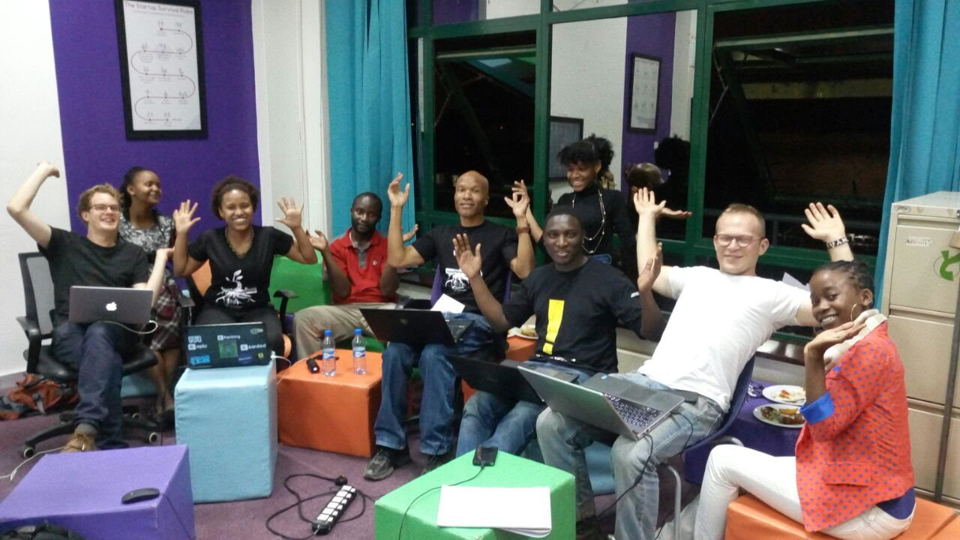
Thank You!!

