Slide 1

CS440/ECE448 Lecture 21: Markov Decision Processes
Slides by Svetlana Lazebnik, 11/2016
Modified by Mark Hasegawa-Johnson, 3/2019

Slide 2
Markov Decision Processes
In HMMs, we see a sequence of observations and try to reason about the underlying state sequence
There are no actions involved
But what if we have to take an action at each step that, in turn, will affect the state of the world?

Slide 3
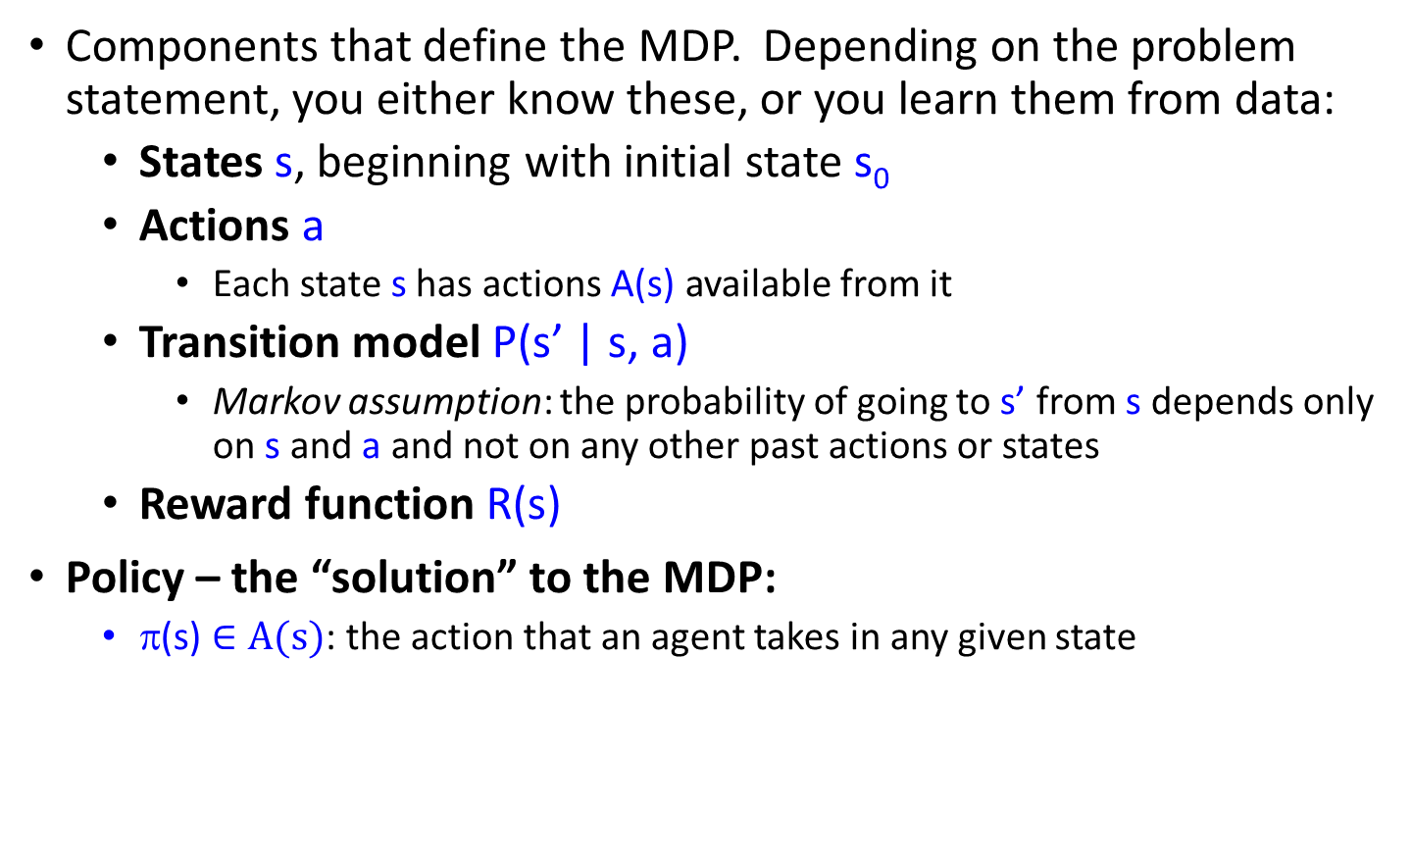
Markov Decision Processes
Components that define the MDP. Depending on the problem statement, you either know these, or you learn them from data:
States s, beginning with initial state s₀
Actions a
Each state s has actions A(s) available from it
Transition model P(s’ | s, a)
Markov assumption: the probability of going to s’ from s depends only on s and a and not on any other past actions or states
Reward function R(s)
Policy – the “solution” to the MDP:
π(s) $∈A(s)$: the action that an agent takes in any given state

Slide 4
Overview
First, we will look at how to “solve” MDPs, or find the optimal policy when the transition model and the reward function are known
Second, we will consider reinforcement learning, where we don’t know the rules of the environment or the consequences of our actions

Slide 5
Game show
A series of questions with increasing level of difficulty and increasing payoff
Decision: at each step, take your earnings and quit, or go for the next question
If you answer wrong, you lose everything
$100 question
$1,000 question
$10,000 question
$50,000 question
Correct:
$61,100
Q1
Correct
Q2
Correct
Q3
Correct
Q4
1/100
3/4
1/2
1/10
99/100
1/4
1/2
9/10
Incorrect:
$0
Incorrect:
$0
Incorrect:
$0
Incorrect:
$0
Quit:
$100
Quit:
$1,100
Quit:
$11,100

Slide 6
Game show
Consider $50,000 question
Probability of guessing correctly: 1/10
Quit or go for the question?
What is the expected payoff for continuing?
0.1 * 61,100 + 0.9 * 0 = 6,110
What is the optimal decision?
$100 question
$1,000 question
$10,000 question
$50,000 question
Correct:
$61,100
Q1
Correct
Q2
Correct
Q3
Correct
Q4
1/100
3/4
1/2
1/10
99/100
1/4
1/2
9/10
Incorrect:
$0
Incorrect:
$0
Incorrect:
$0
Incorrect:
$0
Quit:
$100
Quit:
$1,100
Quit:
$11,100

Slide 7
Game show
What should we do in Q3?
Payoff for quitting: $1,100
Payoff for continuing: 0.5 * $11,100 = $5,550
What about Q2?
$100 for quitting vs. $4,162 for continuing
What about Q1?
U = $3,746
U = $4,162
U = $5,550
U = $11,100
$100 question
$1,000 question
$10,000 question
$50,000 question
Correct:
$61,100
Q1
Correct
Q2
Correct
Q3
Correct
Q4
1/100
3/4
1/2
1/10
99/100
1/4
1/2
9/10
Incorrect:
$0
Incorrect:
$0
Incorrect:
$0
Incorrect:
$0
Quit:
$100
Quit:
$1,100
Quit:
$11,100

Slide 8
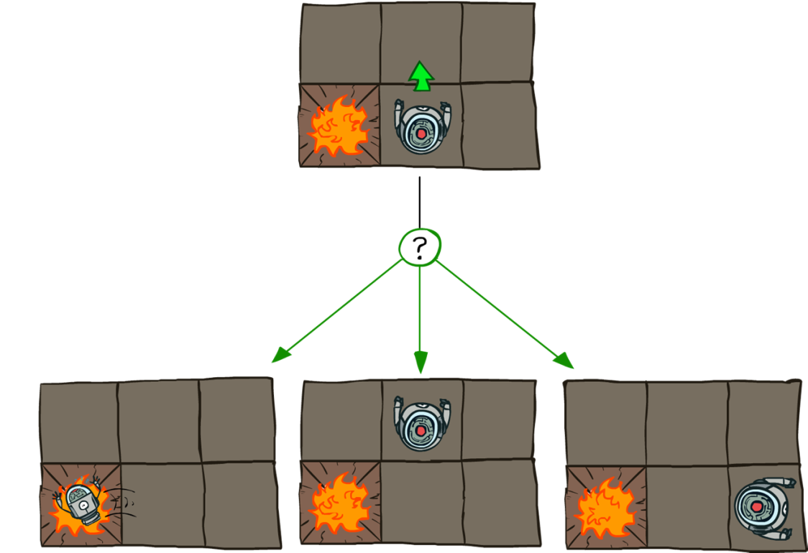
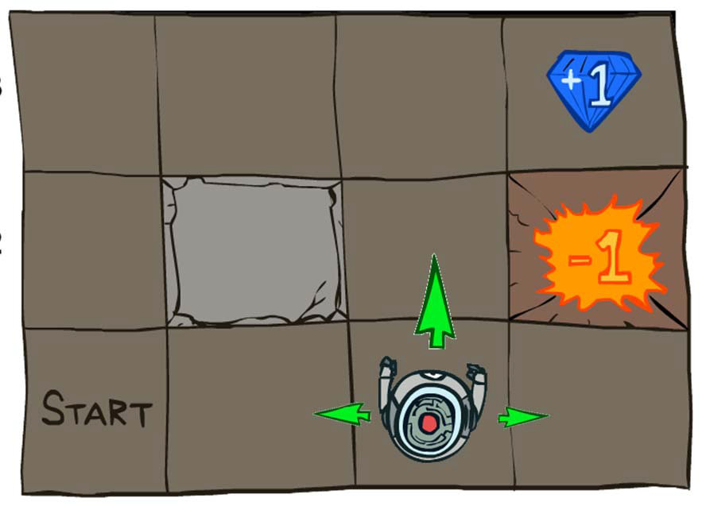
Grid world
Transition model:
0.1
0.8
0.1
R(s) = -0.04 for every non-terminal state
Source: P. Abbeel and D. Klein

Slide 9

Goal: Policy
Source: P. Abbeel and D. Klein

Slide 10
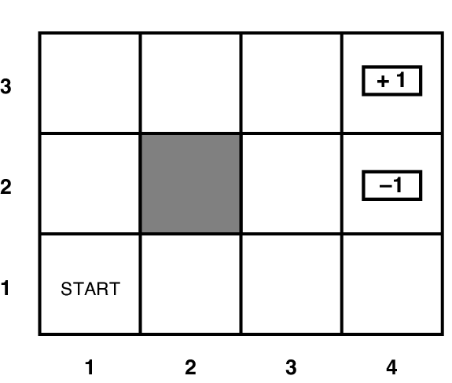
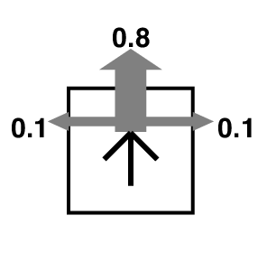
Grid world
Transition model:
R(s) = -0.04 for every non-terminal state

Slide 11
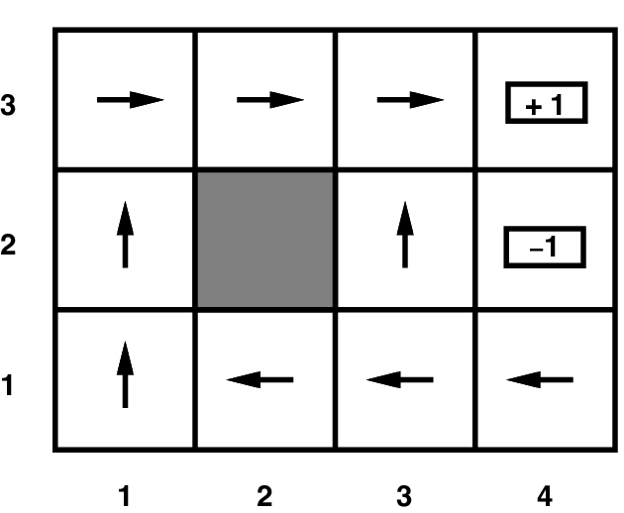
Grid world
Optimal policy when R(s) = -0.04 for every non-terminal state

Slide 12
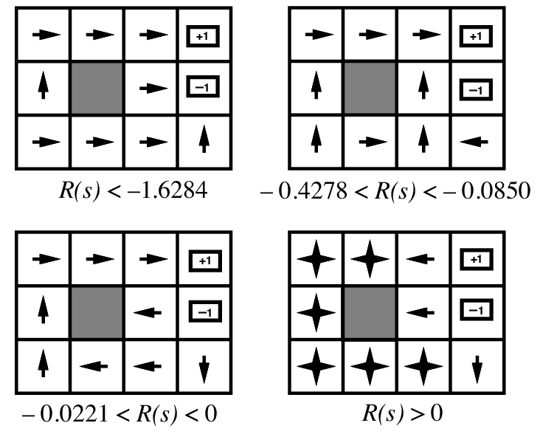
Grid world
Optimal policies for other values of R(s):

Slide 13
Solving MDPs
MDP components:
States s
Actions a
Transition model P(s’ | s, a)
Reward function R(s)
The solution:
Policy π(s): mapping from states to actions
How to find the optimal policy?

Slide 14
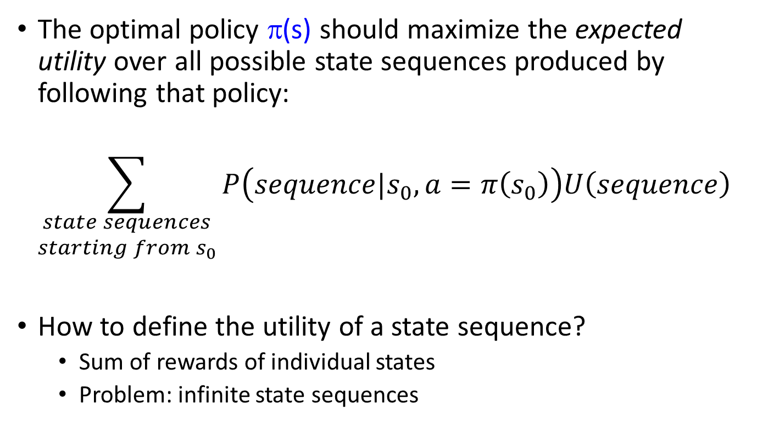
Maximizing expected utility
The optimal policy π(s) should maximize the expected utility over all possible state sequences produced by following that policy:
$$\sum_{\begin{aligned}state sequences \\ starting from s_{0}\end{aligned}}{P\left(sequence|s_{0},a=π\left(s_{0}\right)\right)U\left(sequence\right)}$$
How to define the utility of a state sequence?
Sum of rewards of individual states
Problem: infinite state sequences

Slide 15
Utilities of state sequences
Normally, we would define the utility of a state sequence as the sum of the rewards of the individual states
Problem: infinite state sequences
Solution: discount the individual state rewards by a factor γ between 0 and 1:
Sooner rewards count more than later rewards
Makes sure the total utility stays bounded
Helps algorithms converge

Slide 16
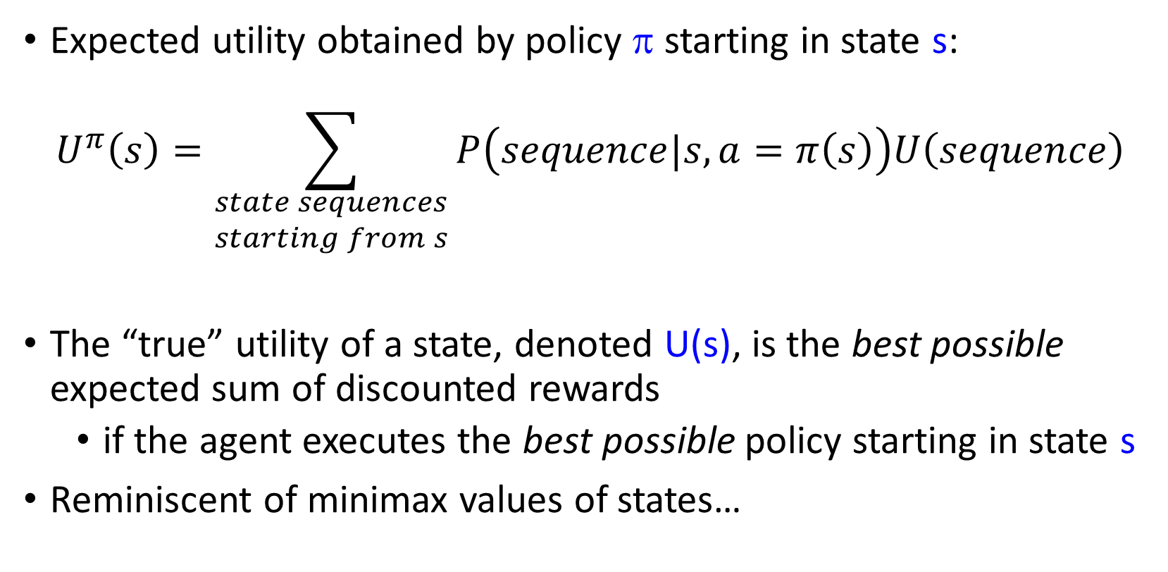
Utilities of states
Expected utility obtained by policy π starting in state s:
$$U^{π}\left(s\right)=\sum_{\begin{aligned}state sequences \\ starting from s\end{aligned}}{P\left(sequence|s,a=π\left(s\right)\right)U\left(sequence\right)}$$
The “true” utility of a state, denoted U(s), is the best possible expected sum of discounted rewards
if the agent executes the best possible policy starting in state s
Reminiscent of minimax values of states…

Slide 17
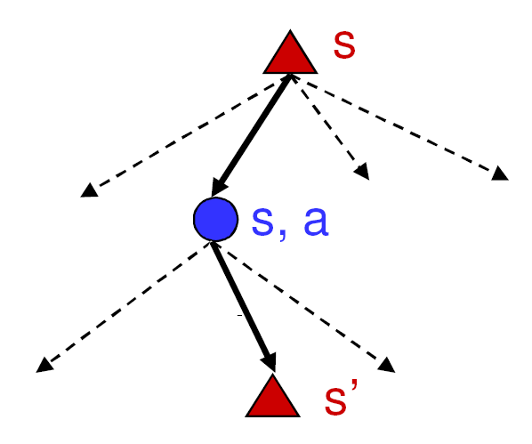
Finding the utilities of states
Max node
If state s’ has utility U(s’), then what is the expected utility of taking action a in state s?
How do we choose the optimal action?
Chance node
P(s’ | s, a)
U(s’)
What is the recursive expression for U(s) in terms of the utilities of its successor states?

Slide 18
The Bellman equation
Recursive relationship between the utilities of successive states:
Receive reward R(s)
Choose optimal action a
End up here with P(s’ | s, a)
Get utility U(s’)
(discounted by γ)

Slide 19
The Bellman equation
Recursive relationship between the utilities of successive states:
For N states, we get N equations in N unknowns
Solving them solves the MDP
Nonlinear equations -> no closed-form solution, need to use an iterative solution method (is there a globally optimum solution?)
We could try to solve them through expectiminimax search, but that would run into trouble with infinite sequences
Instead, we solve them algebraically
Two methods: value iteration and policy iteration

Slide 20
Method 1: Value iteration
Start out with every U(s) = 0
Iterate until convergence
During the ith iteration, update the utility of each state according to this rule:
In the limit of infinitely many iterations, guaranteed to find the correct utility values
Error decreases exponentially, so in practice, don’t need an infinite number of iterations…

Slide 21
Value iteration
What effect does the update have?
Value iteration demo

Slide 22
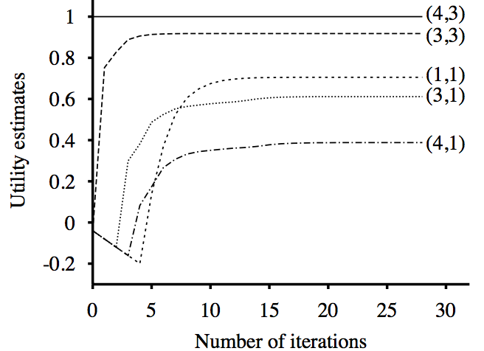
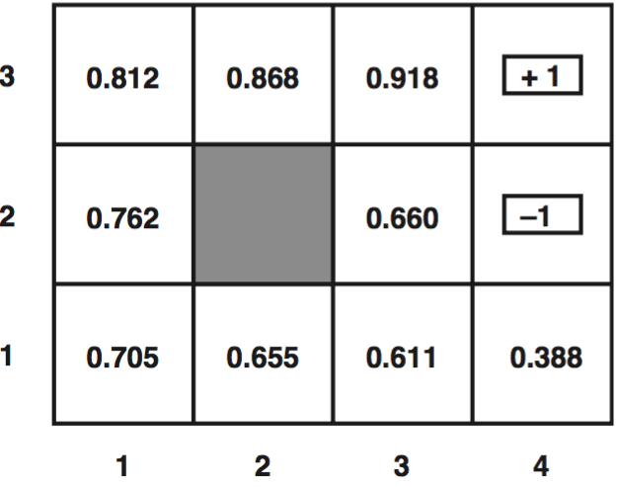
Value iteration
Input (non-terminal R=-0.04)
Utilities with discount factor 1
Final policy

Slide 23
Method 2: Policy iteration
Start with some initial policy π₀ and alternate between the following steps:
Policy evaluation: calculate U^{πi}(s) for every state s
Policy improvement: calculate a new policy π_{i+1} based on the updated utilities
Notice it’s kind of like hill-climbing in the N-queens problem.
Policy evaluation: Find ways in which the current policy is suboptimal
Policy improvement: Fix those problems
Unlike Value Iteration, this is guaranteed to converge in a finite number of steps, as long as the state space and action set are both finite.

Slide 24

Method 2, Step 1: Policy evaluation
Given a fixed policy π, calculate U^{π}(s) for every state s
π(s) is fixed, therefore $P(s^{′}|s,π\left(s\right))$ is an $s’×s$ matrix, therefore we can solve a linear equation to get U^{π}(s)!
Why is this “Policy Evaluation” formula so much easier to solve than the original Bellman equation?

Slide 25
Method 2, Step 2: Policy improvement
Given U^{π}(s) for every state s, find an improved π(s)

Slide 26
Summary
MDP defined by states, actions, transition model, reward function
The “solution” to an MDP is the policy: what do you do when you’re in any given state
The Bellman equation tells the utility of any given state, and incidentally, also tells you the optimum policy. The Bellman equation is N nonlinear equations in N unknowns (the policy), therefore it can’t be solved in closed form.
Value iteration:
At the beginning of the (i+1)’st iteration, each state’s value is based on looking ahead i steps in time
… so finding the best action = optimize based on (i+1)-step lookahead
Policy iteration:
Find the utilities that result from the current policy,
Improve the current policy

