Slide 1

Project Nirbhaya
connect | collaborate | cure
Notes:
Project Nirbhaya
Nirbhaya is the one who is not afraid.
Nirbhaya is a common platform for vulnerable, patients, survivors, doctors and volunteers to fight against breast cancer. Nirbhaya is an ideology to eradicate breast cancer by best use of technology. Nirbhaya is a smart companion of its every user in the journey of survival .

Slide 2
Statistics
Notes:
Let’s have a look at statistics.

Slide 3






1 in 8
women
develop
breast
cancer
40
An
Important
Number
NO
Family History
Healthfeed.uofuhealth.org | buffalohealthyliving.com | breastcancer.org
Notes:
Approximately 1 in 8 women are diagnosed with invasive breast cancer in their lifetime and 1 in 39 women deceases from breast cancer.
As soon as women hits the age 40, the chances increase.
Breast cancer can occur even if there is no family history.
People around us are becoming victim of one or the other type of cancer but statistics shows that breast cancer is the leading cancer in women.
Generally, women do not consider themselves as being susceptible to breast cancer. Women should be aware of the personal risk factors.

Slide 4
Problem
Notes:
Design Thinking approach has been followed to develop empathy with target users, define their problems, ideate innovative solutions and build prototype.

Slide 5




Lack of financial protection in healthcare
Financial Deficit
Lack of positive outlook
Lack of awareness about breast cancer
Societal Concern
Information Gap
Lack of accessibility to technology
Technical Deficiency
Notes:
Our closer interactions with practitioners, survivors, kith and kin of deceased, volunteers and fund raisers helped us to group the problems in to 4 categories.
Societal Concern: There is a lack of positive outlook from the society towards victims, survivors and vulnerable. There is a need for boosting the morale.
Financial Deficit: Lack of funds and knowledge about the healthcare facilities, insurance is one of the primary reasons for the vulnerable and victims to skip diagnosis and treatment.
Information Gap: Lack of awareness about the criticality of the disease, ways to diagnose and cure are important reason for increase in the number of victims and fatality.
Technical Deficiency: Lack of knowledge about available technical resources and their accessibility is a big factor in most rural areas.

Slide 6
Connect Collaborate
Cure
Notes:
An intelligent platform that provides one stop shop solution to all users can reduce the number of fatalities and improve the productivity to a larger extend.
Our proposed state of art solution, “Nirbhaya” achieves this under the theme connect, collaborate and cure.

Slide 7


Over 70% of people prefers interactive UI/UX.
Over 75% of women finds it difficult to get an appointment with right doctor
Connect Collaborate
Cure
Over 13% of breast cancer patients finds themselves in dilemma of going to right doctor.
Over 30% of patients find themselves alone in the fight
Notes:
“Nirbhaya”, an intelligent platform bridges the gap between vulnerable and practitioners, habitants and volunteers, Tech deficits and abundant, indigent and the funding firms. Proposed solution engages all type of users with a highly interactive user interface that provides appropriate information, suggestion and smart assistance.

Slide 8














Ambassador
Hospital
Survivor
Pharma
Clinics
Community
Race
Insurance
Family
Practitioner
Individual
Fund Raisers
Volunteer
Diagnostics
Notes:
Nirbhaya is a platform for collaboration of every unit which are involved in a survivor’s journey.
Nirbhaya is a platform for individuals to connect to healthcare facilities, Volunteers to collaborate with stakeholders to create awareness, firms to help in fund raising, practitioners to improve their productivity, take and review decisions quickly, community to collaborate to provide necessary strength and hospitality, Individuals to perform self-assessment, calculate risk and manage appointments.

Slide 9






Smart Assist
Smart Feeds
Smart Radar
Intelligently analyzes symptoms & mammograms and enables practitioners to decide further diagnosis or treatment options. It swiftly connects to peer group for decision reviews. It’s a one-stop shop for doctors to get all the information of patients.
Posts personalized feeds of awareness programs, survivor stories and healthy lifestyle to users. It publishes demographic & healthcare feeds to volunteers for efficient campaign and notifies practitioners with healthcare advancement feeds.
Smartly senses high-risk groups or individuals based on their community. It promotes effective volunteerism and specific awareness programs. It organizes medical campaigns and virtual engagement sessions by practitioners for vulnerable.
Smart Scheduler
Chatbot
Smart Conclave
Detects self assessed potential positive cases and automatically schedules appointment with specialist practitioners. It smartly reserves slots at radiologist for diagnosis. It sets follow up reminders for survivors on recommended time intervals.
Creates an engaging and effective experience for users. It simulates a conversation in natural language and provides relevant assistance. Further, escalates users to specialists who clarify user queries and recommend related procedure.
Organizes smart collaboration with peers for decision evaluation and swiftly connects for expert opinion. It arranges a virtual summit with survivors to provide guidance and reassurance and virtual conclaves for volunteer induction programs.
Notes:
We need to enable Nirbhaya with cutting edge technology stack and AI to build these capabilities
Chatbot
Nirbhaya is enabled with an interactive chatbot to help a user from navigating to right content to a conversation filled with positive quotes.

Slide 10

Smart Assist
Running against set of 3000 patients of similar kind
Getting insights using deep learning analysis for each Tumor sites
Oncotype score
Oncotype risk
K167
E-Cadherin
Detection category
Suggested procedure
Analyzed report
Background
Age decade
BIRAD
Impression
Running results against Background and Pathology reports of patients
Grading tumor points and categorizing mammograms to t1/t2/t3
Notes:
Smart Assist
Smart assist provide intelligent assistance to doctors to perform accurate diagnosis, take quick treatment decision.
It takes several inputs of test results and reports. It then run them against a set of present data of patients of similar kind. It finds vital points in a mammogram and grade tumor in t1, t2 or t3. Then it runs the result against given background and pathology reports of patient. It gives a detection category, suggests the procedure ideal for such patients and filter the results for specific important points.

Slide 11
Smart Feed
Dynamic analysis of user input by
the intelligent
model
Browsing history
Recent activities
Frequently visited topics
Risk assessment inputs & selections
Chatbot queries
Personalized feed optimization
Priority updates
Interactive assessments
Leverage
personalized feed to the user
Segment the analyzed inputs into categories
Make use of
smart & rule-based decision methods
Notes:
Smart Feed
Smart Feed shows relevant content to users, delivering relevant inspirational stories to victims, correct information to family and volunteers.
It works on browsing history, recent activities, chatbot queries and risk assessment inputs. It analyzes the data to find the category of recommendation, then provide it into regression model-based recommendation system. It engages user by showing personalized feeds, priority updates and interactive assessments. It enables Nirbhaya in landing more user every day.

Slide 12
Smart Radar
Determine the data based on user location
System inputs determined by location
Volunteer events and activities
Hospital information systems
Enhance reachability to the vulnerable category
Personalized recommendations increases user engagement
Analyze and evaluate data based on demographic stats
Run simulation to detect similar
occurrences in
target location
Enhanced geo-targeting algorithm obtains valid results
Notes:
Smart Radar
Smart Radar finds the high-risk potential regions to promote effective Volunteership and organize awareness programs for the needy.
It intelligently uses data from demography, user engagement and health care facilities to determine potential regions. User inputs and statistical data of breast cancer patient are used to mark the different risk levels of vulnerable zone. It suggests smart conclave for awareness programs and volunteer engagements. Additionally, smart radar provides a way to retail connects for contribution in awareness.

Slide 13
Smart Scheduler
Automated data aggregation helps predict a particular appointment
Schedule prediction based on historical information and localized patterns
Risk assessment results
Test report evaluation
Frequent searches
Recommend the critical tests needed
Reserve best fitting and free time slots on user’s approval
Electronic medical records
Hospital and Radiology information systems
Display the information on the schedule and request user approval
Model trains on its own site scheduling data and decision-making definitions
Notes:
Smart Scheduler
To bear the problem of managing different kinds of users, with all the information which system collects from self-assessment results and smart radar outputs, smart scheduler assists users with scheduling an appointment or a virtual conclave for awareness.
It works with the inputs of risk assessment results, hospital and radiology information systems. We automated data aggregation to predict an appointment in such a way that it suggests appointments and conclaves to respective users.

Slide 14
Smart Conclave
Channeling data to volunteers' feed
Channeling data to counsellor feed
Smart Radar results
Generic system evaluation
User activity & requests
Smart scheduled conclave events
Effective collaboration through peer reviews
Accumulating outputs and creating conclave possibility
Channeling data
to Doctors’ feed
Notes:
Smart Conclave
To organize awareness program in the required regions with available volunteers, smart conclave run on the present data and send virtual conclave recommendation to users.
It takes input from smart Radar, user activity and requests. It channels the data to volunteers, available doctors and counsellors feed and accumulate their responses to create next conclave possibility. It sends the result to smart scheduler to create the next awareness conclave.

Slide 15
Connect
Notes:
Now that we have seen how technology is inbuilt in every core use of Nirbhaya, let’s see how it helps us as a system to connect

Slide 16


Success Story
Emotional Support
Awareness
Smart Appointments
Expert Opinion
Self Assessment
Awareness
Events
Endorsement
Philanthropy
Welfare Programs
Emotional Support
Survivor
Ambassador
Awareness
Emotional Support
Analyze Risk
Family Screening
Volunteership
Survivor Connect
Organize Events
People Connect
Social Media
Awareness
Technology Bridge
Information Tunneling
Family
Volunteer
Self Assessment
Analyze Risk
Expert Opinion
Smart Appointments
Claims
Interactive Chatbot
Insurance
NGO
Corporates
Agency
Retail Connect
Awareness
Individual
Firms
Awareness
Events
Emotional Support
Success Stories
Welfare programs
Survivor Connect
Consultation
Diagnosis
Cure
Expert Panel
Pharmacy
Counselling
Healthcare
Community

Slide 17
Collaborate
Notes:
Nirbhaya is a platform for individuals to self asses themselves. It enables them to analyze risk, get an expert opinion, get a better knowledge on claims and a positive buddy as Nirbhaya’s integrated chatbot.
It provides health care system a platform for consultation, diagnosis, smart connect to peers and to create a counselling session. The seamless integration of various input, output channels and internal subsystems improves the productivity of practitioners and other stakeholders of healthcare system. This also helps them to prescribe the appropriate drugs and recommend the best possible treatment.
Firms can give proper knowledge and description about insurance plans in Nirbhaya, it gives a platform to NGOs to get needy victims, it gives agencies and retail connect an opportunity to spread awareness by offering a self-assessment code attached to their apparels.
Volunteers in Nirbhaya can connect and organize events, it also provides them content and posters to spread on social media, it allows them to be the technology bridge for less accessible people.
It provides knowledge about the disease to family and community which encourages them to volunteer. It also provides information about emotional etiquette around a victim.
It is a platform for Survivors to smart schedule their follow up screenings and publish stories to boost the confidence of the vulnerable. Thus, spreading awareness about breast cancer and its fatality. Continuous encouragement to perform self-assessment can reduce the fatality due to recurrence.
Ambassadors with stardom can create a positive outreach to the community using Nirbhaya. The platform also has the capability to engage them in various fund-raising events and philanthropy initiatives. They can use this platform for endorsing various post cure accessories, community centers that provides emotional support to affected individuals.

Slide 18










Individual
Read survivor stories
Mention physical symptoms
Take risk assessment test
Gather info & facts
Connect with oncologist
Upload medical reports
Seek financial assistance
Attend awareness & counselling sessions
Practitioner
Manage appointments
Report assessment
Recommend Treatment
Seek panel Advice
Provide expert opinion
Prescribe medicine
Recommend Radiology test
Provide Counselling
Volunteer
Connect to individuals
Organize awareness event
Provide technical help
Assist with right insurance
Provide NGO details
Firm
Organize awareness campaigns & fundraisers
Provide medical insurance
Connect with contributors
Endorse events

Slide 19
Cure

Slide 20



Share success story
Emotional etiquette
Book/Edit Appointment
Personalized test reports
Virtual Consultation
Practitioner
Patient
Book/Edit Appointment
Virtual Consultation
Community
Volunteer
Organize events
Awareness for self assessment
Awareness on recurrence
Counsellor

Slide 21
Summary
Notes:
And that brings us to the end of our proposal presentation.

Slide 22
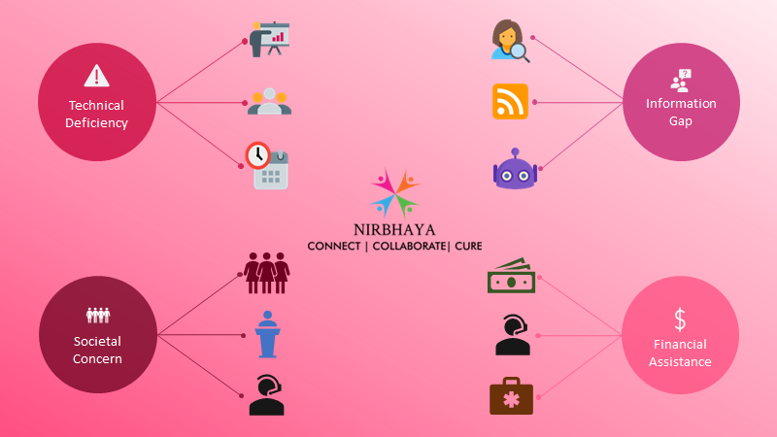
Technical Deficiency
Information Gap
Financial
Assista
Societal
Concern
Notes:
We have seen how Nirbhaya as a platform prevails over the technical deficiency in the existing system through connecting smart features such as Smart Assist, Smart Scheduler and Smart Conclave.
We have also seen how Nirbhaya as a platform bridges the information gap in the existing system by providing personalized feeds to all stakeholders. Highly interactive chatbot provides support round the clock to all the users.
Societal concern is one of the major factors affecting the awareness of breast cancer and its cure. Nirbhaya as a platform overcomes this concern by engaging vulnerable communities with volunteers and ambassadors.
Availability of financial support will do away with many underprivileged vulnerable by providing financial assistance. Nirbhaya as a platform allows firms, fund raising bodies, third party mediators and healthcare systems to collaborate and provide appropriate financial aid to the needy.
It is our strong belief that the proposed solution, Nirbhaya will improvise the existing eco system by creating awareness among the larger population and encourage individuals to connect, collaborate and cure breast cancer!
In the end, let us all resonate with what we learn from this line of Roy T. Bennet, “Do not fear failure but rather fear not trying.”

Slide 23
Crew
Notes:
Team consists of 4 members.

Slide 24


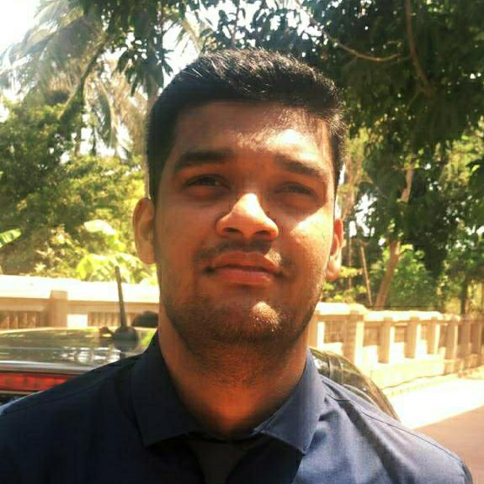
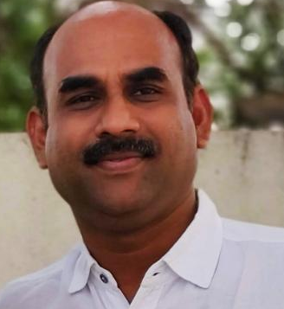
Aditya
aditya.aditya@Infosys.com
Vishaak M
vishaak.m@Infosys.com
Ajeesh GP
ajeesh_gp@Infosys.com
Vernon Cabral
vernon.cabral@Infosys.com
TEAM

