Slide 1
Predictive Analytics Solution
Shangwu Yao
April 28, 2018

Slide 2
Key Challenges
The current MSA products have not incorporated predictive analytics solutions
Competitors have already notice this business opportunities:
Predictive Solutions [1, 2, 3]
Predictive Safety [4]
Arbill [5, 6]
The data collected currently are insufficient for advanced analytics (especially for predictive analytics applications).
Accuracy and reliability requirements for predictive analytics

Slide 3
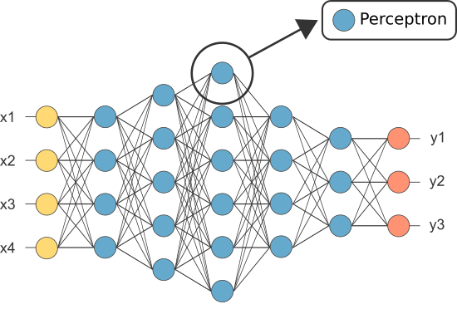
Solution
Machine learning-based failure detection
Learning from past experiences without human supervision
Can match human experts performance with enough training data
Approach #1: Using Deep Neural Networks
Input: a fixed window of information in several consecutive time steps
Output: probability of triggering an alarm in the recent future (hazardous level)
Notes:
I propose to use a solution that combines machine learning-based failure detection
With abnormality detection designed by human experts
There are two models that could be used in this situation, the mlp and lstm model

Slide 4

Solution
Machine learning-based failure detection
Learning from past experiences without human supervision
Can match human experts performance with enough training data
Approach #2: Using LSTM
Input: average and peak gas level and temperature at different time steps
Output: whether the alarm will be triggered or not at what time

Slide 5
Solution
Abnormality detection
Approach #1: Hand-picked Features
Experts pick key indicators of abnormality
Constantly detect the level of abnormalities
A sharp rise or drop of those values might indicate a sudden change in the environment, which could lead to accidents
Approach #2: Trending Detection
A steady increase or decrease of gas level might be another sign of upcoming hazards
A machine learning model (predictor) can simulate the trend forwards to indicate if there is an abnormality
Notes:
Machine learning alg might not perform well when data is different from traning data
So abnormality detection that uses hand-picked features and trending detection designed by hu
Could be a reliable supplement method for machine learning algorithms

Slide 6
Solution
Better Sensor Data and Enterprise Infrastructure
Improving Collected Data
Data shall be collected with lowest level of information (e.g. raw sensor readings with continuous values, leave the post-processing to the software);
It will be helpful to include location data in periodic in each reading, so as to facilitate location-based predictive.
Improving Enterprise Infrastructure
Building a data center that store all data from gas detectors over the world;
Provide open APIs (at least internally) for data access, isolating the data from applications, so that different groups of engineers can access and process the data simultaneously.
Notes:
The quality of colletected data and enterprise infrastructure need to be improved

Slide 7
Go-to-Market Strategy
Branding: Startup a subsidiary predictive analytics company under MSA, with a fresh and energetic appearance to bring impact to the (traditional) industry;
Demoing: Setup a dedicated team with marketing and technical professionals to reach out to different companies with need for gas detection, and present (awesome) demos to them, inferring the great amount of potential risks and hazards that can be mitigated by the solution and thus the cost saved by it;
Like-a-Startup: Run the subsidiary company like a startup, recruiting talents and attracting venture; work with the investors besides MSA on marketing strategy;
Event Marketing: Create or capture the opportunities of events that best show the potential of this product in saving lives, preventing disasters and reducing cost.

Slide 8
Revenue Projection
According to Stratistics MRC, the Global Predictive Analytics market is expected to grow from $3.89 billion in 2016 to reach $14.95 billion by 2023 with a CAGR of 21.2%. [13, 15]
According to Owler [14], a competitor in the same domain created an estimated revenue of $31.8M per year. So it is projected that this product has the potential to bring similar amount of revenue 2~3 years after released to the market.

Slide 9
Conclusion
Accuracy and reliability are the two most important considerations in predictive analytics for gas-related safety hazards
I presented a reliable method that combines abnormality detection and machine learning-based hazard prediction algorithms
Machine learning models such as Multi-layer perceptron and Long short-term memory could be used to incorporate temporal information
It is projected that the predictive analytics solution can generate a decent amount revenue for the MSA company

Slide 10
References
[1] Predictive Solutions: https://www.predictivesolutions.com
[2] Griffin Schultz. Advanced and Predictive Analytics in Safety: Are They Worth The Investment? In EHSToday, 2013.
[3] Elliot Laratonda. Predictive Analytics Using Leading Indicators to Prevent the Next Injury. ASSE, 2014.
[4] Predictive Safety: https://www.predictivesafety.com
[5] JULIE COPELAND. REDUCE WORKPLACE INJURIES WITH PREDICTIVE ANALYTICS.

Slide 11
References
[6] Arbill: http://www.arbill.com/vantage
[7] Sepp Hochreiter and J ̈urgen Schmidhuber. Long short-term memory.Neural computation, 9(8):1735–1780, 1997.
[8] J.A.K. Suykens and J. Vandewalle. Least squares support vector machine classifiers.Neural ProcessingLetters, 9(3):293–300, Jun 1999.
[9] Pedro F Felzenszwalb, Ross B Girshick, David McAllester, and Deva Ramanan. Object detection withdiscriminatively trained part-based models.IEEE transactions on pattern analysis and machine intelli-gence, 32(9):1627–1645, 2010.

Slide 12
References
[10] Ross Girshick. Fast r-cnn.arXiv preprint arXiv:1504.08083, 2015.
[11] Abhinav Shrivastava, Abhinav Gupta, and Ross Girshick. Training region-based object detectors withonline hard example mining. InProceedings of the IEEE Conference on Computer Vision and PatternRecognition, pages 761–769, 2016.
[12] Thomas G. Dietterich. Ensemble methods in machine learning. InMultiple Classifier Systems, pages1–15, Berlin, Heidelberg, 2000. Springer Berlin Heidelberg
[13] Hector Costello. Global Predictive Analytics Market 2017 Statistics, Facts and Figures, Share, Segmentation and Forecast by 2023. Orbis Research, 2017.

Slide 13
References
[14] Predictive Solutions Competitors, Revenue, Number of Employees, Funding and Acquisitions
[15] Predictive Analytics-Global Market Outlook (2017-2023)
[16] Predictive Analytics Market Trends

