Slide 1

Gayathri Ramakrishnan and Nikhila Manikandan

Slide 2
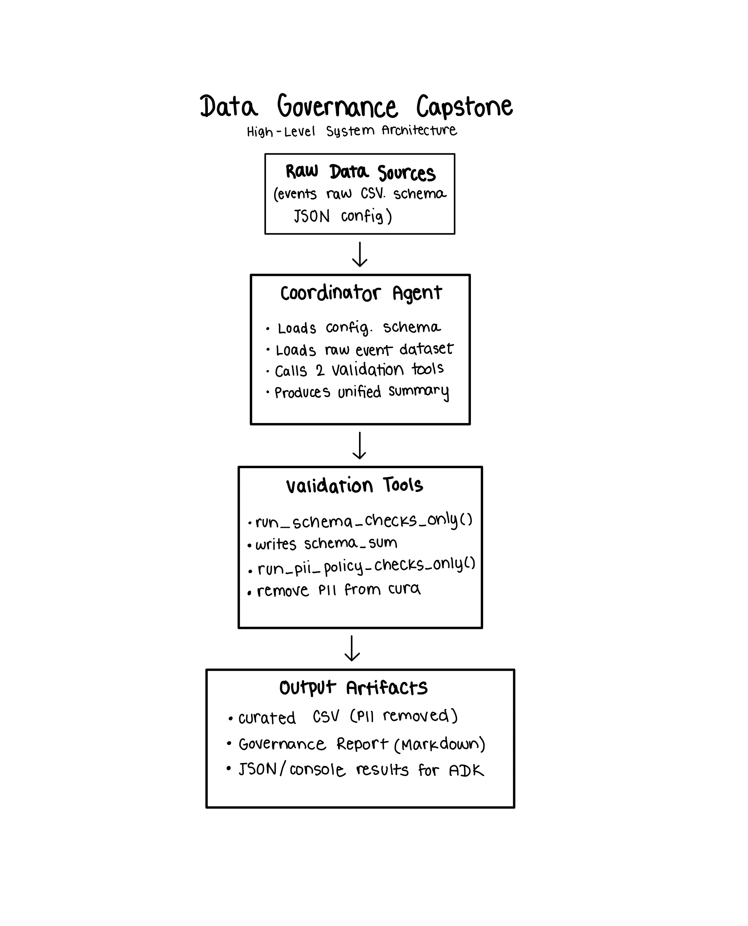

Slide 3
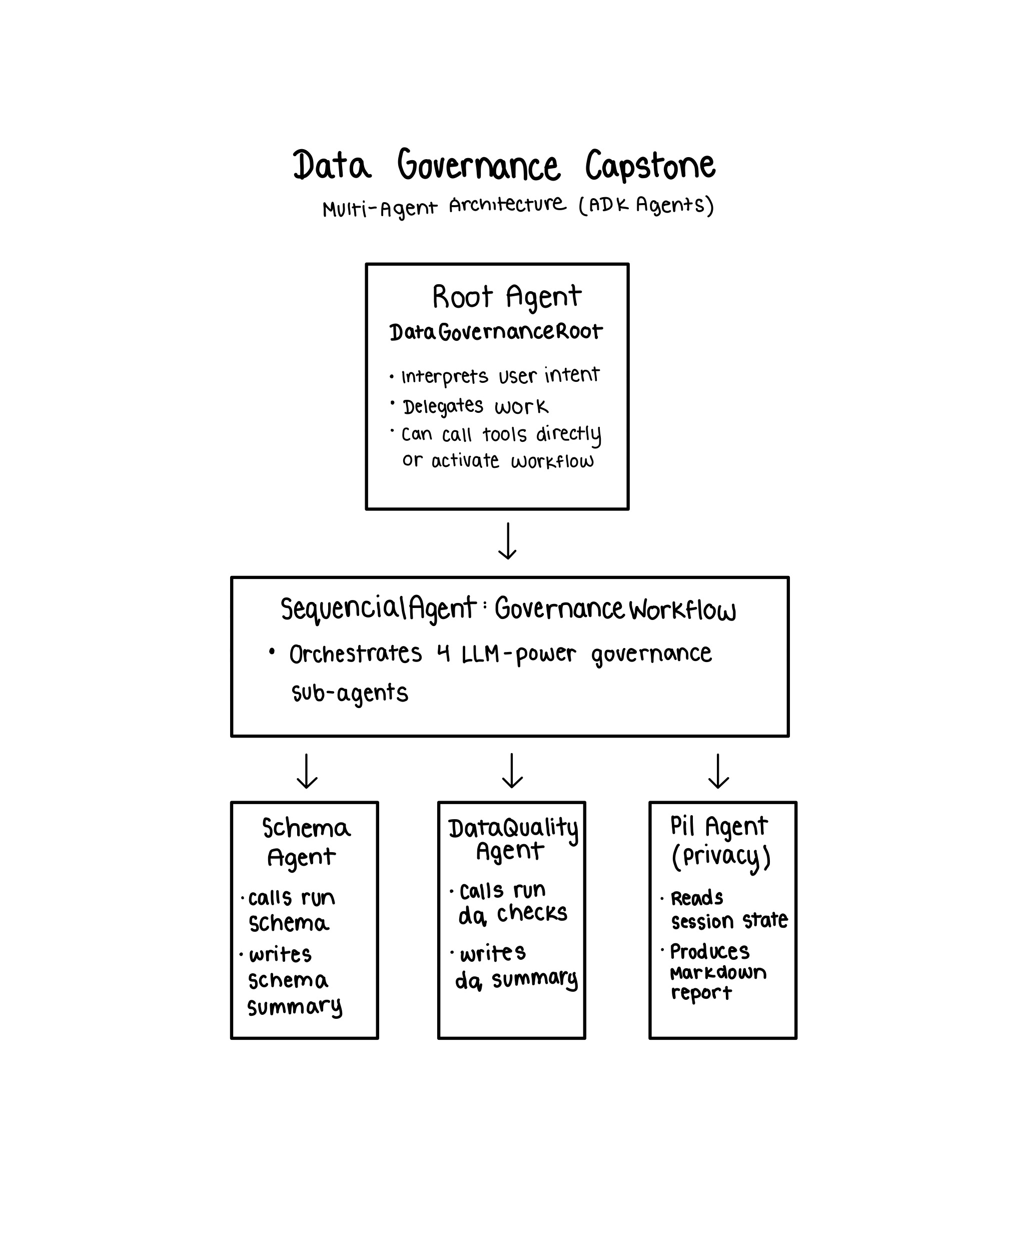

Slide 4
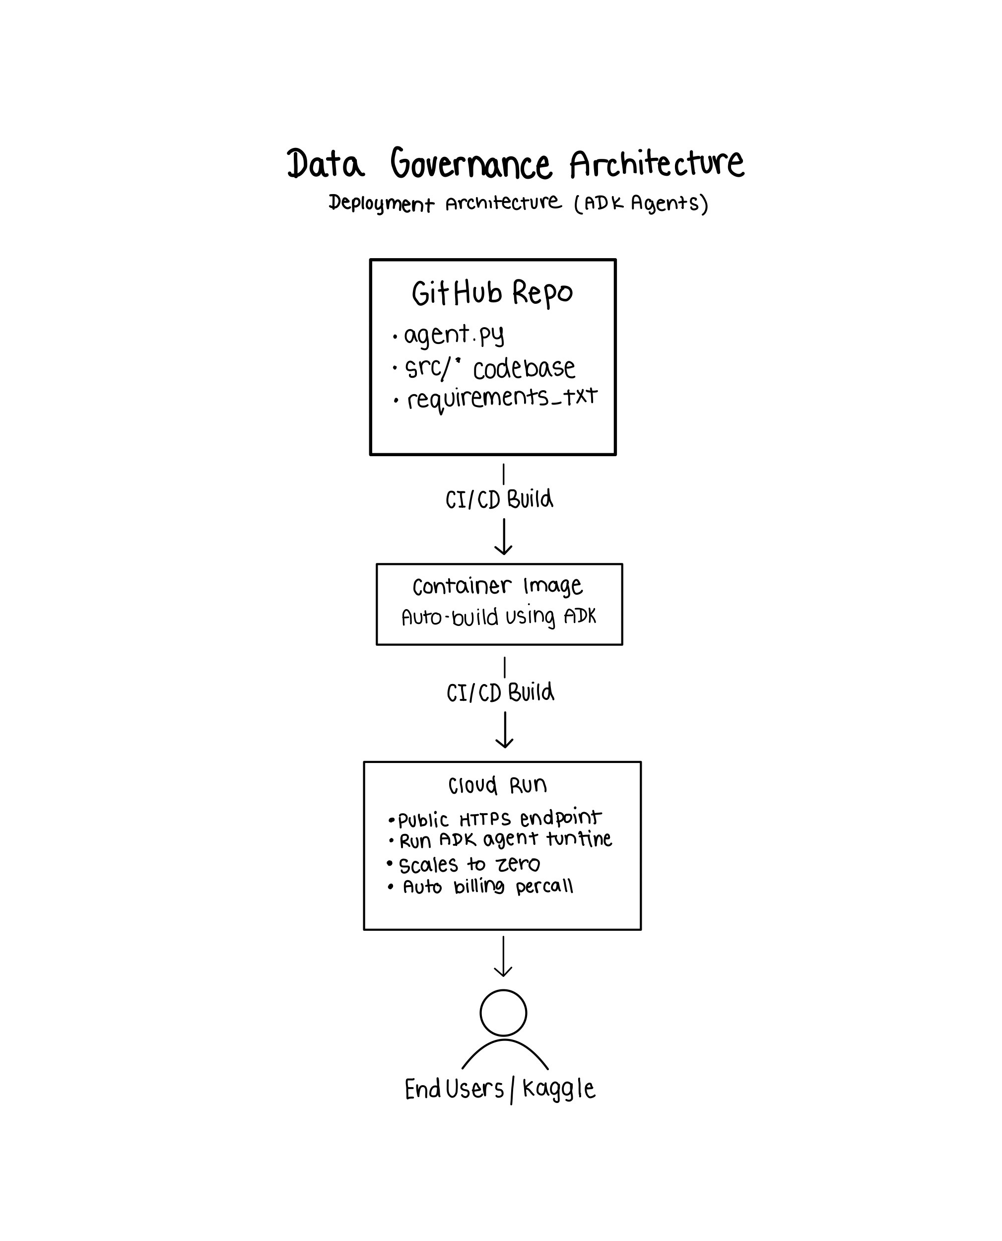

Slide 5
Demo

Slide 6
Thank you!

