Slide 1
Credit Score
Customer Engagement platform

Slide 2
Concept
The main scope of the Project is to bring more customers in the insurance companies with a profitable way, both for the customer and the Company it self. The entry problem out of most insurance companies is how to win a new customer or how to convince their own customers to register all their insurances plans on their current Insurance Company(Car insurance, House insurance, Medical insurance) and so on.
An other huge problem is how to get all the Connected Persons (family members of the Customer), to make all their Insurance plans concurrently. How is this possible to achieved and be profitable for both Customer and Insurance Company?

Slide 3

Idea
We will Develop a Credit score system for each of the Customer. Each customer will have value of points on its account and this point will be a discount at the end of each contract cycle.
We are assuming that 1 Point is 0.1 Euro, so every 10 points you get 1 Euro discount.

Slide 4
Insurance Company problems
Get New customers
Customer satisfaction
Get the whole family of the current customer
Keep your customers satisfy and increase your customers.
Make them to make new and more plans.

Slide 5
Customer Thoughs
Expensive insurance schemes
Insurance Company Confidence
More Schemes, more money.
No reason to make all plans in one company.

Slide 6
Credit Score Solution
Each customer will have a Credit score application
Customer can use the application to gain points which can be redeem as discount to their insurance plans.
There are two ways to gain points:
Customer Referral program
Tracking aggressive driving

Slide 7
Customer Referral Program
Earn points for every successful scheme from their referrals on the insurance company both of the customers earn some points. (many schemes= many points = more discount)
Points from every referral’s scheme can be received into customers’ account and can be used as discount
Customer earn points for every referral’s plan renewal

Slide 8
Track Driving Behavior
We are tracking drivers driving behavior using mobile phone application utilizing Accelerometer, gyro meter and magnetometer .
We are crediting customer’s account with points based on his profile score each month.(No credit if score is <50%)

Slide 9
Tools Used
React Native - front end – Mobile App
Python Flask – Backend – Server Side
MongoDB – Database
Keras library on top of Tensorflow (ML)

Slide 10
Track Driving Behavior
We used machine learning model to track driver behavior.
Achieve 86% accuracy with a 2-layer fully connected feedforward neural network
We use data from accelerometer, gyrometer and magnetic sensor and a publicly available dataset
We train 2 models using labeled dataset for:
- Aggressive Acceleration
- Aggressive Breaking
- Aggressive turn (right/left)
- Aggressive lane change (right/left)
- Non-aggressive driving

Slide 11
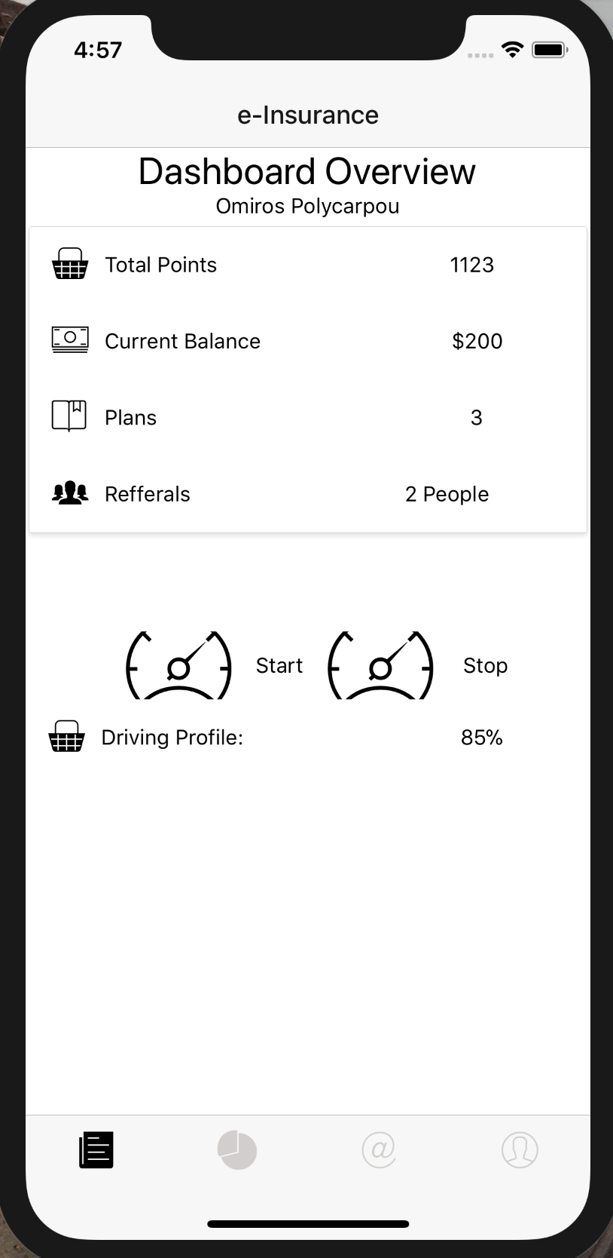
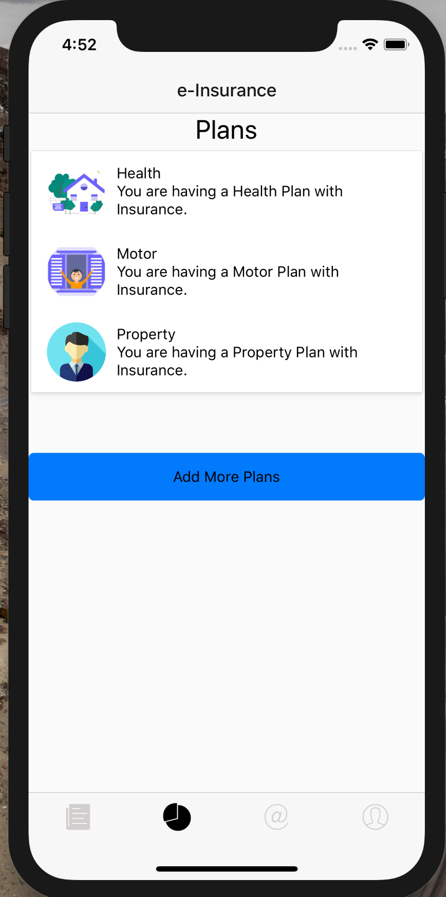
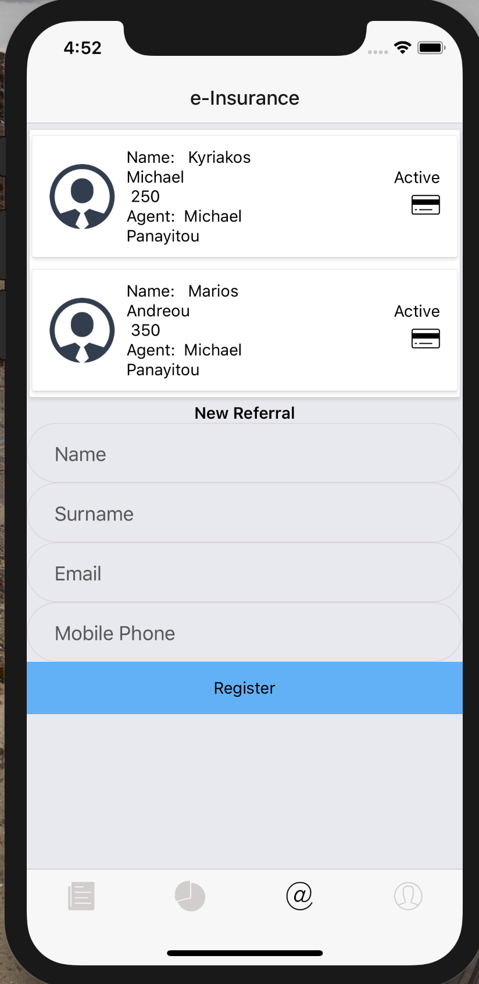
Screenshots

Slide 12
Future Improvements
Make application more user friendly.
Train our machine learning model with more data so it will be more precise.
Advertise our application properly

Slide 13
Provide customer rewards and prompt them bring more people to our insurance.
Convince customer to be “loyal” to our insurance company.
Reward our customer for driving safe. Reduce risk for accidents. Cheaper insurance plans.

