Slide 1

insure.me
Broadcast your insurance needs
created by

Slide 2
Problem
“My insurance expires soon and I do not have the time nor the desire to look for a better deal”
“I feel that by renewing my current insurance plan without looking into other offers I am missing out”

Slide 3

Solution
Market place
Marketplace
Panicos
Andreas
Customer broadcasts insurance needs
Insure my car
Details
Reg.No.
Age.
Submit

Slide 4
Solution
Market place
Listings
1. Panico’s car listing
View
Panicos
Andreas
Customer broadcasts insurance needs
A listing of the request is created in the marketplace
Insurer checks the marketplace for new listings
Proceeds to submit an offer to Panico’s listing
Panico’s car listing
Insure my car
Details
Reg.No.
Age.
Details
Reg.No.
Age.
Details
Reg.No.
Age.
Quote
$16
Submit
Submit

Slide 5
Solution
Market place
Listings
1. Panico’s car listing
View
Panicos
Andreas
Customer broadcasts insurance needs
A listing of the request is created in the marketplace
Customer reviews offers and proceeds with the preferred one
Insurer checks the marketplace for new listings
Proceeds to submit an offer to Panico’s listing
Listing closes with acceptance of the offer
Car listing
Panico’s Car listing
Insure my car
Panico’s Car listing
Insurer
Andreas
Details
Reg.No.
Age.
Quote
$16
Quote
$16
Quote
$16
Your offer has been accepted
Accept
Your offer has been accepted
Submit
Reject

Slide 6
Solution
Market place
Listings
1. Panico’s car listing
View
Panicos
Andreas
Customer broadcasts insurance needs
A listing of the request is created in the marketplace
Customer reviews offers and proceeds with the preferred one
Insurer checks the marketplace for new listings
Proceeds to submit an offer to Panico’s listing
Listing closes with acceptance of the offer
Car listing
Panico’s Car listing
Insure my car
Panico’s Car listing
Insurer
Andreas
Details
Reg.No.
Age.
Quote
$16
Quote
$16
Quote
$16
Your offer has been accepted
Accept
Your offer has been accepted
Submit
We reverse aggregate the insurance business
Reject
Customers feel the comfort that they have reviewed several offers and chose the best one within limited time.
Insurance companies now have the opportunity to quote customers that they would have never ended up at their doorstep.

Slide 7
Business Plan
Business Opportunity
Insurance industry is experiencing a transformation
Digital servicing is expected by customers
Platform does not exist in Cypriot Market
Milestones
300 man days to develop platform
Investment to recruit 3 full time developers
Agreement with 3-4 Cypriot Insurance Companies

Slide 8
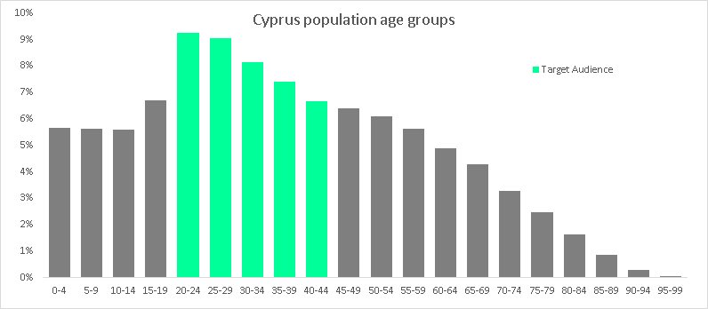
Business Plan
Cypriot Insurance Market
22 Insurance Companies
€360 mil General Business Premium written
(€165 mil motor , €155 mil non-motor, €35 mil health)
Target Audience
Millennials (40.56% of Cypriot population )
Insurance Companies
Revenue Streams
Commission from the sale of each product
Data analytics for cross selling and up selling
Licence and maintenance fee for the use of our platform

Slide 9
DEMO

Slide 10
Future Development
Machine learning to suggest quote
Clustering / Predictive analytics for cross selling / up-selling / underwriting
Expansion to other industries (e.g. Housing)
Business rules engine (e.g. Drools)
Automated quote generation

