Slide 1
trustwise - #insurtech
Swiss Blockchain Platform

Slide 2

Insurance Contract

Slide 3

Blockchain Contract
smart_contract.sol

Slide 4
Blockchain Insurance Contract
insurance_contract.sol

Slide 5

blockchain + insurance == insurtech
Issues
insuree
proposition
Notes:
Insuree issues insurance proposition

Slide 6

blockchain + insurance == insurtech
Bids
insuree
proposition
Notes:
Insurers bid on propositions

Slide 7
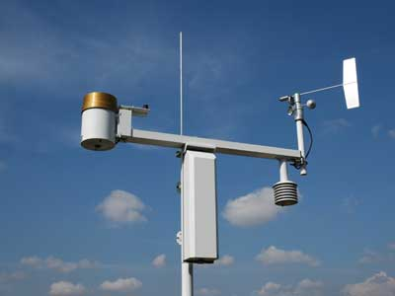
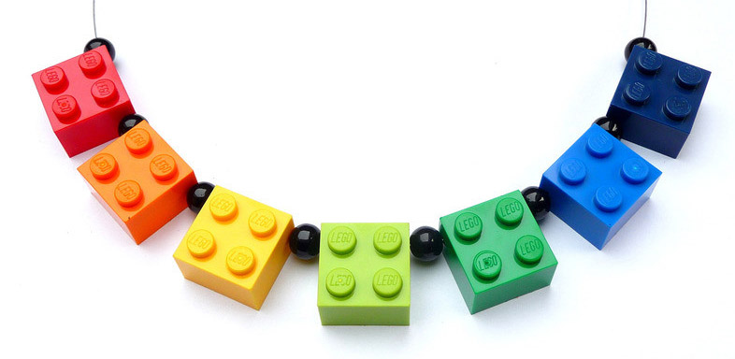

blockchain + insurance == insurtech
Feeds
sensor
blockchain
Notes:
Verifiable sensor data feed the blockchain

Slide 8

blockchain + insurance == insurtech
Notes:
Smart contracts decide the state of each insurance deterministically

Slide 9
blockchain + insurance == insurtech
Claim Premium
Claim Cover
Smart contract
insurer
insuree
Notes:
When the smart contract releases the funds, any party can request the money they got allocated

Slide 10
Monetization Plan
Insurance industry is build around primitive technology
Market experts expect this industry to be disrupted soon
Blockchain is the perfect emerging technology to disrupt this industry
4.7 trillion $ market size

Slide 11
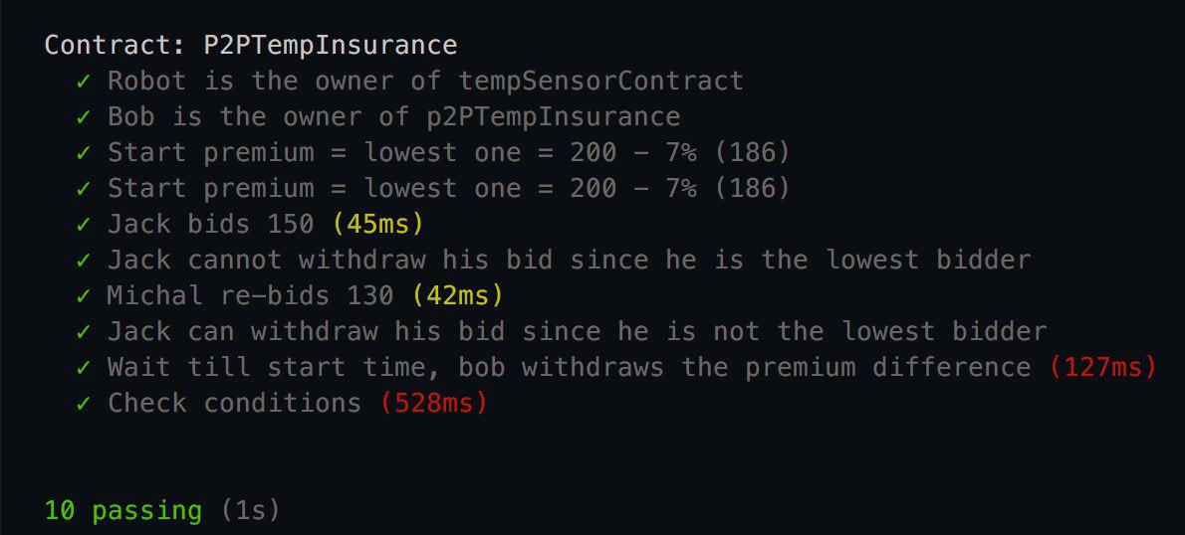
Smart contract – Extensive testing

Slide 12
Smart contract – Extensive testing
Date | T |  | Date | T
01-Jan-18 | 3 |  | 15-Jan-18 | 5
02-Jan-18 | 0 |  | 16-Jan-18 | 6
03-Jan-18 | 2 |  | 17-Jan-18 | 7
04-Jan-18 | 5 |  | 18-Jan-18 | 8
05-Jan-18 | 4 |  | 19-Jan-18 | 5
06-Jan-18 | 3 |  | 20-Jan-18 | 6
07-Jan-18 | 2 |  | 21-Jan-18 | 3
08-Jan-18 | 5 |  | 22-Jan-18 | 2
09-Jan-18 | 6 |  | 23-Jan-18 | 3
10-Jan-18 | 5 |  | 24-Jan-18 | 3
11-Jan-18 | 4 |  | 25-Jan-18 | 3
12-Jan-18 | 6 |  | 26-Jan-18 | 2
13-Jan-18 | 4 |  | 27-Jan-18 | 3
14-Jan-18 | 3 |  | 28-Jan-18 | 4

