Slide 1

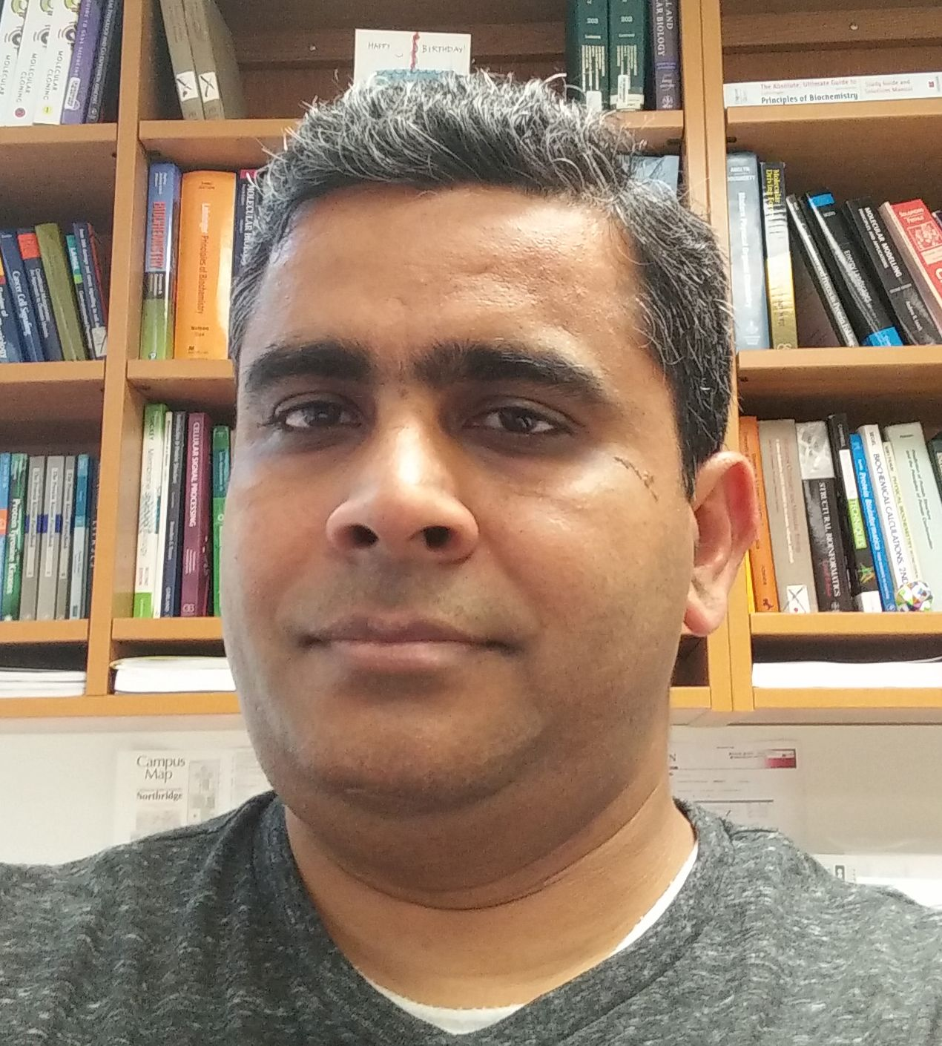

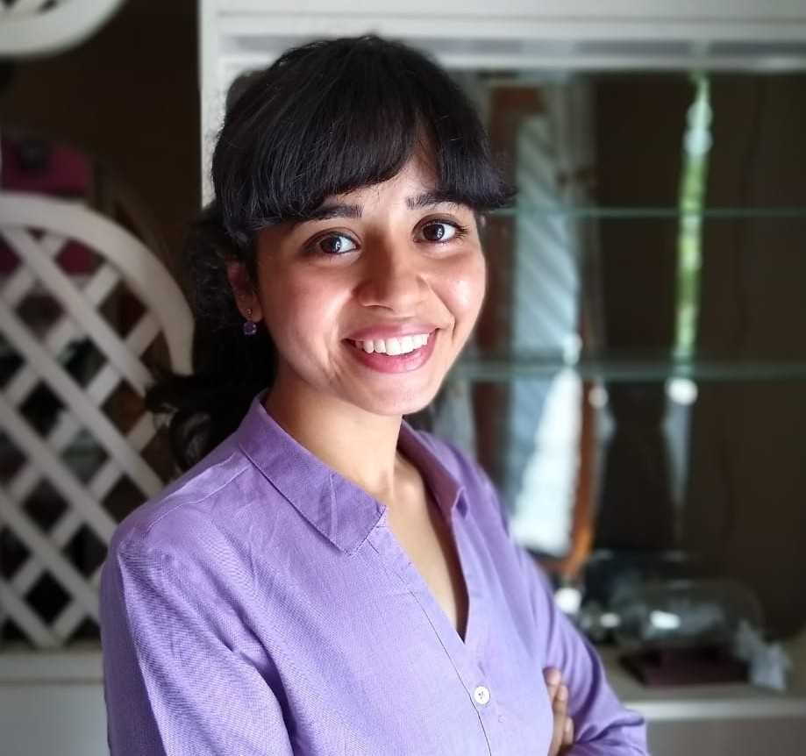
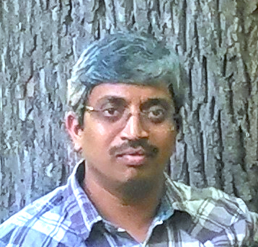
Structural Protein Ligand INTERaction descriptors in iCn3D
Hackathon @ ISMB 2020
Ravi Abrol Aaron Ayllon-Benitez Rachita K Kumar Sridhar Acharya Malkaram

Slide 2
