Slide 1
TASK - EXTRACT XML TO JSON
PDBID input
Protein-Ligand Interaction Profiler
XML result
Python script
JSON file
Notes:
We need a PDB id to use as input into the Protein-Ligan interaction progiler (PLIP)
Then the results is a XML
I did a python script that transform all the XML in a JSON file
Next step is to adapt this JSON into the ICn3D JSON specification

Slide 2
Root
bindsite 1
Identifiers
longname
ligtype hetid
chain
positions
smiles structure
lig_properties
bs_residues
bs_residue 1
bs_residue 2
…
interactions
hydrophobic_interactions
hydrophobic_interaction 1
INFO
…
hydrogen_bonds
hydrogen_bond 1
INFO
…
bindsite 2
...
TREE FORMAT

Slide 3
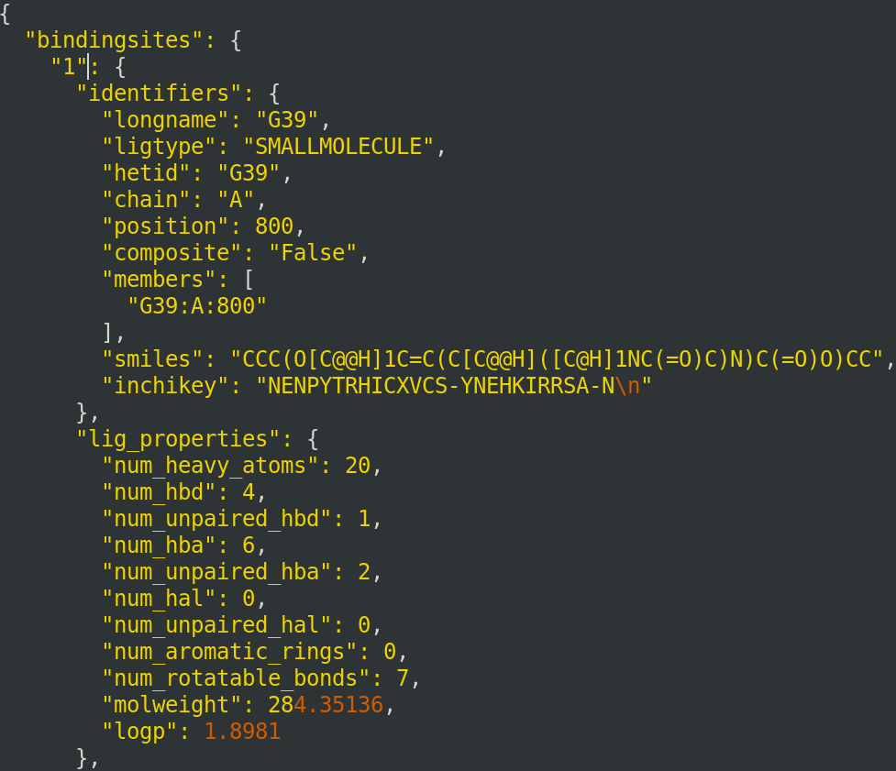
Root
bindsite 1
Identifiers
longname
ligtype hetid
chain
positions
smiles structure
...
lig_properties
bs_residues
bs_residue 1
bs_residue 2
…
interactions
hydrophobic_interactions
hydrophobic_interaction 1
INFO
…
hydrogen_bonds
hydrogen_bond 1
INFO
…
bindsite 2
...
TREE FORMAT

Slide 4
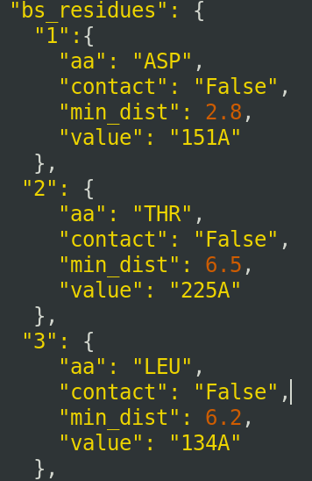
Root
bindsite 1
Identifiers
longname
ligtype hetid
chain
positions
smiles structure
lig_properties
bs_residues
bs_residue 1
bs_residue 2
…
interactions
hydrophobic_interactions
hydrophobic_interaction 1
INFO
…
hydrogen_bonds
hydrogen_bond 1
INFO
…
bindsite 2
...
TREE FORMAT

Slide 5
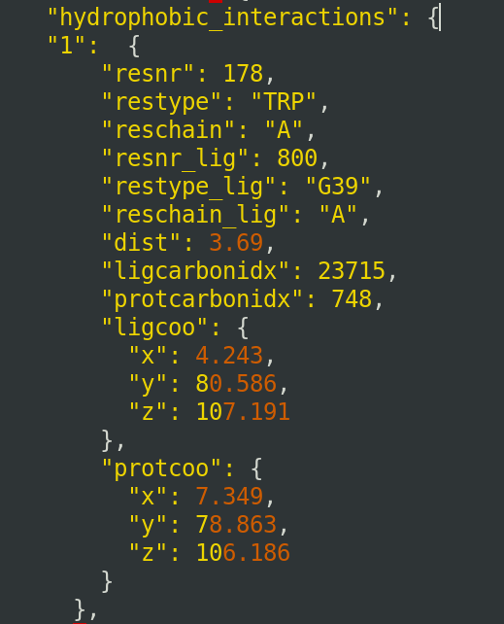
Root
bindsite 1
Identifiers
longname
ligtype hetid
chain
positions
smiles structure
lig_properties
bs_residues
bs_residue 1
bs_residue 2
…
interactions
hydrophobic_interactions
hydrophobic_interaction 1
INFO
…
hydrogen_bonds
hydrogen_bond 1
INFO
…
bindsite 2
...
TREE FORMAT

