Slide 1

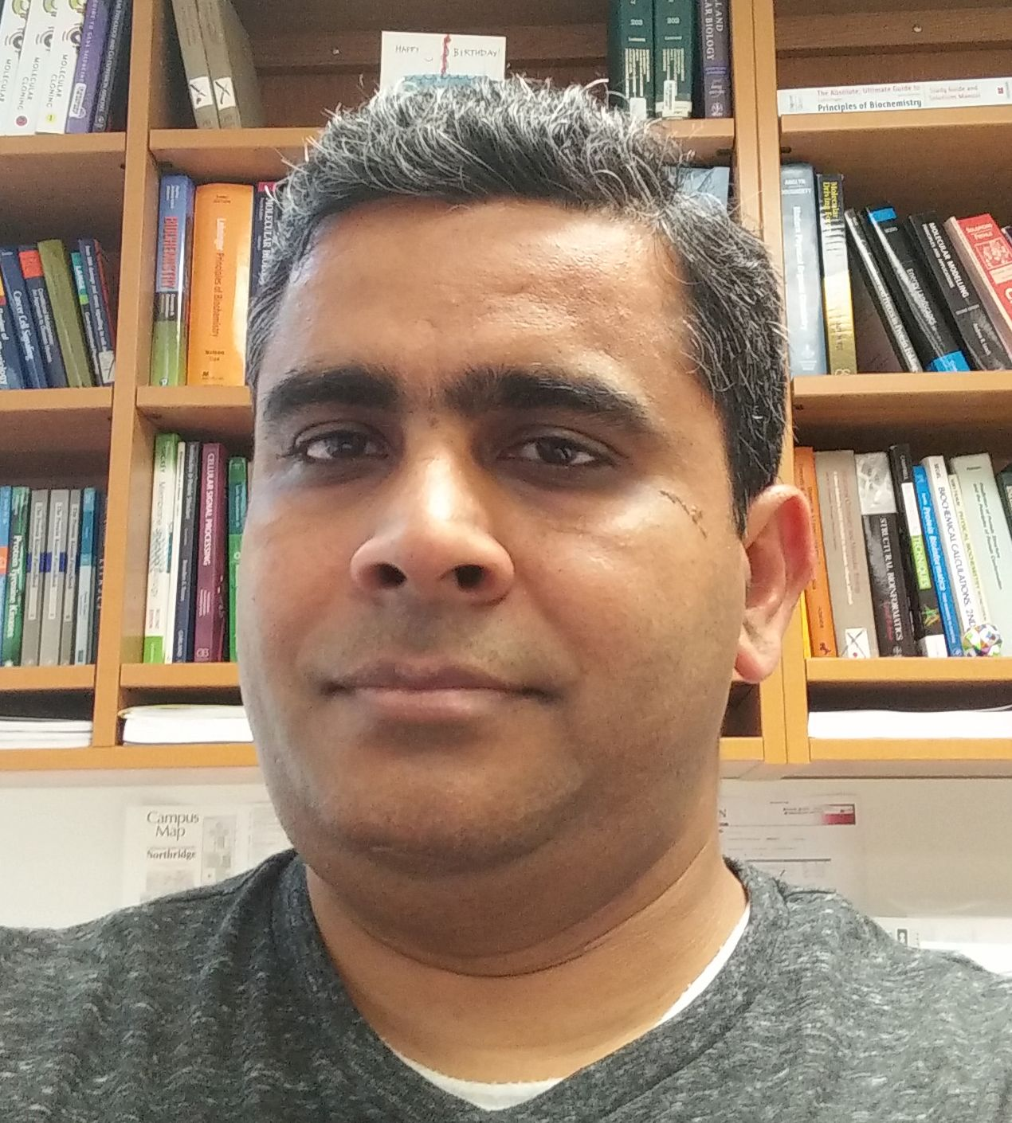

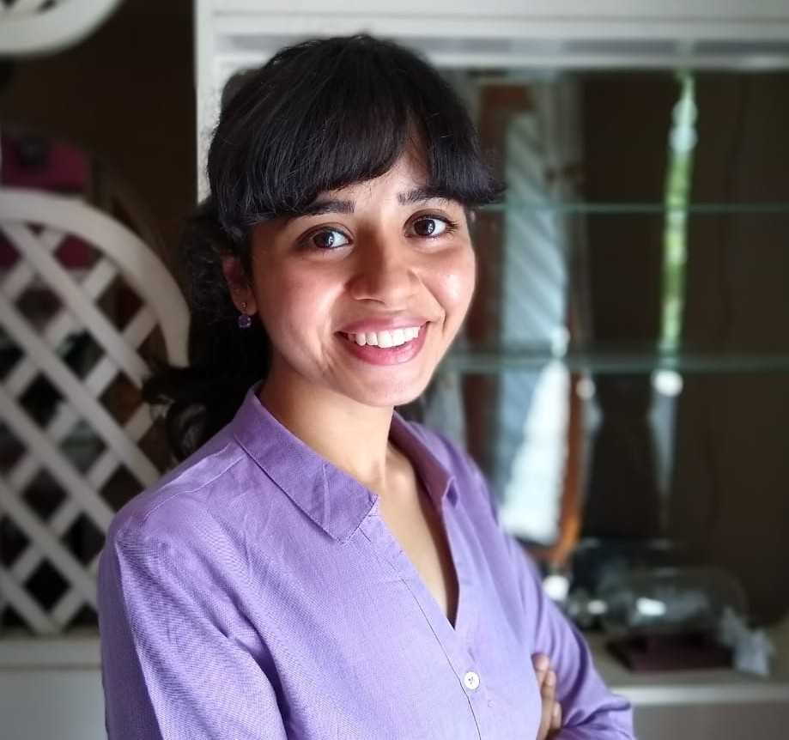
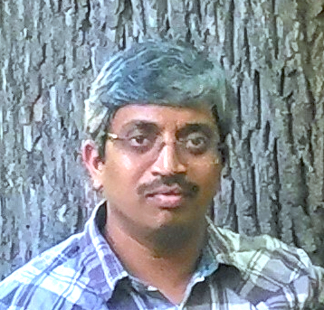
Structural Protein Ligand INTERaction descriptors in iCn3D
Hackathon @ ISMB 2020
Ravi Abrol Aaron Ayllon-Benitez Rachita K Kumar Sridhar Acharya Malkaram

Slide 2
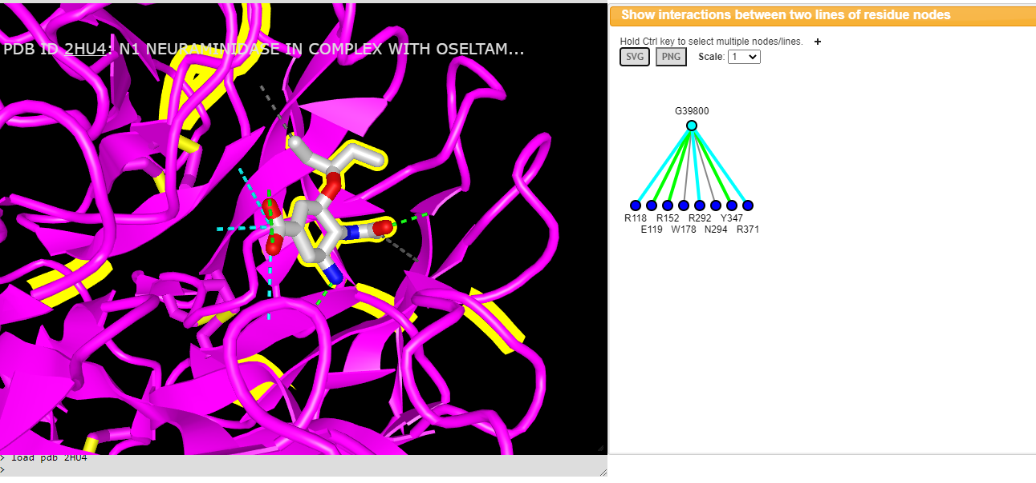
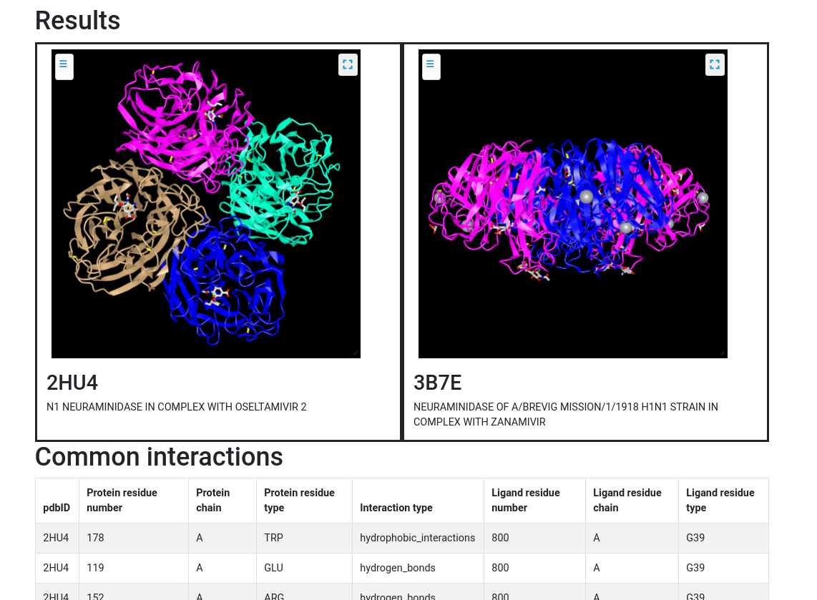
Neuraminidase in complex with:
Oseltamivir (PDB ID: 2HU4)
Zanamivir (PDB ID: 3B7E)

