Slide 1
Team B: Annotations in iCn3D
Jiyao Wang (lead)
Raphael Trevizani
Sachendra Kumar (writer)
Li Chuin Chong (writer)
Jack Lin

Slide 2
Retrieve Annotations (Scrapper)
  Python Scripts (Raphael Trevizani and Li Chuin Chong )
  Node.js Scripts (Jiyao Wang)
Add Annotations (Annotator)
  PhosphoSitePlus (Sachendra Kumar)
    Problem: Many annotation data require LICENSE.
    iCn3D: Allow users to add annotations easily with a clean UI

Slide 3
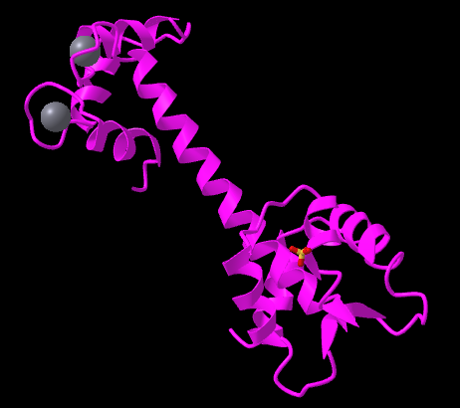
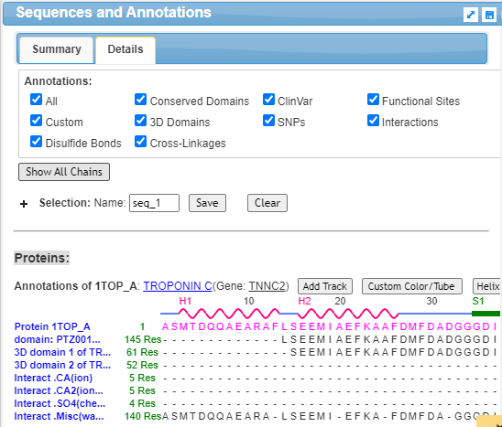
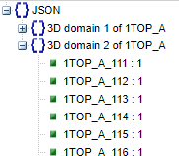
Node.js Scripts to Retrieve Annotations
- from UI to Data
Command: node annotation.js 1TOP 5
Output:

Slide 4
Node.js Scripts to Retrieve Annotations
- code
// Step 1. retrieve coordinates
ic.mmdbParserCls.parseMmdbData(dataJson);
// Step 2. prepare the sequence data
let result = ic.showAnnoCls.showAnnotations_part1();
ic.showAnnoCls.processSeqData(ic.chainid_seq);
ic.showAnnoCls.showAnnoSeqData(nucleotide_chainid, chemical_chainid, chemical_set);
// Step 3. Load 3D domain annotations, and output the data
if(annoType == 5) { // 5: 3D Domains, 1: SNPs, 2: ClinVar, 3: Conserved Domains
ic.annoDomainCls.showDomainAll();
console.log(JSON.stringify(ic.domain2resid));
}

Slide 5
Annotation of Post-translational Modification (PTMs) in iCn3D
Post-translational modifications (PTMs) are the functionally important chemical modifications that regulate protein activity, its localization, and interactions with other cellular molecules such as proteins, lipids, nucleic acids, and cofactors.
PTMs: Phosphorylation (S/T/Y), Ubiquitylation (K), Acetylation (K), Methylation (K/R), Sumoylation (K)
Database: PhosphoSitePlus

Slide 6
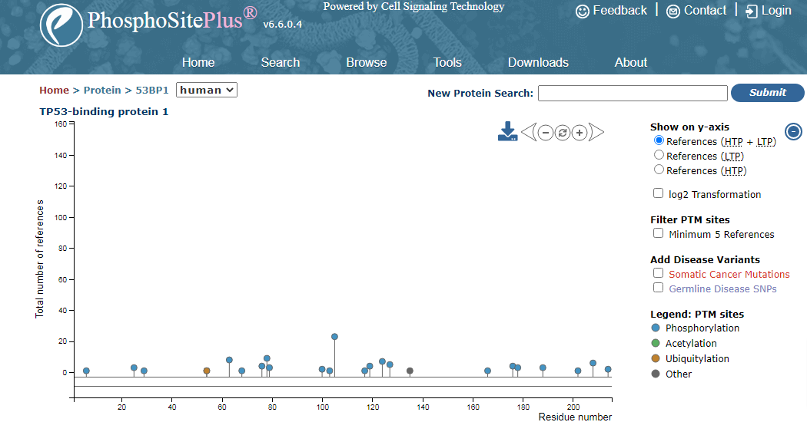
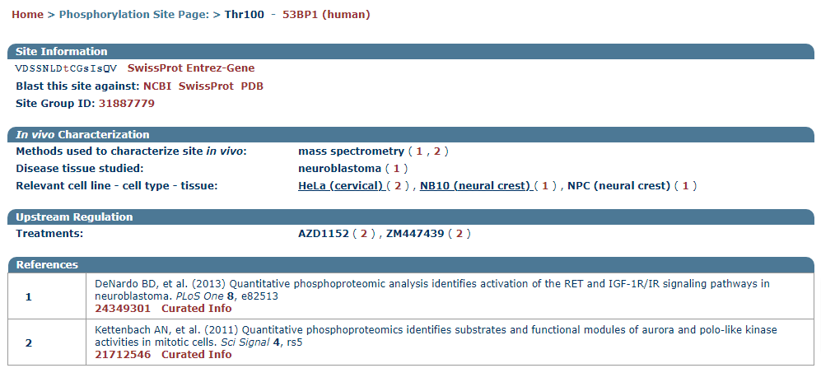
PhosphoSitePlus
Metadata
https://www.phosphosite.org

Slide 7
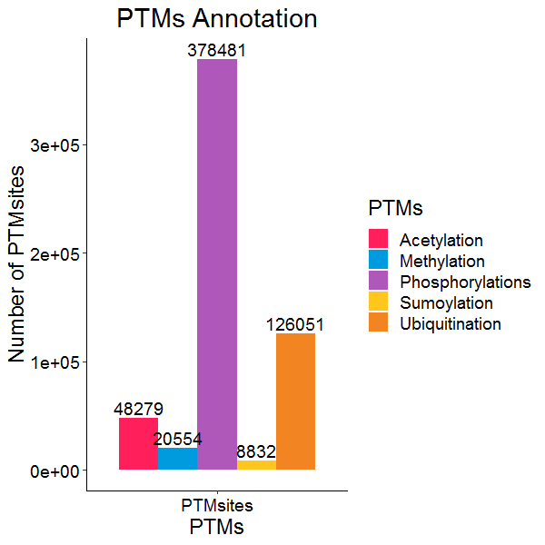
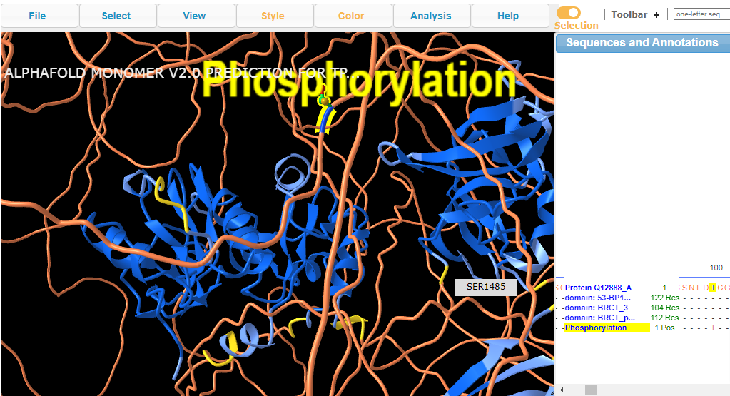
PTMs Annotation
Preprocessing Input Data
UniprotId | PTMaa | PTMpos | Metadata
Q12888 | T | 100 | https://www.phosphosite.org/siteAction.action?id=31887780
iCn3D

Slide 8
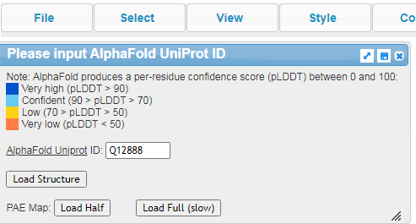
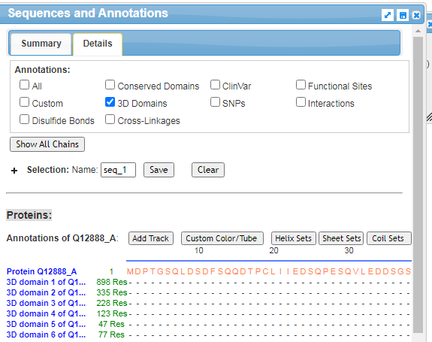
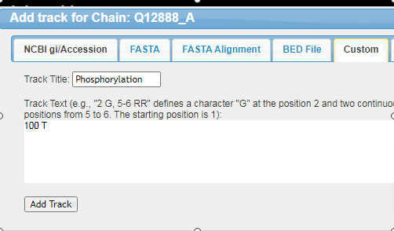
PTMs Annotation in iCn3D
User Interface
to display PTMs

Slide 9
Thanks!!

