Slide 1
Use Python or Node.js scripts to output any protein residue annotations (such as SNP, domain, binding site, secondary structure, surface area, etc) in iCn3D
Team B
Li Chuin Chong, Sachendra Kumar, Raphael Trevizani, Jiyao W

Slide 2
Annotation of Post-translational Modification (PTMs) in iCn3D
PTMs: Chemical modification that regulate protein activity, localization, interactions with cellular molecules
Database: PhosphoSitePlus (NIH funded)
PTMs: phosphorlyation (S/T/Y), ubiquitylation (K), acetylation (K), methylation (K/R) and Sumoylation (K)
Preliminary study: Phosphorlyation (S/T/Y)
https://www.phosphosite.org

Slide 3
Annotation of Post-translational Modification (PTMs) in iCn3D
Preliminary study: Phosphorlyation (S/T/Y)
File 1 (Phosphorlyation sites)
File 2 (FASTA file)
GENE | PROTEIN | ACC_ID | HU_CHR_LOC | MOD_RSD | SITE_GRP_ID | ORGANISM | MW_kD | DOMAIN | SITE_7_AA | LT_LIT | MS_LIT | MS_CST | CST_CAT#
Tp53 | p53 | P10361 | 10q24 | S4-p | 448716 | rat | 43.45 |  | ____MEDsQsDMsIE | 1
TP53 | p53 | P04637 | 17p13.1 | S6-p | 447537 | human | 43.65 | P53_TAD | __MEEPQsDPsVEPP | 28 | 2 | 1 | 9285
>GN:TP53|p53|human|P04637
MEEPQSDPSVEPPLSQETFSDLWKLLPENNVLSPLPSQAMDDLMLSPDDIEQWFTEDPGP
DEAPRMPEAAPPVAPAPAAPTPAAPAPAPSWPLSSSVPSQKTYQGSYGFRLGFLHSGTAK
SVTCTYSPALNKMFCQLAKTCPVQLWVDSTPPPGTRVRAMAIYKQSQHMTEVVRRCPHHE
RCSDSDGLAPPQHLIRVEGNLRVEYLDDRNTFRHSVVVPYEPPEVGSDCTTIHYNYMCNS
SCMGGMNRRPILTIITLEDSSGNLLGRNSFEVRVCACPGRDRRTEEENLRKKGEPHHELP
PGSTKRALPNNTSSSPQPKKKPLDGEYFTLQIRGRERFEMFRELNEALELKDAQAGKEPG
GSRAHSSHLKSKKGQSTSRHKKLMFKTEGPDSD

Slide 4
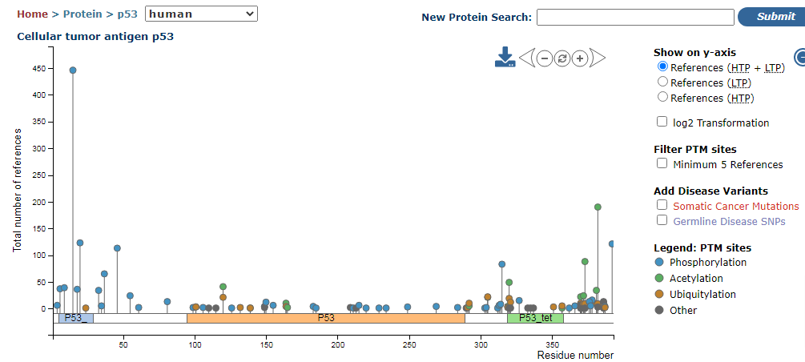
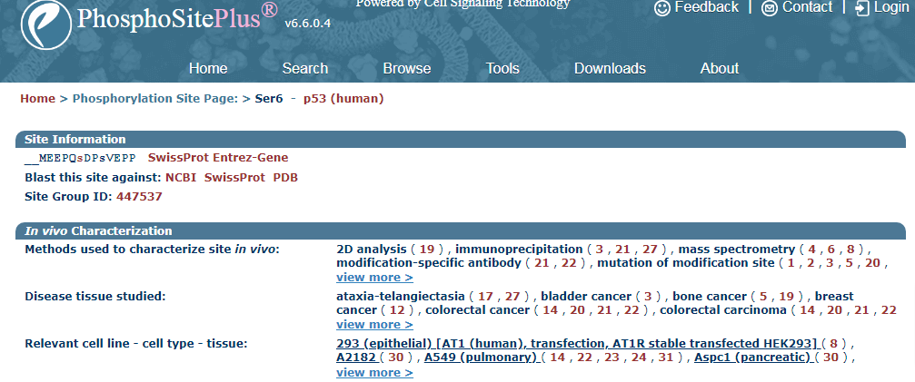

Slide 5
Annotation of Post-translational Modification (PTMs) in iCn3D: Workflow
Step 1: Input file preparation using the two downloaded files: FASTA file with phosphorylation site written in lower case
Step 2: Case sensitive Multiple sequence alignment based on Uniprot Id: Adding track in iCn3D + adding link to the metadata (http://www.phosphosite.org/uniprotAccAction?id=P04637)
Step 3: Implementation in the node js script: Display in iCn3D

Slide 6
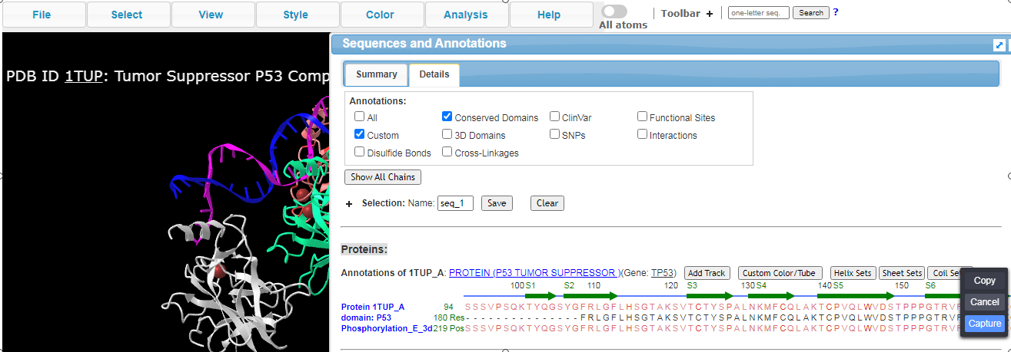

Slide 7
Annotation of Post-translational Modification (PTMs) in iCn3D: Challenges
Multiple annotation tracks: As Lysine involved in multiple PTMs
Multiple phosphorylation sites per Uniprot Id: Input file prep.
Limited to PDB amino acid sequence due to MSA
Need to update the data every 6 months: although the input files size <50 MB

Slide 8
Annotation of Post-translational Modification (PTMs) in iCn3D: Input file preparation
(PTM) k3sachin@icn3d:~/PTM$ head -10 output_ptms.csv
UniprotId,PTMaa,PTMpos,Metadata
Q8R3W2,S,119,http://www.phosphosite.org/uniprotAccAction?id=Q8R3W2
Q9CTA4,S,10,http://www.phosphosite.org/uniprotAccAction?id=Q9CTA4
Q9CTA4,T,11,http://www.phosphosite.org/uniprotAccAction?id=Q9CTA4

Slide 9
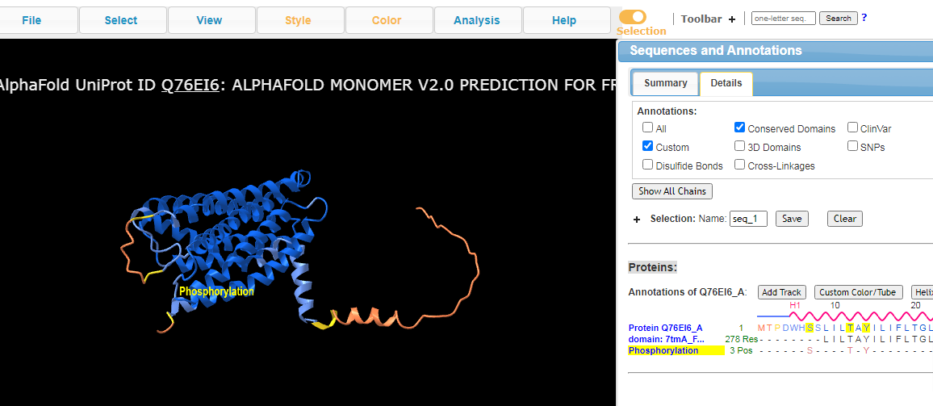
Annotation of Post-translational Modification (PTMs) in iCn3D: Custom annotations

