Slide 1
Creation of a Membrane Protein Extended Topology Standard
Team 3B
Team Lead: Ravi Abrol
Email: abrol@csun.edu

Slide 2
Team 3B
Azza Ahmed
Erik Serrano
Jeffrey Zahratka
Ravi Abrol

Slide 3
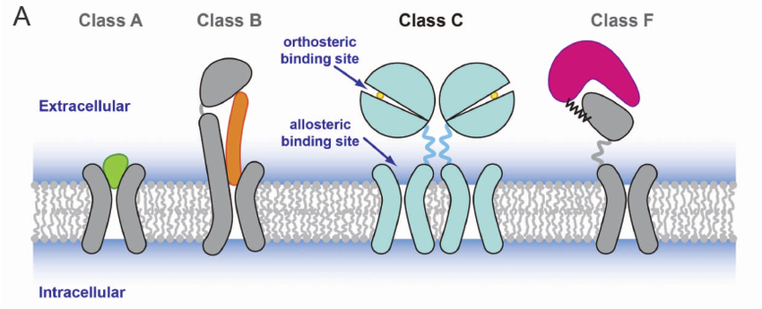
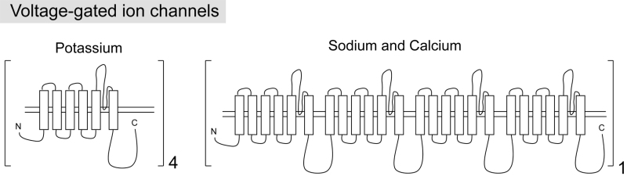
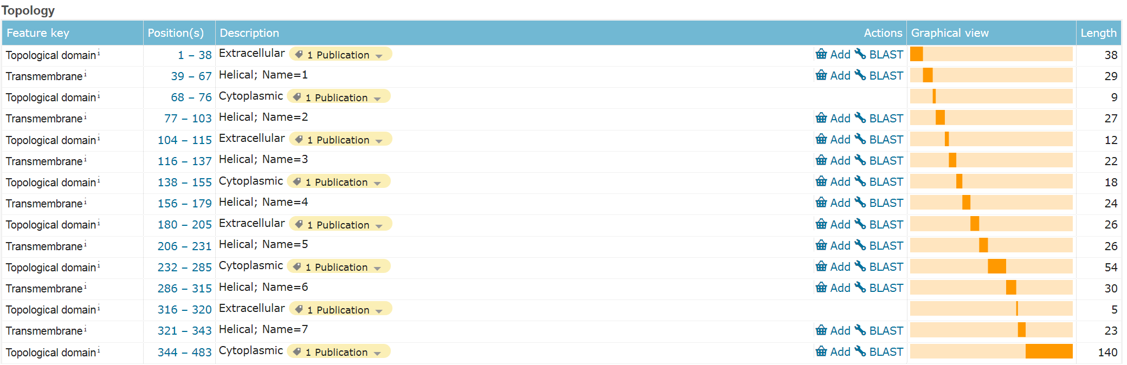
Currently available information (UniProt, OPM, PDBTM etc)
UniProt

Slide 4
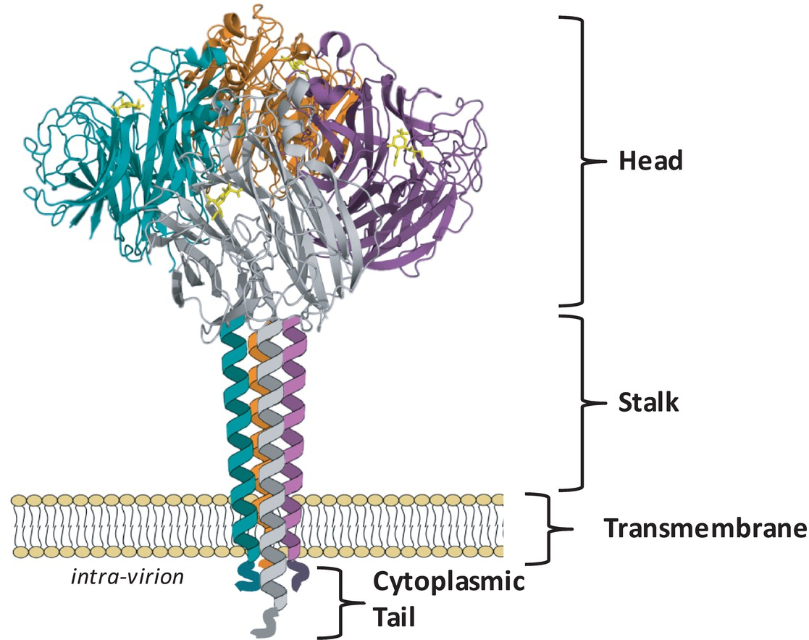
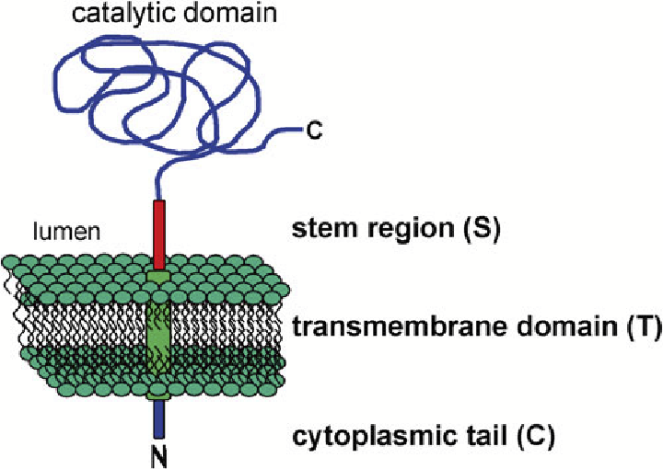
Currently available: mainly TM domains Don’t capture stem, stalk, head, regions

Slide 5
Team 3B: Specific Aims for the hackathon
Design membrane fasta file with topological features in JSON (new mfta format)
Implement this in json along with consensus domains
Create mysql db to allow searching and comparison of domains

Slide 6
Consensus domains
3eml TM1 33…63 .---…---..
4ug2 TM1 32…64 ----…----.
5g53 TM1 35…65 ...-…-----
Consensus1.1 (3eml,4ug2,5g53) TM1 35…63
Consensus1.2 (3eml,4ug2,5g53,2vt4) TM1 …

Slide 7
Tools/Databases available
OPM
TM domains
PDBTM
TM domains
PDB
Structures
UniProt
Fasta files

Slide 8
Team 3B Tasks
Design membrane fasta file with topological features in JSON (new mfta format)
Implement this in json along with consensus domains
Create mysql db to allow searching and comparison of domains
Team member name | Expertise | Tentative task assignment
Erik Serrano | js, python | 1,(2), 3
Jeffrey Zahratka | shell, python, R, C | 1, Writer,
Azza Ahmed | shell, R | 2
Ravi Abrol | Shell, python | 1

Slide 9
Team 3B Schedule
Sat 7/11 – 4pm: First team meeting
Flextimes
Sun 7/12 – 1pm: Teams-checkin meeting
Flextimes
Mon 7/13 – 1pm: Teams-checkin meeting
Flextimes
Tues 7/14 – 1:30pm: Final team presentations
Thur 7/16 – 12:50pm: Final project presentations at ISMB

Slide 10
Team 3B Progress
Membrane topological features to be annotated:
How exactly will this filetype relate to PDBs?
MFTA/mpj mockfile annotation
JSON format
Resources
Details on google doc

