Slide 1
Intelli-MO (Intelli meeting organizer)

Slide 2


most employees are attending 62 meetings a month
most employees are attending 62 meetings a month
A company of the size of cisco –
62 * 70000 = 4,340,000 meetings / month
= 52m meetings / year
Even a bit of saving can reduce a lot of wasted time
Source: https://www.atlassian.com/time-wasting-at-work-infographic

Slide 3


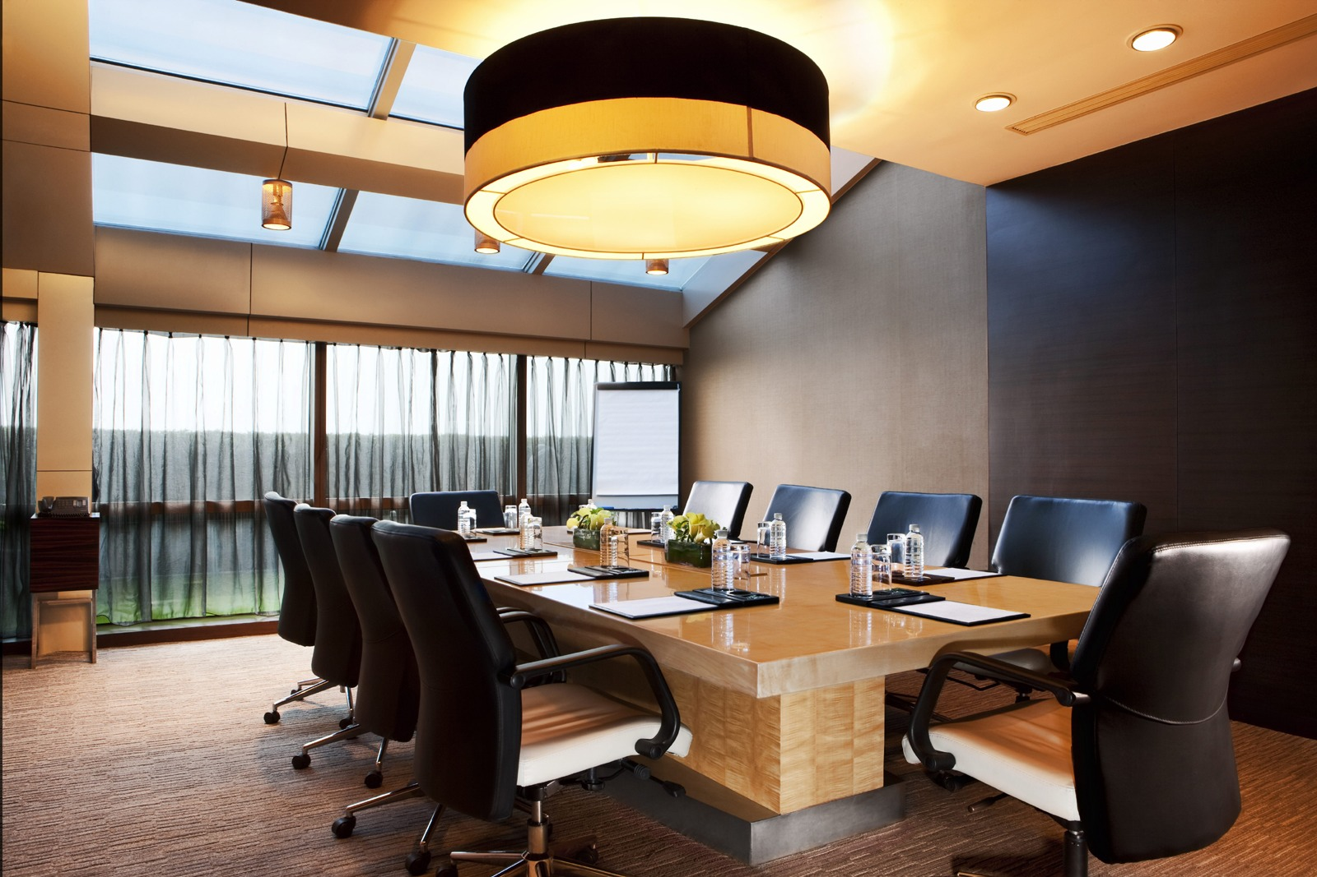
demo
Going into the meeting room, automatically join meeting spark
Meraki for location
Location
wifi
bluetooth

Slide 4
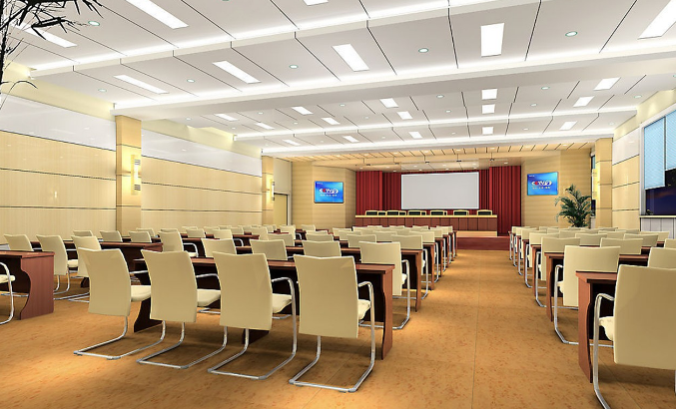
demo
Add nearby people into spark

Slide 5


demo
Location-based Sms Reminder
If you are far away from meeting room

Slide 6

Demo
Sms to join spark conversation

Slide 7
demo
Conferencing to another meeting room

Slide 8
Many other applications for location based spark
Conference sessions
Classroom
Restaurant
Emergency broadcast

