Slide 1
Mbed-OS Porting mbed to the XMC Infineon platform
Ney Fränz (es16m013)
22.02.2018

Slide 2

Mbed-OS overview
Initial release: September 2009
Maintained & developed by ARM
Platform & OS for internet connected device (IoT)
Designed for the 32 bit Cortex-M family
Real Time Software execution
Free & open source
Written in C/C++

Slide 3
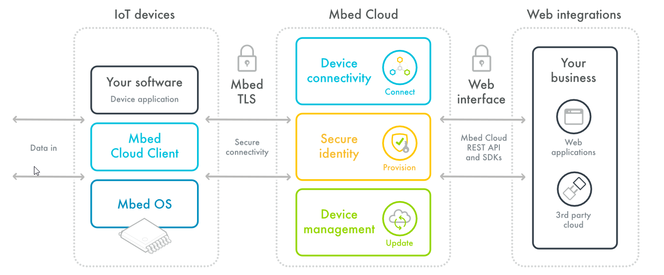
How the mbed platform works

Slide 4



Key Features
Enable connectivity and communication for selected devices. 6LoWPAN, Bluetooth Low Energy, Thread, LoRa, WiFi, NFC, RFID and Ethernet.
The Mbed IoT platform secures the device itself from untrusted or malicious code, the communications between device and cloud, and the lifecycle of the system itself using uVisor and Mbed TLS.
Mbed provides several management services. Software lifecycle tools like GIT and Mercurial SCM. Test frameworks like Greentea. Strong & powerful build engine.

Slide 5
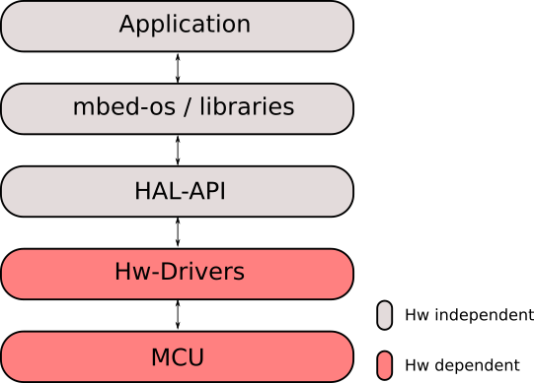
Infineon XMC driver support
Milestones:
Linker-Scripts & Start-up files modification
Setup GitHub Repository
Run the first Blinky Example
AnalogIn / AnalogOut
InterruptIn
Serial
SPI / I2C
PwmOut
RTC
Flash
Watchdog
USB
Ethernet (ongoing)

Slide 6
Master Thesis concept
Answer:
The Future of Embedded Software?
Summarize Trends:
C -> C++, Python, etc.
8 -> 32-bit Cortex-M/R
Bare-bone -> OS-based
Single Core -> Multi Core
Study & Evaluate:
Impact of OO Concepts
Classes, Templates, Inheritance, etc.
Benchmarking
Compiled vs. Interpreted Approaches
Safety & Security Aspects
Coding Guidelines
Verification Aspects

Slide 7
References
https://www.mbed.com/en/
https://github.com/mbed-Infineon-XMC/mbed-os

