Slide 1


Slide 2
CONTENTS
ABSTRACT
INTRODUCTION
LITERATURE REVIEW
OBJECTIVES
METHODOLOGY
RESULTS AND DISCUSSION
CONCLUSION AND FUTURE SCOPE
REFERENCES

Slide 3
ABSTRACT
Diabetes is caused due to increase in blood sugar level and it is considered as one of the deadliest and most chronic disease.
If it is untreated or unidentified there will be a chances of occurring many complications.
The rise in machine learning approaches solves this critical problem.
The motive of this study is to design a model which can prognosticate the likelihood of diabetes in patients with maximum accuracy.
Therefore, Machine learning classification algorithms namely Logistic Regression, Random Forest, Decision tree, KNN and SVM are used in this experiment to detect diabetes at an early stage.
Experiments are performed on Diabetes Dataset (BDD) which is sourced from Kaggle machine learning repository.
The performances of these algorithms are evaluated on various measures like Precision, Accuracy, F-Score, and Recall.

Slide 4
INTRODUCTION
Diabetes is one of the most noxious diseases in the world.
Diabetes is caused because of obesity, high blood glucose level.
It affects the hormone insulin, resulting in abnormal metabolism of carbs and improving the level of sugar in the blood.
Approximately 537 million adults (20-79 years) are living with diabetes. The total number of people living with diabetes is projected to rise to 643 million by 2030 and 783 million by 2045.
The types of Diabetes are ; Type 1 ,Type 2 and Type 3
Type 1 diabetes means that the immune system is compromised, and the cells fail to produce insulin in sufficient amounts.
Type 2 diabetes means that the cells produce a low quantity of insulin, or the body can’t use the insulin correctly.
Type 3- Gestational diabetes is a type of diabetes that develops during pregnancy. Gestational diabetes is usually diagnosed in the 24th to 28th week of pregnancy.
Machine learning is considered to be one of the most important artificial intelligence features supports development of computer systems having the ability to acquire knowledge from past experiences with no need of programming for every case.

Slide 5
LITERATURE SURVEY
AUTHOR | YEAR | DATASET | TITLE | PROS | CONS
Umm e Laila , Khalid Mahboob , Abdul Wahid Khan , Faheem Khan, and Whangbo Taekeun | 2022 | The dataset with 520 instances and 17 attributes were collected from the UCI repository which contains different datasets. | “An Ensemble Approach to Predict Early-Stage Diabetes Risk Using Machine Learning’’ | The Random Forest Ensemble Method had the best accuracy (97%). | Ensemble approaches can be more complex than single-model approaches, which can make them more difficult to interpret and less user-friendly.
U. Ahmed, G.F, Issa, Muhammad Khan | 2022 | The dataset used in the proposed system comes from the UCI Machine Learning repository compiled by the hospital of Sylhet, Bangladesh. | “Prediction of diabetics empowered with fused Machine Learning” | The proposed fuzzy decision system has achieved the accuracy of 94.87. | Fused machine learning requires large amounts of high-quality data to build reliable and accurate predictive models.

Slide 6
AUTHOR | YEAR | DATASET | TITLE | PROS | CONS
V. K. Daliya, T. K. Ramesh and SEOK-Bum Ko | 2021 | A Stacking Ensemble is proposed in com_x0002_bination with Genetic Algorithm for Pima Indian Diabetic Dataset and US hospital data. | “An Optimised Multivariable Regression Model for Predictive Analysis of Diabetic Disease Progression” | RMSE values in the range of 54 to 65 for the tested existing models, while the optimised Regression model has given RMSE of 1.5 units. | While regression models can identify factors that are associated with disease progression, they may not be able to establish causality or determine the direction of the causal relationship. This may limit the ability of clinicians to intervene and make meaningful changes to improve patient outcomes.
MD. Kamrul Hasan, MD. Ashraful Alam | 2020 | Pima Indian Diabetic dataset | “Diabetes Prediction Using Ensembling of Different Machine Learning Classifiers” | Our proposed ensembling classifier (AB+XB) for predicting diabetes is a better diagnosis, with an AUC of 0.950. | The accuracy and completeness of the data used to train the model can impact its performance. If the data is incomplete, contains errors or biases, or is not representative of the population of interest, the model's predictions may not be reliable

Slide 7
AUTHOR | YEAR | DATASET | TITLE | PROS | CONS
Hruaping Zhou, Raushan Myrzashova and Ruiz Heng | 2020 | Extensive experiments have been conducted on the Pima Indians diabetes and diabetic type datasets | “Diabetic Prediction model based on an enhanced deep neural network” | The best training accuracy of the diabetes type data set is 94.02174%, and the training accuracy of the Pima Indians diabetes data set is 99.4112%. | In this paper they used deep neural network algorithm to predict diabetics
A Yahyauoi, A. Jamil, J. Raheed and M. Yesiltepe | 2020 | The proposed method was evaluated on the online available PIMA Indians diabetes dataset | “A decision support system for diabetics prediction using Machine Learning and Deep Learning Techniques” | The overall accuracy obtained using DL, SVM and RF was 76.81%, 65.38% and 83.67% respectively. The experimental results show that RF was more effective for diabetes prediction compared to deep learning and SVM methods. | In this model that canhelp in predict of diseases but it cannot determine the type of diabetes.

Slide 8
OBJECTIVES
To predict whether a person is diabetic or not at an early stage.
To understand and analyse the present diabetics diseases.
To reduce the processing time of data sets we can use machine learning techniques.
To evaluate the performance of the proposed model.

Slide 9
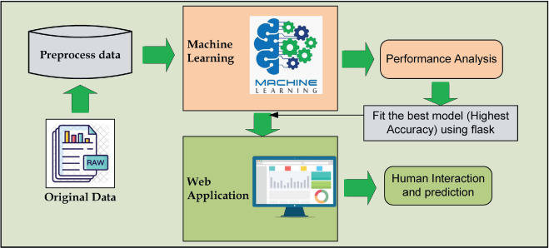
METHODOLOGY

Slide 10
1. Data Collection
This module includes data collection and understanding the data to study the patterns and trends which helps in prediction and evaluating the results.
2. Data Preparation
Data preprocessing is most important process. Mostly healthcare related data contains missing vale and other impurities that can cause effectiveness of data.
To improve quality and effectiveness obtained after mining process, Data preprocessing is done.
3. Model Building
When data has been ready, we apply Machine Learning Technique. Main objective to apply Machine Learning Techniques to analyze the performance of these methods and find accuracy of them
4.Training and Test Phase
The process of training an ML model involves providing an ML algorithm with training data to learn from. Initially, the data set is divided into training and test data.
5. Performance Evaluation
This is the final step of prediction model. Here, we evaluate the prediction results using confusion matrix and various evaluation metrics like classification accuracy, presion and f1-score.
Confusion matrix. The columns represents the predicted values of the target variables. The row represents the actual values of the target variables.
Metrics in a classification problem , the model performance is measured using the confusion matrix to know how accurately the true “+ve” and “-ve” were predicted.

Slide 11
Accuracy Classification accuracy is what we usually mean, when we use the term accuracy. It is the ratio of number of correct prediction to the total number of input samples.
Precision It is implied as the measure of correctly identified positive case(Tp) from all the predictive positive cases(Tp+Fp).
c. Recall/Sensitivity It is implied as the measure of correctly identified positive case(Tp) from all the actual positive cases
d. F1-Score It is harmonic mean of precision and recall. It gives the better measure of incorrectly classified cases than the accuracy metric
To develop a smart web application, we have used the Streamlit-framework and integrated the best model.
To predict diabetes, a user is required to submit a form with necessary numbers of diabetes related parameters.
The application uploaded in a server predicts the results using the adopted machine learning model.
We describe the adopted machine learning algorithms in the following sections

Slide 12
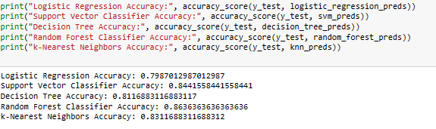
RESULTS AND DISCUSSION
The proposed approach uses different classification and ensemble methods and implemented using python.
These methods are standard Machine Learning methods used to obtain the best accuracy from data.
In this work we see that random forest classifier achieves better compared to others.
Overall, we have used best Machine Learning techniques for prediction and to achieve high performance accuracy.
Figure shows the result of these Machine Learning method

Slide 13
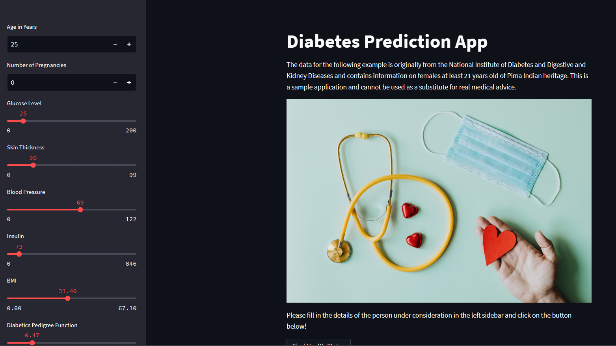
In this ratio of data splitting Here we found that Random Forest predicted with 86.36% of accuracy as highest accuracy for the dataset.
The last part of the project is the creation of a user interface for the model.
This user interface is used to enter unseen data for the model to read and then make a prediction.
The user interface is created using “Streamlit” Web app using python libraries.

Slide 14
CONCLUSION AND FUTURE SCOPE
In conclusion, the use of machine learning techniques for predicting diabetes has shown promising results.
Various studies have shown that machine learning algorithms are effective in predicting diabetes, with high accuracy rates.
These algorithms can help healthcare professionals in identifying individuals at risk of diabetes at an early stage, thus enabling them to take preventive measures and reduce the likelihood of developing diabetes.
Identifying diabetics or predicting the upcoming of a diabetic life can be propelled by using various machine learning techniques like SVM, Random Forest , KNN, Decision Tree etc.
we can conclude that the best method of prediction of diabetics is Random Forest. This method gives us an approximate result after the splitting and analysis of the training and testing data.
Early detection and diagnosis: Machine learning models can be trained on large datasets of patient information, including demographics, medical history, and clinical test results.
By analyzing these data, machine learning algorithms can identify patterns and risk factors associated with diabetes.
This can aid in early detection and diagnosis, allowing for timely intervention and treatment.
Machine learning techniques can be integrated with wearable devices and mobile apps to provide seamless monitoring and management of diabetes.

Slide 15
REFERENCES
Umm e Laila , Khalid Mahboob , Abdul Wahid Khan , Faheem Khan, and Whangbo Taekeun,“An Ensemble Approach to Predict Early-Stage Diabetes Risk Using Machine Learning’’,2022.
U. Ahmed,G.F,Issa,Muhammad Khan,“Prediction of diabetics empoweredwith fused Machine Learning”,2022.
V. K. Daliya, T. K. Ramesh and SEOK-Bum Ko,“An Optimised Multivariable Regression Modelfor Predictive Analysis of DiabeticDisease Progression”,2021.
Hruaping Zhou, Raushan Myrzashova and Ruiz Heng,“Diabetic Prediction model based on an enhanced deep neural network”,2020.
MD. Kamrul Hasan, MD. Ashraful Alam,“Diabetes Prediction Using Ensembling of Different Machine Learning Classifiers”,2020.
A Yahyauoi,A. Jamil,J. Raheed and M.Yesiltepe,“A decisionsuppor system for diabetics prediction using Machine Learning and Deep Learning Techniques”,2020.

Slide 16


