Slide 1
TASK-4 Setup and use firewall on Windows
Open Firewall Setting
View current rules
Block Inbound Traffic on Port 23
Test the rule (nmap)
Remove the rule

Slide 2
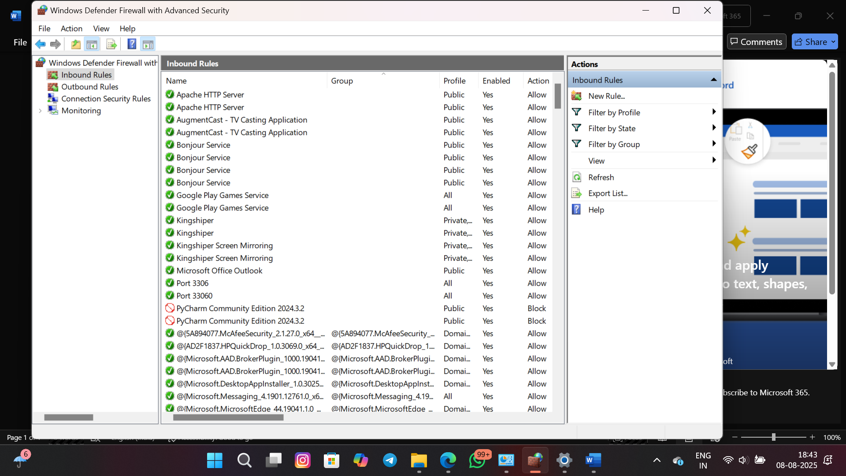
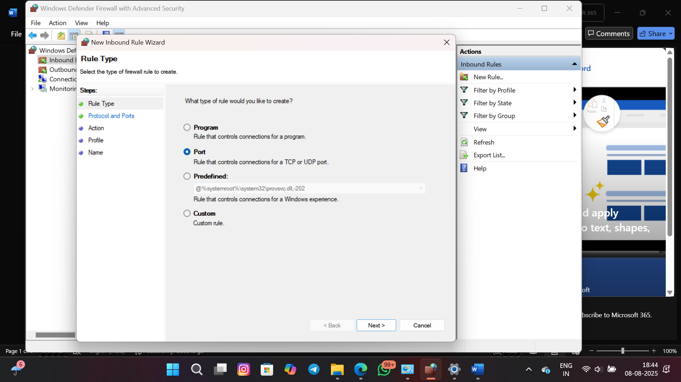
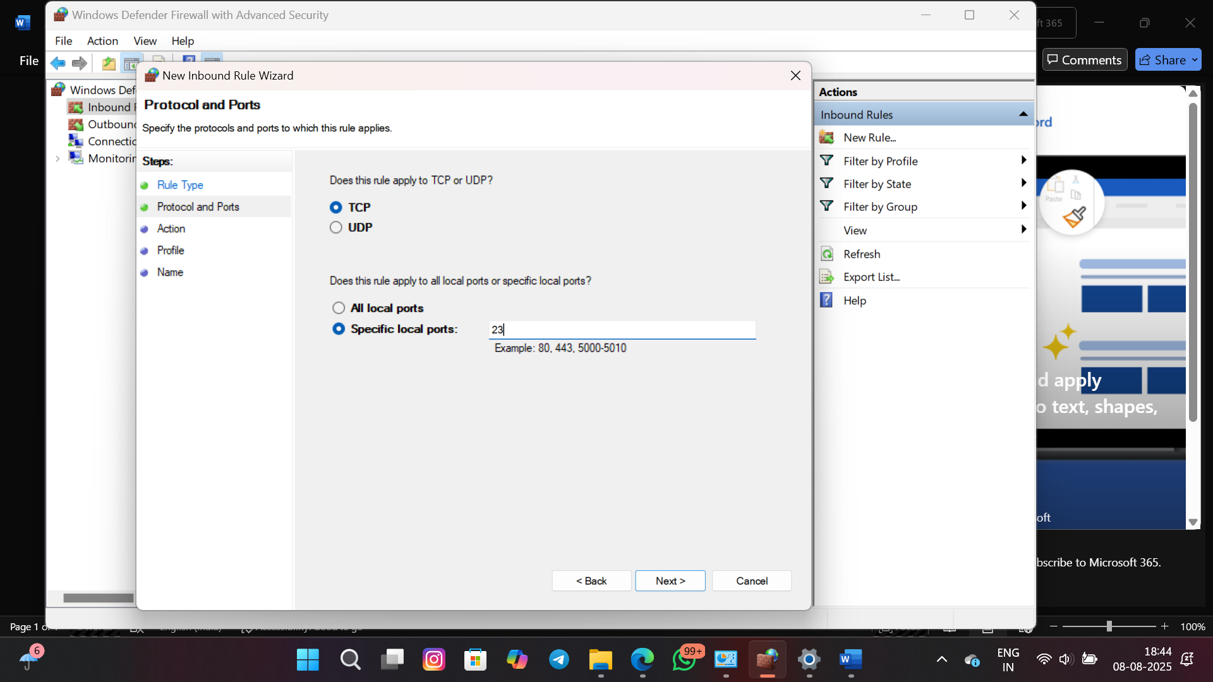
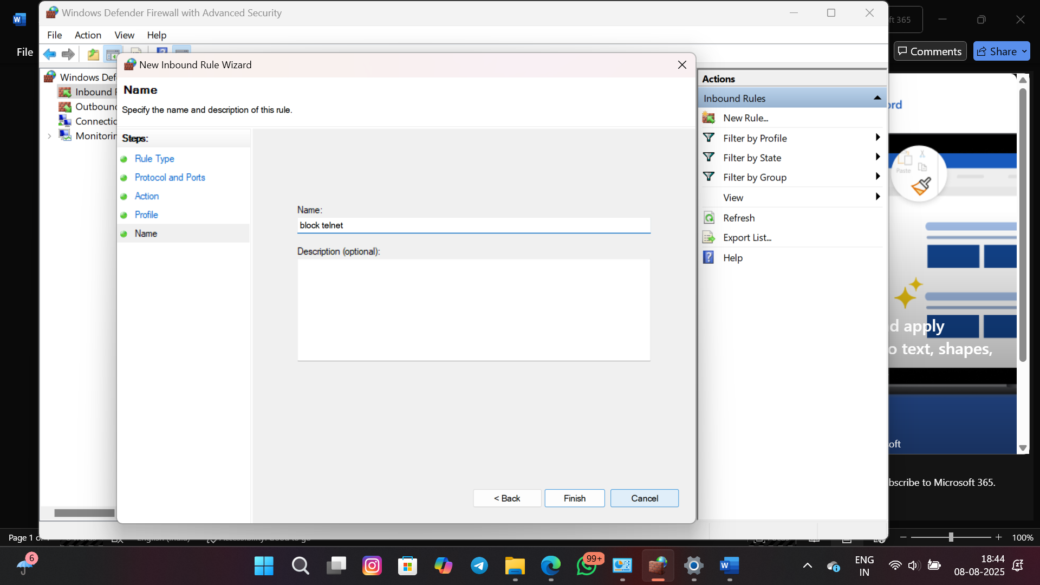
Open Firewall Settings
View Current Rules (Inbound and Outbounds)

Slide 3
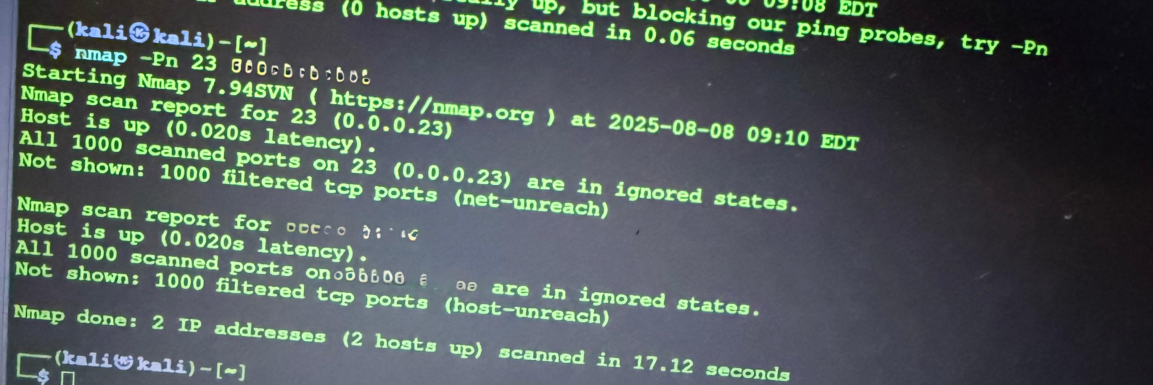
Test Result

