Slide 1
Analysis of Temperature and humidity using Arduino for a Green House.

Slide 2
Materials required:
Arduino Uno
LDR
Wires
DHT
USB
Breadboard
7 Segment Display

Slide 3
Theory
Arduino
Arduino is an open source computer hardware and software company, project, and user community that designs and manufactures single-board microcontrollers and microcontroller kits for building digital devices and interactive objects that can sense and control objects in the physical and digital world. Arduino boards are available commercially in preassembled form, or as do-it-yourself (DIY) kits.
Arduino board designs use a variety of microprocessors and controllers. The boards are equipped with sets of digital and analog input/output (I/O) pins that may be interfaced to various expansion boards or Breadboards (shields) and other circuits. The boards feature serial communications interfaces, including Universal Serial Bus (USB) on some models, which are also used for loading programs from personal computers. The microcontrollers are typically programmed using a dialect of features from the programming languages C and C++. In addition to using traditional compiler toolchains, the Arduino project provides an integrated development environment (IDE) based on the Processing language project.

Slide 4
DHT
The DHT11 humidity and temperature sensor makes it really easy to add humidity and temperature data to your DIY electronics projects. It’s perfect for remote weather stations, home environmental control systems, and farm or garden monitoring systems.
LDR
An LDR is a component that has a (variable) resistance that changes with the light intensity that falls upon it. This allows them to be used in light sensing circuits.

Slide 5
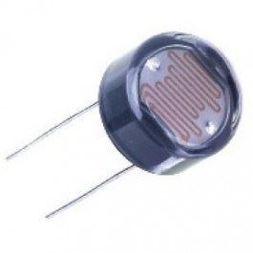
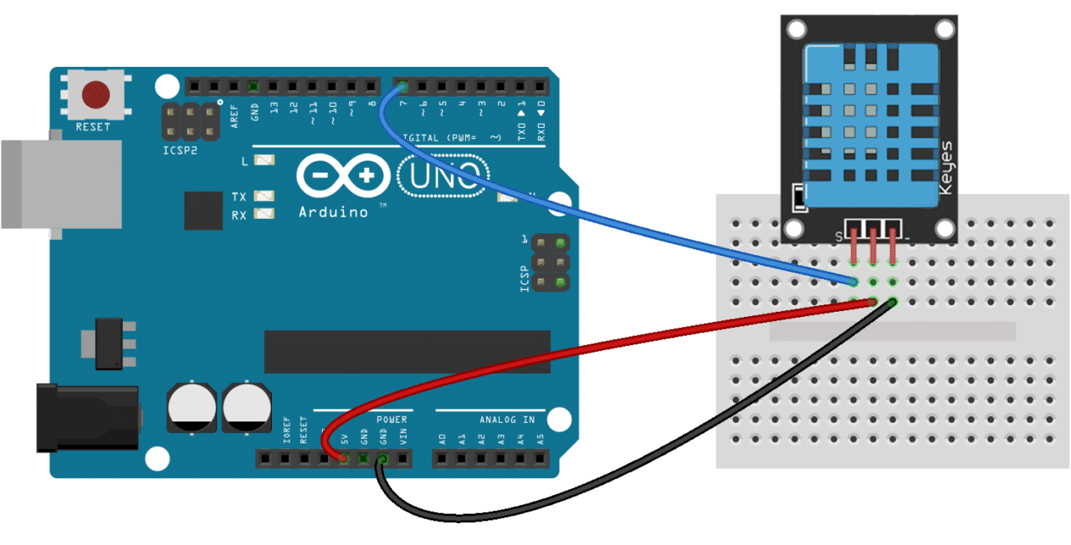
LDR
Arduino Uno along with a DHT sensor

Slide 6
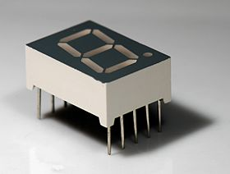
7 Segment Display
A seven-segment display (SSD), or seven-segment indicator, is a form of electronic display device for displaying decimal numerals that is an alternative to the more complex dot matrix displays.
Seven-segment displays are widely used in digital clocks, electronic meters, basic calculators, and other electronic devices that display numerical information.

Slide 7
Analysis
Data was logged from the temperature and humidity sensor to an excel sheet using gobetwino software.
This data was further required to apply on the machine learning model.
This data was used as the testing data after the model was trained using a dataset about weather downloaded from Kaggle.
Then the mean square error and the variance were calculated.

Slide 8
Conclusion
Mean square error:- 59-60
The model aimed at testing what kind of temperature and humidity we were expecting to see if the specific parameters were mentioned.
The model could easily tell what temperature we could expect at a specific humidity or vice versa.

Slide 9
Practical Application
In places with a wide range of temperature variations, we have to make sure that we have the suitable temperature for the healthy growth of the plant.
Along with this, a correct humidity is also required to ensure good plant moisture content.
To help with this, our project records the temperature and humidity spread over a large amount of time, and then we are able to make predictions with an MSE of 59.

