Slide 1
Establishing a Server log system for E-governance with appropriate notification and content based classification of log AICTE
CSE7101- Capstone Project
Review-4
Batch Number: CCS_05
Under the Supervision of,
Guide - Dr. Sharmasth Vali
School of Computer Science and Engineering
Presidency University
( Cyber Security )
Roll Number | Student Name
20231CCS3007 | Anup R Ganiger
20231CCS3008 | Sampath Kumar MS
20221CCS0145 | Sumeet D
Name of the Program: CSE Cyber Security
Name of the HoD: Dr. Anandaraj S.P
Name of the Program Project Coordinator: Dr. Sharmasth Vali
Name of the School Project Coordinators: Dr. Sampath A K , Dr. Geetha A

Slide 2
Content
Architecture Diagram
Modules
Algorithm Details
Hardware and software details
working Screenshot
Git-hub Link
References
Timeline of the Project
Problem Statement
Analysis of Problem Statement
Abstract
Literature Survey
Objectives
Existing Methods
Drawbacks
Proposed Method & Feasibility Study

Slide 3
Problem Statement Number:
Organization: AICTE
Category : Software
Problem Description
A server log system, also known as a log management system, is a software tool that records and stores log messages generated by various components and applications running on a server. It provides a centralized location for collecting, analyzing, and managing logs to monitor and troubleshoot system issues and performance problems. Here are some basic Requirement of a server log system: 1. Log Collection: The system collects log data from various sources, including operating systems, applications, services, and network devices. It can gather logs from different servers and consolidate them into a central repository. 2. Log Storage: Log entries are typically stored in a structured format, such as plain text files or a database. The system may also employ compression and archival mechanisms to optimize storage space and retain logs for an extended period. 3. Log Analysis and Search: The log system enables searching, filtering, and querying log data based on specific criteria, such as time range, log level, s for auditing, compliance, or performance analysis. 6. Log Retention and Compliance: Server logs retained for a certain period to comply with regulatory requirements or internal policies. The log system should support flexible retention
periods and secure storage to meet these obligations. 7. Integration and APIs: A robust log system offers APIs and integrations with other tools and systems. This allows developers and administrators to automate log analysis, integrate with security information and event management (SIEM) systems, or build custom

Slide 4
Analysis of Problem Statement
SIEM systems like Splunk, ELK Stack, Graylog → powerful but costly & complex.
Government organizations need affordable & tailored log systems.
Related work:
Logstash for log aggregation.
Cloudflare/Sucuri for web security monitoring.
Our system → integrates logging + classification + alerting + security focus in one lightweight solution.
Traditional log tools often lack real-time alert mechanisms.
Existing solutions prioritize enterprises, not government-specific needs.
This project fills a gap between complexity and usability.
Easy to deploy , Easy to use , Easy to backup

Slide 5
Abstract
Quirk is an intelligent web security dashboard designed to protect websites from modern cyber threats such as SQL injection, XSS attacks, proxy misuse, and spam bots.
The system leverages pattern recognition, anomaly detection, and industry-standard algorithms to identify both known and unknown vulnerabilities in real time.
It provides a centralized admin panel with advanced features like traffic monitoring, banning malicious users, error tracking, and analytics to ensure proactive defense.
By combining automated security mechanisms with easy-to-use tools, Quirk offers a cost-effective, scalable, and reliable security solution for individuals and enterprises.

Slide 6
Literature Survey
Web Application Security Challenges
Increasing threats like SQL injection, XSS, and bot attacks reported in research papers.
Existing tools focus on detection but lack integrated monitoring and prevention.
Existing Solutions & Tools
WAFs (Web Application Firewalls): Provide strong protection but are costly and resource-intensive.
IDS/IPS Systems: Effective in anomaly detection but prone to false positives and require expertise.
Log-based Monitoring Tools: Help in auditing but lack real-time prevention mechanisms.
Research Gaps Identified
Most solutions are either expensive or complex to manage.
Limited availability of lightweight, modular, and user-friendly dashboards.
Lack of integrated approach combining detection, monitoring, and analytics in one platform.

Slide 7
Objectives
Web applications remain primary targets for cyber-attacks such as SQLi, XSS, and DDoS due to widespread adoption.
Researchers have proposed intrusion detection systems (IDS), anomaly detection, and AI-based solutions for identifying malicious activities.
SQL Injection and XSS remain the most common attack vectors, with surveys highlighting gaps in detection accuracy and prevention methods.
Machine learning and deep learning models have been widely explored for anomaly detection but face scalability and real-time performance challenges.
Recent works emphasize integration of multiple defense mechanisms like proxy detection, spam filtering, and log analysis for enhanced security.
Despite advances, existing systems often lack centralized management, user-friendly dashboards, and integration flexibility for small organizations.

Slide 8
Drawbacks
High Resource Usage: Continuous monitoring, logging, and analytics can consume significant CPU and memory resources, especially on low-end servers.
False Positives & Negatives: Some legitimate users may be blocked mistakenly, while some sophisticated attacks might bypass detection.
Limited Coverage: Focused mainly on web application security; does not fully protect other layers like network or endpoint devices.
Manual Rule Updates: Detection rules and threat signatures need periodic manual updates to stay effective against new attack vectors.
Server Dependency: Performance and reliability depend heavily on the server environment and configuration.
Learning Curve: Admins need technical expertise to configure and interpret analytics effectively.
Scalability Challenges: Handling a large number of concurrent users and traffic analytics may require additional infrastructure.

Slide 9
Proposed Method & Feasibility Study
Proposed Method
Quirk integrates multi-layer protection: SQLi/XSS filtering, proxy & bot detection, spam control.
Provides a real-time dashboard with traffic analytics, threat logs, and admin tools.
Uses adaptive pattern recognition to detect known and unknown attacks.
Lightweight, easy to deploy with a simple PHP integration.
Feasibility Study
Technical: Built with PHP & MySQL, compatible with common servers, low resource usage.
Operational: Easy setup wizard and intuitive dashboard for admins.
Economic: Open-source and cost-effective alternative to enterprise WAFs.

Slide 10
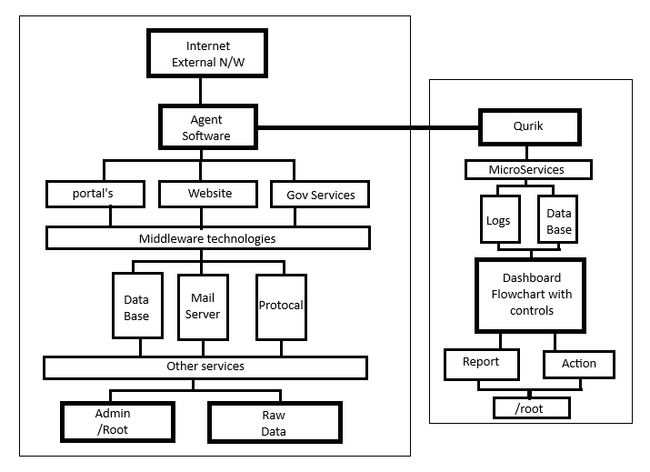
System Architecture
Log Collection Layer → from servers, applications, and network devices.
Backend Layer → Database + APIs for log storage & retrieval.
Analysis Engine → Log parsing, classification, anomaly detection.
Alert & Notification Module → Email/SMS/Push alerts.
Frontend Dashboard → Visualization (charts, reports, search).
Designed using modular microservices approach.
Backend APIs ensure easy integration with external systems.
Frontend supports responsive design for desktop & mobile access.

Slide 11
Modules
Dashboard – system overview & alerts
System Info – server & PHP details
Login Activity – track logins & suspicious attempts
SQL Injection Detection – block injection attacks
Bad Bot & Proxy Detection – filter malicious bots
Spam Detection – prevent spam submissions
IP & File Whitelisting/Blocking – manage access
Logging – maintain attack & event logs
PHP Function & Config Checker – monitor vulnerabilities
Traffic Analytics – web traffic patterns
Error Tracking – log & report errors
.htaccess Manager – configure access rules
Port Analyzer – check open ports
Hash Generator – create cryptographic hashes
Country/IP Banning – restrict access by region
File Integrity Checker – detect unauthorized changes
Real-Time Alerts – notify admin instantly
User Activity Monitoring – track user actions on the site

Slide 12
Algorithms Used
SQL Injection Detection Algorithm
XSS Detection Algorithm
Bot & Proxy Detection Algorithm
Logging & Monitoring Algorithm
Decision Algorithm (Mitigation)

Slide 13
Hardware specification
Supported Platforms:
Web Servers → Apache, Nginx, XAMPP, WAMP.
Databases → MySQL, MariaDB, Elasticsearch.
Framework Supported:
WordPress, Joomla, Drupal, Laravel, CodeIgniter, Symfony, PHP
System Requirements:
Minimum: 2 GB RAM, Dual-Core CPU, 10 GB storage.
Recommended: 4 GB RAM, Quad-Core CPU, 50 GB storage.

Slide 14
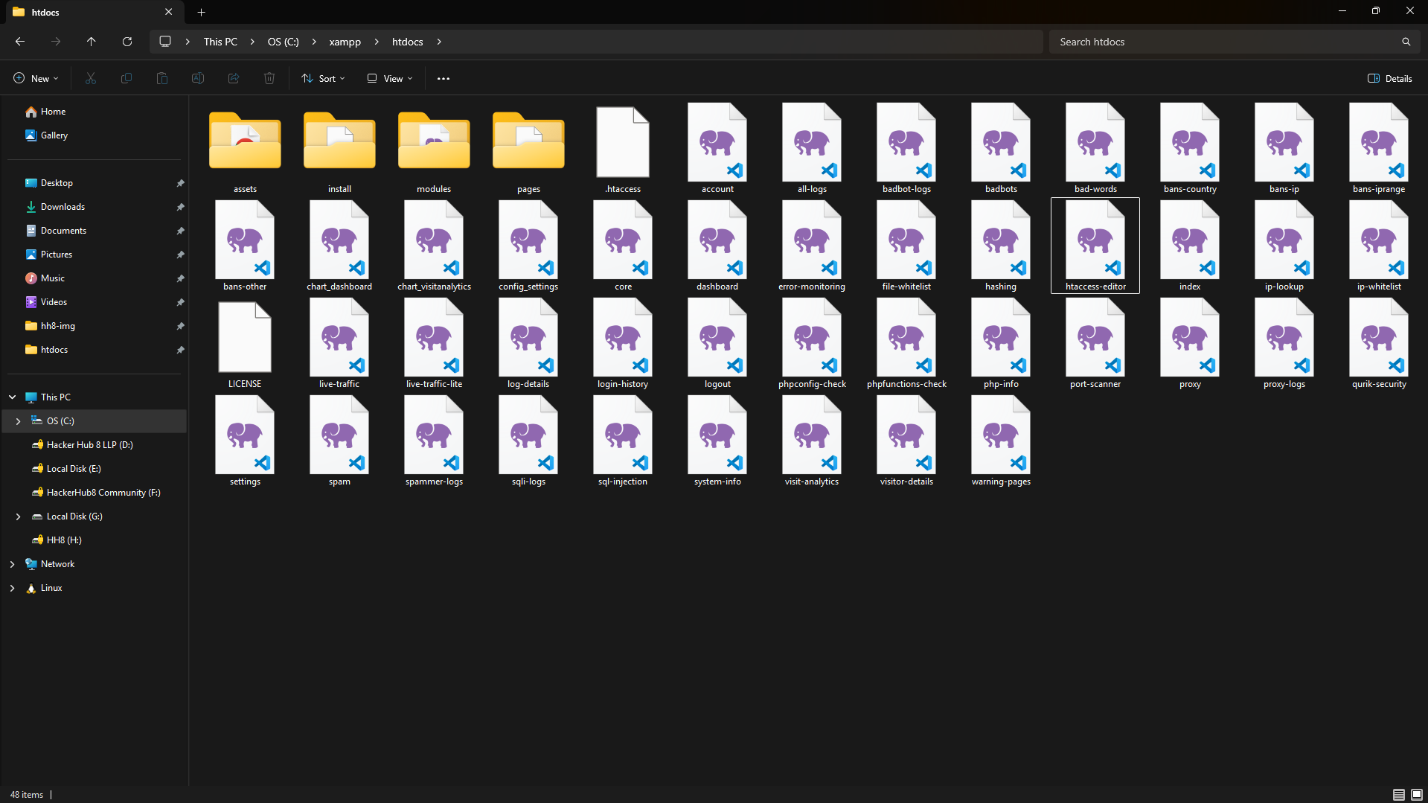
Copy the files to htdocs folder of XAMPP

Slide 15
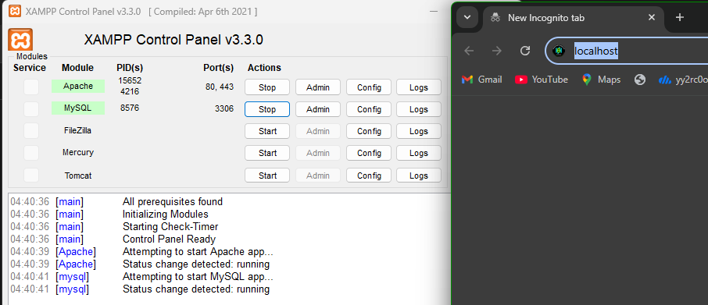
Turn on the Apache & MySQL in Xampp panel

Slide 16
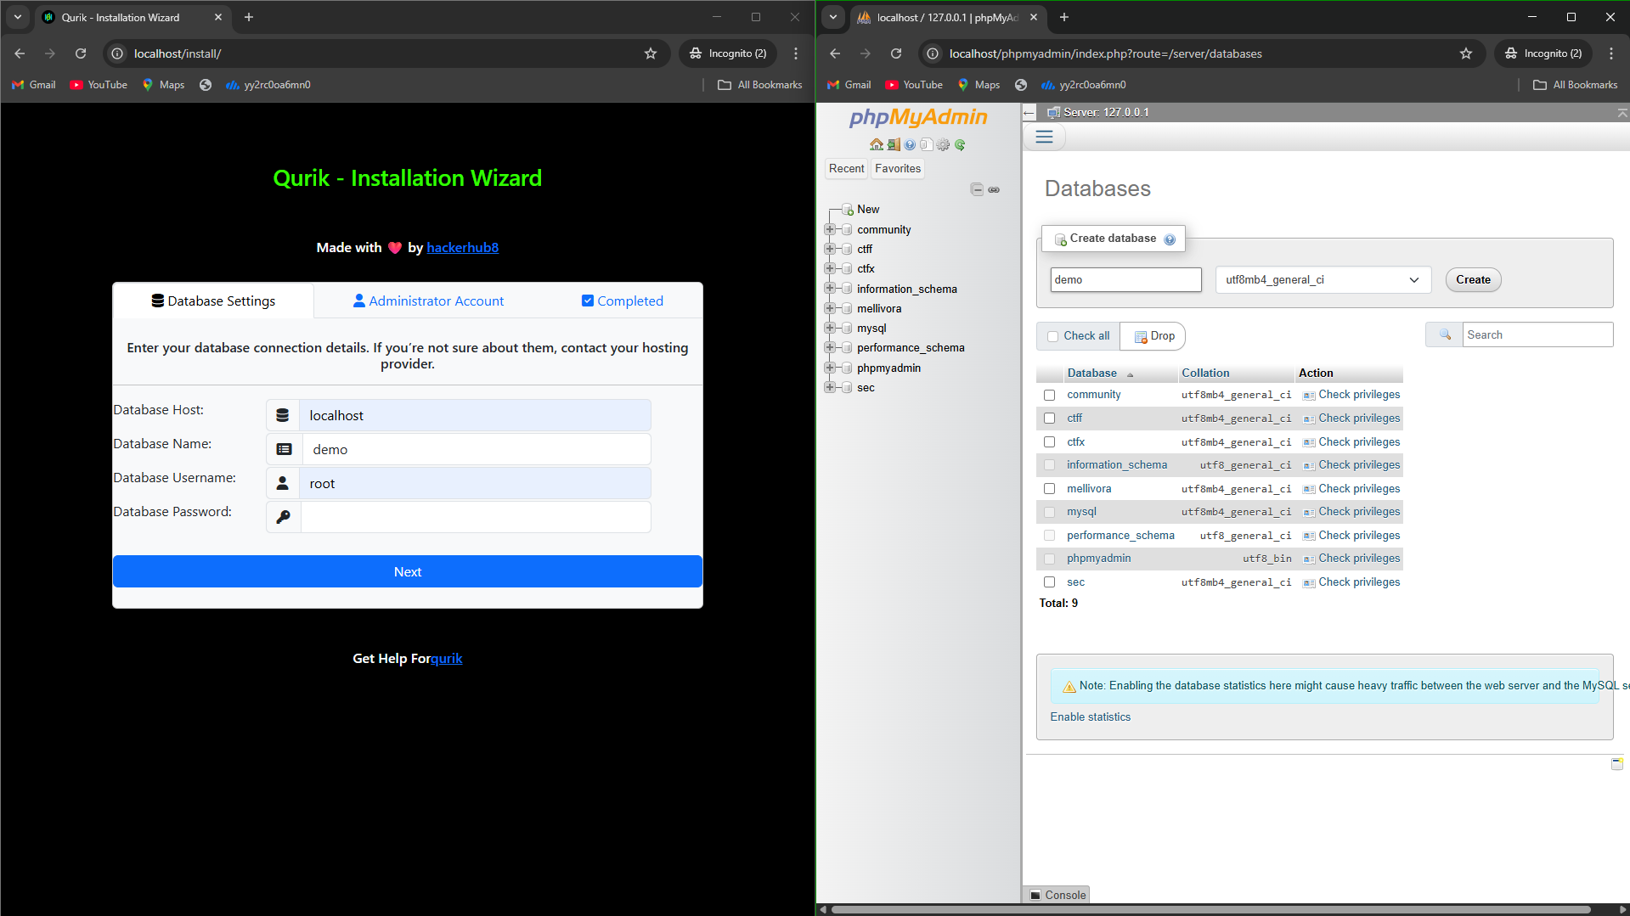
Just go to localhost/quirk to enter installation

Slide 17
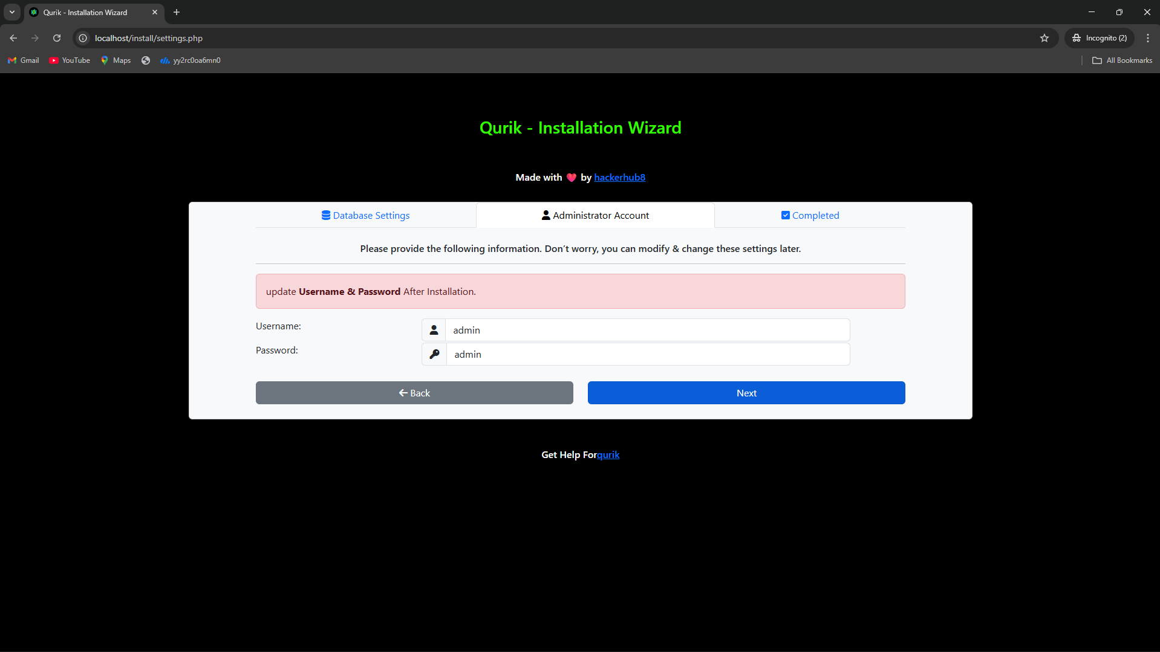
Default username & password will be set as admin

Slide 18
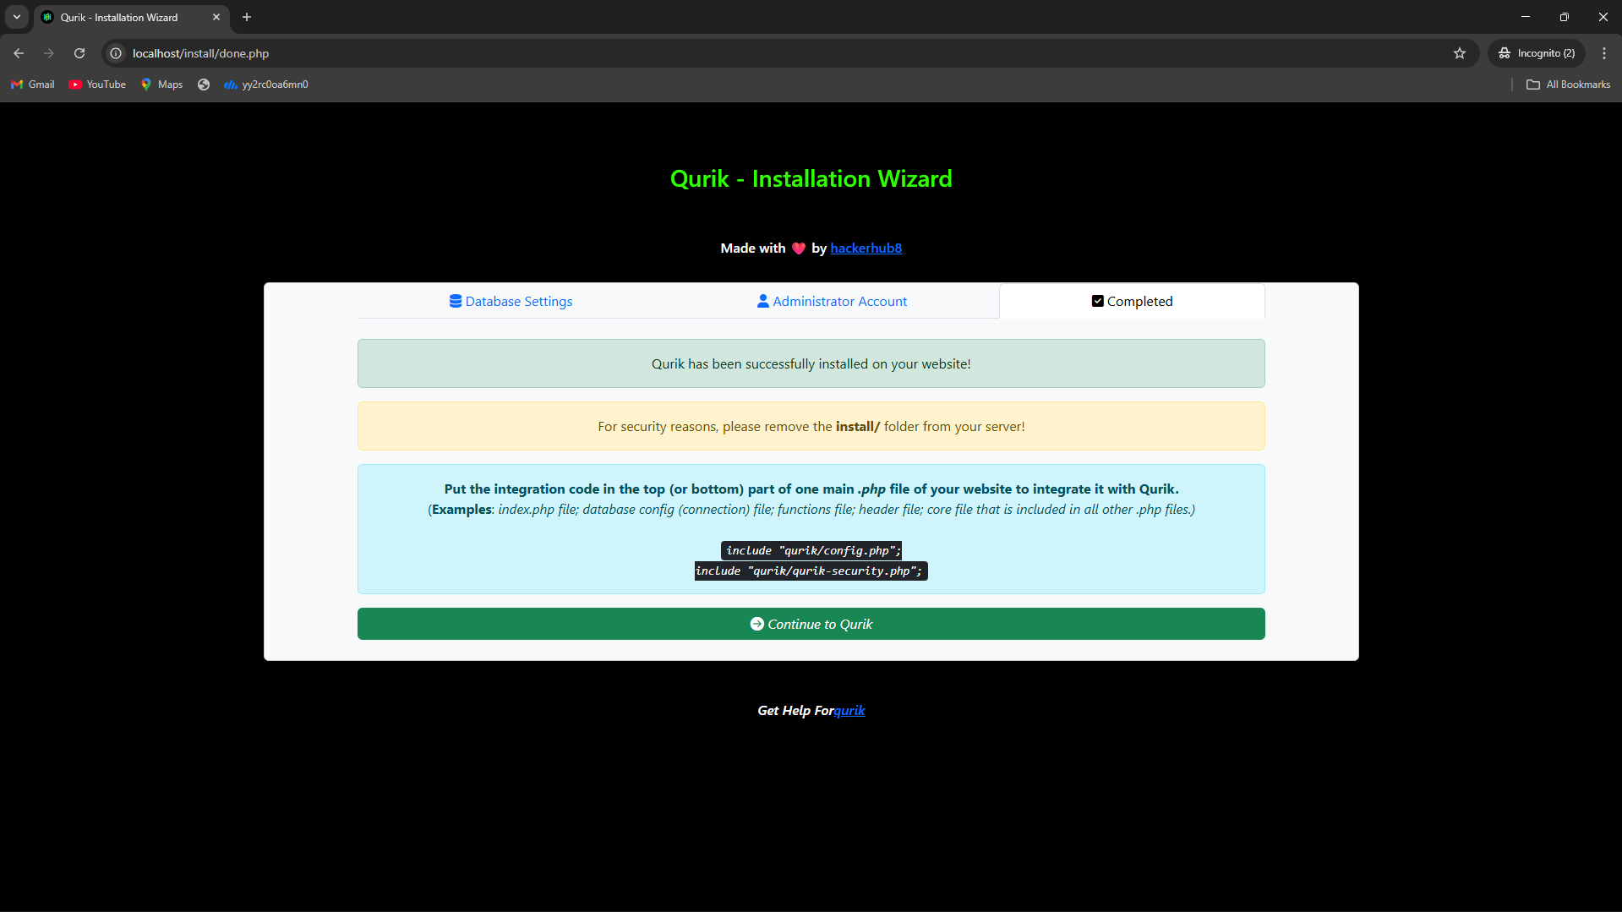
Copy the integration code

Slide 19
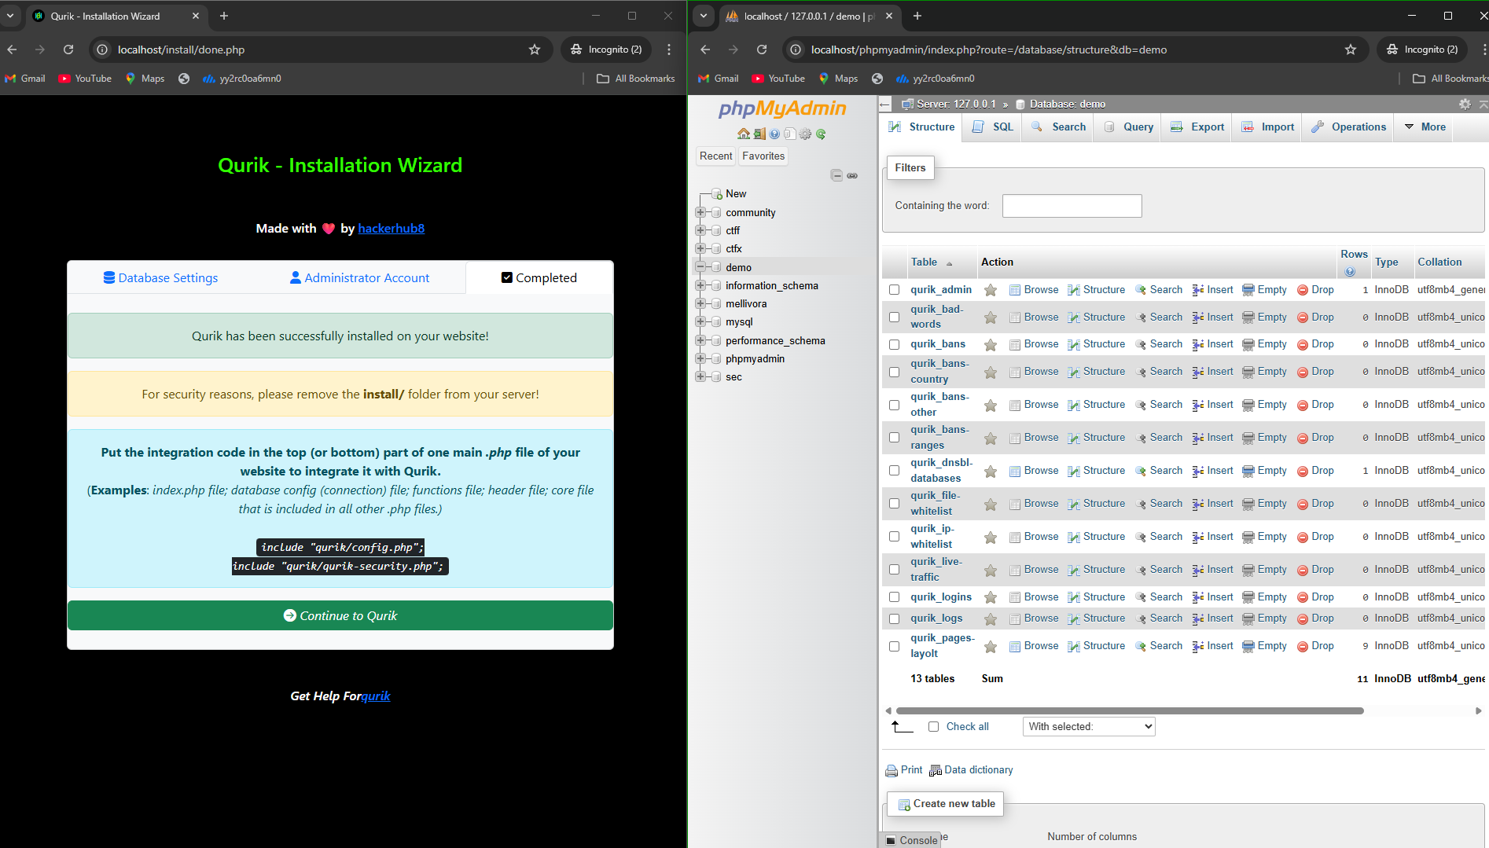
Check DB is created or not

Slide 20
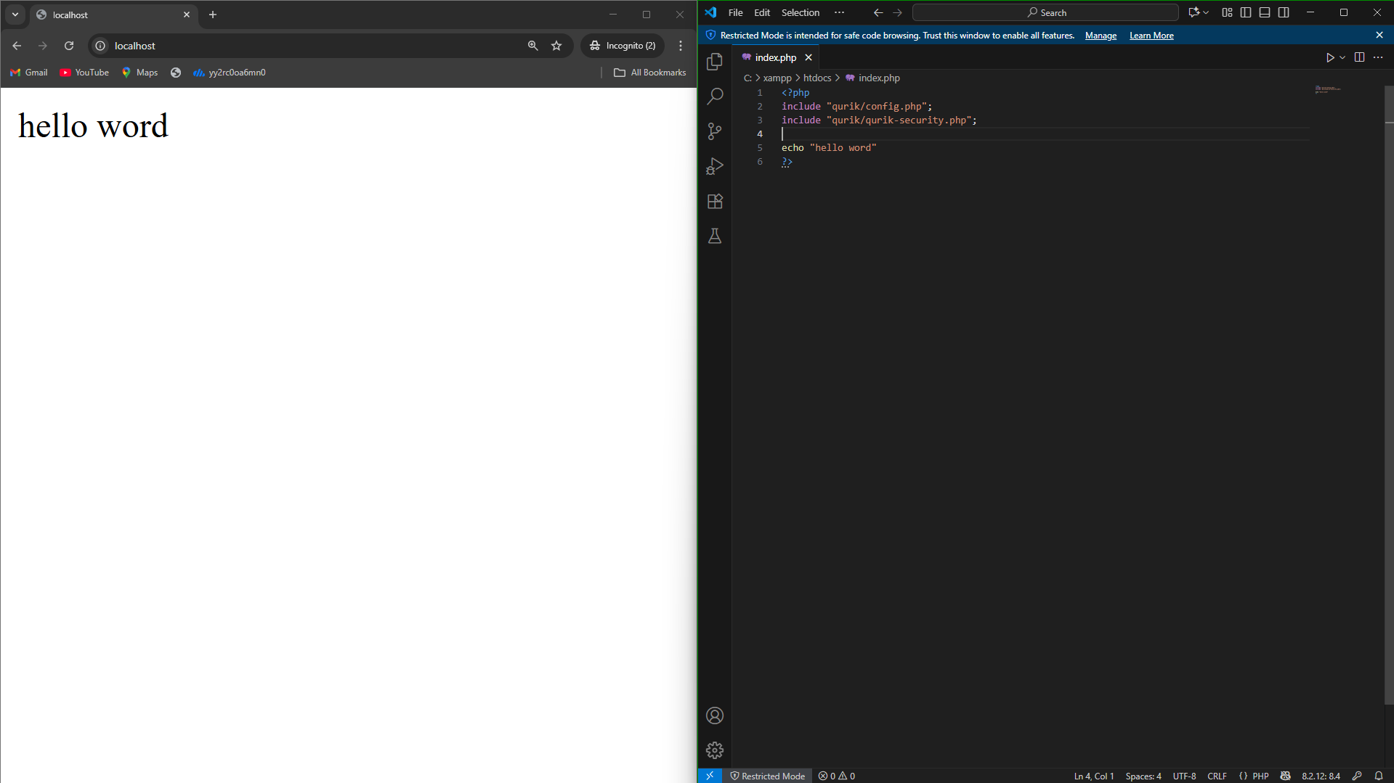
Apply integration code

Slide 21
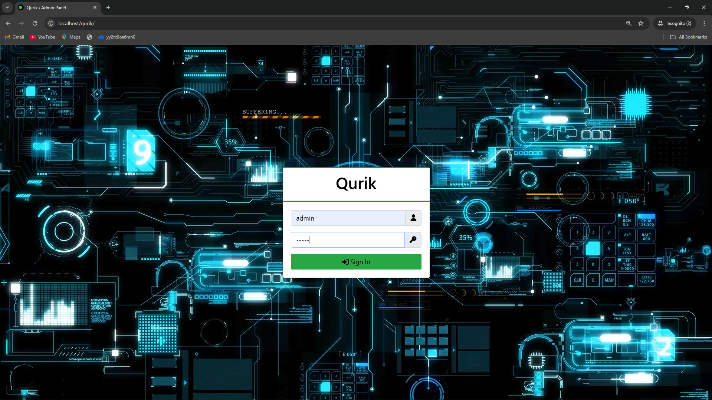
After login to dashboard

Slide 22
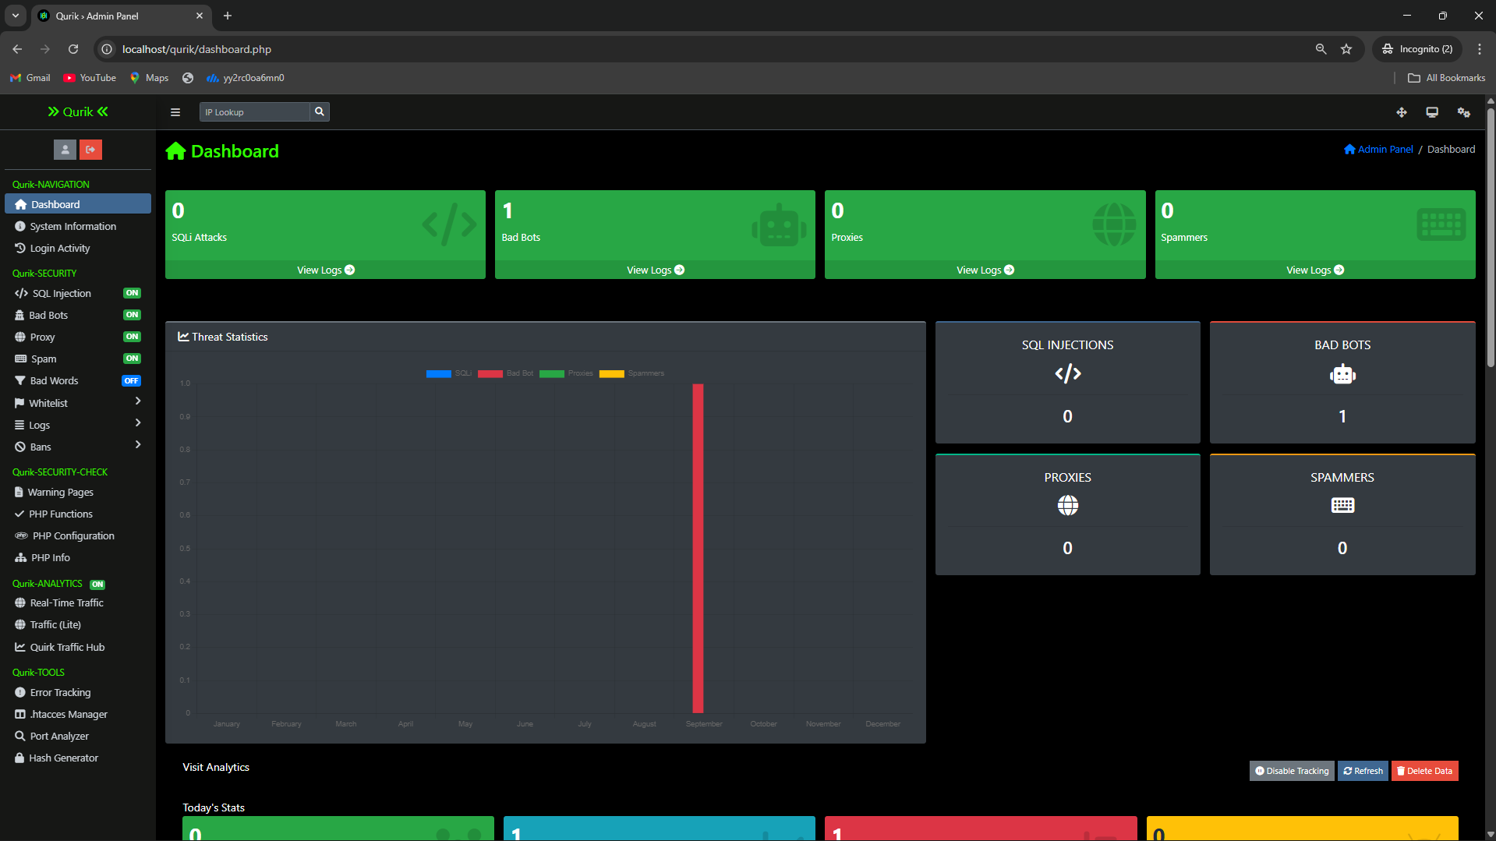
Qurik Dashboard

Slide 23
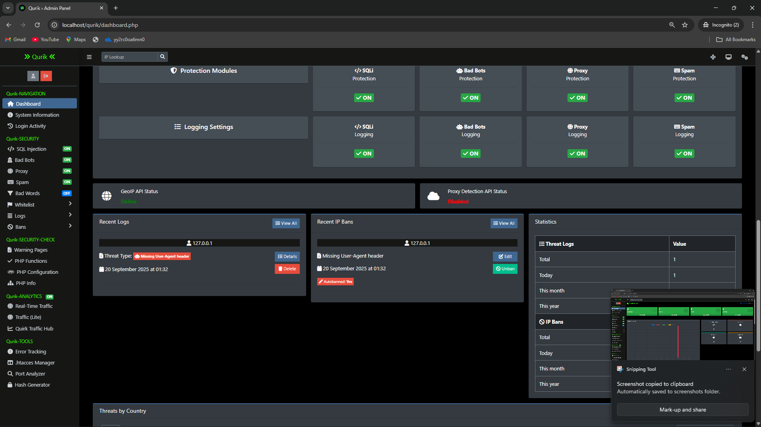
Qurik Dashboard

Slide 24
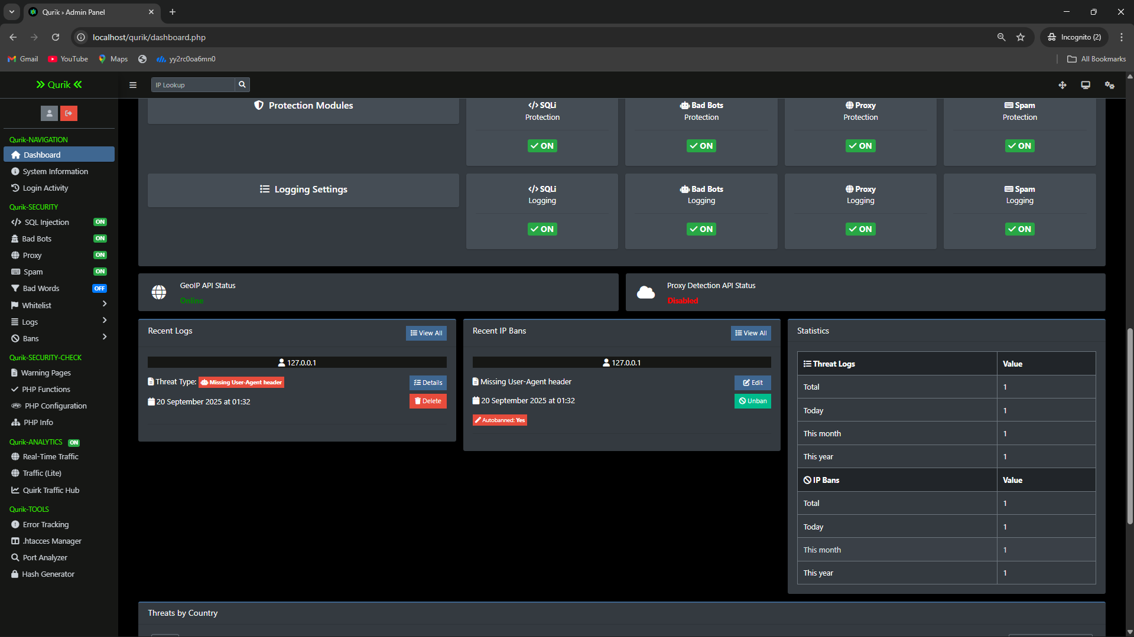

Slide 25
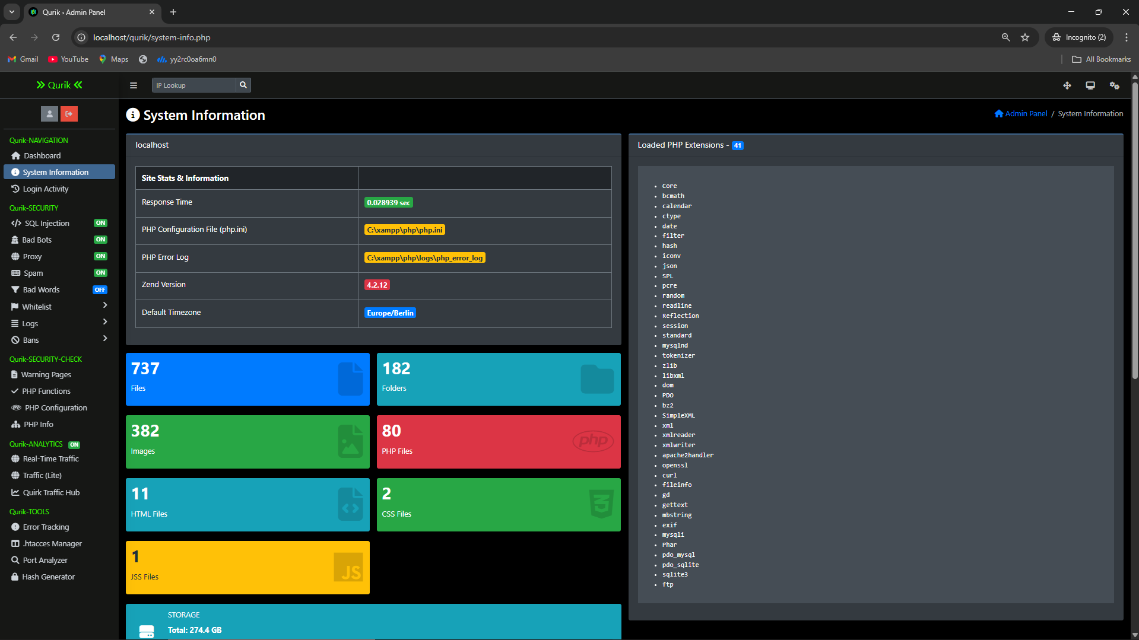
System information section

Slide 26
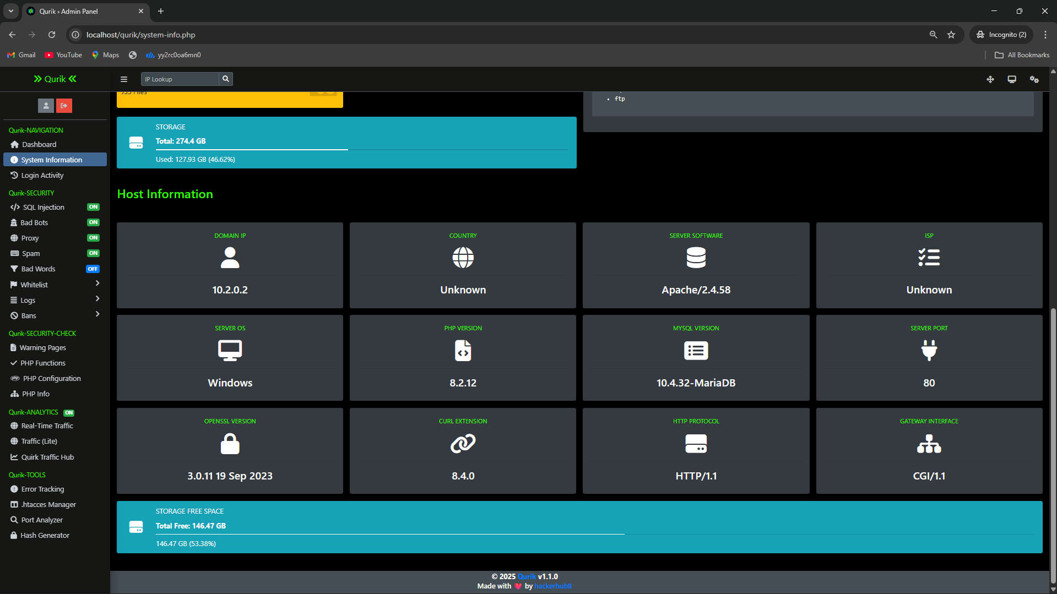
System information section

Slide 27
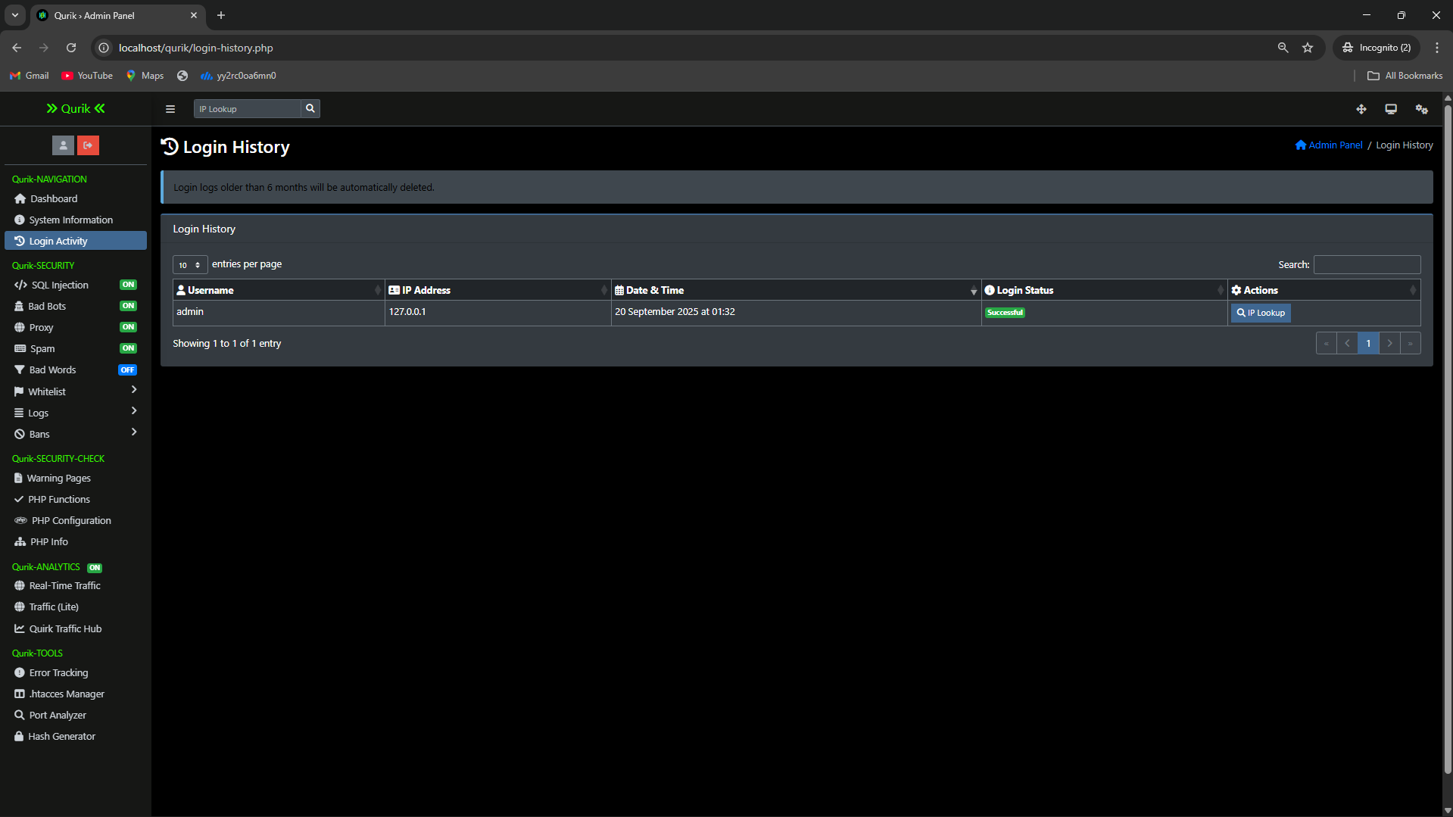
Login information section

Slide 28
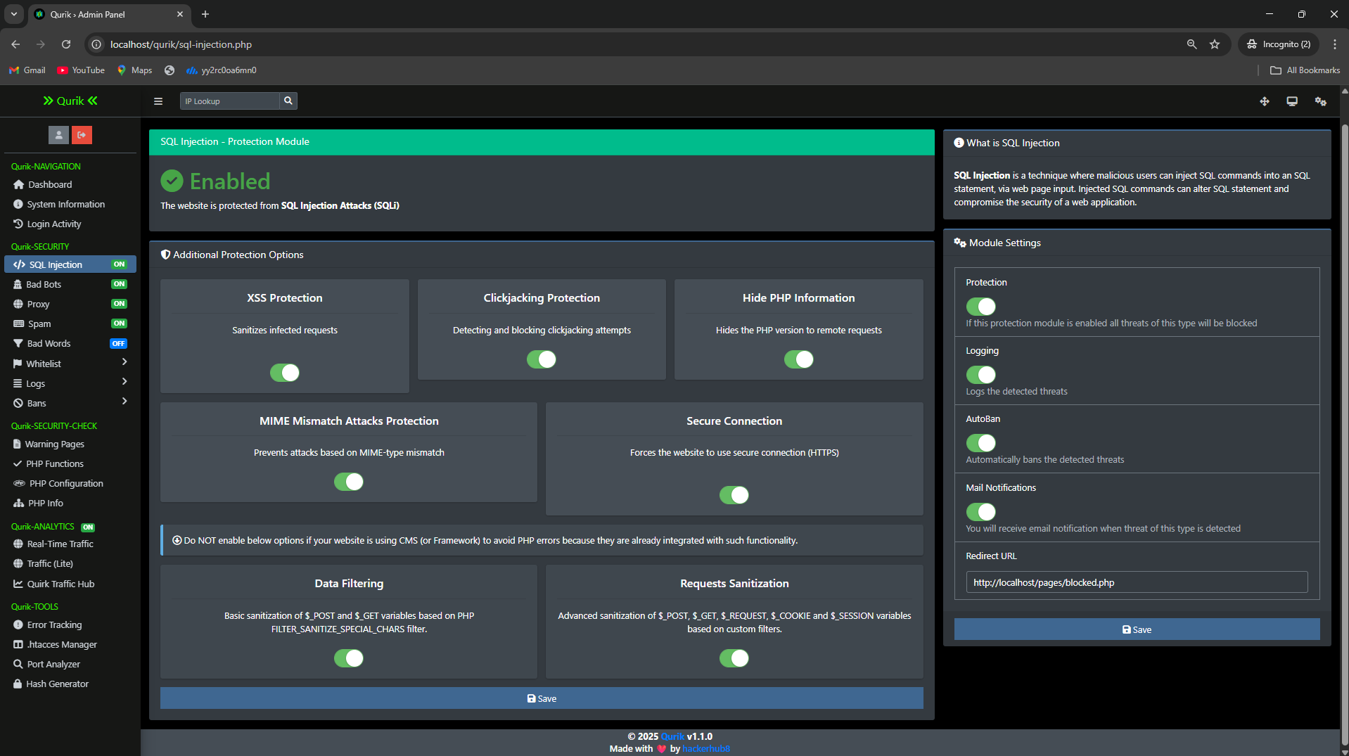
SQL injection section

Slide 29
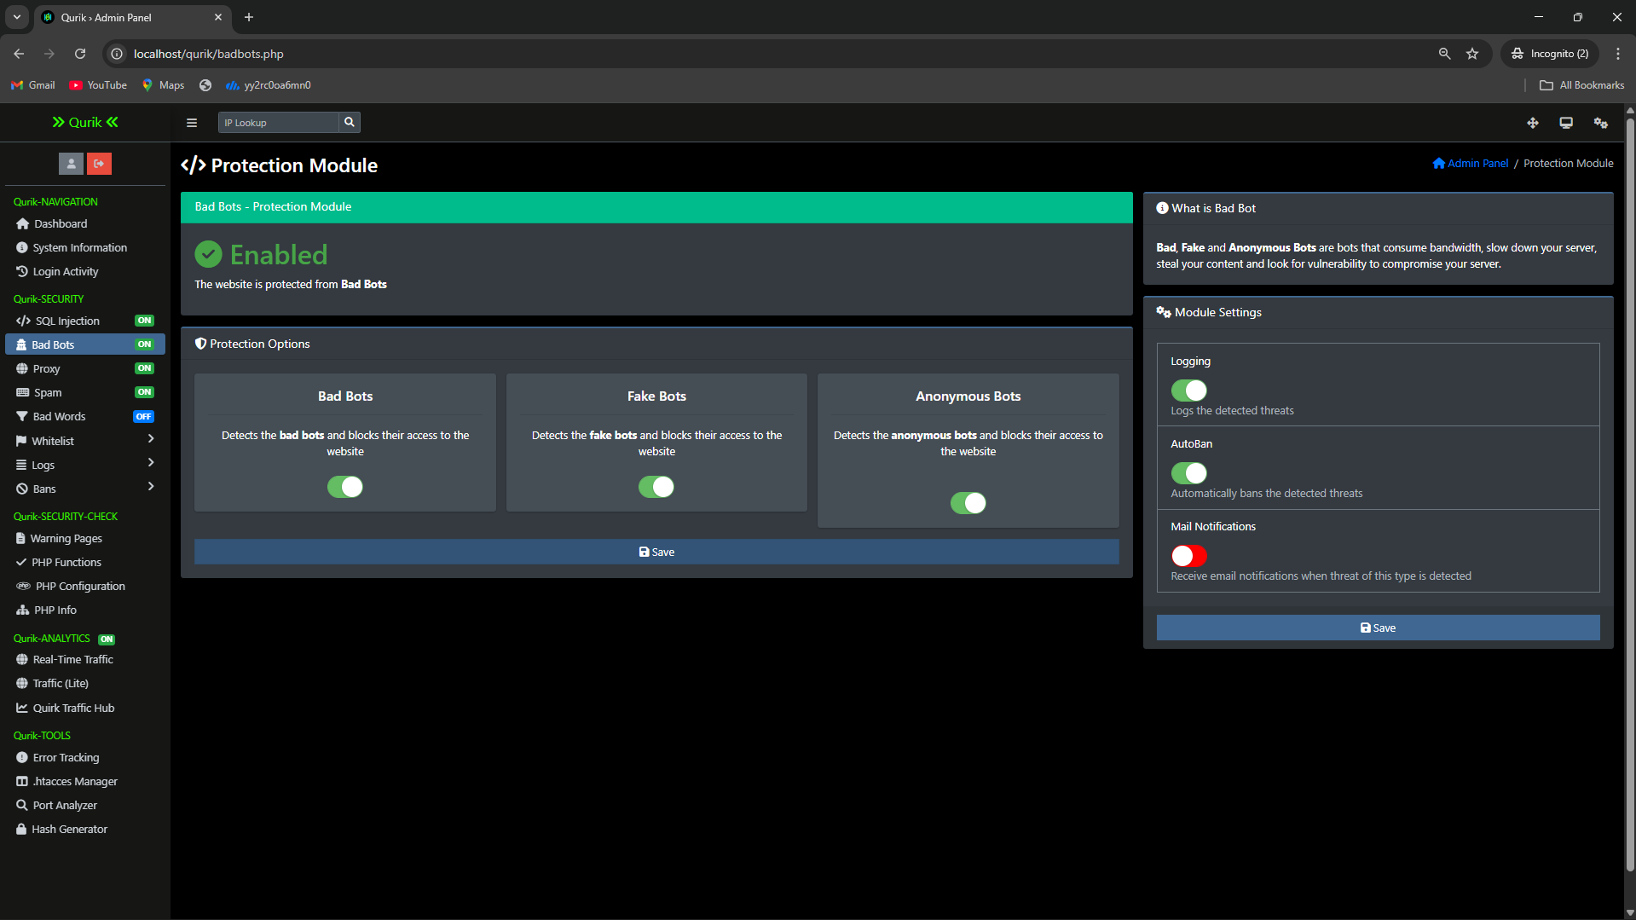
Bad Bot section

Slide 30
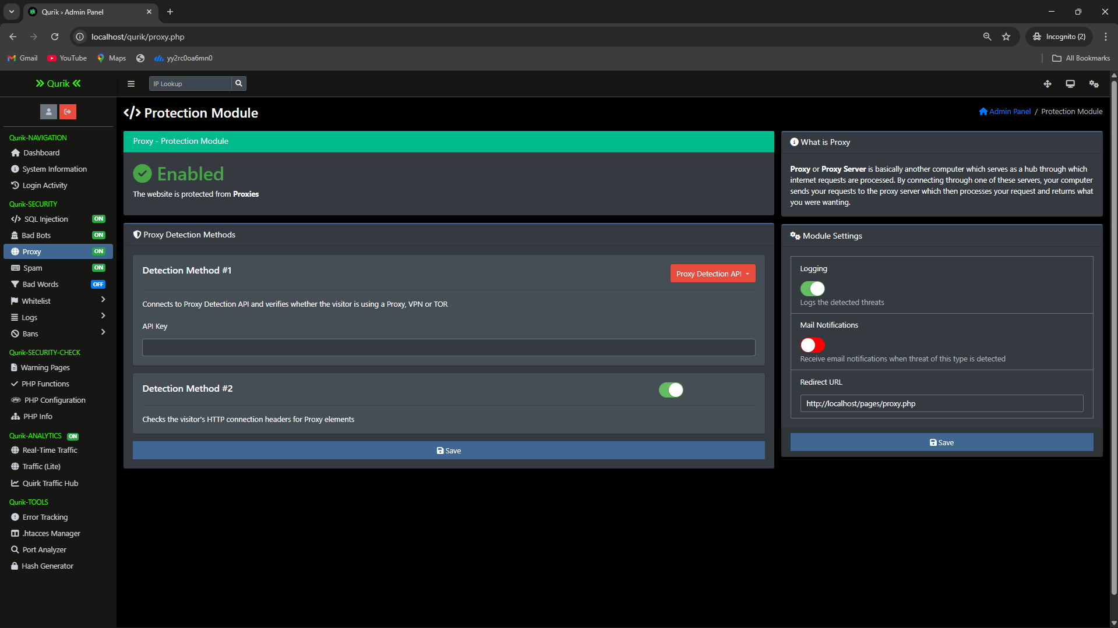
Proxy section

Slide 31
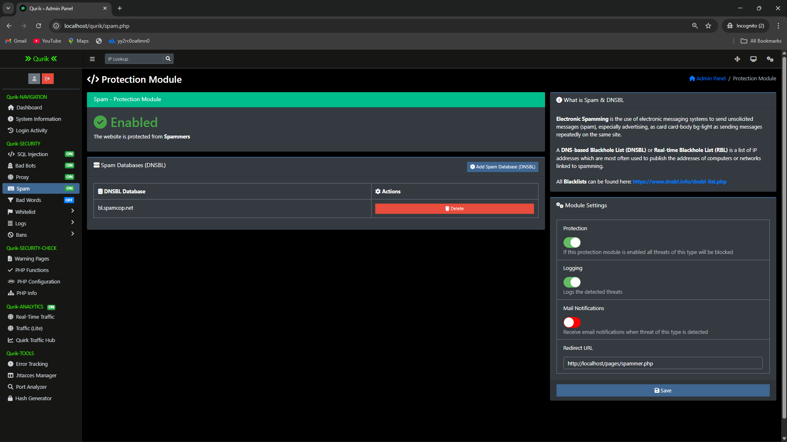
DNSBL configuration section

Slide 32
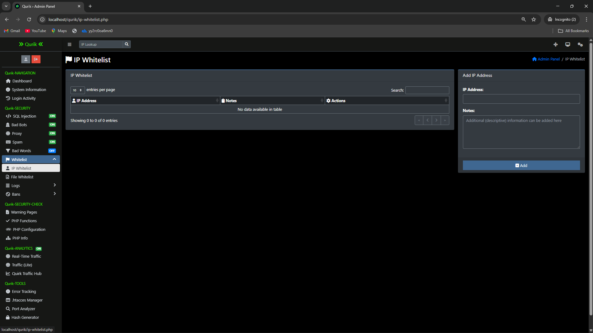
IP Whitelist section

Slide 33
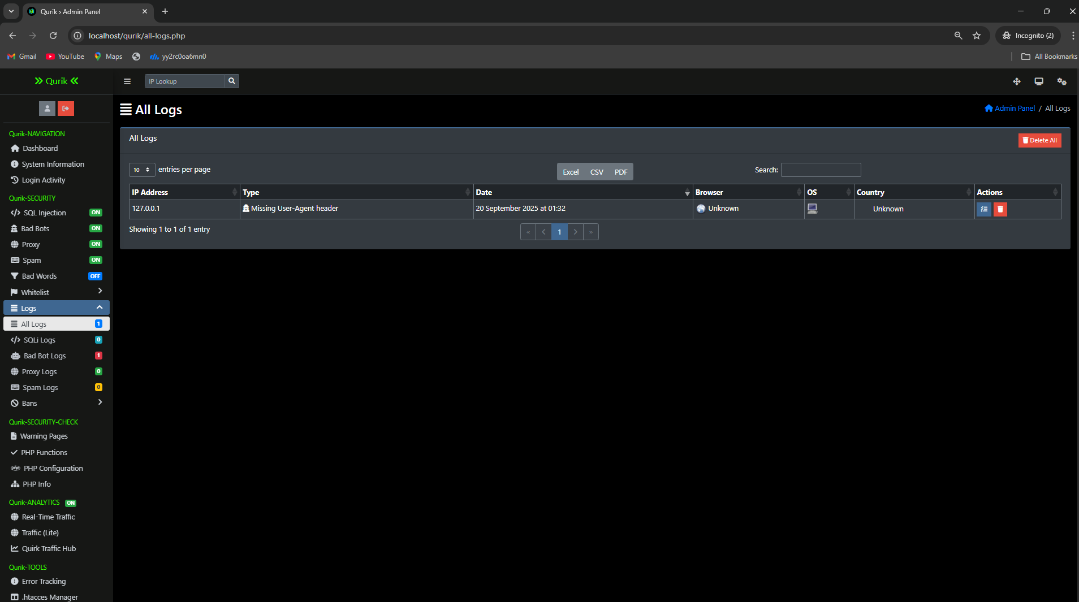
Log section

Slide 34
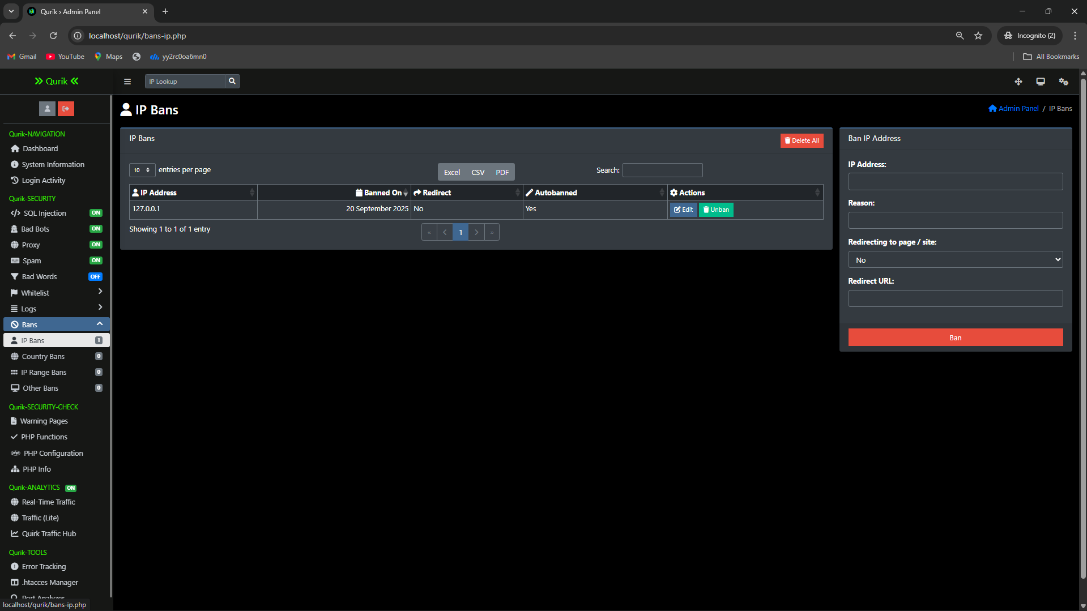
IP Ban section

Slide 35
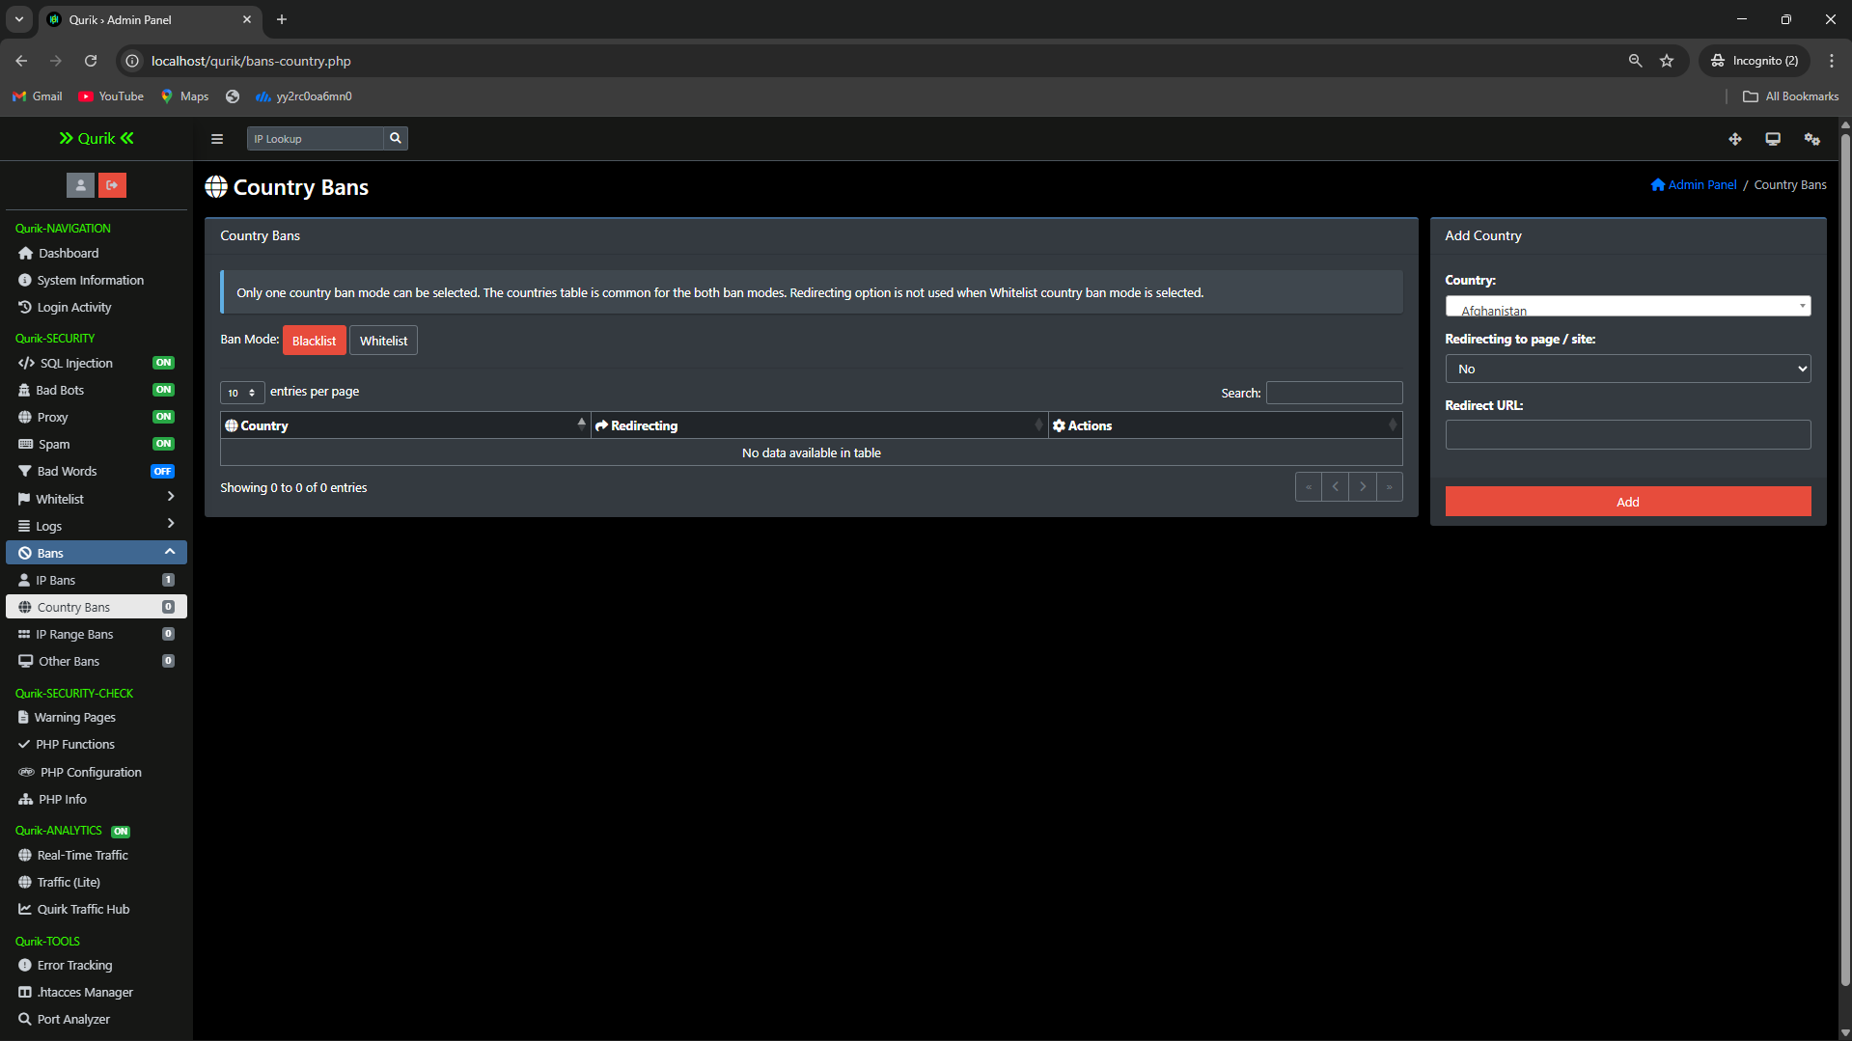
Country Ban section

Slide 36
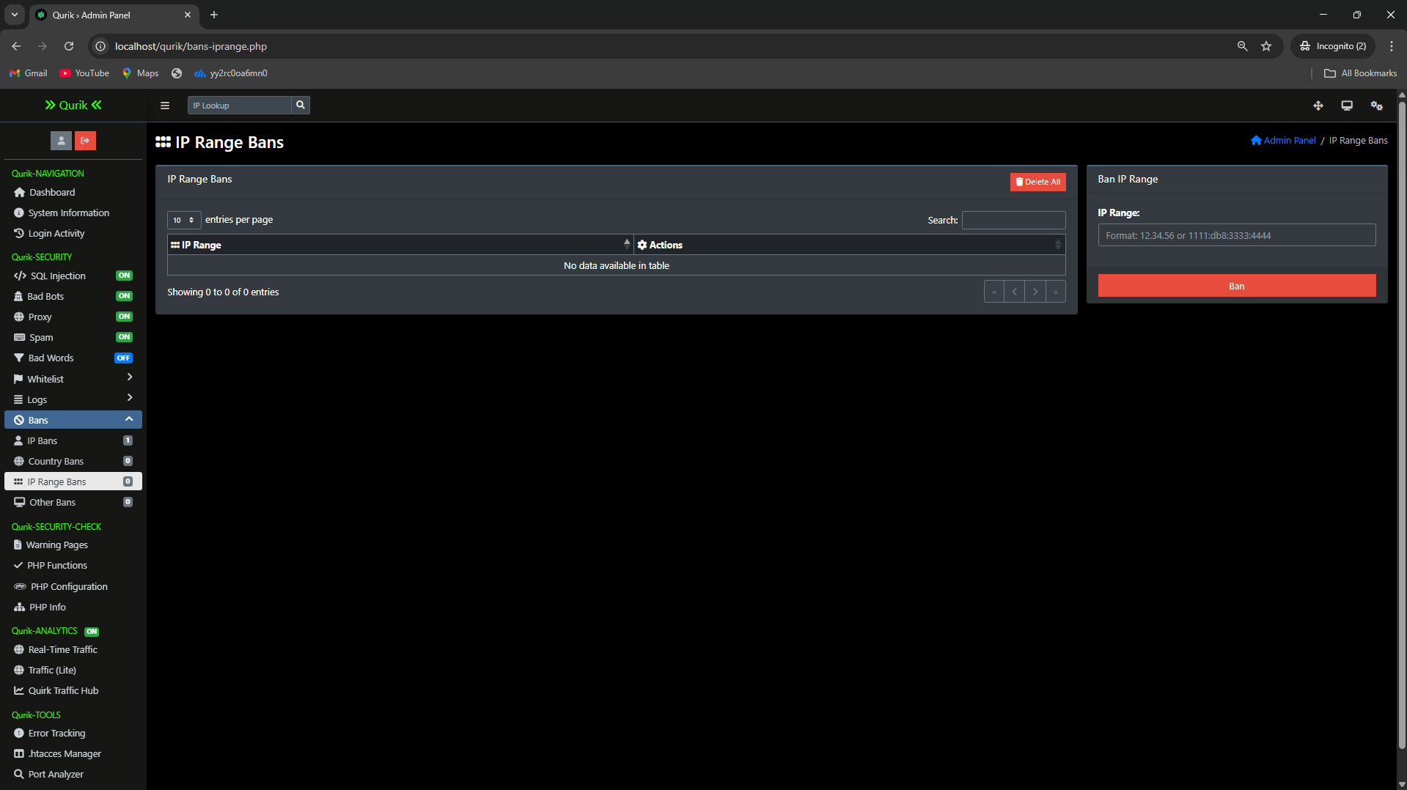
IP Range Ban section

Slide 37
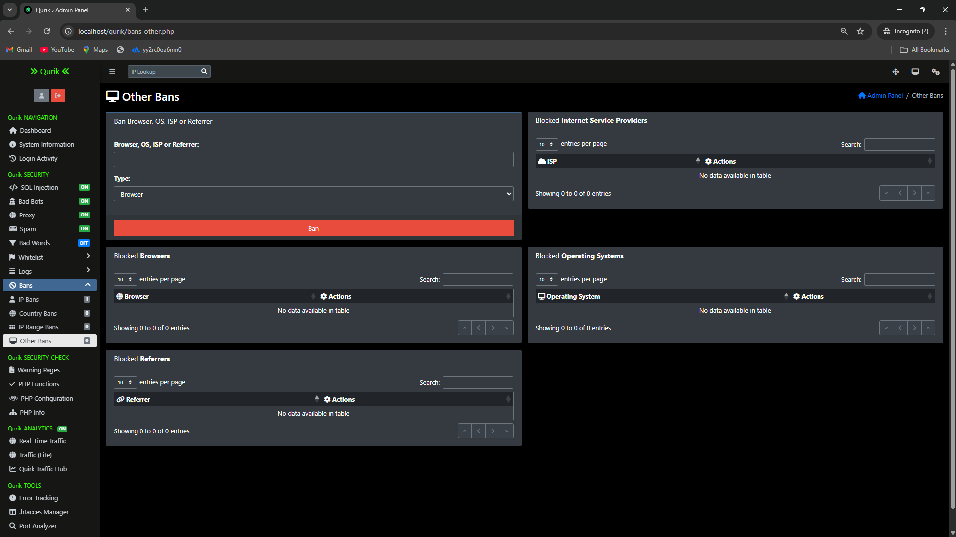
Other Manual Ban section

Slide 38
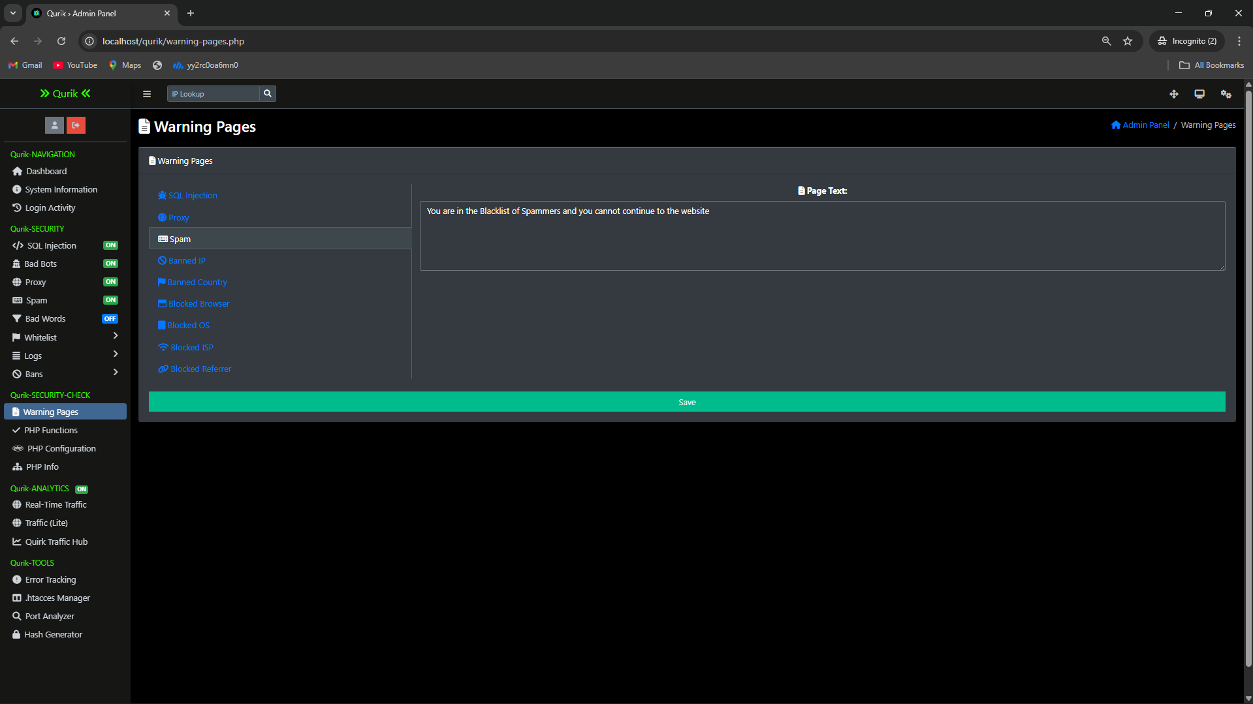
Warning page Modification section

Slide 39
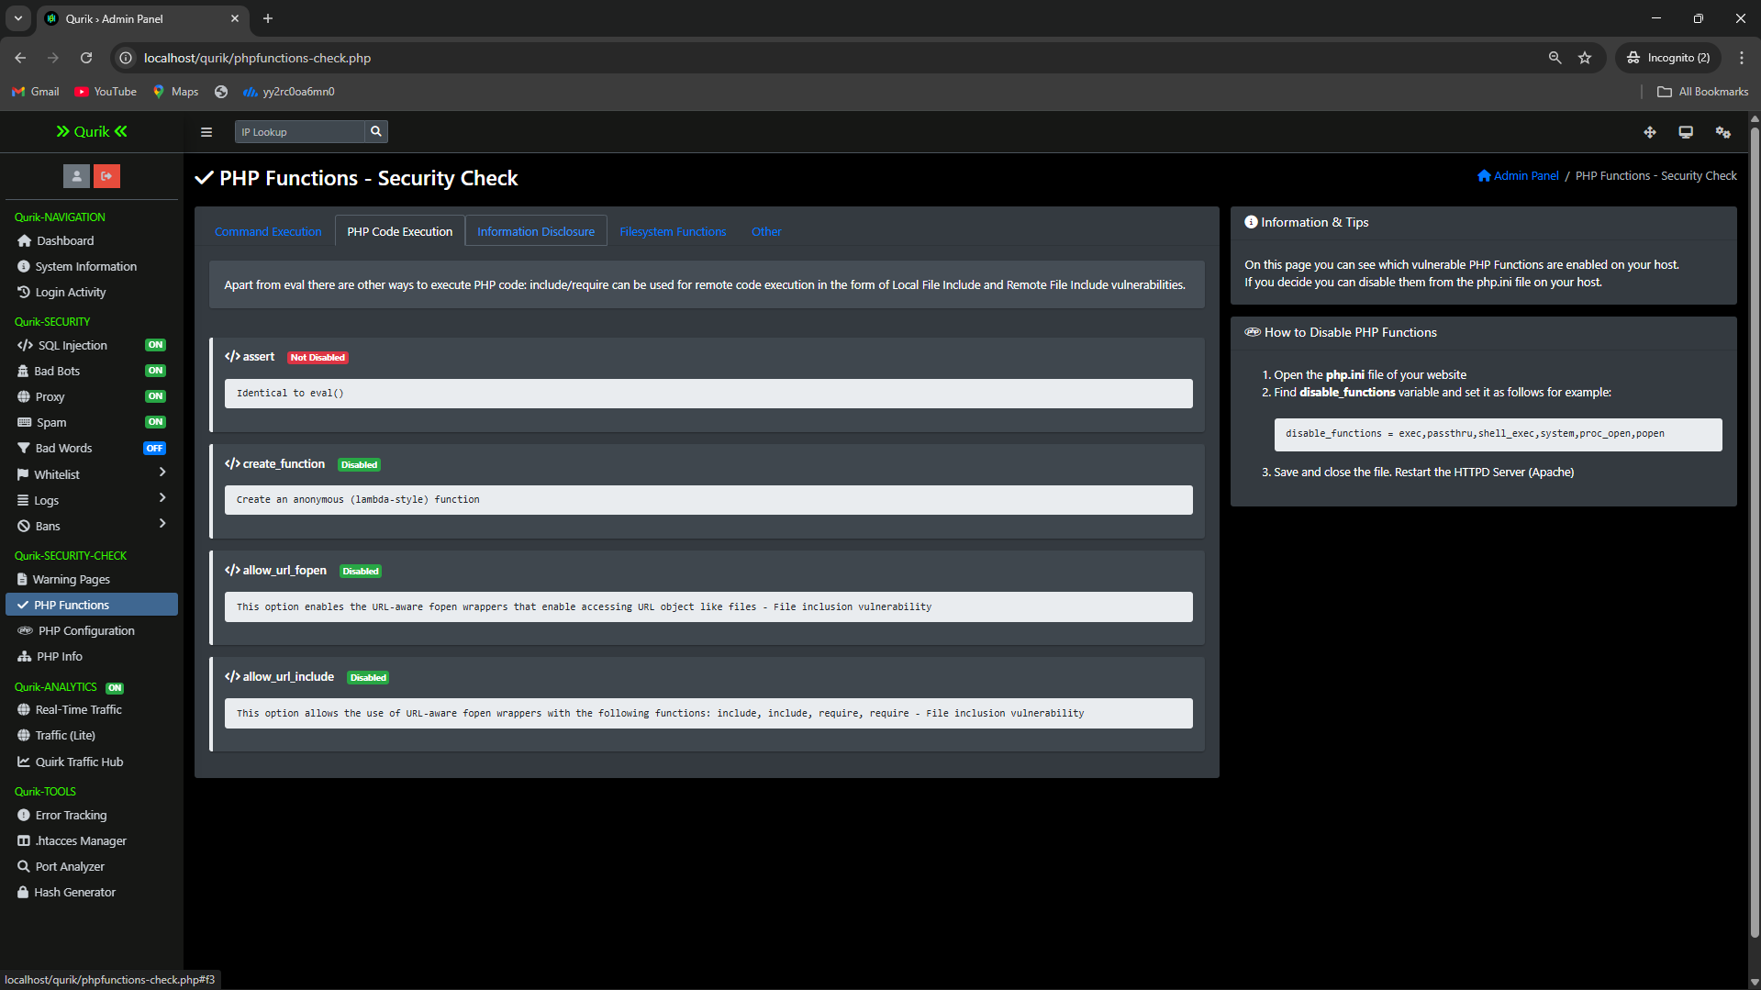
PHP function Checking section

Slide 40
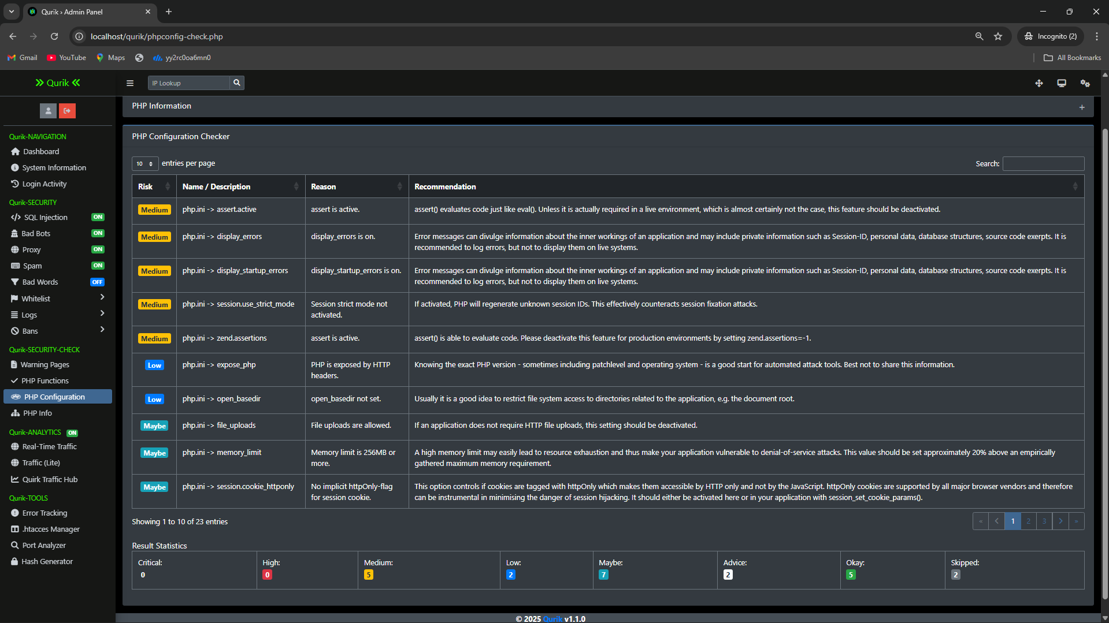
PHP Configuration section

Slide 41
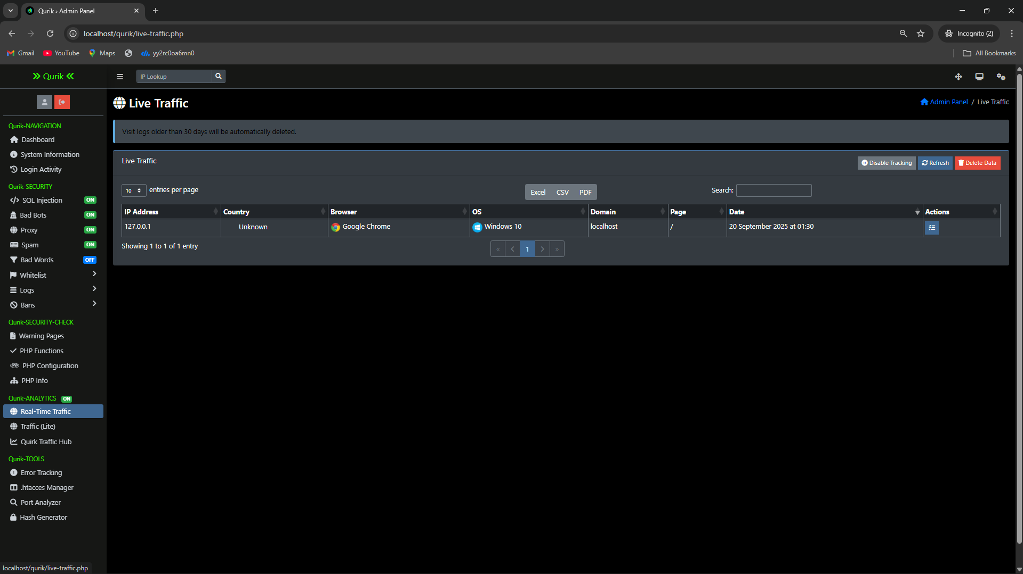
Live Traffic section

Slide 42
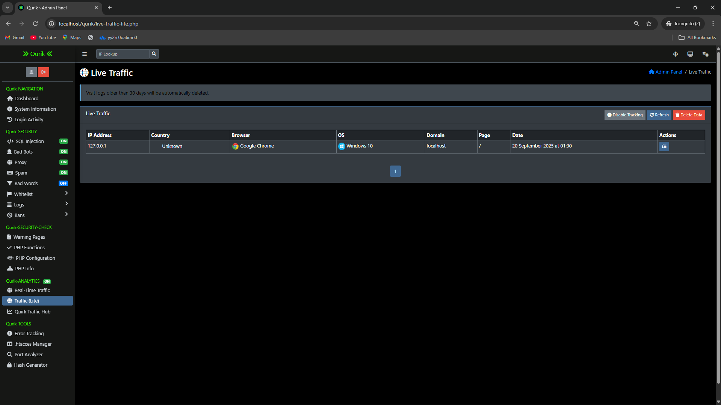
Live Traffic (Lite v.1)section

Slide 43
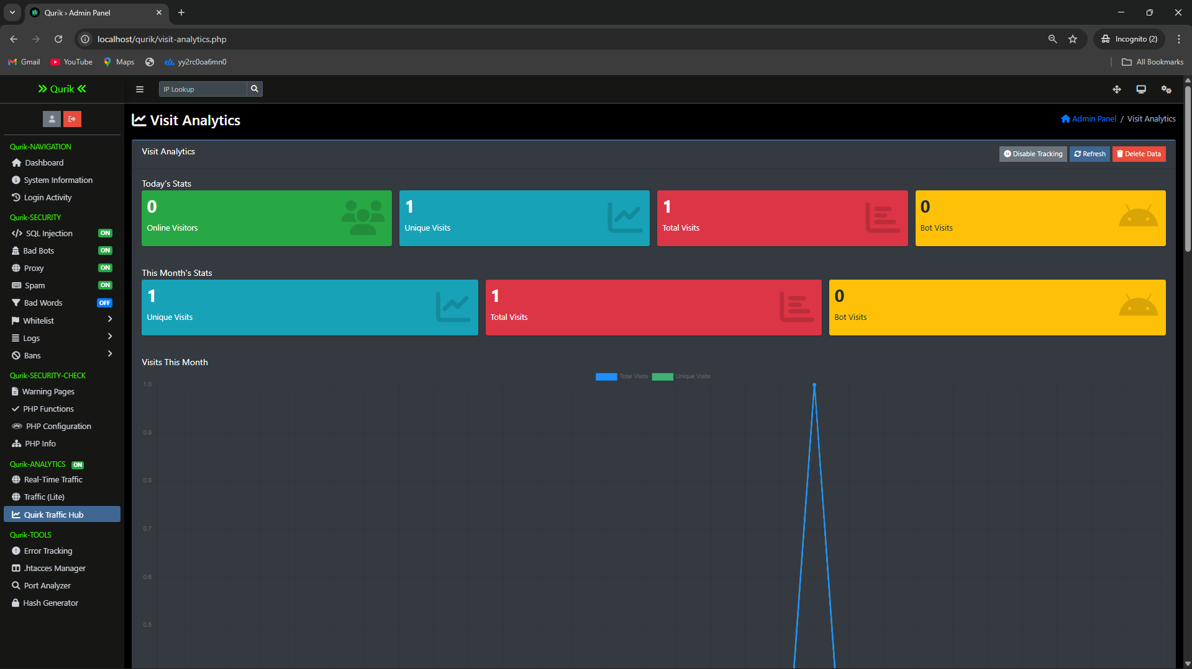
Visit Analytics section

Slide 44
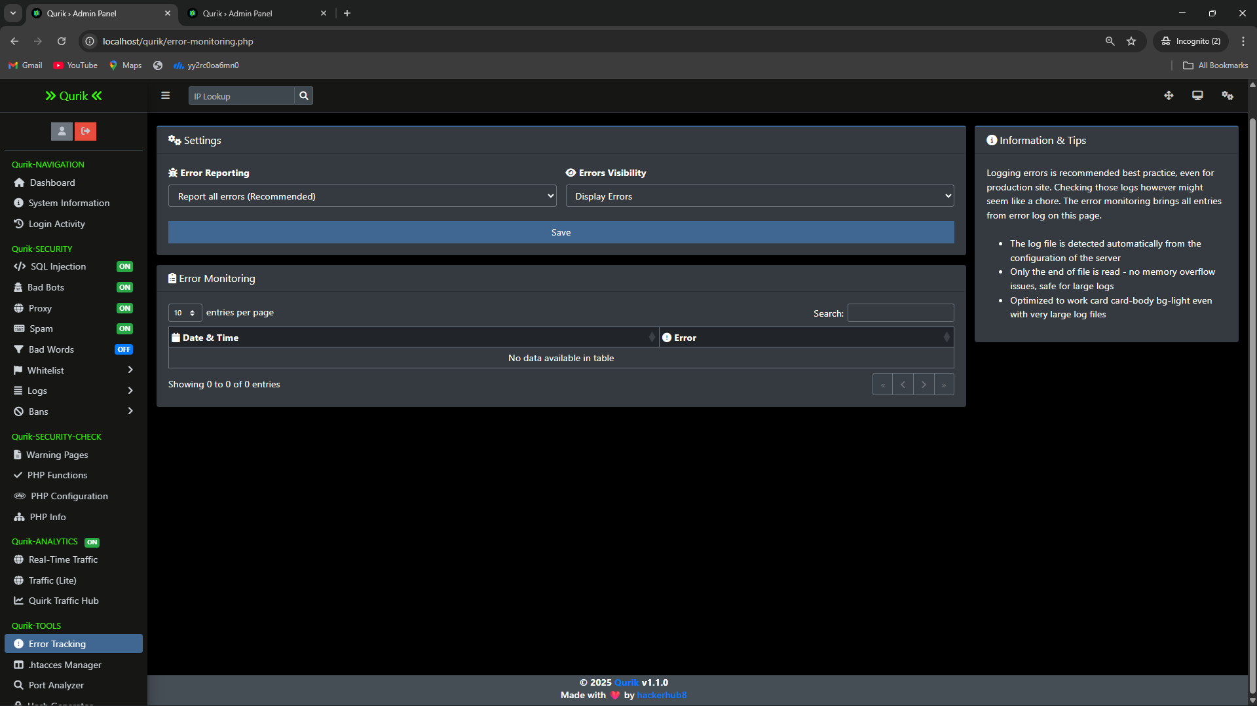
Error tracking & Reporting section

Slide 45
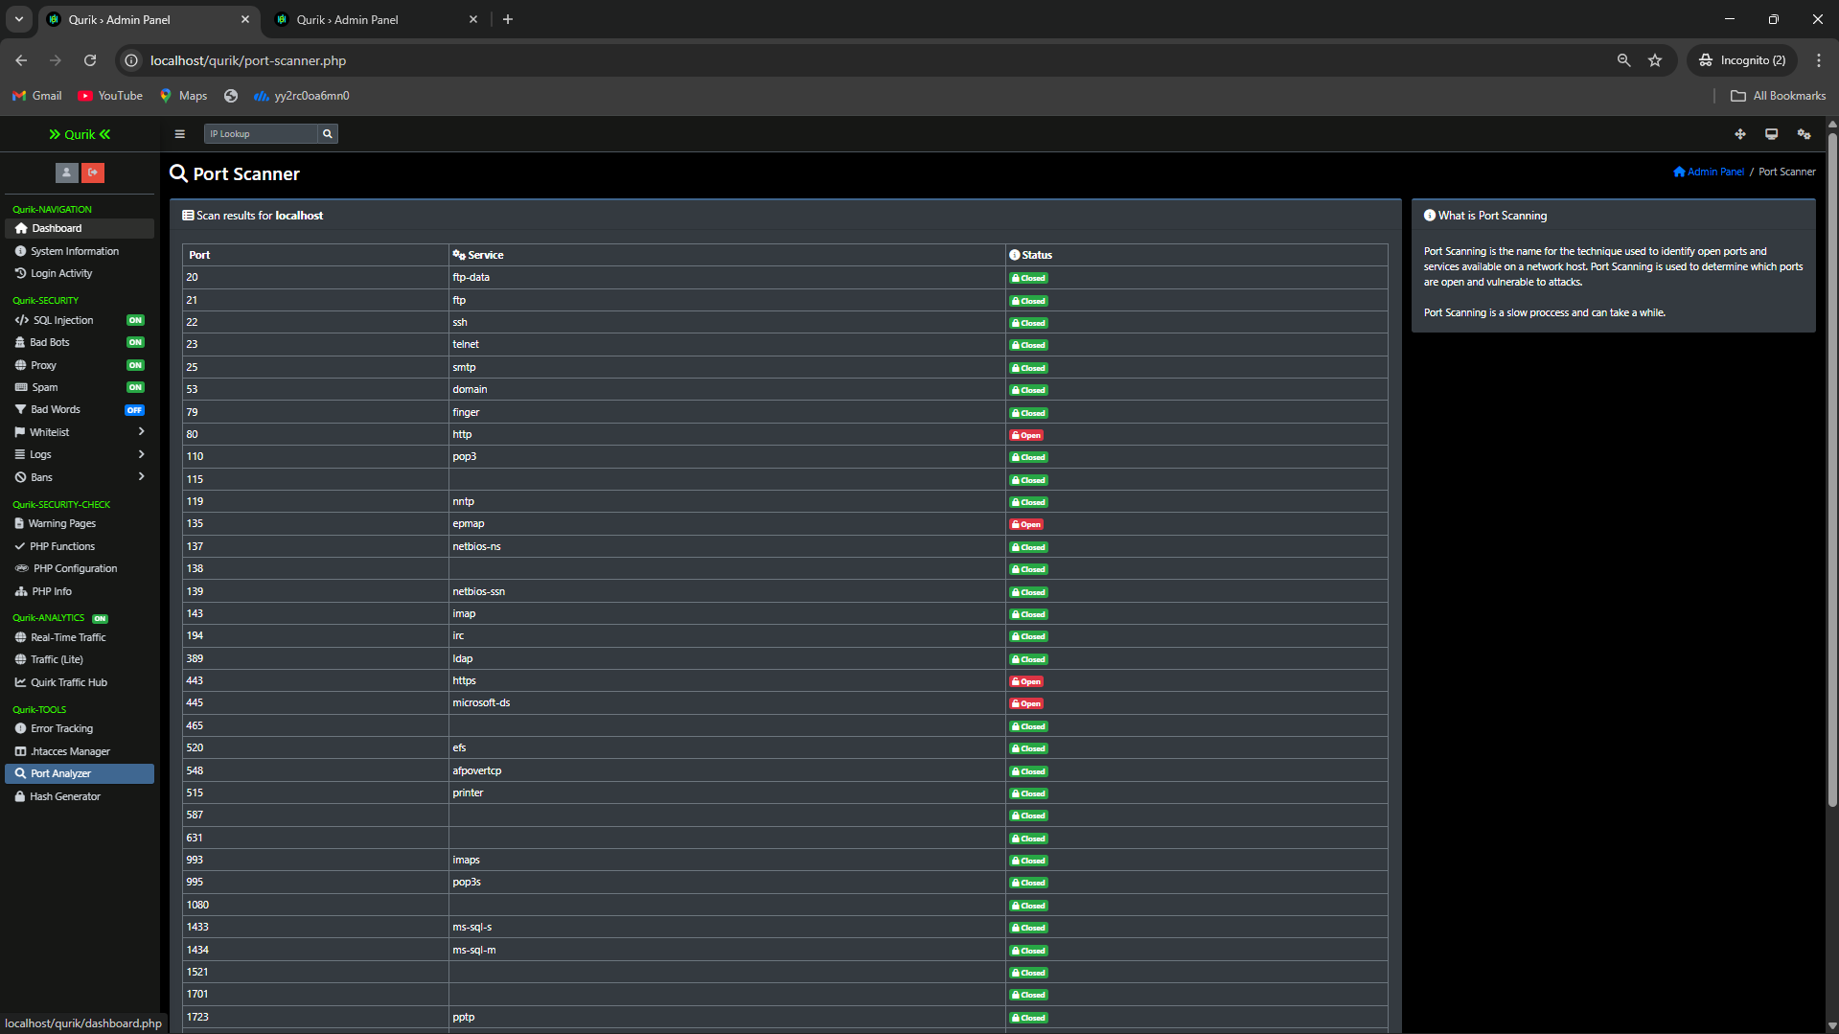
Port Scanner section

Slide 46
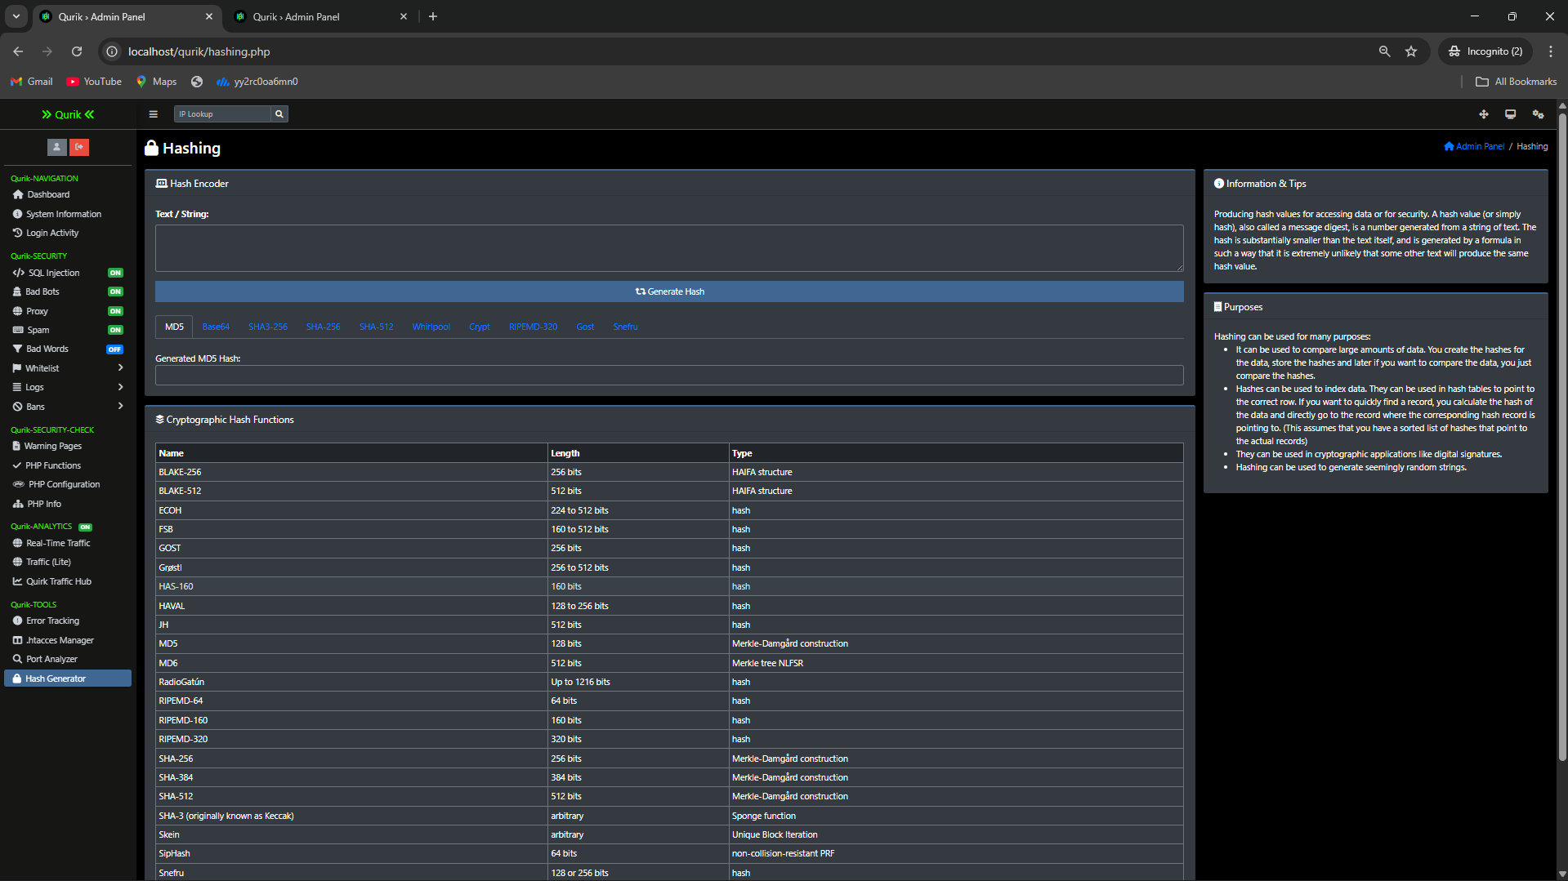
Hash Tool section

Slide 47

Github Link
The Github link provided should have public access permission.
Github Link
https://github.com/hacker-hub8/qurik

Slide 48
References (Development)
Font Awesome Icons - FontAwesome.com
Bootstrap Framework - GetBootstrap.com
DataTables - DataTables.net
jQuery - jQuery.com
AdminLTE - github.com/almasaeed2010/AdminLTE
Select2 - select2.github.io
OpenLayers - github.com/openlayers/openlayers
Chart.js - Chartjs.org
Flag Sprites - Flag-Sprites.com
iP.NF - ip.nf
ipapi.co - ipapi.co
IPHub - iphub.info
proxycheck.io - proxycheck.io
IPHunter - iphunter.info
Switchery - abpetkov.github.io/switchery
Popper.JS - popper.js.org
OverlayScrollbars - github.com/KingSora/OverlayScrollbars
cloudflare - https://www.cloudflare.com/

Slide 49
References (IEEE Paper format)
[1] S. Z. A. Shah, A. M. Khattak, and S. U. Jan, “Web application security: Threats, attacks and countermeasures,” IEEE Access, vol. 7, pp. 153779–153795, Oct. 2019.
[2] P. Biswas, A. Gupta, and S. Roy, “A survey on SQL injection: Detection and prevention techniques,” IEEE Transactions on Dependable and Secure Computing, vol. 18, no. 6, pp. 2560–2577, Nov.–Dec. 2021.
[3] A. S. Rawat and R. Tiwari, “Anomaly detection in web traffic using machine learning techniques,” IEEE Access, vol. 10, pp. 54628–54640, Jun. 2022.
[4] H. Tahir, M. A. Shah, and A. Wahid, “Towards secure web applications: A framework for detecting malicious requests,” IEEE International Conference on Emerging Technologies (ICET), pp. 1–6, Dec. 2020.
[5] A. A. Ghorbani, W. Lu, and M. Tavallaee, “Network intrusion detection and prevention: Concepts and techniques,” IEEE Communications Surveys & Tutorials, vol. 21, no. 1, pp. 70–94, Jan.–Mar. 2019.
[6] M. Singh and K. Kumar, “Cross-site scripting (XSS) attack detection using ensemble learning,” IEEE Access, vol. 8, pp. 170588–170602, Sept. 2020.

Slide 50
References (IEEE Paper format)
[7] R. Beghdad, “SQL injection attacks detection and prevention techniques: A survey,” IEEE Access, vol. 9, pp. 160312–160329, Nov. 2021.
[8] J. He, C. Yang, and X. Liu, “Real-time detection of web attacks using deep learning,” IEEE Transactions on Information Forensics and Security, vol. 16, pp. 2478–2492, Apr. 2021.
[9] V. Sharma, A. Yadav, and S. Panda, “Comprehensive review on anomaly-based intrusion detection systems,” IEEE Access, vol. 8, pp. 73345–73371, May 2020.
[10] F. Hussain, A. K. Malik, H. Ali, and M. A. Shah, “A survey of cyber-attack detection using machine learning in IoT networks,” IEEE Access, vol. 8, pp. 219650–219673, Dec. 2020.
[11] M. S. Hossain, M. A. Rahman, and R. R. Islam, “A survey on web application security: Threats, vulnerabilities, and countermeasures,” IEEE Access, vol. 8, pp. 123456–123478, Jan. 2020.
[12] J. K. Gupta, S. R. S. Iyengar, and P. N. Suganthan, “Deep learning for web application security: A comprehensive survey,” IEEE Transactions on Neural
Networks and Learning Systems, vol. 31, no. 7, pp. 2345–2361, Jul. 2020.
[13] L. Zhang, Y. Liu, and Z. Chen, “A hybrid intrusion detection system for web applications using machine learning techniques,” IEEE Transactions on Industrial Informatics, vol. 17, no. 5, pp. 3456–3464, May 2021.

Slide 51


