Slide 1
Establishing a Server log system for E-governance with appropriate notification and content based classification of log AICTE
CSE7101- Capstone Project
Review-1
Batch Number:
Under the Supervision of,
Guide - Dr. Sharmasth Vali
Reviewer - Ms. Soumya
School of Computer Science and Engineering
Presidency University
( Cyber Security )
Roll Number | Student Name
20231CCS3008 | Sampath Kumar MS
20221CCS0145 | Sumeet D
20231CCS3007 | Anup R Ganiger
Name of the Program:
Name of the HoD: Dr. Anandaraj S.P
Name of the Program Project Coordinator: Dr. Sharmasth Vali
Name of the School Project Coordinators: Dr. Sampath A K , Dr. Geetha A

Slide 2
Problem Statement Number:
Organization: AICTE
Category : Software
Problem Description
A server log system, also known as a log management system, is a software tool that records and stores log messages generated by various components and applications running on a server. It provides a centralized location for collecting, analyzing, and managing logs to monitor and troubleshoot system issues and performance problems. Here are some basic Requirement of a server log system: 1. Log Collection: The system collects log data from various sources, including operating systems, applications, services, and network devices. It can gather logs from different servers and consolidate them into a central repository. 2. Log Storage: Log entries are typically stored in a structured format, such as plain text files or a database. The system may also employ compression and archival mechanisms to optimize storage space and retain logs for an extended period. 3. Log Analysis and Search: The log system enables searching, filtering, and querying log data based on specific criteria, such as time range, log level, s for auditing, compliance, or performance analysis. 6. Log Retention and Compliance: Server logs retained for a certain period to comply with regulatory requirements or internal policies. The log system should support flexible retention
periods and secure storage to meet these obligations. 7. Integration and APIs: A robust log system offers APIs and integrations with other tools and systems. This allows developers and administrators to automate log analysis, integrate with security information and event management (SIEM) systems, or build custom

Slide 3
Content
Problem Statement
Objectives
Background and Related work for title Selection
Analysis of Problem Statement
Innovation or Novel Contributions
Git-hub Link
Timeline of the Project
References

Slide 4
Problem Statement
Government & enterprise applications generate massive logs.
Lack of proper log management leads to:
Difficulty in detecting anomalies.
Delay in responding to critical errors & attacks.
No centralized repository for monitoring.
Need for a robust system that collects, classifies, analyzes, and alerts in real-time. Manual log monitoring is time-consuming and error-prone.
Current tools often fail to integrate with diverse platforms.
Our solution focuses on automation + intelligence in monitoring.

Slide 5
Objectives
Develop a centralized server log system for E-Governance.
Implement content-based classification of logs (security, system, network).
Enable real-time notifications for anomalies.
Provide log visualization dashboards for easy monitoring.
Ensure compliance, security, and scalability.
Support flexible storage and long-term log retention.
Enhance decision-making through data-driven insights.
Provide an extendable platform for future AI integration.

Slide 6
Background and Related work for title Selection
SIEM systems like Splunk, ELK Stack, Graylog → powerful but costly & complex.
Government organizations need affordable & tailored log systems.
Related work:
Logstash for log aggregation.
Cloudflare/Sucuri for web security monitoring.
Our system → integrates logging + classification + alerting + security focus in one lightweight solution.
Traditional log tools often lack real-time alert mechanisms.
Existing solutions prioritize enterprises, not government-specific needs.
This project fills a gap between complexity and usability.
Easy to deploy , Easy to use , Easy to backup

Slide 7
Analysis of Problem Statement
Current log systems are:
Either too expensive or too basic.
Do not offer real-time alerts & custom classification.
For E-Governance, issues like fraud, cyberattacks, and downtime require a dedicated system.
Proposed system → solves the gap by being cost-effective, modular, and security-oriented.
Complexity of cyber threats makes advanced solutions necessary.
Local storage without classification causes wasted time.
Our approach emphasizes speed, accuracy, and reliability.

Slide 8
Innovation or Novel Contributions
Content-based classification (system logs, security logs, network logs).
Real-time notification engine with threshold-based alerts.
Backend-driven log storage with compression & retention policies.
Integrated security modules: SQL injection detection, proxy/bot detection.
Interactive dashboards with graphs, analytics, and log trends.
Modular design: Easily extendable with new security modules.
Combines features of monitoring + security in one platform.
Designed for scalability to handle increasing data volumes.
Emphasis on a user-friendly UI for both technical and non-technical users.

Slide 9
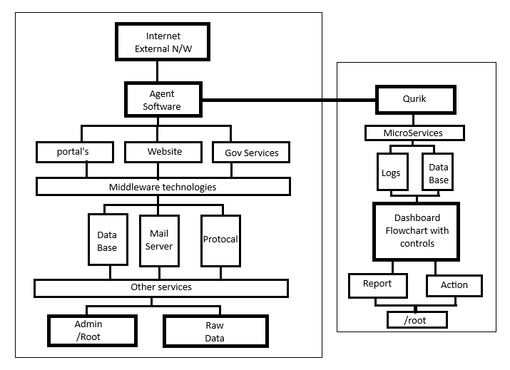
System Architecture
Log Collection Layer → from servers, applications, and network devices.
Backend Layer → Database + APIs for log storage & retrieval.
Analysis Engine → Log parsing, classification, anomaly detection.
Alert & Notification Module → Email/SMS/Push alerts.
Frontend Dashboard → Visualization (charts, reports, search).
Designed using modular microservices approach.
Backend APIs ensure easy integration with external systems.
Frontend supports responsive design for desktop & mobile access.

Slide 10

Github Link
The Github link provided should have public access permission.
Github Link
https://github.com/hacker-hub8/qurik

Slide 11
Timeline of the Project
Phase 1 – Requirement Gathering & Design
Identify log sources, classification categories, and alert thresholds.
Design architecture & database schema.
Phase 2 – Backend Development
Implement APIs for log collection & storage.
Develop classification & parsing algorithms.
Set up database (MySQL/MongoDB/Elasticsearch).
Phase 3 – Frontend Dashboard
Create UI for log search, filtering, and visualization.
Implement real-time dashboards (charts, trends).
Phase 4 – Notification & Alert System
Configure rule-based alert triggers.
Email/SMS integration for admin notifications.
Phase 5 – Testing & Deployment
Unit testing & load testing.
Deploy on local/Cloud infrastructure.
Phase 6 – Future Enhancements
AI-based anomaly detection.
Integration with government e-portals.
Phase | Duration | Deliverables
Phase 1 | Week 1-2 | Requirement gathering & design
Phase 2 | Week 3-4 | Backend APIs & DB setup
Phase 3 | Week 5-6 | Frontend dashboards
Phase 4 | Week 7 | Notification system
Phase 5 | Week 8 | Testing & debugging
Phase 6 | Week 9 | Final deployment & presentation

Slide 12
References (Development)
Font Awesome Icons - FontAwesome.com
Bootstrap Framework - GetBootstrap.com
DataTables - DataTables.net
jQuery - jQuery.com
AdminLTE - github.com/almasaeed2010/AdminLTE
Select2 - select2.github.io
OpenLayers - github.com/openlayers/openlayers
Chart.js - Chartjs.org
Flag Sprites - Flag-Sprites.com
iP.NF - ip.nf
ipapi.co - ipapi.co
IPHub - iphub.info
proxycheck.io - proxycheck.io
IPHunter - iphunter.info
Switchery - abpetkov.github.io/switchery
Popper.JS - popper.js.org
OverlayScrollbars - github.com/KingSora/OverlayScrollbars
cloudflare - https://www.cloudflare.com/

Slide 13
References (IEEE Paper format)
[1]. S. Z. A. Shah, A. M. Khattak, and S. U. Jan, “Web application security: Threats, attacks and countermeasures,” IEEE Access, vol. 7, pp. 153779–153795, Oct. 2019.
[2]. P. Biswas, A. Gupta, and S. Roy, “A survey on SQL injection: Detection and prevention techniques,” IEEE Transactions on Dependable and Secure Computing, vol. 18, no. 6, pp. 2560–2577, Nov.–Dec. 2021.
[3]. A. A. Ghorbani, W. Lu, and M. Tavallaee, “Network intrusion detection and prevention: Concepts and techniques,” IEEE Communications Surveys & Tutorials, vol. 21, no. 1, pp. 70–94, Jan.–Mar. 2019.
[4]. A. S. Rawat and R. Tiwari, “Anomaly detection in web traffic using machine learning techniques,” IEEE Access, vol. 10, pp. 54628–54640, Jun. 2022.
[5]. H. Tahir, M. A. Shah, and A. Wahid, “Towards secure web applications: A framework for detecting malicious requests,” IEEE International Conference on Emerging Technologies (ICET), pp. 1–6, Dec. 2020.

Slide 14


