Slide 1


CSE7101- Capstone Project
Review-2
Establishing a Server log system for E-governance with appropriate notification and content based classification of log AICTE
Batch Number : CCS_05
Roll Number Student Name
Under the Supervision of,
Guide - Dr. Sharmasth Vali
School of Computer Science and Engineering
Presidency University ( Cyber Security )
20221CCS0145 | Sumeet D
20231CCS3008 | Sampath Kumar MS
20231CCS3007 | Anup R Ganiger
Name of the HoD: Dr. Anandaraj S.P
Name of the Program Project Coordinator: Dr. Sharmasth Vali
Name of the School Project Coordinators: Dr. Sampath A K , Dr. Geetha A

Slide 2

Abstract
Quirk is an intelligent web security dashboard designed to protect websites from modern cyber threats such as SQL injection, XSS attacks, proxy misuse, and spam bots.
The system leverages pattern recognition, anomaly detection, and industry-standard algorithms to identify both known and unknown vulnerabilities in real time.
It provides a centralized admin panel with advanced features like traffic monitoring, banning malicious users, error tracking, and analytics to ensure proactive defense.
By combining automated security mechanisms with easy-to-use tools, Quirk offers a cost-effective, scalable, and reliable security solution for individuals and enterprises.

Slide 3
Literature Survey
Web Application Security Challenges
Increasing threats like SQL injection, XSS, and bot attacks reported in research papers.
Existing tools focus on detection but lack integrated monitoring and prevention.
Existing Solutions & Tools
WAFs (Web Application Firewalls): Provide strong protection but are costly and resource-intensive.
IDS/IPS Systems: Effective in anomaly detection but prone to false positives and require expertise.
Log-based Monitoring Tools: Help in auditing but lack real-time prevention mechanisms.
Research Gaps Identified
Most solutions are either expensive or complex to manage.
Limited availability of lightweight, modular, and user-friendly dashboards.
Lack of integrated approach combining detection, monitoring, and analytics in one platform.

Slide 4
Objectives
Web applications remain primary targets for cyber-attacks such as SQLi, XSS, and DDoS due to widespread adoption.
Researchers have proposed intrusion detection systems (IDS), anomaly detection, and AI-based solutions for identifying malicious activities.
SQL Injection and XSS remain the most common attack vectors, with surveys highlighting gaps in detection accuracy and prevention methods.
Machine learning and deep learning models have been widely explored for anomaly detection but face scalability and real-time performance challenges.
Recent works emphasize integration of multiple defense mechanisms like proxy detection, spam filtering, and log analysis for enhanced security.
Despite advances, existing systems often lack centralized management, user-friendly dashboards, and integration flexibility for small organizations.

Slide 5
Existing Methods
Web Application Firewalls (WAFs): Commercial WAFs analyze HTTP/HTTPS traffic and block malicious requests based on rule sets and signatures. While effective, they are often costly, require frequent updates, and may generate high false positives that disrupt legitimate users.
Intrusion Detection and Prevention Systems (IDPS): These systems detect anomalies in traffic using signature-based or anomaly-based methods. However, signature-based systems cannot detect zero-day attacks, while anomaly-based systems often suffer from complex configuration and high resource consumption.
Input Validation and Sanitization Tools: Many frameworks provide libraries for sanitizing inputs and filtering bad content. Although essential, these tools are limited to known attack vectors and cannot handle advanced or evolving threats.
Blacklist and DNSBL Databases: IP-based blacklisting is commonly used to block known malicious IPs, spammers, and proxies. The drawback is that attackers can easily bypass blacklists using VPNs, TOR networks, or botnets.
Security Plugins for CMS Platforms: Platforms like WordPress and Joomla offer plugins to improve security. However, these are often platform-specific, not scalable, and prone to compatibility issues.

Slide 6
Drawbacks
High Resource Usage: Continuous monitoring, logging, and analytics can consume significant CPU and memory resources, especially on low-end servers.
False Positives & Negatives: Some legitimate users may be blocked mistakenly, while some sophisticated attacks might bypass detection.
Limited Coverage: Focused mainly on web application security; does not fully protect other layers like network or endpoint devices.
Manual Rule Updates: Detection rules and threat signatures need periodic manual updates to stay effective against new attack vectors.
Server Dependency: Performance and reliability depend heavily on the server environment and configuration.
Learning Curve: Admins need technical expertise to configure and interpret analytics effectively.
Scalability Challenges: Handling a large number of concurrent users and traffic analytics may require additional infrastructure.

Slide 7
Proposed Method & Feasibility Study
Proposed Method
Quirk integrates multi-layer protection: SQLi/XSS filtering, proxy & bot detection, spam control.
Provides a real-time dashboard with traffic analytics, threat logs, and admin tools.
Uses adaptive pattern recognition to detect known and unknown attacks.
Lightweight, easy to deploy with a simple PHP integration.
Feasibility Study
Technical: Built with PHP & MySQL, compatible with common servers, low resource usage.
Operational: Easy setup wizard and intuitive dashboard for admins.
Economic: Open-source and cost-effective alternative to enterprise WAFs.

Slide 8
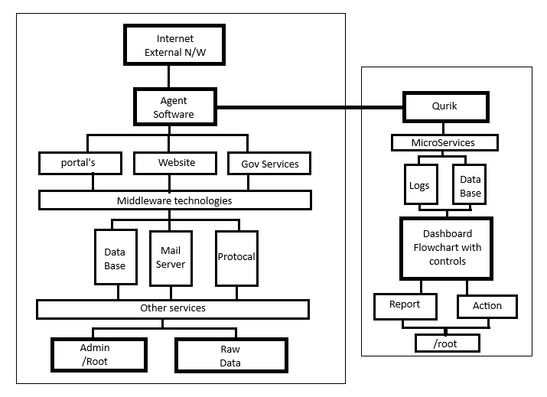
Architecture Diagram

Slide 9
Modules
Dashboard – system overview & alerts
System Info – server & PHP details
Login Activity – track logins & suspicious attempts
SQL Injection Detection – block injection attacks
Bad Bot & Proxy Detection – filter malicious bots
Spam Detection – prevent spam submissions
IP & File Whitelisting/Blocking – manage access
Logging – maintain attack & event logs
PHP Function & Config Checker – monitor vulnerabilities
Traffic Analytics – web traffic patterns
Error Tracking – log & report errors
.htaccess Manager – configure access rules
Port Analyzer – check open ports
Hash Generator – create cryptographic hashes
Country/IP Banning – restrict access by region
File Integrity Checker – detect unauthorized changes
Real-Time Alerts – notify admin instantly
User Activity Monitoring – track user actions on the site

Slide 10
Software Details
Font Awesome Icons - FontAwesome.com
Bootstrap Framework - GetBootstrap.com
DataTables - DataTables.net
jQuery - jQuery.com
AdminLTE - github.com/almasaeed2010/AdminLTE
Select2 - select2.github.io
OpenLayers - github.com/openlayers/openlayers
Chart.js - Chartjs.org
Flag Sprites - Flag-Sprites.com
iP.NF - ip.nf
ipapi.co - ipapi.co
IPHub - iphub.info
proxycheck.io - proxycheck.io
IPHunter - iphunter.info
Switchery - abpetkov.github.io/switchery
Popper.JS - popper.js.org
OverlayScrollbars - github.com/KingSora/OverlayScrollbars
cloudflare - https://www.cloudflare.com/

Slide 11
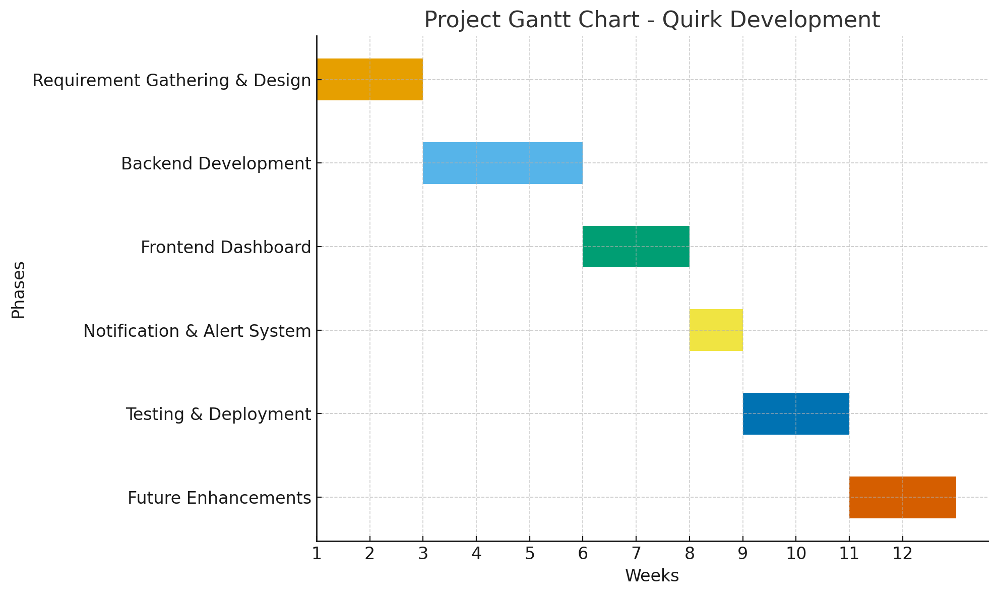
Timeline

Slide 12
IEEE References
[1] S. Z. A. Shah, A. M. Khattak, and S. U. Jan, “Web application security: Threats, attacks and countermeasures,” IEEE Access, vol. 7, pp. 153779–153795, Oct. 2019.
[2] P. Biswas, A. Gupta, and S. Roy, “A survey on SQL injection: Detection and prevention techniques,” IEEE Transactions on Dependable and Secure Computing, vol. 18, no. 6, pp. 2560–2577, Nov.–Dec. 2021.
[3] A. S. Rawat and R. Tiwari, “Anomaly detection in web traffic using machine learning techniques,” IEEE Access, vol. 10, pp. 54628–54640, Jun. 2022.
[4] H. Tahir, M. A. Shah, and A. Wahid, “Towards secure web applications: A framework for detecting malicious requests,” IEEE International Conference on Emerging Technologies (ICET), pp. 1–6, Dec. 2020.
[5] A. A. Ghorbani, W. Lu, and M. Tavallaee, “Network intrusion detection and prevention: Concepts and techniques,” IEEE Communications Surveys & Tutorials, vol. 21, no. 1, pp. 70–94, Jan.–Mar. 2019.

Slide 13
IEEE References
[6] M. Singh and K. Kumar, “Cross-site scripting (XSS) attack detection using ensemble learning,” IEEE Access, vol. 8, pp. 170588–170602, Sept. 2020.
[7] R. Beghdad, “SQL injection attacks detection and prevention techniques: A survey,” IEEE Access, vol. 9, pp. 160312–160329, Nov. 2021.
[8] J. He, C. Yang, and X. Liu, “Real-time detection of web attacks using deep learning,” IEEE Transactions on Information Forensics and Security, vol. 16, pp. 2478–2492, Apr. 2021.
[9] V. Sharma, A. Yadav, and S. Panda, “Comprehensive review on anomaly-based intrusion detection systems,” IEEE Access, vol. 8, pp. 73345–73371, May 2020.
[10] F. Hussain, A. K. Malik, H. Ali, and M. A. Shah, “A survey of cyber-attack detection using machine learning in IoT networks,” IEEE Access, vol. 8, pp. 219650–219673, Dec. 2020.

Slide 14


