Slide 1

Real Time Sign Language Gesture Recognition with Text and Audio Output
DEPARTMENT OF COMPUTER SCIENCE & ENGINEERING
SCHOOL OF STUDIES,ENGINEERING AND TECHNOLOGY
GURU GHASIDAS VISHWAVIDYALAYA
(A CENTRAL UNIVERSITY)
KONI, BILASPUR
CHHATTISGARH
Guided by:
Dr Devendra Kumar Singh
Asst. Professor(CSE)
Presented by:
Abhishek Kumar Singh(20103004)
Yatindra Deo(20103072)

Slide 2
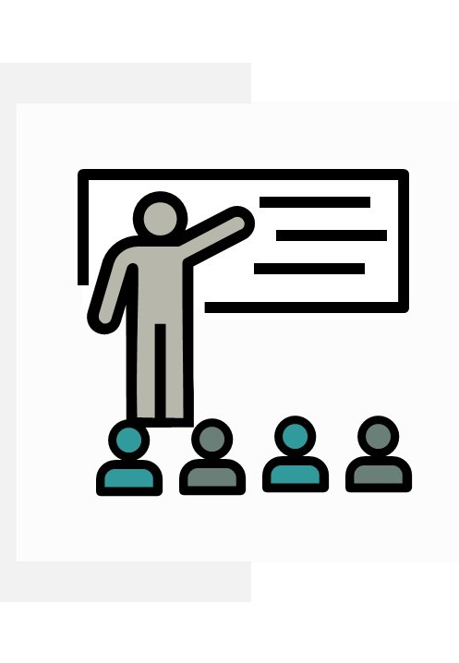
outline
INTRODUCTION
PROBLEM STATEMENT
OBJECTIVE
DATASET
PROPOSED WORK
FLOW DIAGRAM
IMPLEMENTATION AND RESULT
CONCLUSION AND FUTURE WORK

Slide 3
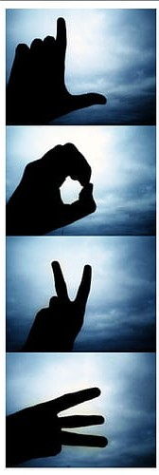
introduction
Sign language is a rich and expressive form of communication for the deaf and hard-of-hearing community. In the digital age, bridging the communication gap between sign language users and the wider world is a compelling challenge.
Sign language gesture recognition technology represents a groundbreaking solution. By harnessing the power of computer vision, machine learning, and innovative algorithms, this technology aims to interpret and translate sign language gestures into text and speech.

Slide 4

Problem statement
In the field of sign language gesture recognition, a significant challenge arises from the inability to seamlessly integrate new signs into pre-existing datasets, resulting in limited vocabulary.
The reliance on thresholding principles for sign detection often leads to decreased accuracy and robustness.

Slide 5
objective
The primary objective of this project is to develop a sign language gesture recognition system that overcomes the limitations associated with the integration of new signs into pre-existing datasets and the challenges posed by thresholding-based sign detection methods. This includes expanding the vocabulary of recognized signs in a dynamic and efficient manner, ensuring that the system can readily accommodate the inclusion of new signs without extensive manual data collection and labeling. Additionally, In our model we aims to enhance recognition accuracy by using alternative techniques to thresholding, thereby providing a more robust and precise means of detecting sign gestures. The ultimate goal is to create a versatile and accurate sign language recognition system that can effectively adapt to the evolving needs of the sign language community for better communication and accessibility.

Slide 6
Dataset
Our custom image and audio dataset is meticulously crafted for precision, addressing shortcomings in existing collections. Tailored to diverse conditions, it ensures heightened accuracy. Its unique flexibility allows for the inclusion of unlimited variations, providing a robust foundation for advanced image and audio processing applications.
Flaws in Pre-existing Datasets:
Environmental Limitations: Many pre-existing datasets may lack diversity in environmental conditions, leading to models that struggle in real-world scenarios, especially in low light or varied backgrounds.
Limited Gesture Variety: Fixed datasets may not adequately represent the breadth of gestures or nuances in real-world applications, hindering the model's ability to generalize effectively.
Benefits of Using Custom Dataset:
Improved Accuracy: A custom dataset, tailored to the project's context, often results in higher accuracy due to its relevance and specificity to the task at hand.
Flexibility and Expansion: The ability to continuously update and expand the dataset enables the model to adapt to evolving requirements and challenges, enhancing its overall performance.

Slide 7
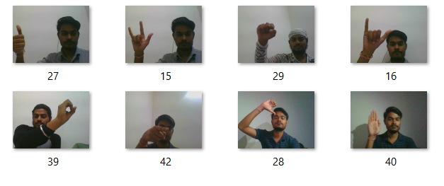
Custom Dataset

Slide 8
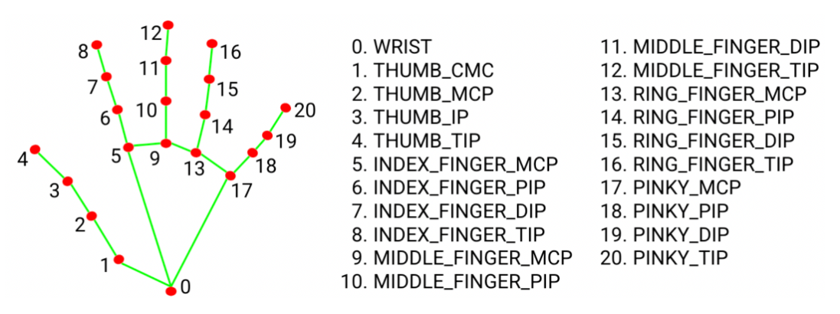
PROposed Model
First we collect the images for dataset
For Hand detection we used Mediapipe hand landmark which identifies and tracks a set of key landmarks on the hand. These landmarks include the tips of each finger, the base of the palm, and other key points on the hand. The system can track up to 21 hand landmarks in total.
Create dataset and store the landmark along with its label in file Also add sound data for audio output

Slide 9
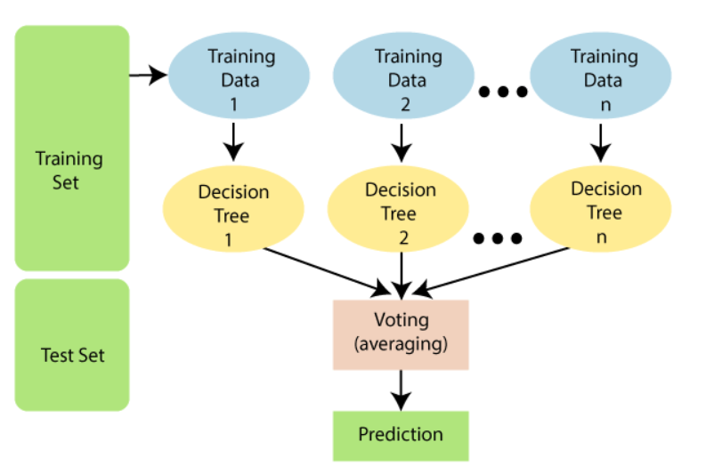
Proposed model
Next we train the model using Random Forest classifier in which we split our data set in test data(20%) and train data(80%). Random forest classifier is a machine learning algorithm used for classification of data in supervised learning .
Random Forest is a classifier that contains a number of decision trees on various subsets of the given dataset and takes the average to improve the predictive accuracy of that dataset.
Now we use the trained model to predict the sign.
In output we added Text as well as our own Audio.

Slide 10
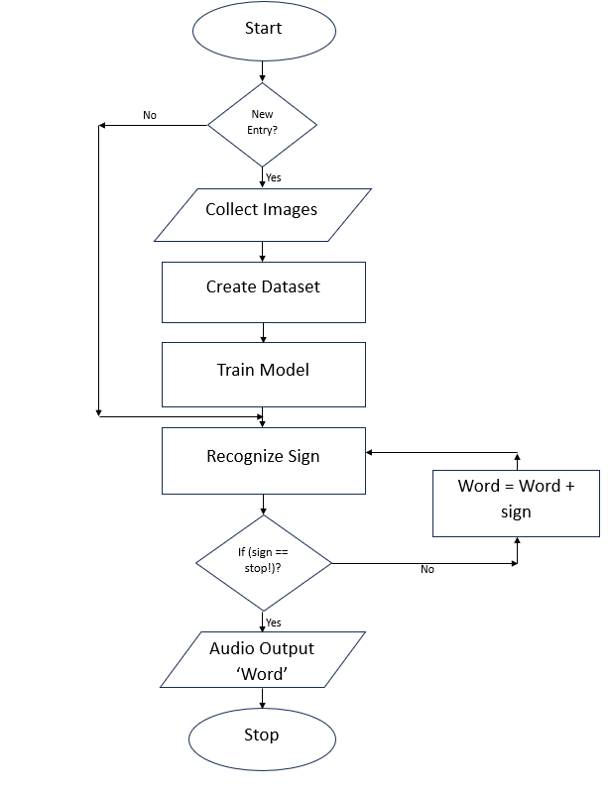
Flow Diagram

Slide 11
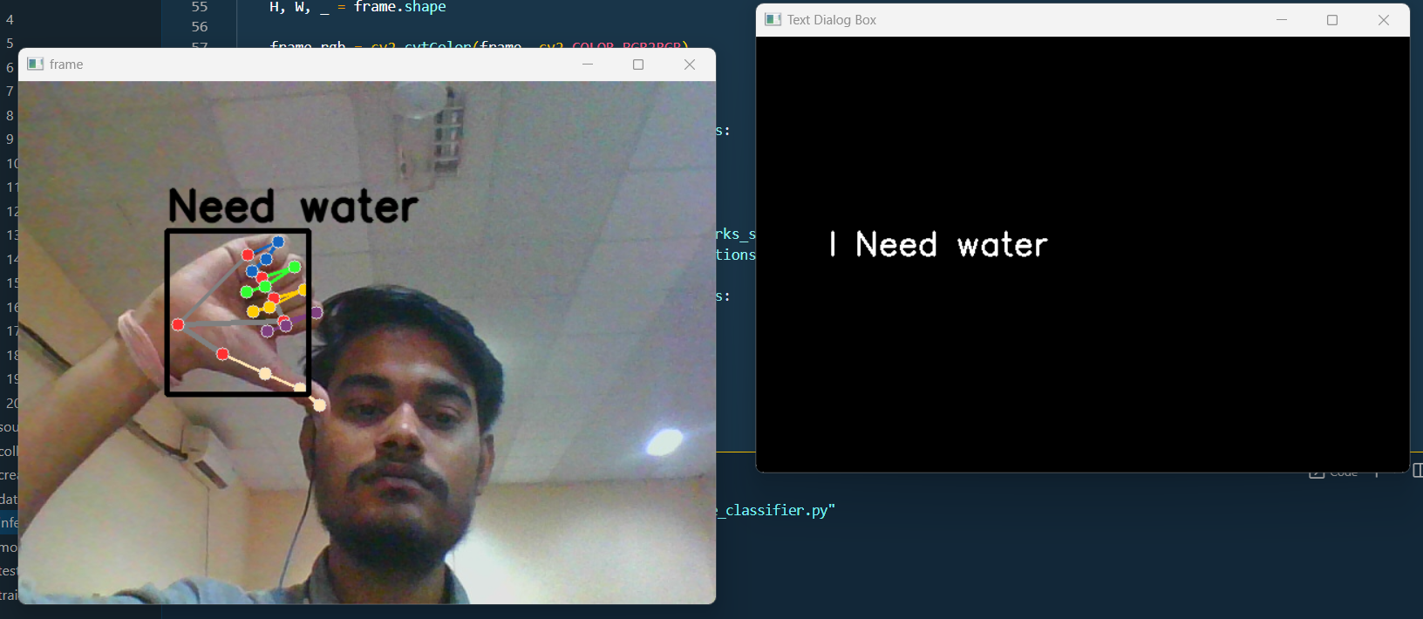
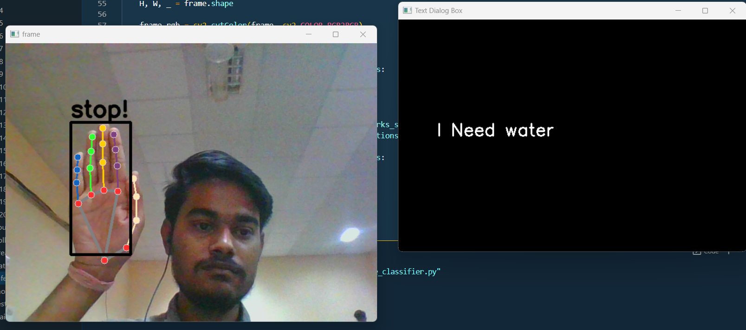
implementation AND RESULT
Stop sign for Audio Output
Complete the statement

Slide 12
CONclusion
We concluded that our project model addresses critical challenges in sign language recognition. By developing a dynamic vocabulary expansion system and moving beyond thresholding-based sign detection, we have taken significant steps towards a more inclusive and adaptable solution. This work not only enhances the recognition of sign gestures but also ensures that the system can readily accommodate new signs, ultimately benefiting the deaf and hard-of-hearing community. The project underscores the importance of technological innovation in fostering accessibility and effective communication.

Slide 13

FUTURE WORK
Incorporating Deep Learning: Exploring the integration of deep learning techniques that can further boost recognition accuracy and robustness, allowing for more complex and dynamic sign gestures to be recognized.
Interactive User Interface : The development of an interactive user interface with intuitive features and a user-friendly design is essential.
Integration with web and App: The expansion would make the technology more accessible, facilitating real-time communication for a broader audience.

Slide 14
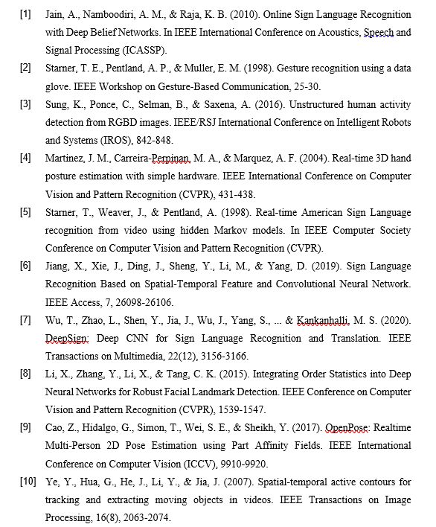
Refrences

Slide 15


