Slide 1


Exam Quiz Application Project
PRESENTED BY:
Muskan Garg (2115800018)
Ritika Singh(2115800021)
Shiva Srivastava (2115800023)

Slide 2
Contents:
Introduction to Exam quiz Application
Working of quiz application
Problem Statement
Features of Exam Quiz Application
Technology Used in quiz application
Future Scope

Slide 3
Introduction to quiz Application
This Quiz application provide a great platform for practice and solving query by taking feedback from the user, which is having a great user interface.
The proposed work in this field are available on internet in huge amount like; many application are available for playing quizzes online and query solving of the users
These application provide a large varieties of questions.
These application provides question and answer for quiz , query box for query solving.

Slide 4

Problem Statement:
“To develop an application for the users in which a user can attempt any number of quizzes related to his/her choice as well as it includes for admin to create and modify quizzes and profiles.
The application uses the technology that is Java Core, JSP, Servlet, MySQL.

Slide 5
Features of Exam Quiz Application
User Authentication
Update and Maintenance
Intuitive Quiz Management
Dynamic Question Randomization
Result Management

Slide 6

Features of Exam Quiz Application
User Authentication: Secure login with hashed passwords for educators and students.
Role-based access control to manage permissions.
Intuitive Quiz Management: User-friendly interface for educators to create, edit, and organize quizzes using JSP.
Support for various question types through Java servlets.
Update and Maintenance: Admit create and modify the quiz.
Dynamic Question Randomization: Configurable options for randomized answer choices.

Slide 7
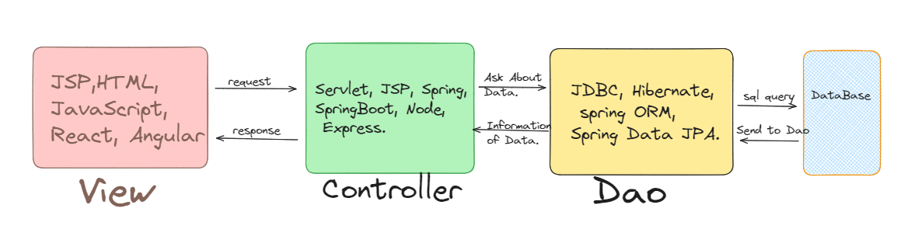
Model-View-Controller Design Pattern
Model (Data):
Manages quiz data and business logic.
View (Presentation):
Handles user interface and displays quiz content.
Controller (Logic):
Mediates between Model and View, manages user input.

Slide 8
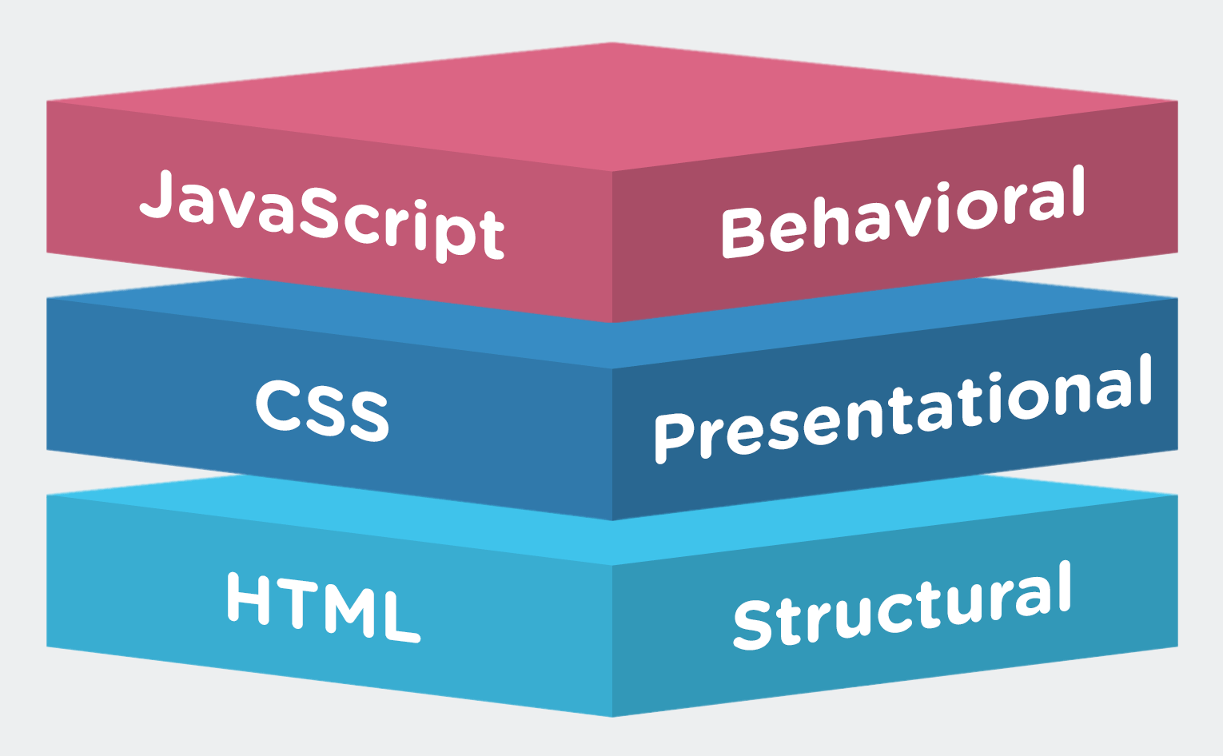
Technology Used in Frontend
HTML, CSS, and JavaScript are the building blocks for web development.
These technologies work together to create dynamic and interactive web applications.
JSP: Used to structure the content of web pages and helpful to write Java code inside the page.
CSS (Cascading Style Sheets): Used to layout of web pages, by doing style and format HTML content.
JavaScript: Used to add interactivity and dynamic behavior to web pages.
Bootstrap: Used to enhance its user interface and ensure a responsive design.

Slide 9

Technology Used in Backend
Java, Servlet is used for backend in Exam Quiz Application.
Java: Java is responsible for implementing the core business logic of the quiz application, including quiz creation, question management, grading, and result processing.
Servlet: Handling login requests, session management, and user authorization.
Controlling access to different parts of the application based on user roles.

Slide 10
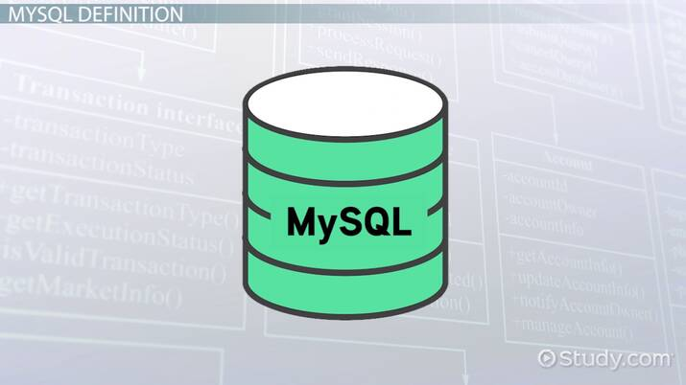

Database:
MySQL: MySQL stores structured data related to the exam quiz application, including information about quizzes, questions, users, results, and any other relevant entities.
Cloud:
AWS: AWS can be involved in the development and deployment of an exam quiz application

Slide 11
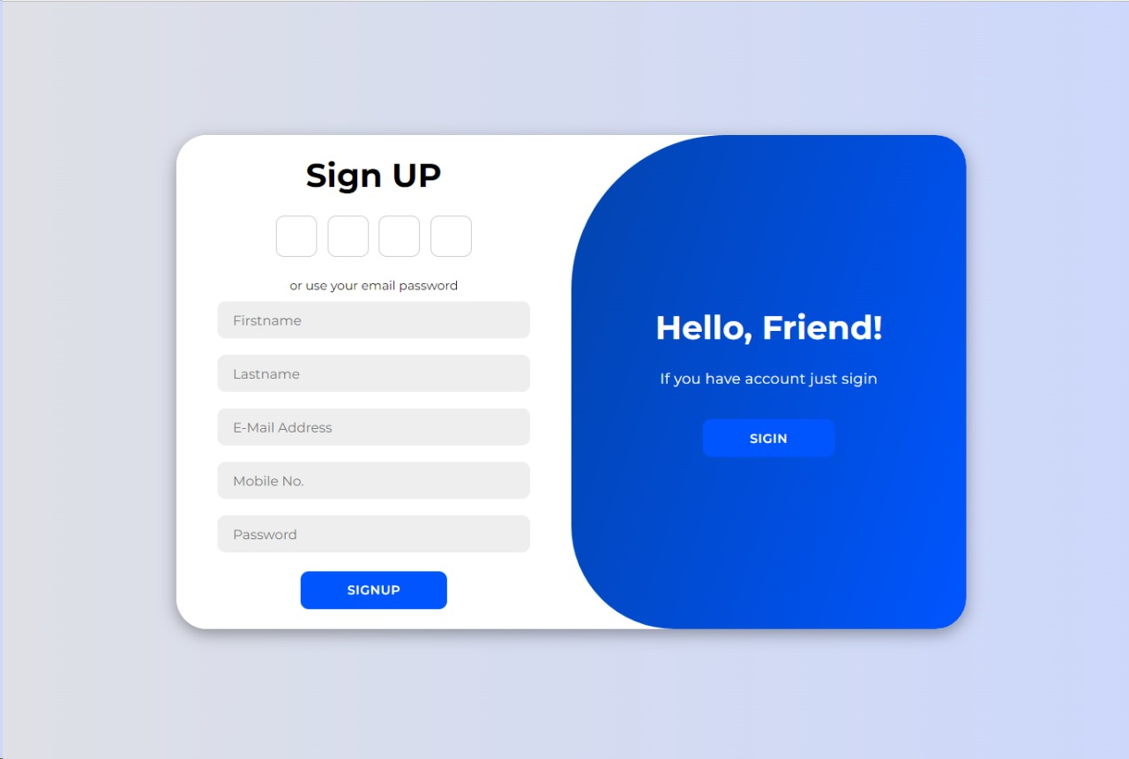
Working of Quiz Application
An quiz application typically involves several components and functionalities to provide a seamless and effective experience for users.
User Authentication and Registration: Users need to create an account or log in to access the quiz application..

Slide 12

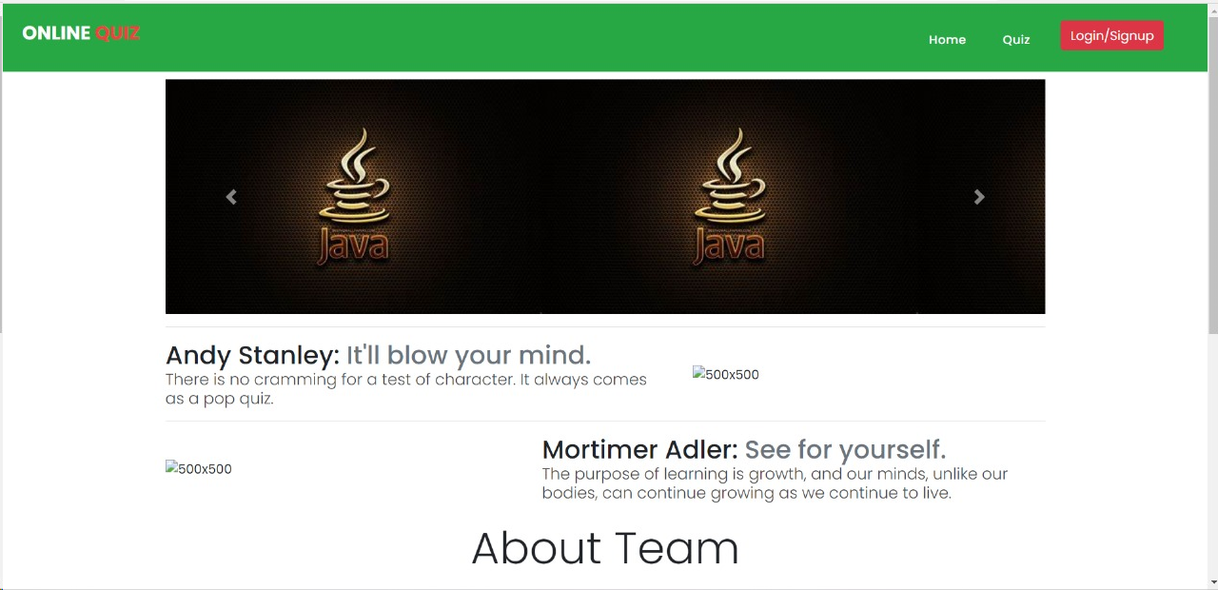
Home Page

Slide 13

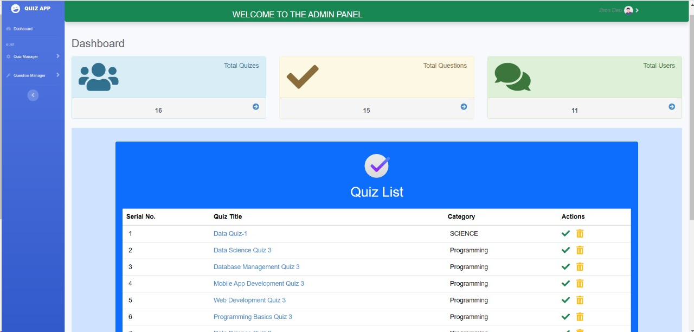
Dashboard

Slide 14

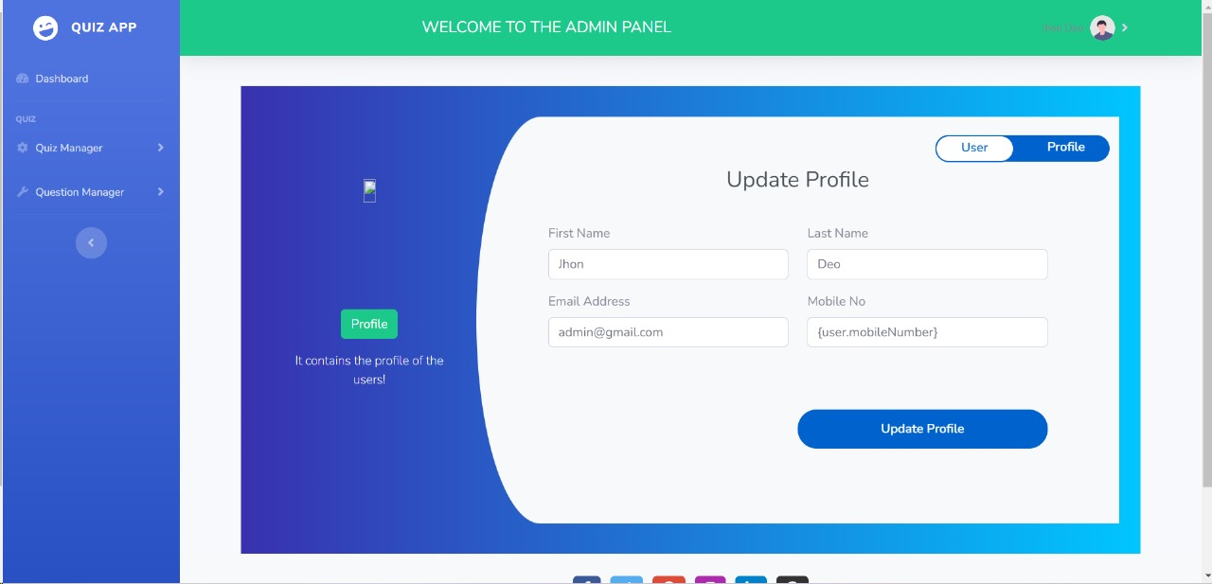
Admin Page

Slide 15

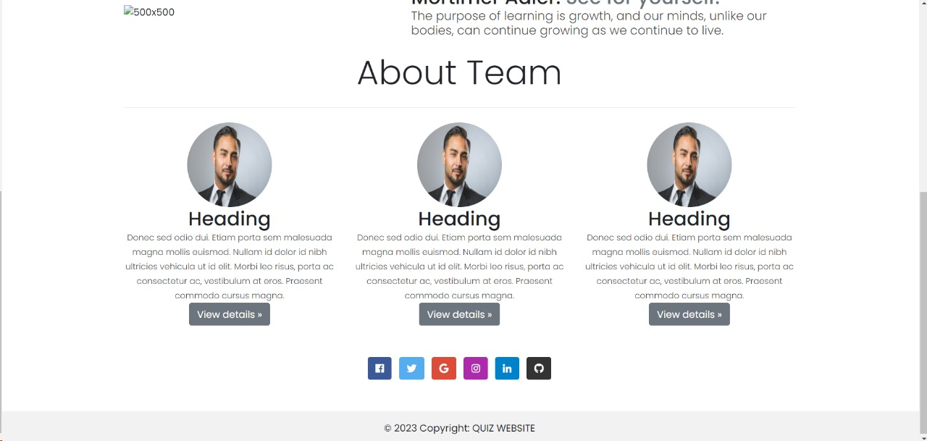
About Page

Slide 16

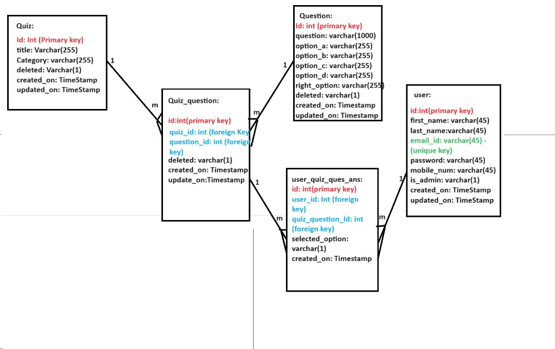
Flow Diagram

Slide 17

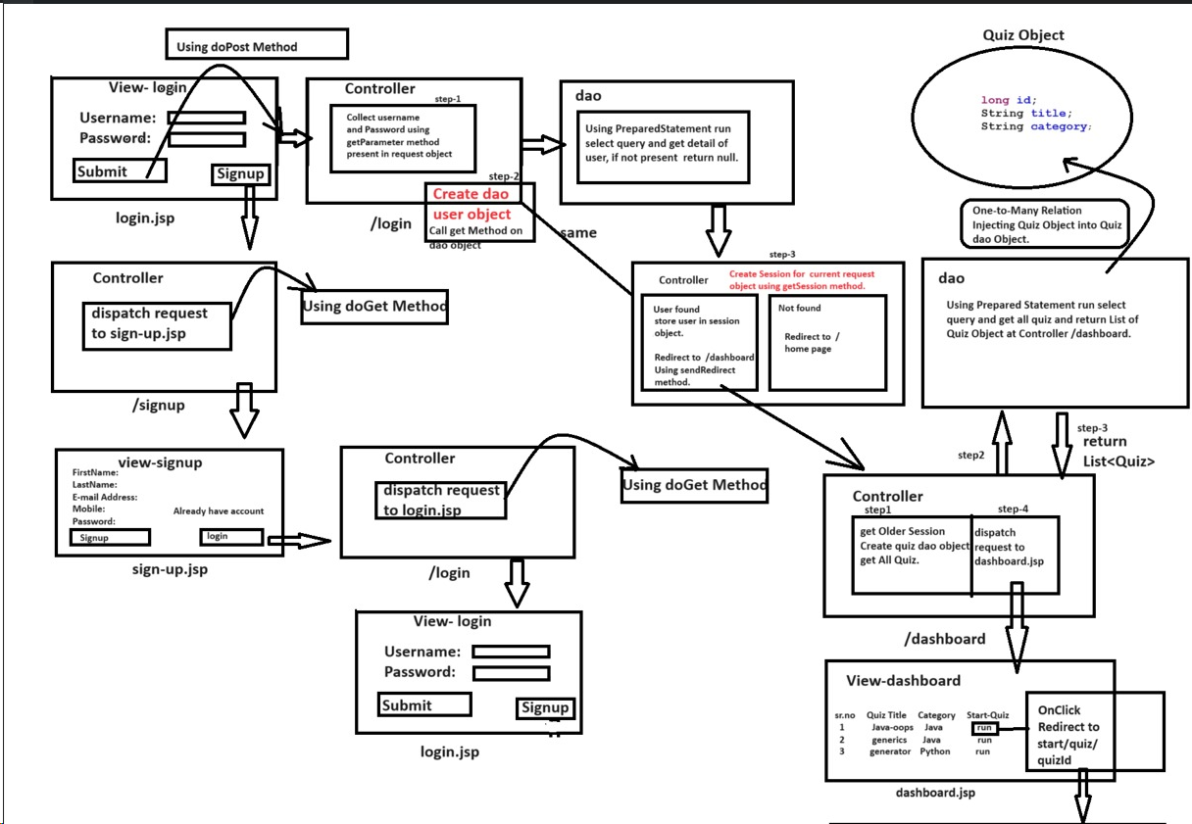
Communication Between model, view, controller

Slide 18

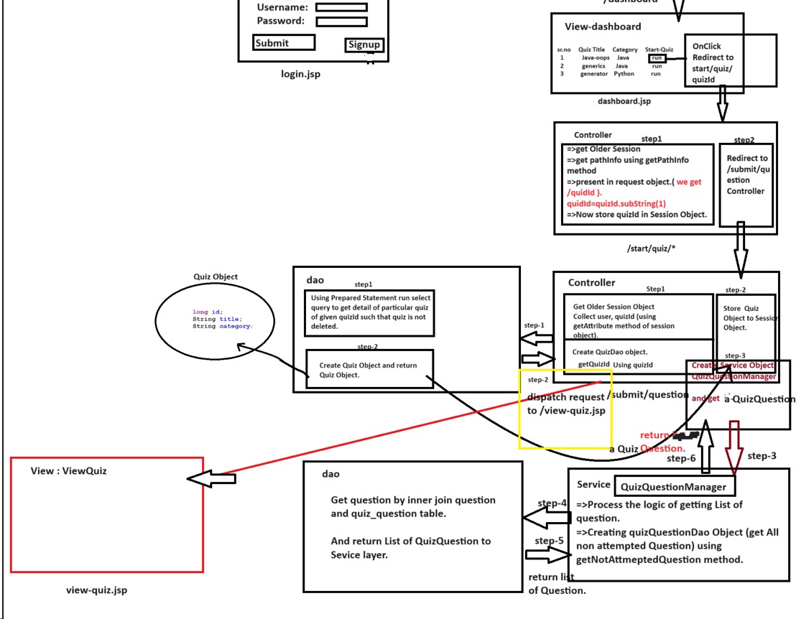
communication between components

Slide 19

Future Work
In future we want to add some coding exams like Gfg, Hacker Rank coding Platform.
Facilitating communication between users, by allowing users to launch mobile apps to communicate with customer care, or send messages to service center and avail free information related to quizzes and its related technologies and issues as well.
Admin also can make some quizzes as paid so we are going to add a payment gateway also in the existing system.

Slide 20
THANK YOU

