Slide 1
GLA UNIVERSITY
Presentation :
Topic: Session Variable
Presented by:
Shiva Srivastava
Dheeraj Sharma
Ritika Singh
Guided by:
Mr.Jitesh Bhatia Sir

Slide 2

Session variable
What is Session?
A session is a method of storing data (using variables).
It can be used to store information on the server for future use.
Why do we need Session or Session Variable?
Sessions allow data to be transferred from one page to another.
We can send same data to multiple page but using get or post we cannot do such task.
Session information is temporary and information is valid until the user is using
the website . Therefore it is secure as compare to cookies.

Slide 3
How Do we use Session or Session Variable in php?
For using session we need:
We need a basic understanding of html.
Basic understanding of syntax in php.
<?php
echo “shiva tutorial”;
?>
3)Knowledge about variables in php.
4)Know how to use associative arrays in php.
$_SESSION[‘shiva’]=‘Ritika’.
Here ‘shiva’ is Key and ‘Ritika’ is Value.
5)Know some of function in PHP
session_start();
header(“location:url”);
session_unset();

Slide 4
session_start() function:
session is started with the session_start() function.
session_start() function must be the very first thing in your
document. Before any HTML tags.
session variables are not passed individually to each new page,
instead they are retrieved from the session we open at the
beginning of each page (session_start()).

Slide 5
index.php
<html>
<head>
</head>
<body>
<form method="post" action="tutorial0.php">
<table class="table1">
<tr><th><label>Login Id</label></tr> </tr>
<tr><th><label for="username">Username</label><br>
<input type="text" id="username" name="username" required></th> </tr>
<tr><th><label for="Email">Email</label><br>
<input type="email" id="email" name="email" required></th></tr>
<tr> <th><label for="password">Password</label><br>
<input type="password" id="password" name="password" required></th> </tr>
<tr> <th><input type="submit" value="submit"></th> </tr>
</table> </form></body></html>

Slide 6
tutorial0.php
<?php
session_start();
$text1=$_POST['username']; $text2=$_POST['email'];
$text3=$_POST['password']; $sum="$text1::$text2::$text3\r\n";
$file=fopen("storage.txt","a+"); $read=fread($file,filesize("storage.txt"));
$check1=strpos($read,$text1); $check2=strpos($read,$text2);
if(!$check1&&!$check2)
{fwrite($file,$sum); fclose($file);
echo" <center><h1>you are succesfully registered </h1></center><br>";
}
else
echo "you are already registered ";
echo "<center><h1>Tell about your Group members </h1></center> <br>";
$_SESSION['hello'] =$text1;
//header("location:tutorial1.php");
?>
<html> <body>
<h2>If you want to know my group member Please click below </h2>
<a href="tutorial1.php">Click here</a>
</body></html>

Slide 7
tutorial1.php
<?php
//session_start();
echo "
<h3> My group member unordered list</h3>
<ul> <li> Shiva Srivastava </li>
<li> Dheeraj Sharma </li>
<li> Ritika Singh </li>
</ul> <br>";
echo $_SESSION['hello'];
?><html>
<body>
<h3>If you want to know my University click below</h3>
<a href="tutorial2.php">Click here</a>
</body>
</html>
Imp: here you can see ,we are not using session_start() function
in this page ,because ones you write that function in starting they donot need
to use in any another code.we can access directly with $_SESSION[].

Slide 8
tutorial2.php
<?php
session_start();
echo '<center > <h2>Know about my University</h2> </center>
<p style="color:Red; font-size:20px">We are study in prestigious
GLA University which is in Mathura . <br> We all in course of B-tech CS (HONS)
which is directly led by CEO Neeraj Agarwal. </p><br>';
echo $_SESSION['hello'];
?><html>
<body>
<h3>If you want to know my Internet Programming teacher </h3>
<a href="tutorial3.php">Click here</a>
</body>
</html>

Slide 9
tutorial.3.php
<?php
session_start();
echo "My Jitesh bhatia internet programming sir one of
best teacher in gla university <br>";
echo $_SESSION['hello'];
header("location:tutorial4.php");
?>
Use of header function vs <a> tag

Slide 10
tutorial4.php
<?php
session_start();
echo " <h3> since I am using <span style='color:red'>header function in tutorial3.php
</span> therefore
page tutorial3.php not seen </h3>
<b><p style ='font-size:20px'> I am only here due to my sir . <br>
Mr Jitesh bhatia is internet programming sir ,one of best teacher in gla university. <br>
He knows atlest 5 programming language. <br>
Due to sir i am able to stand here</p> </b><br> ";
echo $_SESSION['hello'];
?><html>
<body>
<h3>If you want to know my Internet Programmming teacher </h3>
<a href="tutorial5.php">Click here</a>
</body>
</html>

Slide 11
tutorial.5.php
<?php
session_start();
echo "In this page i am unset the variable";
Session_unset();
echo $_SESSION['hello'];
?>
After using session_unset() , we free all the variable

Slide 12
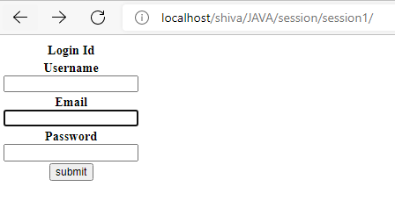
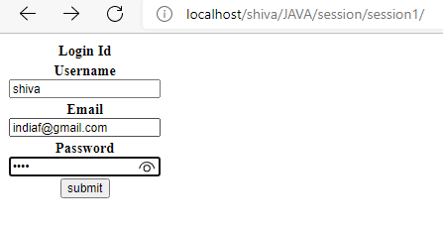
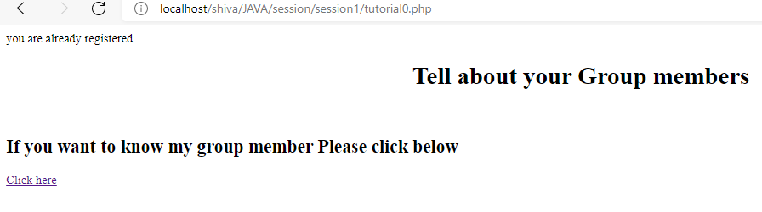
Execution:
index.php
On Clicking Submit button

Slide 13
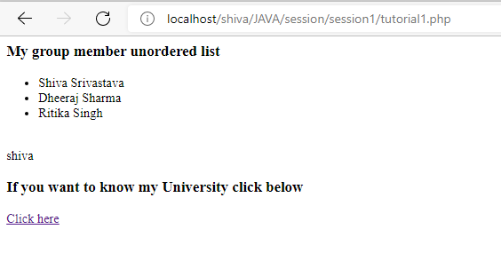
tutorial0.php
On Clicking ‘click here’

Slide 14
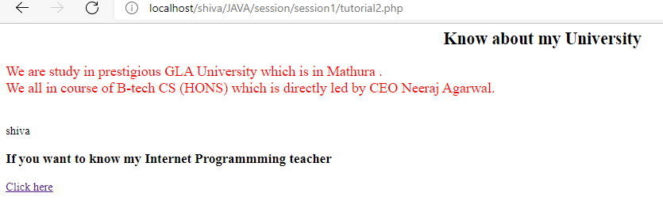
tutorial1.php
On Clicking ‘click here’

Slide 15
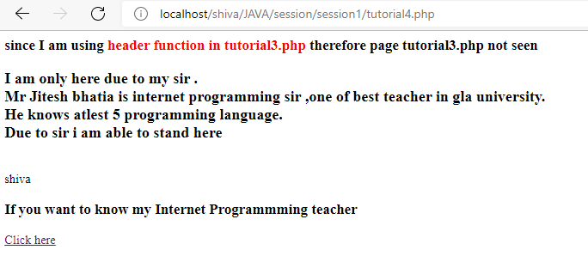
tutorial2.php
On Clicking ‘click here’

Slide 16
tutorial3.php
Why this page is empty?

Slide 17
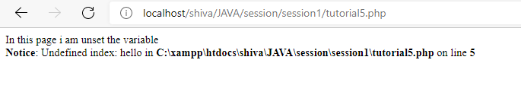
tutorial4.php
On clicking ‘click here’

Slide 18
tutorial5.php
Since I am using session_unset() function therefore ,
variable $_SESSION[‘hello’] become free.

Slide 19
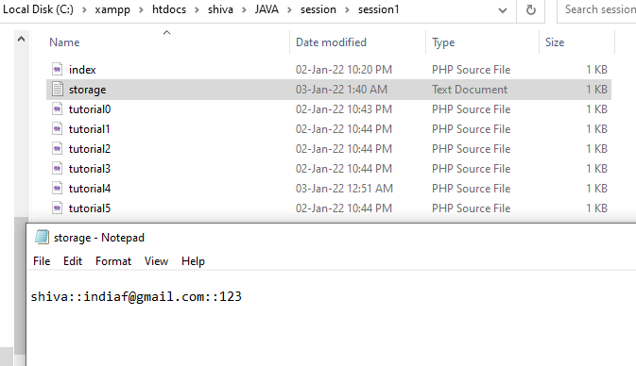
storage.txt

Slide 20


