Slide 1
Project 1 Shell scripting
Composite Experiment for OS

Slide 2
Requirement
Develop a Student Score Management system using Shell Scripting (Tutorial for shell scripting)
The System should have below basic functions
Add: add a new record, e.g. “Mary Stone 98”
Delete: delete a record by name
Search: search records by name
Display: display all the records
Help: show the help menu
Exit: exit the system
Each of them should be implemented by individual functions called in the main script

Slide 3
Requirement (continue)
Bonus
You can add some checks to make the script more robust. For example
Before adding a new record, you can check whether the record file exists. If no, a file should be created first
Before deleting, you can check whether the name exists and show some message
Before searching, you can check whether the name exists and show some message
Hints
Below commands can be used
echo, read, grep, pipe, cat/more, exist
function, if/case, loop
To implement delete, you can first copy existing record file to a backup file, then use invert match to find non-matching lines, then write to the record file

Slide 4
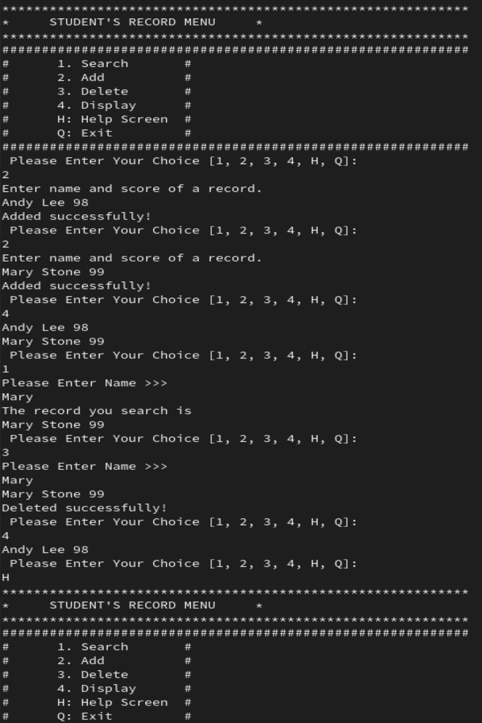
Sample
A sample screenshot of the system

Slide 5
Requirement to the report
Please submit a report in WORD/PDF format.
The report should include below three parts:
the design of your system (such has the provided functions, error handling, code structure)
the code of your system
the sample usage of your system (similar as the screenshot above)

