Slide 1
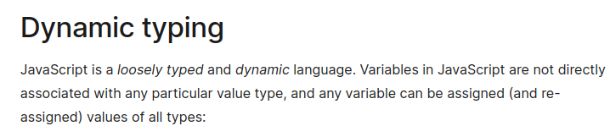
JavaScript
MDN Doc

Slide 2
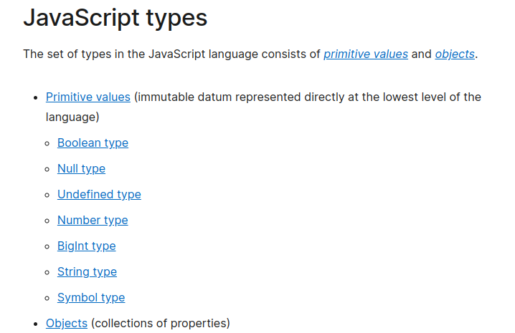
MDN

Slide 3
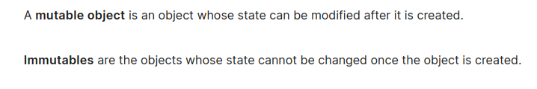
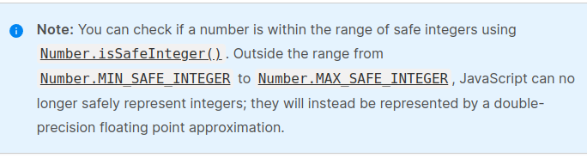

Slide 4
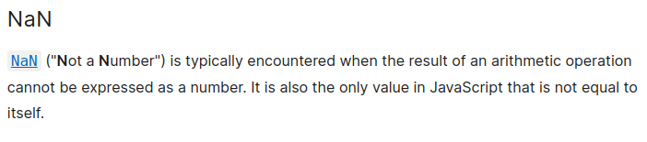

Slide 5
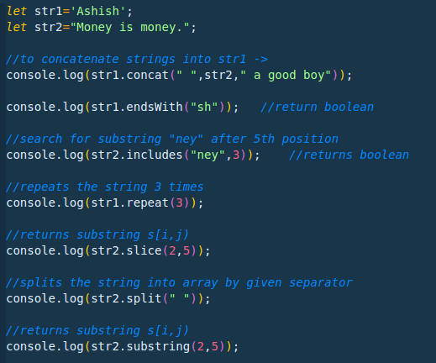
Some string functions in javascript

Slide 6
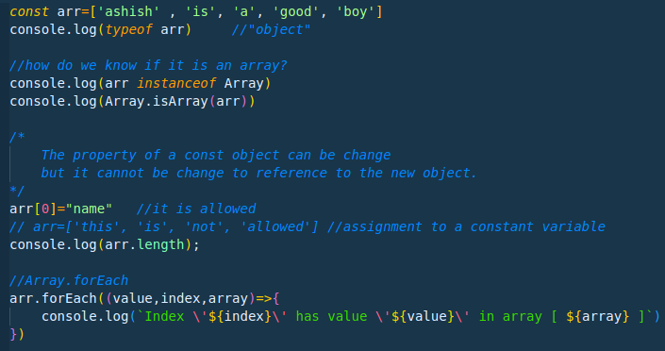
Arrays in JavaScript

Slide 7
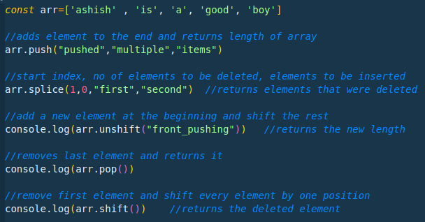

Slide 8
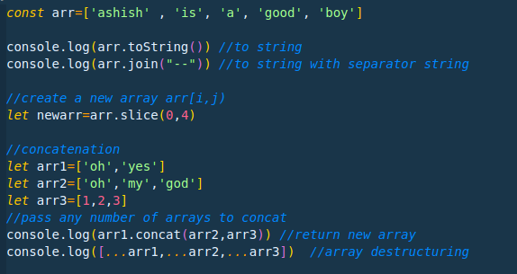

Slide 9
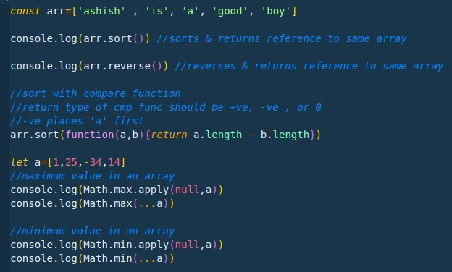

Slide 10
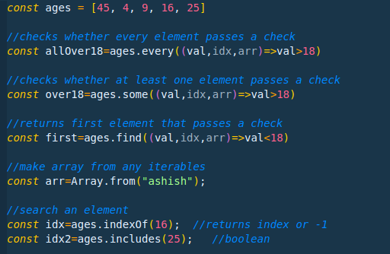

Slide 11
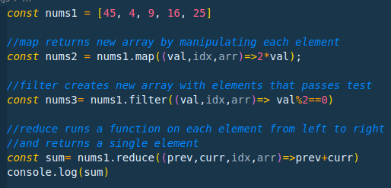

Slide 12
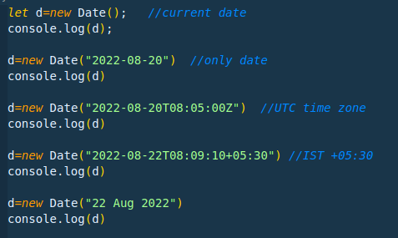
Dates in JavaScript

Slide 13
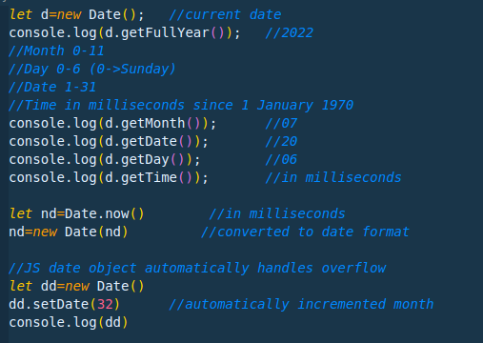

Slide 14
React
InterviewBit

Slide 15
Client Side rendering
Server Side rendering
1. Server sends all the html, js
and css files and, in browser, virtual dom
is created and javascript runs and
then the page is viewed.
2. Client-side rendering means that a
website’s JavaScript is rendered in your
browser, rather than on the website’s
Server. It reduces the load on servers.
3. It can increase the load time of a web
-page.
4. JavaScript can also slow search engine
bots down while they’re crawling a
website.
1. Server-side rendering means that a
website’s JavaScript is rendered on the
website’s server.
2. both search engine bots and humans get a
faster page experience.
3. server-side rendering is better for SEO
than client-side rendering.
4. Server-side rendering can be expensive
and resource-intensive (for servers).

Slide 16
Dynamic Rendering:
Dynamic rendering is a hybrid of client-side and server-side rendering.
When a search engine bot tries to access a page, the website sends over a fully-rendered page. But when a human tries to access a page, their browser has to render the page.

Slide 17
DOM
The Document Object Model (DOM) is a programming interface for web documents. It represents the page so that programs can change the document structure, style, and content.
React uses two virtual DOMs to render the user interface. One of them is used to store the current state of the objects and the other to store the previous state of the objects. Whenever the virtual DOM gets updated, react compares the two virtual DOMs and gets to know about which virtual DOM objects were updated. After knowing which objects were updated, react renders only those objects inside the real DOM instead of rendering the complete real DOM. This way, with the use of virtual DOM, react solves the problem of inefficient updating

Slide 18
Keys: A key is a special string attribute that needs to be included when using lists of elements.
Keys used within arrays should be unique among siblings
JSX: JSX stands for JavaScript XML. It allows us to write HTML inside JavaScript and place them in the DOM without using functions like appendChild( ) or createElement( ).

Slide 19
Node Js
Interviewbit
Blocking vs Non Blocking

Slide 20
Nodejs is single threaded, then how to handle concurrency??
asynchronous nature makes it possible to handle concurrency and perform multiple I/O operations at the same time. Node js uses an event loop to maintain concurrency and perform non-blocking I/O operations.
Blocking is when the execution of additional JavaScript in the Node.js process must wait until a non-JavaScript operation completes. This happens because the event loop is unable to continue running JavaScript while a blocking operation is occurring.

Slide 21
Event Loop
The event loop is what allows Node.js to perform non-blocking I/O operations — despite the fact that JavaScript is single-threaded — by offloading operations to the system kernel whenever possible.
Since most modern kernels are multi-threaded, they can handle multiple operations executing in the background. When one of these operations completes, the kernel tells Node.js so that the appropriate callback may be added to the poll queue to eventually be executed.

Slide 22
JS Patterns
Frontend Masters

