Slide 1
Mircroprocessor 8085
A microprocessor is a multipurpose, programmable, clock-driven, register-based electronic device that reads binary instructions from a storage device called memory, accepts binary data as input and processes data according to those instructions and provide results as output.

Slide 2
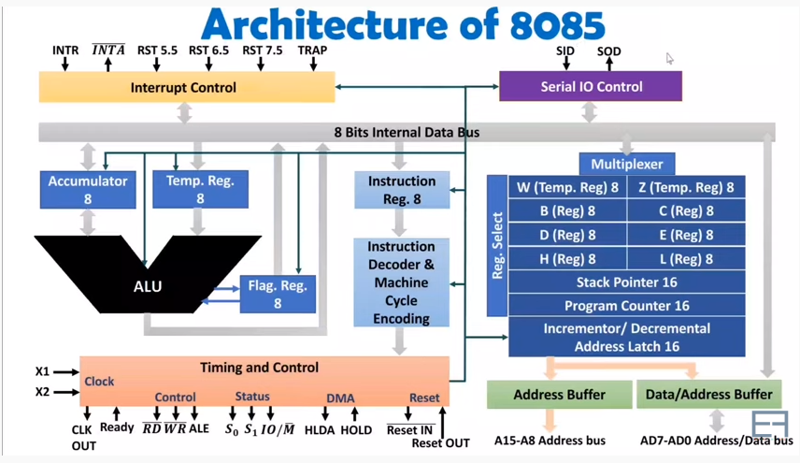

Slide 3
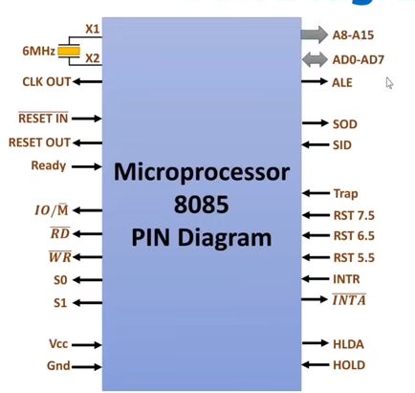
Pin diagram of 8085

Slide 4
1. The address bus and data bus is a group of sixteen lines i.e A0-A15. The address bus is unidirectional, i.e., bits flow in one direction from the microprocessor unit to the peripheral devices.
2. Control and Status Signals:
ALE – It is an Address Latch Enable signal. It goes high during first T state of a machine cycle and enables the lower 8-bits of the address, if its value is 1 otherwise data bus is activated.
IO/M’ – It is a status signal which determines whether the address is for input-output or memory. When it is high(1) the address on the address bus is for input-output devices. When it is low(0) the address on the address bus is for the memory.
SO, S1 – These are status signals. They distinguish the various types of operations such as halt, reading, instruction fetching or writing.
RD’ – It is a signal to control READ operation. When it is low the selected memory or input-output device is read.
WR’ – It is a signal to control WRITE operation. When it goes low the data on the data bus is written into the selected memory or I/O location.
READY – It senses whether a peripheral is ready to transfer data or not. If READY is high(1) the peripheral is ready. If it is low(0) the microprocessor waits till it goes high. It is useful for interfacing low speed devices.

Slide 5
3. Power Supply and Clock Frequency:
Vcc – +5v power supply
Gnd or Vss – Ground Reference
XI, X2 – A crystal is connected at these two pins. The frequency is internally divided by two, therefore, to operate a system at 3MHZ the crystal should have frequency of 6MHZ.
CLK (OUT) – This signal can be used as the system clock for other devices.
4. Interrupts and Peripheral Initiated Signals:
The 8085 has five interrupt signals that can be used to interrupt a program execution.
(i) INTR
(ii) RST 7.5
(iii) RST 6.5
(iv) RST 5.5
(v) TRAP

Slide 6
INTR – It is an interrupt request signal.
INTA’ – It is an interrupt acknowledgement sent by the microprocessor after INTR is received.
5. Reset Signals:
RESET IN’ – When the signal on this pin is low(0), the program-counter is set to zero, the buses are tristated and the microprocessor unit is reset.
RESET OUT – This signal indicates that the MPU is being reset. The signal can be used to reset other devices.

Slide 7
6. DMA Signals:
HOLD – It indicates that another device is requesting the use of the address and data bus. Having received HOLD request the microprocessor relinquishes the use of the buses as soon as the current machine cycle is completed. Internal processing may continue. After the removal of the HOLD signal the processor regains the bus.
HLDA – It is a signal which indicates that the hold request has been received after the removal of a HOLD request, the HLDA goes low.
7. Serial I/O Ports:
Serial transmission in 8085 is implemented by the two signals,
SID and SOD– SID is a data line for serial input where as SOD is a data line for serial output.

Slide 8
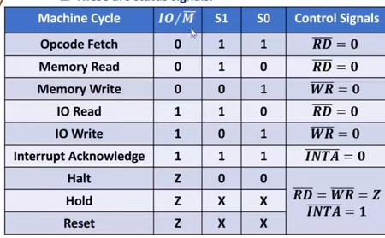

Slide 9
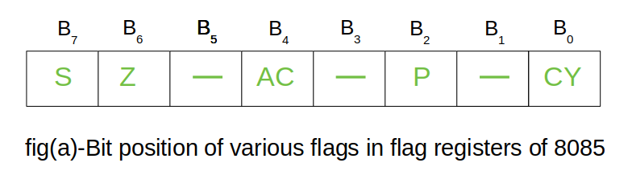
Registers in 8085
(a) General Purpose Registers –
The 8085 has six general-purpose registers to store 8-bit data; these are identified as- B, C, D, E, H, and L. These can be combined as register pairs – BC, DE, and HL, to perform some 16-bit operation.
(b) Specific Purpose Registers –
Accumulator:
The accumulator is an 8-bit register that is the part of the arithmetic and logical unit (ALU). After performing arithmetical or logical operations, the result is stored in accumulator. Accumulator is also defined as register A.
Flag registers:

Slide 10
Flag register consists of 8 bits and only 5 of them are useful.
Sign Flag: It occupies the seventh bit of the flag register, which is also known as the most significant bit. It helps the programmer to know whether the number stored in the accumulator is positive or negative. If the sign flag is set, it means that number stored in the accumulator is negative, and if reset, then the number is positive.
Zero Flag: It occupies the sixth bit of the flag register. It is set, when the operation performed in the ALU results in zero(all 8 bits are zero), otherwise it is reset. It helps in determining if two numbers are equal or not.
Auxiliary Carry Flag: It occupies the fourth bit of the flag register. In an arithmetic operation, when a carry flag is generated by the third bit and passed on to the fourth bit, then Auxiliary Carry flag is set. If not flag is reset. This flag is used internally for BCD(Binary-Coded decimal Number) operations.
Note – This is the only flag register in 8085 which is not accessible by user.
Parity Flag: It occupies the second bit of the flag register. This flag tests for number of 1’s in the accumulator. If the accumulator holds even number of 1’s, then this flag is set and it is said to even parity. On the other hand if the number of 1’s is odd, then it is reset and it is said to be odd parity.
Carry Flag: It occupies the zeroth bit of the flag register. If the arithmetic operation results in a carry(if result is more than 8 bit), then Carry Flag is set; otherwise it is reset.

Slide 11
(c) Memory Registers –
There are two 16-bit registers used to hold memory addresses. The size of these registers is 16 bits because the memory addresses are 16 bits. They are :-
Program Counter: This register is used to sequence the execution of the instructions. The function of the program counter is to point to the memory address from which the next byte is to be fetched. When a byte (machine code) is being fetched, the program counter is incremented by one to point to the next memory location.
Stack Pointer: It is used as a memory pointer. It points to a memory location in read/write memory, called the stack. It is always incremented/decremented by 2 during push and pop operation.

Slide 12
Addressing Modes in 8085
The way of specifying data to be operated by an instruction is called addressing mode.
1. Immediate Addressing Mode –
In this mode the source operand is always data. If the data is 8-bit, then the instruction will be of 2 bytes, if the data is of 16-bit then the instruction will be of 3 bytes.
Examples:
MVI B 45 (move the data 45H immediately to register B)
LXI H 3050 (load the H-L pair with the operand 3050H immediately)
JMP address (jump to the operand address immediately)
2. Register Addressing Mode –
In this mode, the data to be operated is available inside the registers and registers is operands. Therefore the operation is performed within various registers of the microprocessor.
Examples:
MOV A, B (move the contents of register B to register A)
ADD B (add contents of registers A and B and store the result in register A)
INR A (increment the contents of register A by one)
3. Direct Addressing Mode –
In this, the data to be operated is available inside a memory location and that memory location is directly specified as an operand. The operand is directly available in the instruction itself.
Examples:
LDA 2050 (load the contents of memory location into accumulator A)
LHLD address (load contents of 16-bit memory location into H-L register pair)
IN 35 (read the data from port whose address is 35)

Slide 13
4. Register Indirect Addressing Mode –
In register indirect addressing mode, the data to be operated is available inside a memory location and that memory location is indirectly specified by a register pair.
Examples:
MOV A, M (move the contents of the memory location pointed by the H-L pair to the accumulator)
LDAX B (move contents of B-C register to the accumulator)
STAX B (store accumulator contents in memory pointed by register pair B-C)
5. Implied/Implicit Addressing Mode –
In implied/implicit addressing mode the operand is hidden and the data to be operated is available in the instruction itself.
Examples:
CMA (finds and stores the 1’s complement of the contents of accumulator A in A)
RRC (rotate accumulator A right by one bit)
RLC (rotate accumulator A left by one bit)

