Slide 1
Operating Systems
An operating system is a program that controls the execution of application programs and acts as an interface between the user of a computer and the computer hardware.
An operating system is concerned with the allocation of resources and services, such as memory, processors, devices, and information. The operating system correspondingly includes programs to manage these resources, such as a traffic controller, a scheduler, a memory management module, I/O programs, and a file system.

Slide 2
Objectives of OS
Convenience: An OS makes a computer more convenient to use.
Efficiency: An OS allows the computer system resources to be used efficiently.
Ability to Evolve: An OS should be constructed in such a way as to permit the effective development, testing, and introduction of new system functions at the same time without interfering with service.
Throughput: An OS should be constructed so that It can give maximum throughput(Number of tasks per unit time).

Slide 3
OS Services
* Program Development
* Program Execution
* Access I/O Devices
* File System Access
* Error detection and response

Slide 4
Roles of OS
Resource Management: When parallel accessing happens in the OS (when multiple users are accessing the system) the OS works as Resource Manager.
Process Management: It includes various tasks like scheduling, termination of the process.
Storage Management: The file system mechanism used for the management of the storage, NIFS, CFS, CIFS, NFS, etc.
Memory Management: OS also has to allocate and deallocate the memory space.
Security/Privacy Management: Privacy is also provided by the Operating system by means of passwords so that unauthorized applications can’t access programs or data.

Slide 5
Evolution of OS
Why to evolve? :
* Hardwares are upgraded
* New type of Hardware are to be added
* New Services are introduced
Types of OS:
Serial Processing
Simple Batch system
Multiprogrammed batch system
Parallel Systems
Distributed Systems
Time sharing system
Realtime Operating System

Slide 6
Serial Processing System
* Used in earliest computers
* Users interacted directly with the H/W
* Computer used to run from a console with display lights, toggle switches,
some I/O devices and printer.
* Users have access to computer in series.(execute everything in series)

Slide 7
Simple Batch System
Batch: set of jobs with similar needs.
* In this type, There is an operator which takes similar jobs having the same requirement and group them into batches. It is the responsibility of the operator to sort jobs with similar needs.
Advantages:
* multiple users can share the batch systems
* easy to manage large work repeatedly
Disadvantages:
* Hard to debug
* CPU remains idle for longer time (because I/O speed< processor speed)
* Other jobs need to wait for an unknown time if any job fails.
* No mechanism to prioritise a process.
Examples: Payroll System, Bank Statements, etc.

Slide 8
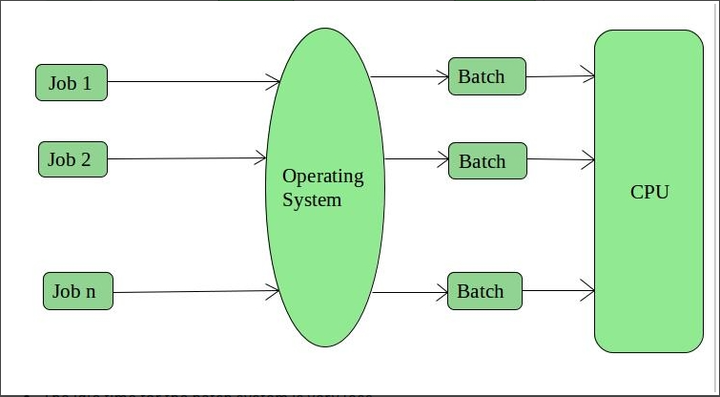
Diagram of simple batch OS

Slide 9
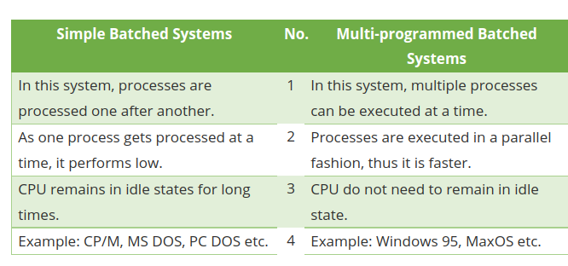
Multiprogrammed Batch System
Multiprogramming operating system allows to execute multiple processes by monitoring their process states and switching in between processes. It executes multiple programs to avoid CPU and memory underutilization. It is also called as Multiprogram Task System.

Slide 10
Parallel Systems
Parallel Systems are designed to speed up the execution of programs by dividing the programs into multiple fragments and processing these fragments at the same time.
Four types based on parallelism in the instructions and in the data streams.
1. Single Instruction stream, single data stream
2. Single Instruction stream, multiple data stream
3. Multiple Instruction stream, single data stream
4. Multiple Instruction stream, multiple data stream

Slide 11
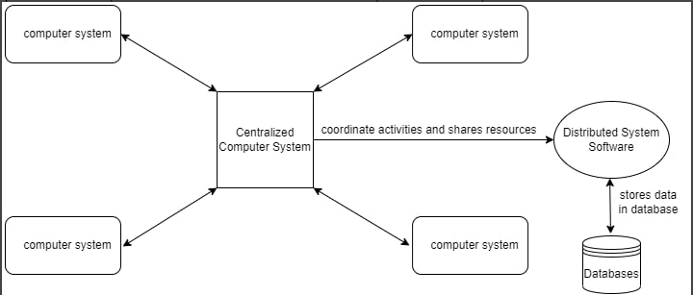
Distributed Systems
It is a collection of independent computers connected via network (not
physically) capable of collaborating on a task.
The autonomous computers will communicate among each system by sharing
resources and files and performing the tasks assigned to them.
Used in: e-commerce websites, social networks, online gaming, etc.
Examples: LOCUS and MICROS are some examples of distributed operating systems.

Slide 12
Parallel System Distributed Systems
Tightly coupled system, shared memory Loosely coupled system, distributed memory
These systems share a memory, clock, These systems do not share memory or clock in
and peripheral devices. contrast to parallel systems.
There is a global clock control for sync. There is no global clock control (It uses sync
algorithms).

Slide 13
Time Sharing Systems
Time sharing is a logical extension of multiprogramming. A time shared operating system allows multiple users to share computers simultaneously. It aims to minimize the response time.
The short period of time during which user gets attention of CPU is known as time slice, time slot or quantum.
Advantages:
* Each task gets an equal opportunity.
* Less chances of duplication of software.
* CPU idle time can be reduced.
Disadvantages:
* Reliability problem.
* One must have to take of security and integrity of user programs and data.
* Data communication problem.

Slide 14
Real Time OS
A realtime system is defined as a data processing system in which the time
Interval required to process & response to I/O is so small that it controls the
Environment.
e.g. controlling traffic signals, nuclear reactor, or aircraft.
Hard Real time OS: tasks must be strictly completed within a range of time.
e.g. missile launching system, airbag controls in car.
Soft Real time OS: it provides some relaxation in the time limit.
e.g. multimedia system, etc.

Slide 15
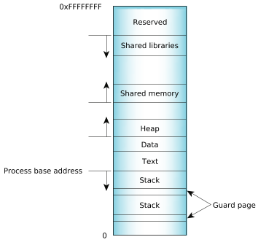
Process
* A process is a program in execution.
* An instance of a program running on a computer.
Memory layout for a typical process
The process load segments (corresponding to “text” and“data” in the diagram) are loaded at the process's base address. The main stack is located just below and grows downwards. Any additional threads that are created will have their own stacks, located below the main stack. Each of the stacks is separated by a guard page to detect stack overflows. The heap is located above the process and grows upwards.

Slide 16
Process States
New: The process is being created.
Running: The instructions are being executed.
Waiting: The process waits for some event to occur like I/O operation.
Ready: The process is waiting to be assigned to a processor.
Terminated: The process has finished execution.

Slide 17
Process Control Block
* Process Control Block is a data structure that contains information of the process related to it. It is used to track the process’s execution status.
* The process control block is also known as a task control block, entry of the process table, etc.
* It is identified by an integer (PID).
* It contains info like process state, program counter, stack pointer, status
of opened files, scheduling algorithms, priority, etc.
The process table is an array of PCB’s, i.e., it logically contains a PCB for all of the current processes in the system.

Slide 18
Inter Process Communication
Inter-process communication (IPC) is a mechanism that allows processes to communicate with each other and synchronize their actions.
Processes can communicate with each other through both:
1. Shared Memory: Communication between processes using shared memory requires processes to share some variable.
2. Message passing

Slide 19
Thread
* A thread is also known as lightweight process.
* The idea is to achieve parallelism by dividing a process into multiple threads.
* Threads share code section, data section, and OS resources (like open files and signals), but Each thread has PC, thread ID, stack, registers.
Advantages over Process:
1. Responsiveness
2. Faster context switch
3. Effective utilization of multiprocessor system.
4. Resource sharing
5. Enhanced throughput

Slide 20
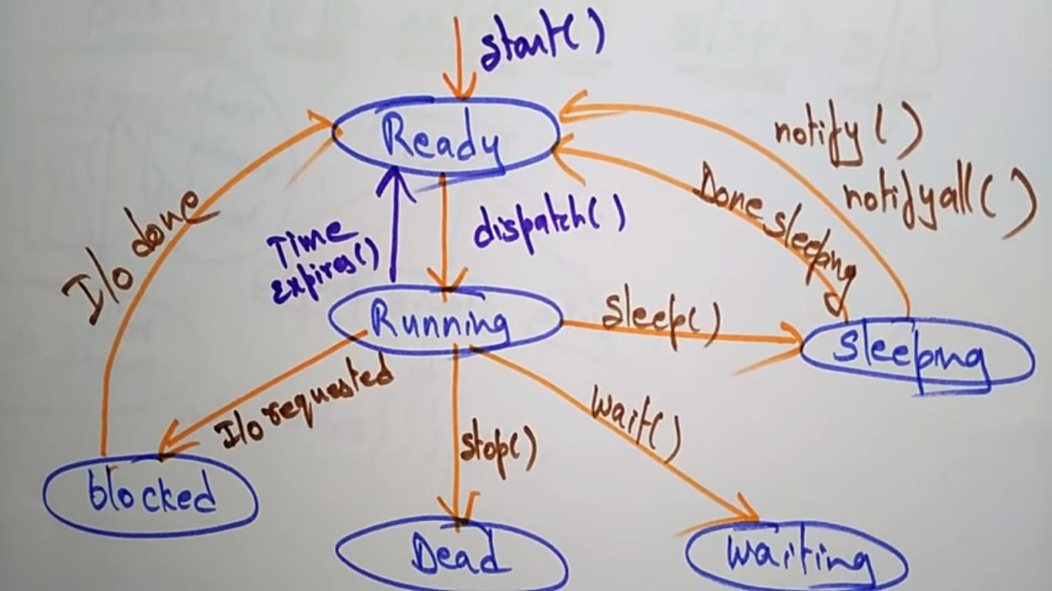
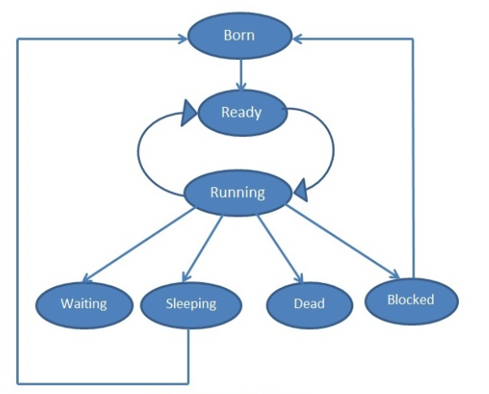
Life Cycle of Thread

Slide 21
Types of Threads
1. User Level thread (ULT): – It is implemented in the user level library, they are not created using the system calls. Thread switching does not need to call OS and to cause interrupt to Kernel. Kernel doesn’t know about the user level thread and manages them as if they were single-threaded processes.
Advantages:
* simple to create (no kernel intervention)
* thread switching is fast (no OS calls needed)
* can be implemented on OS that doesn’t support multithreading.
Limitations:-
* No or less co-ordination among the threads and Kernel.
* If one thread causes a page fault, the entire process blocks.

Slide 22
2. Kernel Level Thread (KLT): – Kernel knows and manages the threads. Instead of thread table in each process, the kernel itself has thread table (a master one) that keeps track of all the threads in the system. In addition kernel also maintains the traditional process table to keep track of the processes. OS kernel provides system call to create and manage threads.
Advantages:-
* Since kernel has full knowledge about the threads in the system, scheduler may decide to give more time to processes having large number of threads.
* Good for applications that are frequently blocked.
Limitations:-
* Slow and inefficient.
* It requires thread control block which is an overhead.

Slide 23
Multi threading Models
Many to many model:-
* It is the best multi threading model.
* Multiple user threads multiplex to same or lesser number of kernel level threads.
* If a user thread is blocked we can schedule others user thread to other kernel thread. Thus, System doesn’t block if a particular thread is blocked.
Many to one model:-
* The thread management is done on the user level so it is more efficient.
* Multiple user threads are mapped to one kernel thread.
* When a user thread makes a blocking system call entire process blocks. (since only 1 user thread can access kernel at a time)
* Thread management is done on the user level so it is more efficient.

Slide 24
One to One Model:-
* There is one to one relationship between kernel and user thread.
* In this model multiple thread can run on multiple processor.
* Problem with this model is that creating a user thread requires creating the corresponding kernel thread. (causing an overhead, which can hinder the performance of the parent process)
* As each user thread is connected to different kernel , if any user thread makes a blocking system call, the other user threads won’t be blocked.

Slide 25
CPU Scheduling
* CPU Scheduling is a process that allows one process to use the CPU while another process is delayed (in standby) due to unavailability of any resources such as I / O etc, thus making full use of the CPU.
* The purpose of CPU Scheduling is to make the system more efficient, faster, and fairer.
Arrival Time: Time at which the process arrives in the ready queue.
Completion Time: Time at which process completes its execution.
Burst Time: Time required in milli seconds by a process for its execution.
Turn Around Time: Time Difference between completion time and arrival time.
Waiting Time: Time difference between turn around time and burst time.
Preemptive Scheduling: It is used when a process switches from running state to ready state or from the waiting state to the ready state.
Non-Preemptive Scheduling: It is used when a process terminates, or when a process switches from running state to waiting state.

Slide 26
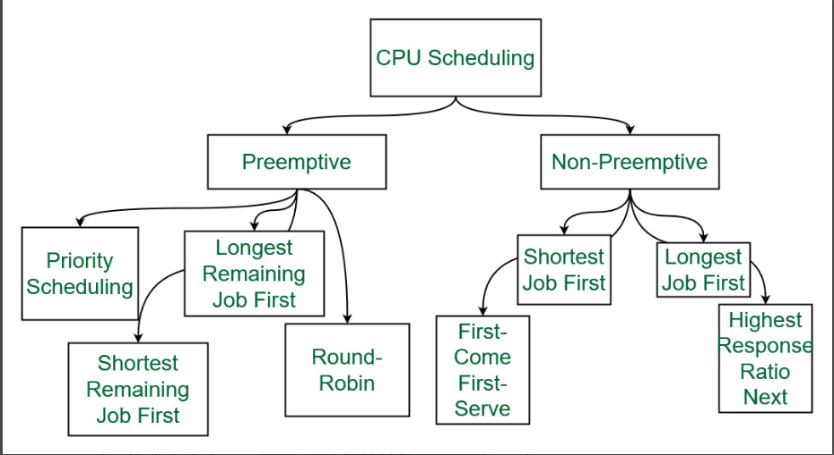

Slide 27
Process Schedulers
1. Long Term or job scheduler :
* It brings the new process to the ‘Ready State’.
* It controls Degree of Multi-programming, i.e., number of process present in ready state at any point of time.
* It is important that the long-term scheduler make a careful selection of both I/O and CPU-bound processes. The job scheduler increases efficiency by maintaining a balance between the two.
I/O bound tasks are which use much of their time in input and output operations while CPU bound processes are which spend their time on CPU.

Slide 28
2. Short term or CPU scheduler :-
* It is responsible for selecting one process from ready state for scheduling it on the running state.
* Short-term scheduler only selects the process to schedule it doesn’t load the process on running.
* Here is when all the scheduling algorithms are used.
* The CPU scheduler is responsible for ensuring there is no starvation owing to high burst time processes.
* Dispatcher is responsible for loading the process selected by Short-term scheduler on the CPU (Ready to Running State) Context switching is done by dispatcher only.
A dispatcher refers to a module that provides the control of the CPU to that process that gets selected by the short term-scheduler.
* A dispatcher does the following:
Switching context.
Switching to user mode.
Jumping to the proper location in the newly loaded program.

Slide 29
3. Medium-term scheduler :
* It is responsible for suspending and resuming the process.
* It mainly does swapping (moving processes from main memory to disk and vice versa).
* Swapping may be necessary to improve the process mix or because a change in memory requirements has overcommitted available memory, requiring memory to be freed up.
* It is helpful in maintaining a perfect balance between the I/O bound and the CPU bound.
* It reduces the degree of multiprogramming.

Slide 30
Scheduling Algorithms
1. First Come First Serve
* The simplest of all operating system scheduling algorithms.
* First come first serve scheduling algorithm states that the process that requests the CPU first is allocated the CPU first and is implemented by using FIFO queue.
* This algorithm is not much efficient in performance, and the wait time is quite high.
* FCFS supports non-preemptive and preemptive CPU scheduling algorithms.

Slide 31
2. Shortest Job First(SJF):-
* The shortest job first (SJF) or shortest job next, is a scheduling policy that selects the waiting process with the smallest execution time to execute next.
* SJN, also known as Shortest Job Next (SJN), can be preemptive or non-preemptive.
* It has a minimum avg waiting time.
* It is practically infeasible as OS may not know burst times to sort the processes.
* Sort all the processes according to arrival time and then select that process that has minimum arrival time and minimum burst time.
* SJF may cause very long turn-around times or starvation.

