Slide 1


U20CSPR02- MAJOR PROJECT
BATCH No.:CS10
DOMAIN:CYBER SECURITY
PROJECT TITLE :Autonomous Exploitation via Malware Injection using Raspberry Pi
S. No. | Register number | Name of the Student
1 | U21CC038 | SANJAI J
2 | U21CC039 | SARAVANAN K
3 | U21CC019 | HARI VIKAS M
4 | U21CC018 | HARIHARAN S
GUIDED BY: DR.L.Godlin Atlas

Slide 2
CONTENTS
Abstract
Objective
Introduction
Literature Survey
Problem Statement
Existing System
Proposed System
System Architecture
Modules
Implementation
Results and Discussion
Conclusion and Future Scope
References

Slide 3

Abstract
Cyber threats are evolving rapidly, with automated intrusion techniques posing significant risks to modern systems. This project explores autonomous exploitation via malware injection using a Raspberry Pi, demonstrating how small, low-cost devices can be leveraged for offensive cybersecurity research. The system is designed to autonomously scan, identify vulnerabilities, and deploy malicious payloads to compromise target machines. Key components include network reconnaissance, vulnerability assessment, and malware execution, enabling hands-free exploitation with minimal human intervention. By integrating tools like, the Raspberry Pi serves as an automated cyber weapon capable of bypassing traditional security mechanisms. The study also discusses potential countermeasures, highlighting the need for robust threat detection and mitigation strategies. While this project aims to understand and mitigate autonomous cyber threats, it also raises ethical concerns about the misuse of AI-driven exploitation techniques in real-world cyberattacks.

Slide 4
Problem Statement
With the increasing sophistication of cyber threats, attackers are leveraging automation and low-cost hardware to exploit system vulnerabilities efficiently. Traditional security measures often struggle to detect and prevent autonomous malware-driven attacks, especially those executed via compact, inconspicuous devices like the Raspberry Pi. This raises a critical concern: how can autonomous exploitation through malware injection bypass traditional security defenses, and what countermeasures can effectively mitigate such threats? This project investigates how a Raspberry Pi can be programmed to autonomously identify, exploit, and compromise vulnerable systems through malware injection. It examines the efficacy of automated cyberattacks, the security loopholes they exploit, and the limitations of conventional defense mechanisms. The study aims to highlight the growing risks posed by ultimately providing insights into improving intrusion detection, real-time threat mitigation, and proactive cybersecurity measures.

Slide 5
Objective
Develop an Autonomous Exploitation Framework – Create a Raspberry Pi-based system using custom scripts to autonomously scan, identify vulnerabilities, and inject malware for system exploitation.
Implement Script-Based Network Reconnaissance & Exploitation – Write Python and Bash scripts to detect open ports, analyze system weaknesses, and execute malware payloads without relying on external tools.
Assess Security Vulnerabilities & Defense Limitations – Evaluate how script-based autonomous attacks exploit system flaws and analyze the gaps in conventional cybersecurity defenses.
Propose Countermeasures & Mitigation Strategies – Develop and recommend custom intrusion detection, script-based threat mitigation, and proactive security measures to prevent automated cyber intrusions.

Slide 6
Literature Survey
S. No. | Paper Title, Author Name,Year & Journal name | Techniques Used | Observations
1 | Malware Injection in Operational Technology Networks Mayuri Khadpe, Pranita Binnar, Dr. Faruk Kazi | Write a python code as per the requirement of Attack. A code which contain 3 Function or Module such as Network Scanning function which collect all IP address | The paper is only focusing on performing an attack but it is important to prevent it also. To monitor different types of threat in Industry
2 | Ethical Hacking and Penetration Testing Using Raspberry PI Maryna Yevdokymenko, Elsayed Mohamed, Paul Onwuakpa Arinze | It implements a virtual environment of how a hacker attack a system.It point out the holes where an intruder or a attacker may take advantage of and use it to attack. | Pentesting is one of the most affective approaches to study the security parameters of a network of any size and it helps to analyze the security level of a network.
3 | Malware Injection in Wireless Networks Matej Kacic , Petr Hanacek , Martin Henzl , Peter Jurnecka | This part describes our idea of how to inject malware to specific wireless client with purpose, for example, buffer overflow insertion attack to specific network application. | The main function of this service is to listen on some port and wait for IP packet with specific payload from network.

Slide 7
Literature Survey
S.N0 | Paper Title, Author Name,Year & Journal name | Techniques Used | Observations
4 | Stealthy Information Leakage Through Peripheral Exploitation in Modern Embedded Systems Dimitrios Tychalas, Anastasis Keliris, Michail Maniatakos | Our proposed attack is a malware designed to break air gapped PLC devices and expose information through some available analog output, identified by automatically parsing the Device Tree. | The attack can be deployed to a device either remotely, or directly through physical interaction. In our end-to-end case study, data from arbitrary memory locations are transmitted through available LED.
5 | Raspberry PI and role of IoT in Education Salman Mahmood, Puttaswamy Malali Rajegowda , Kamal Uddin Sarker | There are different methods for feature extraction like appearance-based method, geometric based method, texture based method and so forth. | To achieve the investigating procedure more efficiently, a smart algorithm plays an important role to do it in an automated manner. To deal with these automated algorithm machine learning is the field that comes under the umbrella of artificial intelligence.

Slide 8
Feasibility of the Project Proposal
Technical Feasibility
Hardware Requirements: Uses a Raspberry Pi Zero, microSD card, and power source, making it a low-cost solution.
Software Compatibility: Supports Linux-based OS, scripting languages (Bash, Python, JavaScript), and networking tools (Netcat, PowerShell).
Automation & Execution: Scripts can be preloaded for autonomous execution, reducing manual effort.
Operational Feasibility
Ease of Deployment: Simple plug-and-play approach requires minimal configuration.
Attack Capabilities: Performs various exploits like HID-based keystroke injection, reverse shell attacks, and credential theft.
Stealth & Adaptability: Can be customized to evade security defenses, making it practical for cybersecurity testing.

Slide 9
Feasibility of the Project Proposal
Economic Feasibility
Low Cost: Implementation requires minimal investment (under $50), making it cost-effective for research.
No High-End Infrastructure Needed: Runs independently without expensive cloud services or enterprise security tools.
High ROI for Security Testing: Offers penetration testing capabilities at a fraction of the cost of commercial alternatives.
Legal & Ethical Feasibility
Ethical Use in Security Research: Should only be used in authorized penetration testing environments.
Legal Considerations: Unauthorized exploitation can violate cybersecurity laws (e.g., Computer Fraud and Abuse Act - CFAA).
Mitigation of Risks: Users must obtain legal consent before deploying the system for ethical hacking.

Slide 10
Methodology of the proposed work
Research & Requirement Analysis
Study various USB-based exploitation techniques and their impact on different operating systems.
Identify potential vulnerabilities in Windows/Linux machines that can be targeted.
Choose effective exploitation techniques, including keystroke injection, credential harvesting, and remote access payloads.
Design & Development
Setting Up the Attack Platform
Install and configure a lightweight Linux-based OS on Raspberry Pi.
Develop custom payloads to execute attacks efficiently.
Enable network capabilities to allow remote control and data exfiltration.

Slide 11
Methodology of the proposed work
Testing & Validation
Deploy attack payloads in a controlled test environment.
Measure execution speed, success rate, and detection probability.
Analyze evasion techniques against antivirus and endpoint security solutions.
Mitigation & Countermeasures
Restrict USB Device Usage by enforcing policies that block unauthorized peripherals.
Implement Endpoint Protection to detect and block suspicious keystroke patterns.
Regular Security Updates & Patches to eliminate vulnerabilities before they can be exploited.

Slide 12
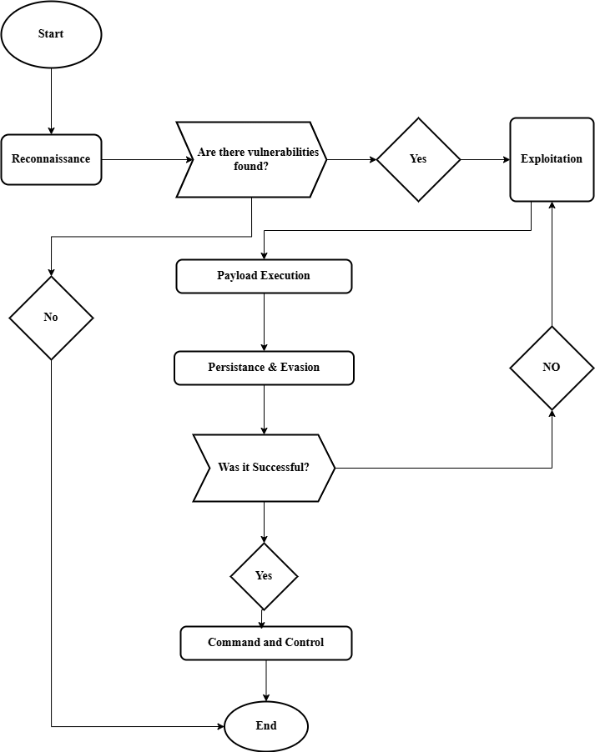
Design Methodology

Slide 13
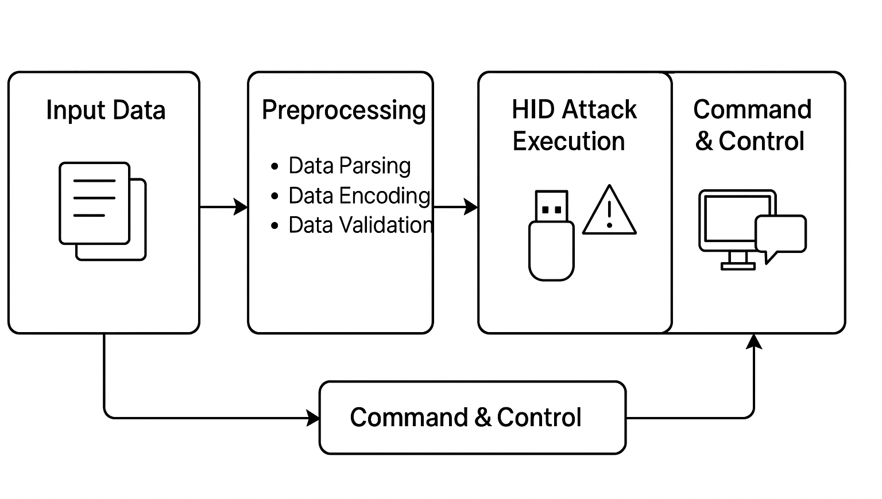
System Architecture

Slide 14
Modules
HID-Based Keystroke Injection Module
Functionality:
Emulates a USB keyboard to inject malicious keystrokes automatically.
Executes predefined PowerShell, Bash, or Python scripts on the target system.
Bypasses security controls by appearing as a legitimate input device
Reverse Shell & Remote Access Module
Functionality:
Establishes a reverse shell for persistent remote access.
Enables command execution on the compromised machine.
Supports Netcat, PowerShell reverse shells, or SSH tunnels.

Slide 15
Modules
Credential Harvesting Module
Functionality:
Extracts stored passwords from the target system.
Retrieves WiFi credentials, browser-saved passwords, and Windows hashes.
Saves or exfiltrates stolen credentials for later use.
Payload Deployment & Execution Module
Functionality:
Manages and deploys different attack payloads based on the target system.
Supports custom script execution, malware injection, and exploit deployment.
Uses bash, Python, and PowerShell scripts to automate attacks.

Slide 16
Modules
Anti-Detection & Evasion Module
Functionality:
Implements techniques to bypass antivirus and endpoint detection systems (EDR).
Uses obfuscated scripts, sandbox evasion, and process injection.
Randomizes execution patterns to avoid behavior-based detection.
User Interface & Control Module
Functionality:
Provides an interface to configure and control attack payloads.
Allows users to select, modify, and execute different exploit scripts.
Displays logs, attack success rates, and exfiltrated data.

Slide 17
Source Code
Keyboard and Consumer Control Handling
Handles key presses and consumer control actions (e.g., volume control)
import usb_hid
from adafruit_hid.keyboard import Keyboard
from adafruit_hid.consumer_control import ConsumerControl
from adafruit_hid.consumer_control_code import ConsumerControlCode
from adafruit_hid.keycode import Keycode
kbd = Keyboard(usb_hid.devices)
consumerControl = ConsumerControl(usb_hid.devices)
def runScriptLine(line):
keys = convertLine(line)
for k in keys:
if k > 1000:
consumerControl.press(int(k-1000))
else:
kbd.press(k)
for k in reversed(keys):
if k > 1000:
consumerControl.release()
else:
kbd.release(k)
def sendString(line):
layout.write(line)

Slide 18
Source Code
Encrypted Payload Execution
This module encrypts and decrypts payloads before execution, ensuring they remain hidden from detection.
from cryptography.fernet import Fernet
import base64
# Generate and store the key securely
def generate_key():
return base64.urlsafe_b64encode(Fernet.generate_key())
# Encrypt payload
def encrypt_payload(payload, key):
cipher = Fernet(key)
return cipher.encrypt(payload.encode())
# Decrypt and execute payload
def execute_encrypted_payload(encrypted_payload, key):
cipher = Fernet(key)
decrypted_payload = cipher.decrypt(encrypted_payload).decode()
exec(decrypted_payload) # Execute payload dynamically
# Example usage
key = generate_key()
encrypted = encrypt_payload("print('Executing hidden payload...')", key)
execute_encrypted_payload(encrypted, key)

Slide 19
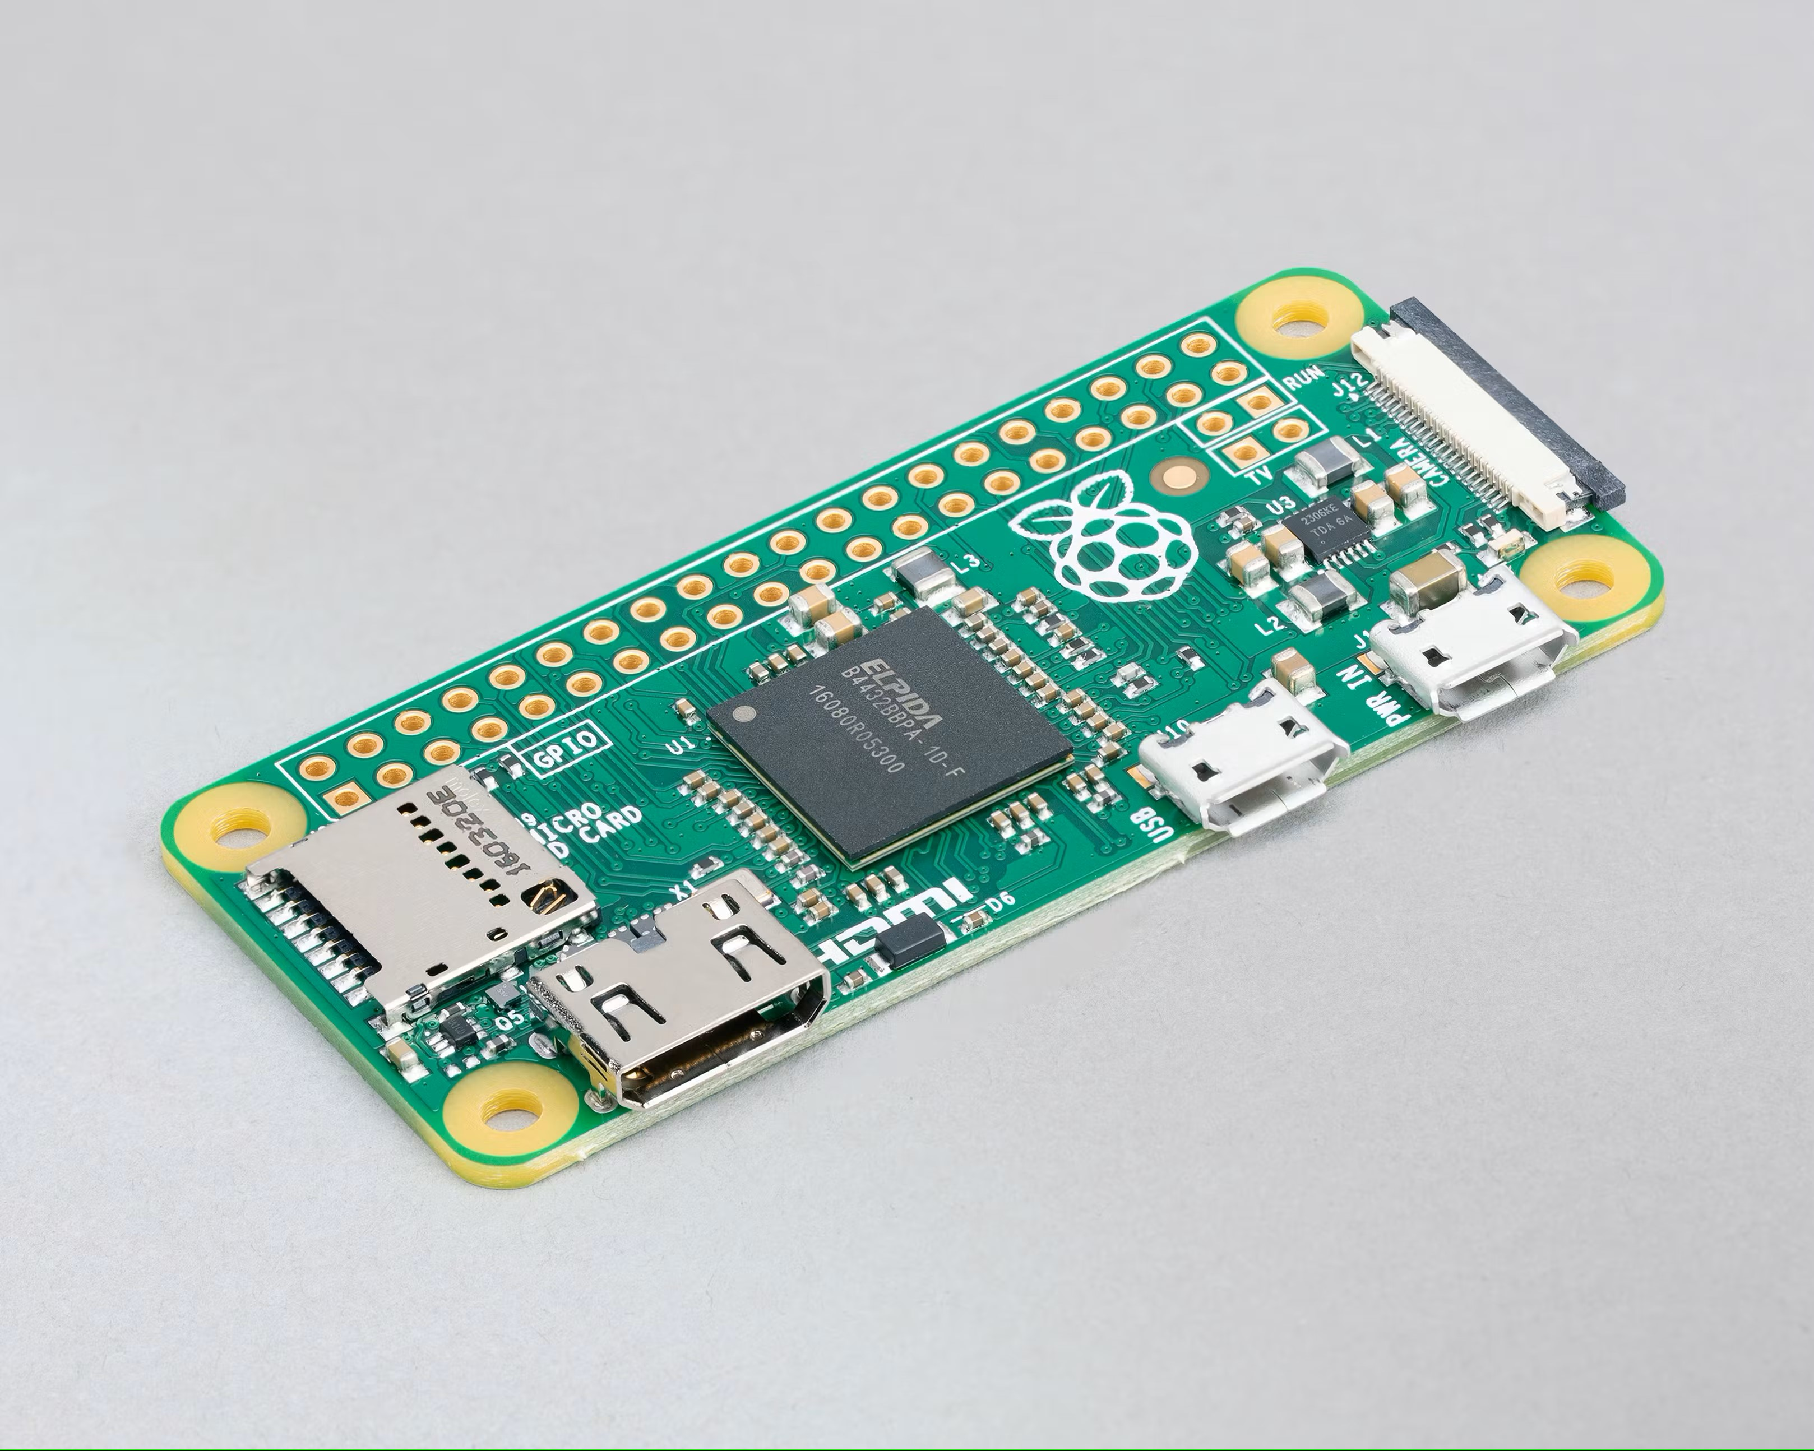
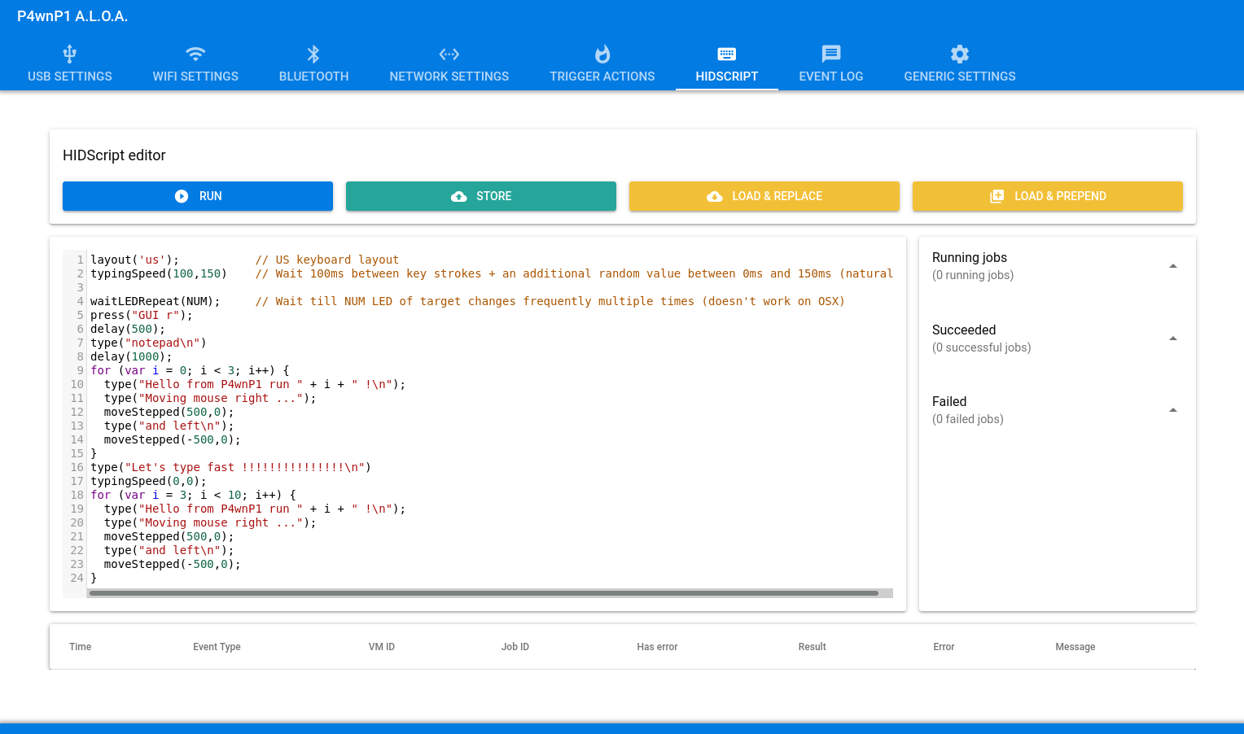
IMPLEMENTATION
Fig-1: Raspberry pi
Fig-2:HID attack

Slide 20
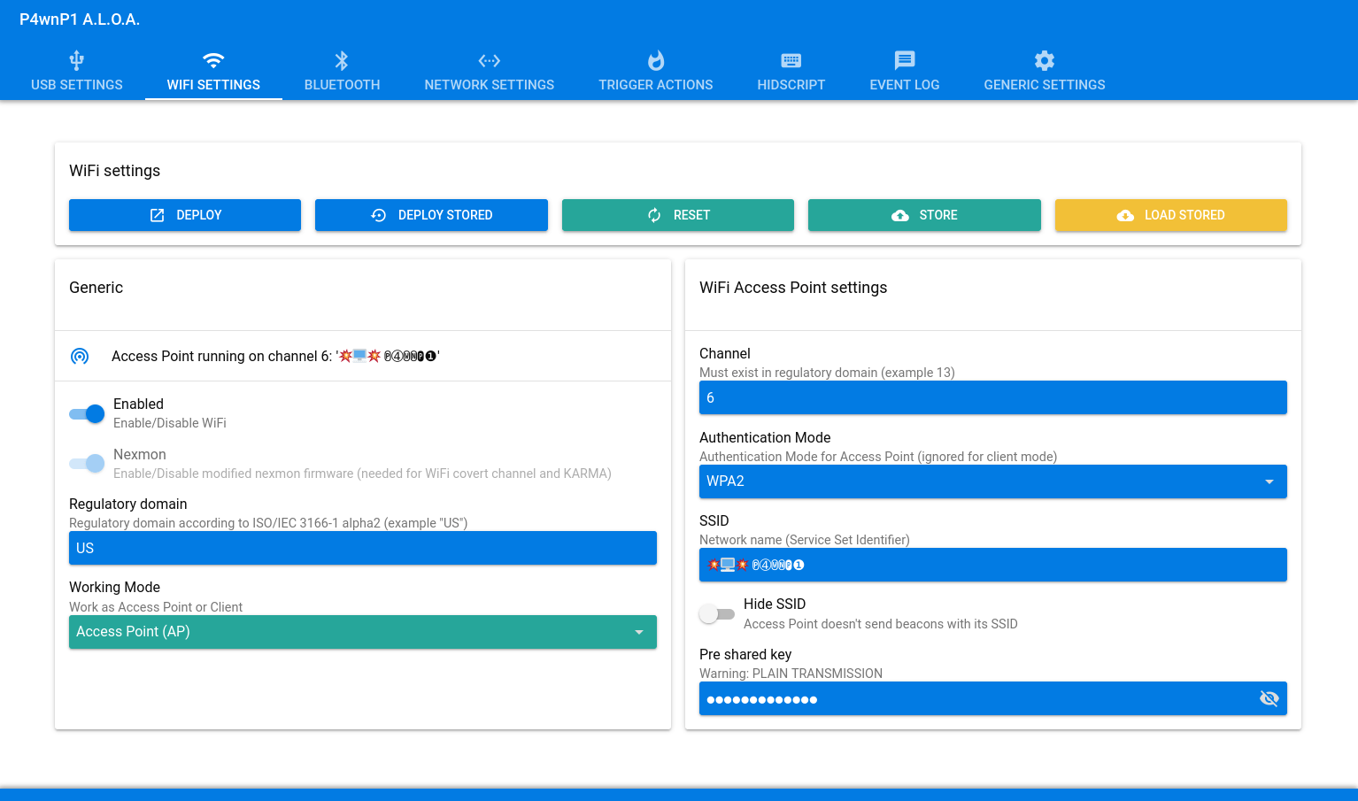
IMPLEMENTATION
Fig-3:Wifi authentication

Slide 21
RESULTS AND DISCUSSION
Key Findings
Successful Payload Execution:
Automated keystroke injection for credential theft and persistence.
Payloads executed efficiently on various operating systems.
Bypassing Security Measures:
Antivirus evasion tested with obfuscated scripts.
UAC (User Account Control) bypass achieved in specific Windows configurations.
Data Exfiltration & Reverse Shell Access:
Encrypted payloads exfiltrated data without detection.
Remote shell established via covert communication channels.

Slide 22
RESULTS AND DISCUSSION
Strengths & Limitations
Strengths:
Highly customizable payloads for different attack vectors.
Works on Raspberry Pi Zero 2W, making it portable and stealthy.
Open-source framework enables continuous improvement.
Limitations:
Requires physical access for initial exploitation.
Some security tools detect known payload signatures.
Ethical concerns limit real-world use cases to testing and research.

Slide 23
CONCLUSION AND FUTURE SCOPE
Conclusion
Effective Cybersecurity Testing Tool
P4wnP1 A.L.O.A. demonstrates the power of HID (Human Interface Device) attacks, showing real-world vulnerabilities in USB security.
Bypassing Security Mechanisms
Successfully exploits weaknesses in OS security, bypassing UAC, AV detection, and executing hidden payloads.
Ethical and Research Use
While powerful, it should be used for penetration testing, Red Team assessments, and security research, not malicious activities.

Slide 24
CONCLUSION AND FUTURE SCOPE
Future Scope
Enhanced Evasion Techniques
Implementing AI-based adaptive payloads that modify behavior to evade detection dynamically.
Improved Anti-Forensic Capabilities
Developing stealth mechanisms to erase execution traces after payload deployment.
Wireless Exploitation & Automation
Expanding capabilities to Bluetooth & Wi-Fi-based attacks for remote execution.
Defensive Countermeasures
Researching automated detection techniques to defend against similar USB-based attacks.

Slide 25
References
S. Kim, ”Anatomy on Malware Distribution Networks,” in IEEE Access, vol. 8, pp. 73919-73930, 2020
O. A. Aslan and R. Samet, ”A Comprehensive Review on Malware Detection Approaches,” in IEEE Access, vol. 8, pp. 6249-6271, 2020.
O. P. Samantray, S. N. Tripathy and S. K. Das, ”A study to Understand Malware Behavior through Malware Analysis,” 2019 IEEE International Conference on System, Computation, Automation and Networking (IC SCAN), Pondicherry, India, 2019, pp. 1-5
Kevin Benton, The Evolution of 802.11 Wireless Security. UNLV Informatics, 2010-04-18 [cit. 2012-01-06].
E. Cozzi, M. Graziano, Y. Fratantonio and D. Balzarotti, ”Understanding Linux Malware,” 2018 IEEE Symposium on Security and Privacy.
O. A. Aslan and R. Samet, ”A Comprehensive Review on Malware Detection Approaches,” in IEEE Access
E. Cozzi, M. Graziano, Y. Fratantonio and D. Balzarotti, ”Understanding Linux Malware,” 2018 IEEE
“Linux wireless [online],” http://linuxwireless.org/en/users/Documentation/iw, 2013 [cit. 2013-01-20].
S. Kim, ”Anatomy on Malware Distribution Networks,” in IEEE Access, vol. 8, pp. 73919-73930, 2020
E. Cozzi, M. Graziano, Y. Fratantonio and D. Balzarotti, ”Understanding Linux Malware,” 2018 IEEE Symposium on Security and Privacy (SP), San Francisco, CA, 2018, pp. 161-175.

