Slide 1
Earthenware Audio

Slide 2
Team
Klayton Hacker: hackerkj@mail.uc.edu
John Paul Wang: wang3jp@mail.uc.edu
Joe Welage: welagejl@mail.uc.edu
Advised By
Prof. Boyang Wang : wang2ba@ucmail.uc.edu

Slide 3
Abstract
Since the development of audio recording, recording artist and musicians alike have been in constant search of tools to make the production process as smooth and efficient as possible. A metronome can keep musicians in time, while a tuner keeps them in tune. Earthenware sets out to provide the artist with a tool which can aid in the communication process. Our software will identify the key most likely played by a musician, given sufficient input that includes a set of parameters provided by the user. With this given output, users of a varying degree of musical and productional knowledge will be able to create music in alignment across all relevant instruments.

Slide 4
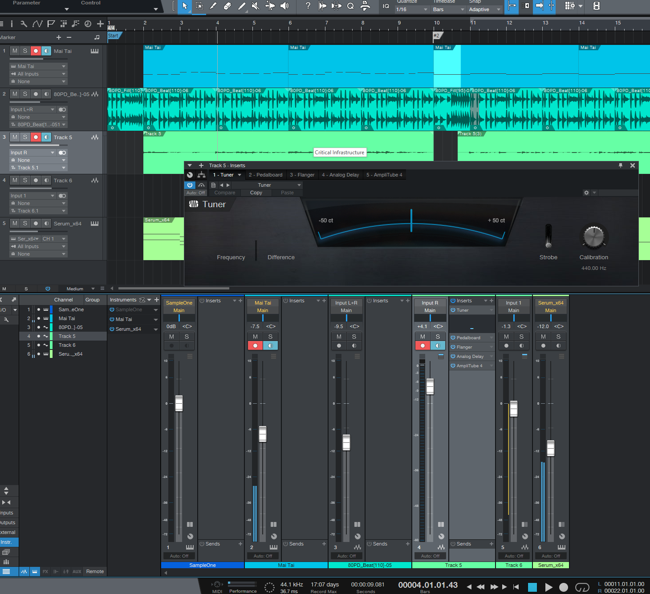
VST Audio Plugin

Slide 5
User Stories
As a Music Producer, I want to write musical parts that go together so that my music sounds better.
As a Musician, I want to understand the musical key that a riff is so that harmonizing the riff takes less time.
As a Composer, I want to visually see the musical options I have, so that I can write something I might not have on my own.

Slide 6
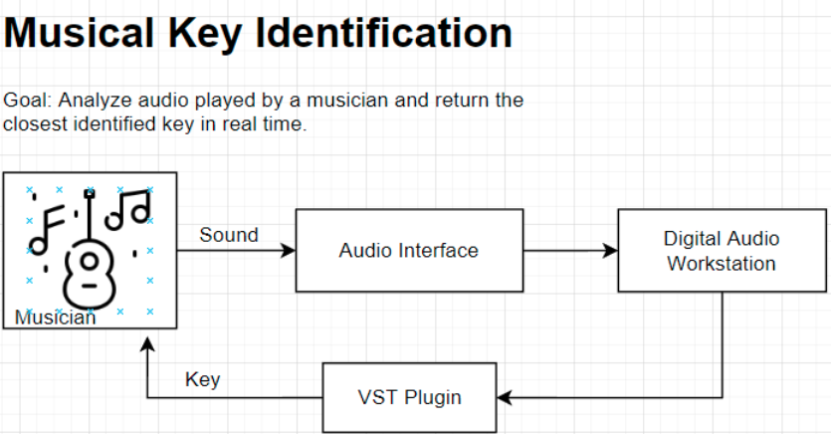
Design Diagram High Level

Slide 7
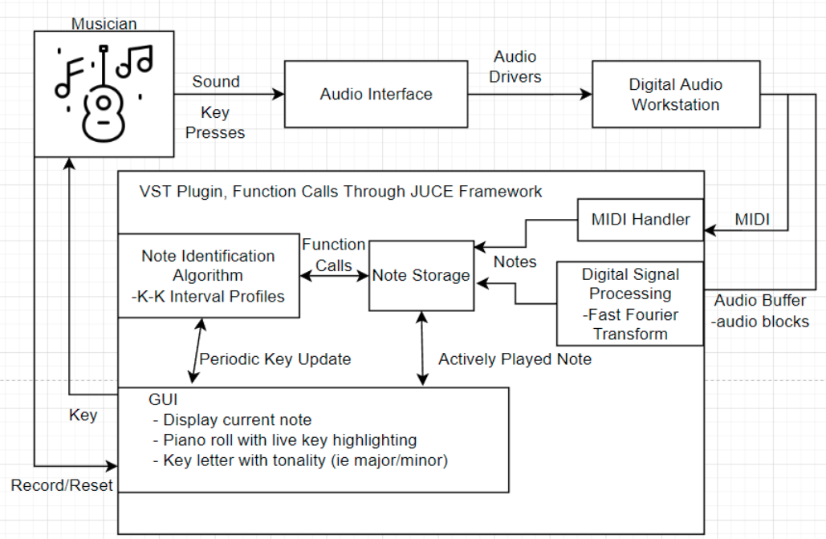
Design Diagram Low Level

Slide 8
Constraints
Economic Constraint
If the plugin where to enter into a commercial market, there would be a cap on the total amount of revenue generated based on the license chosen by the team.
Legal Constraint
Uses the JUCE framework
A JUCE license is required to sell our plugin as a product
Diversity and cultural constraints
The plugin is useful only in a western musical context.
Not all music is based on the 12-tone even tempered system.
The keys will most likely me limited to the common major and minor ones
Modes, such as in the Jazz tradition, will likely be unsupported

Slide 9
Current Progress
Starting to read through, build, and run basic projects that relate to the team’s final project.
Reading through documentation.
Creating basic shell and minimal programming for the plugin.

Slide 10
End of Term Goals
Finish preparation for development
Research best algorithms to use for note identification.
Research best algorithms to use for key identification.
Collect audio and midi data for testing
Utilize the sample projects and documentation in which to provide a base for the plugin plugin

Slide 11
Division of Work
GUI
Design a general layout for GUI elements (Joe)
Create piano roll (Joe)
Create an animated box displaying the currently played note letter (Joe)
Implement note highlighting for piano roll (Joe)
Develop a static box indicating the identified key ranking (Joe)
Animate the static box for key ranking (Joe)
Create a dropdown box for note quantization interval (Joe)
Create a start/stop and reset button (Joe)
Digital Signal Processing
Research a way to identify a fundamental frequency from a Fast Fourier Transform output. (Klay)
Investigate existing implementations of key identification algorithms for reference (Klay)
Implement logic to assign notes to a frequency (Klay)
Create handling to store midi notes (JP)
Implement algorithm for key identification(JP)
Other
Develop real time link between GUI and DSP subsystem for note identification (Klay)
Develop real time link between GUI and DSP subsystem for key identification (JP)
Develop real time link between GUI DSP subsystem for handling start and stop signals (JP)
Accumulate audio and midi data to test accuracy and edge cases for key identification algorithm (Joe)

Slide 12
Expected Demo
The demonstration for the finished product at the exposition should include a functional live demonstration that includes playing a musical instrument and various audio recordings in accordance with the enabling of the plugin to demonstrate the accuracy of the tool.

