Slide 1
A little search engine like google
m730026058 Changyuan LIANG

Slide 2
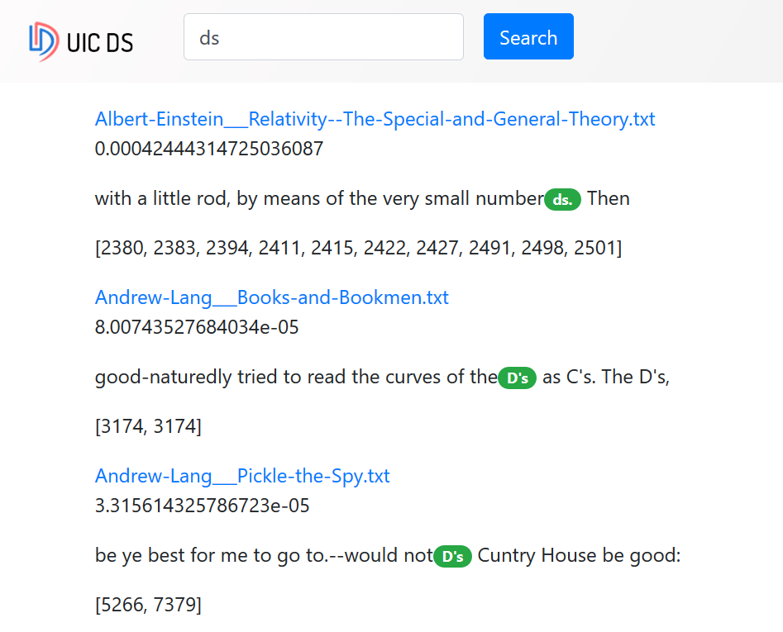
Previous version
Too slow
Offline indexing
Not powerful enough

Slide 3
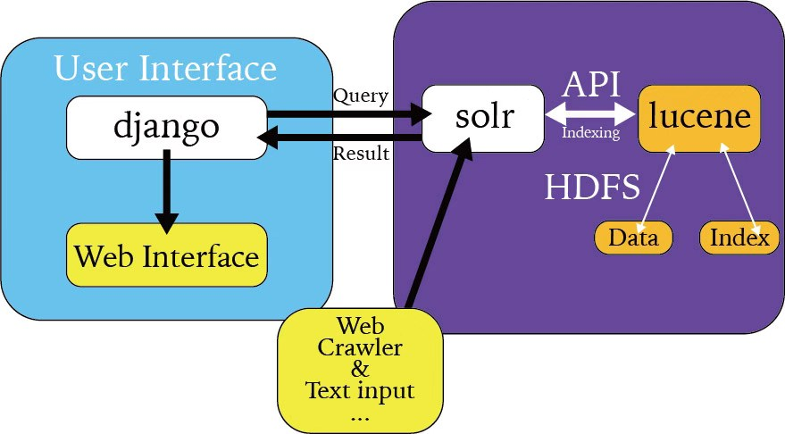
New version

Slide 4
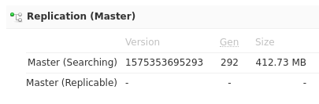
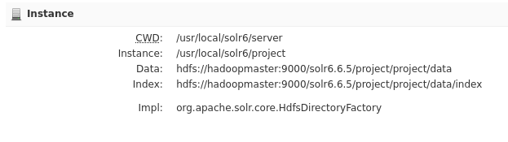
Data Store

Slide 5
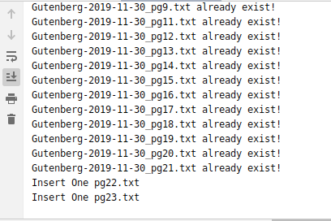
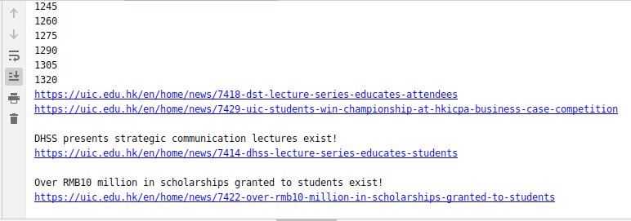
Real time Data collection and indexing
UIC Official Website
Gutenberg eBook

Slide 6
Real time Data Collection
Check the website regularly for new data
Check whether the old data is updated

Slide 7
Message-Digest Algorithm(MD5)
Brute force
Compare each line
Md5
Compare md5
bbca7383e08dc18ad11806fe4f580227

Slide 8
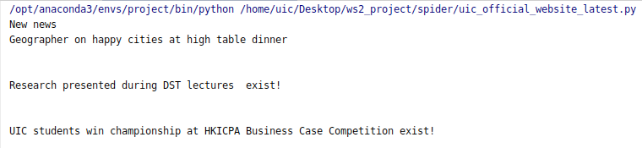
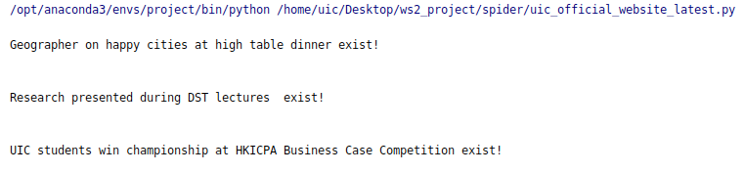
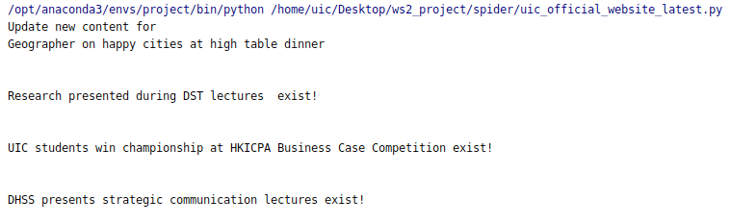

Slide 9
Real Time Indexing
Automatically update index
When New Data Insert.
When existing data changes
Demo it later.

Slide 10
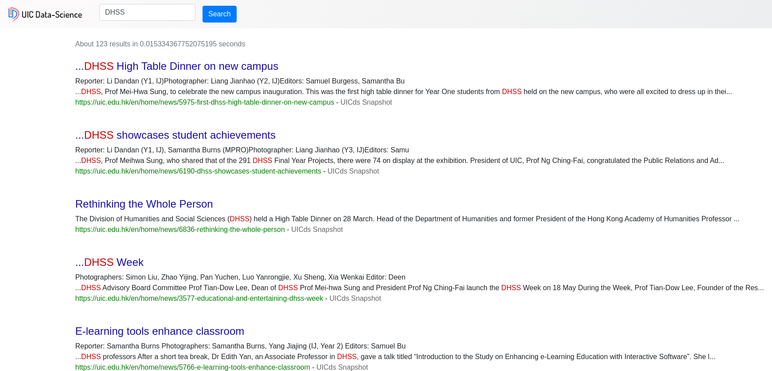
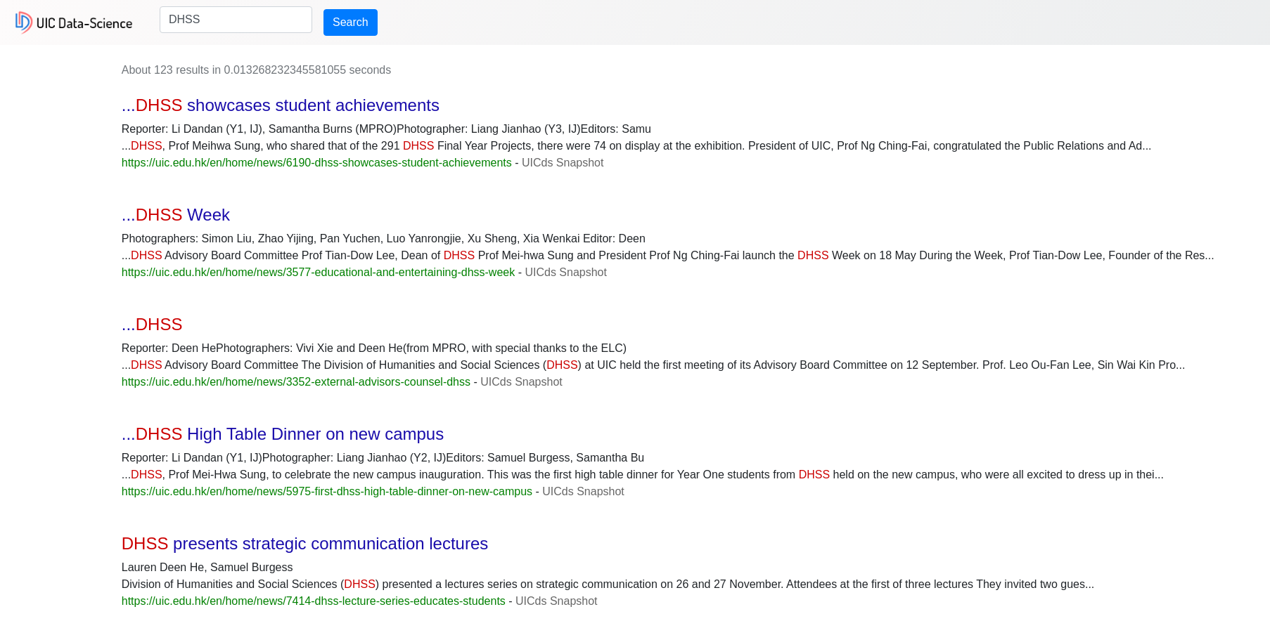
Boost
Add weight to the title
Notes:
Forms.py 118 119

Slide 11
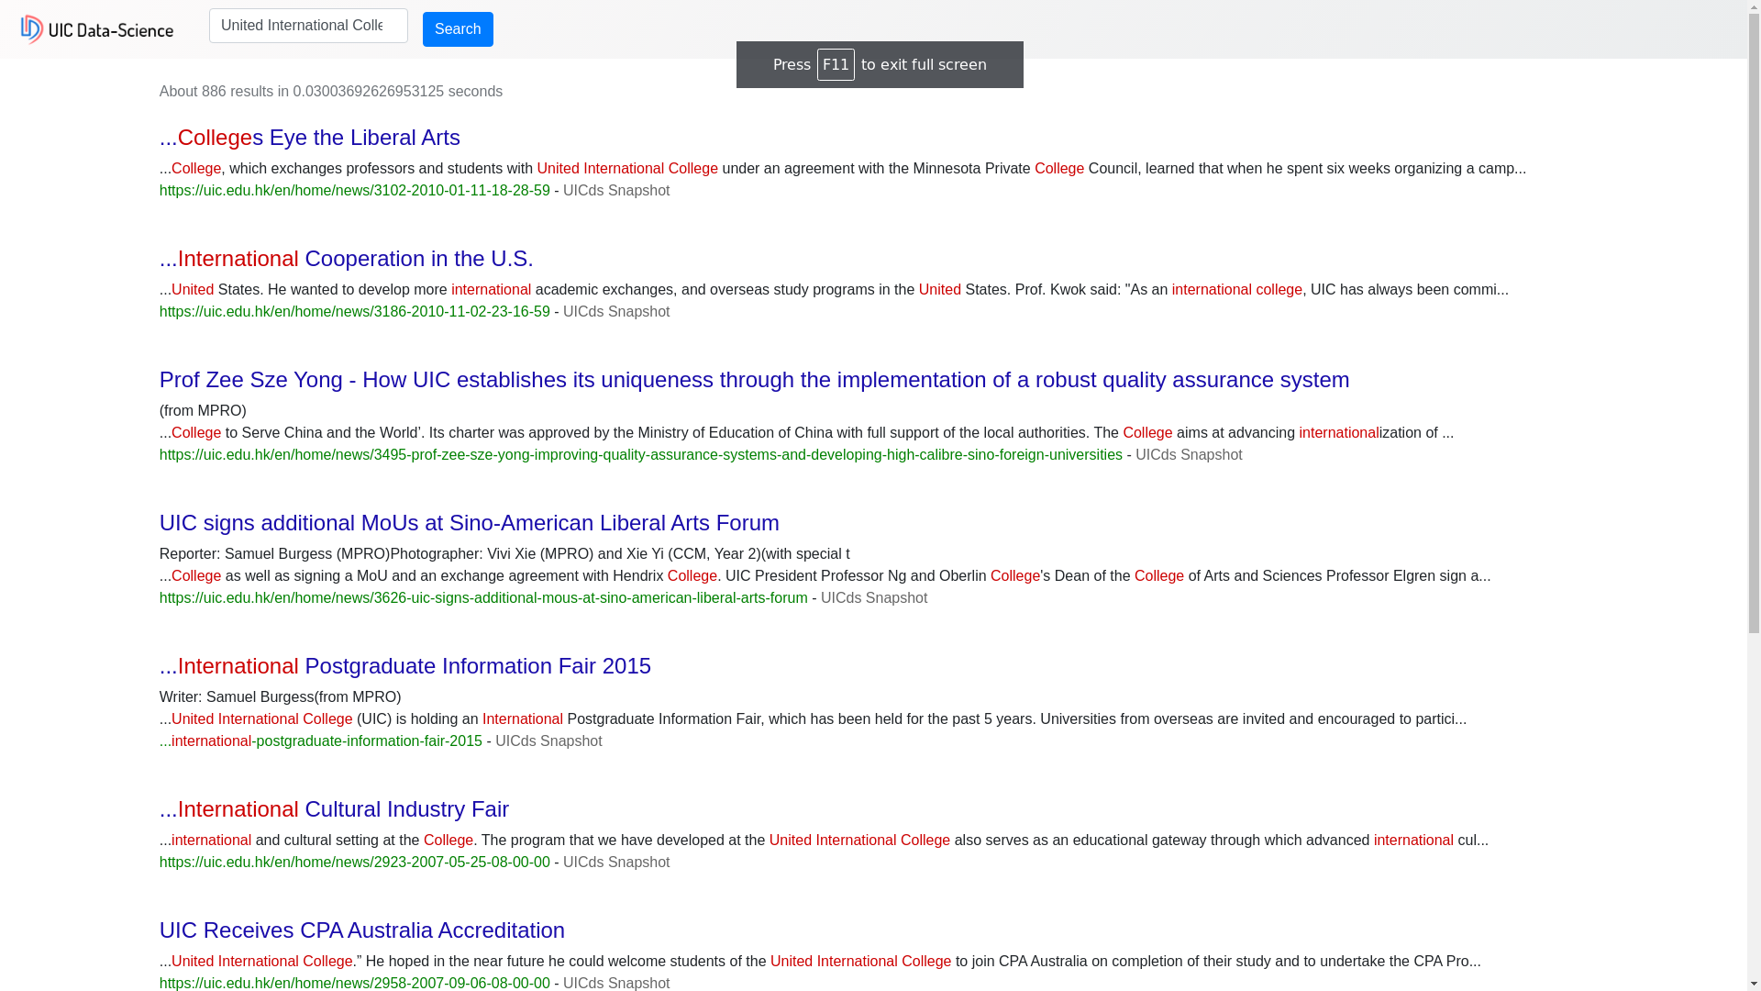
Searching based on phrases

Slide 12
Highlight
We can mark the keywords red, as shown in the previous picture.

Slide 13
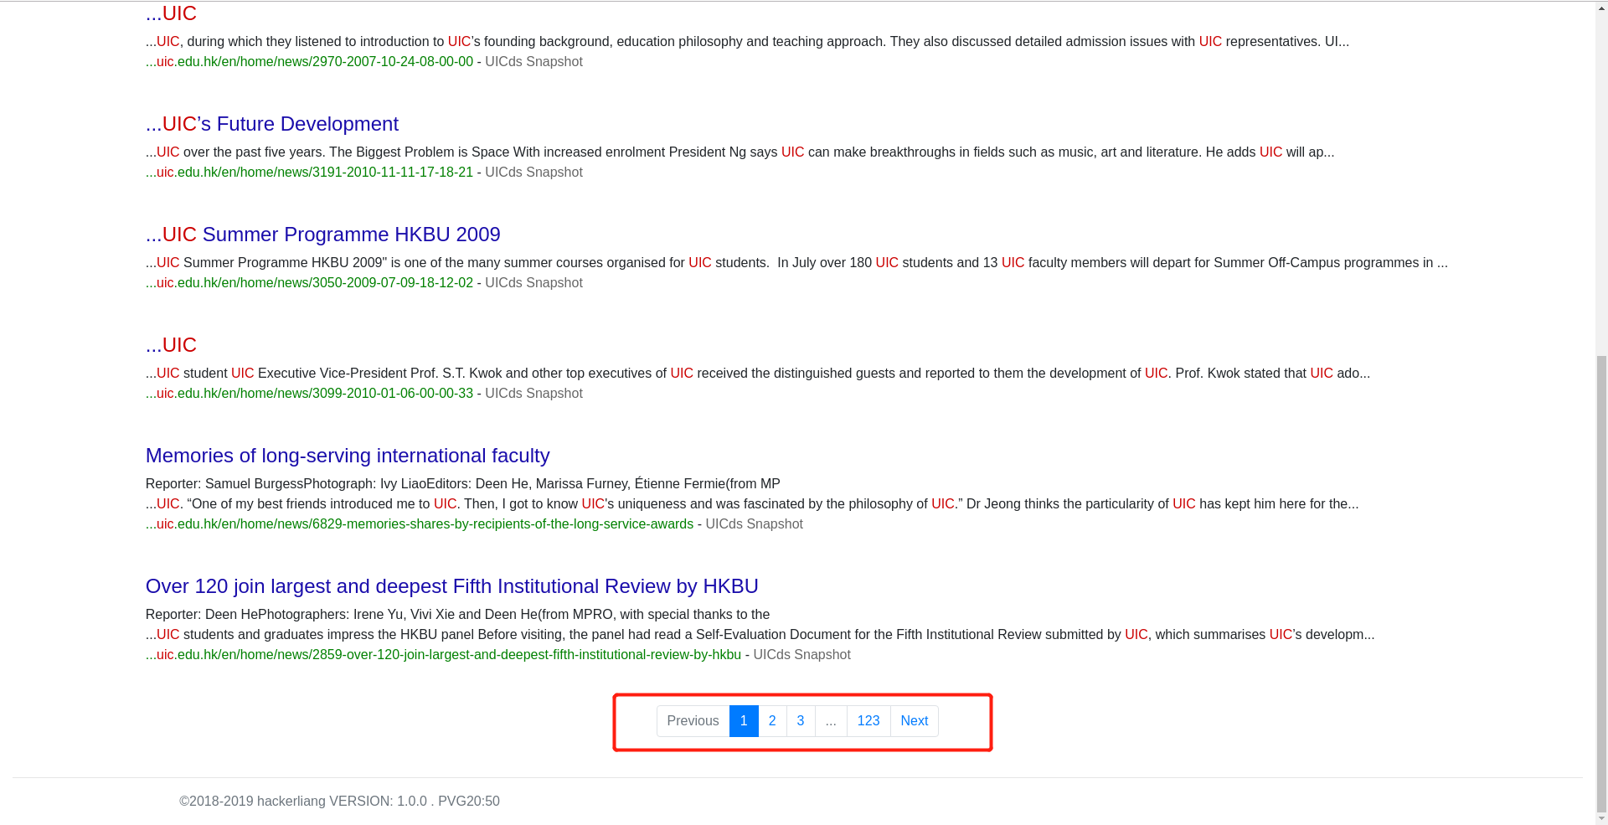
Pagination

Slide 14
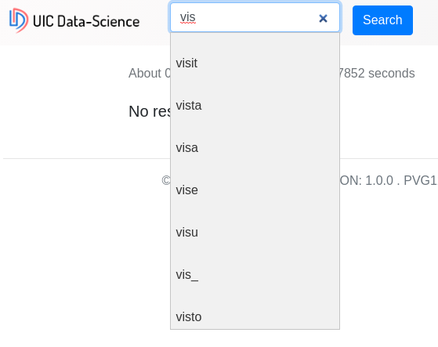
Autocomplete
Notes:
Search about and delete u

Slide 15
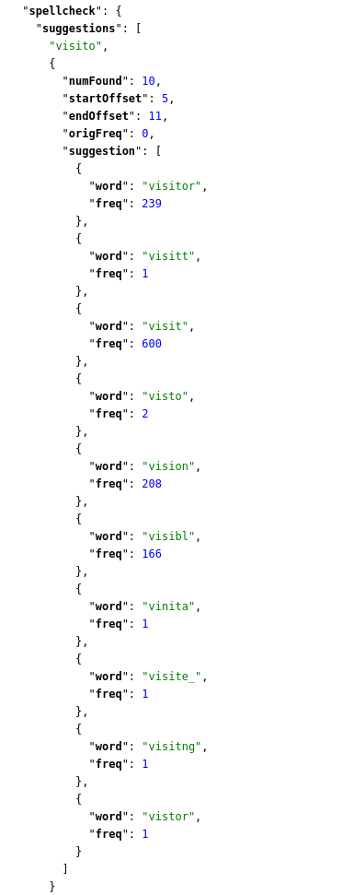
How Autocomplete
Search for “visito”

Slide 16
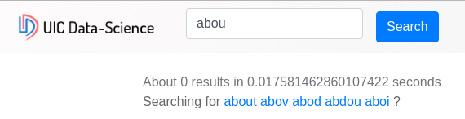
Input correction and suggestion
Spelling correction
Spelling suggestion

Slide 17
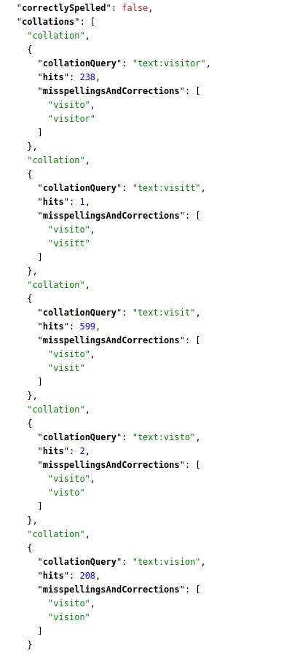
How correction
Search for “visito”

Slide 18
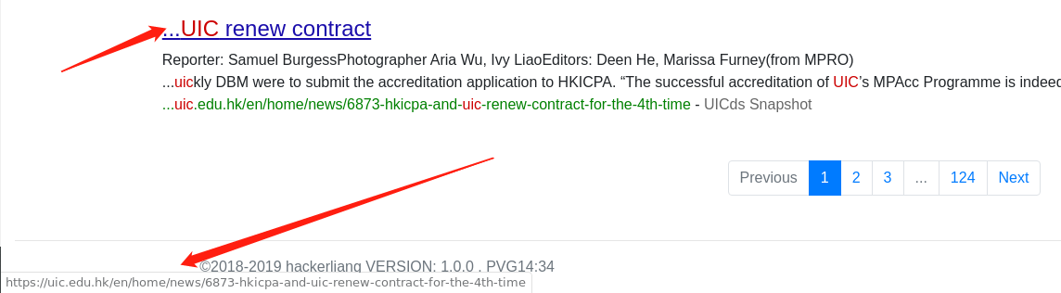
Link to the relevant content directly

Slide 19
The context around the keyword

Slide 20
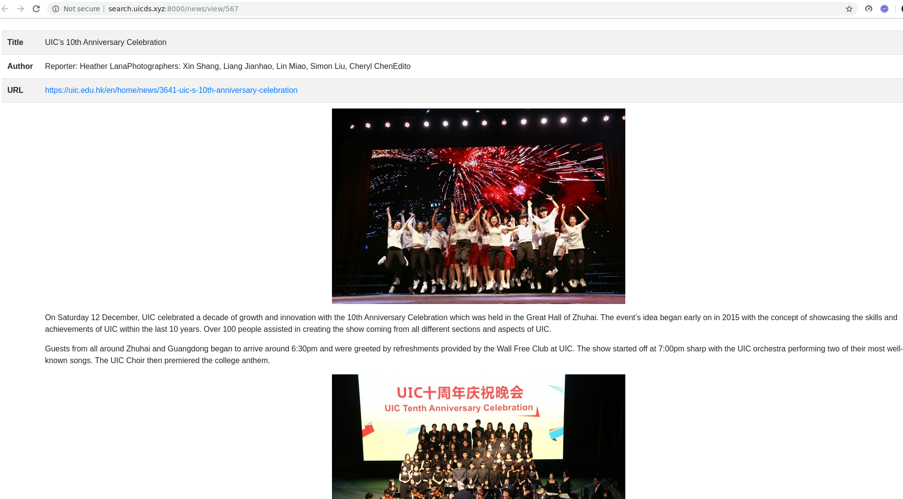

Snapshot for the website
(include images)

Slide 21
Conclusion
In general, I think my system has done a very good job. It can collect, analyze and index data in real time. It can also re index the modified data in real time. At first I thought about the combination of Lucene and MapReduce, but MapReduce is not suitable for analyzing data in real time. His calculation speed is relatively slow. The intermediate results calculated by MapReduce will be written to disk, and the output results will also be written to disk. Reading and writing to disk means that performance cannot meet real-time requirements. This means that only one of MapReduce and real-time index can be selected. But in pursuit of real-time analysis and re-indexing, I abandoned MapReduce. Next, I will try to integrate them, such as MapReduce for offline analysis and indexing, and tools such as spark for real-time indexing.

Slide 22
DEMO

