Slide 1
Manifold learning: MDS and Isomap

Slide 2
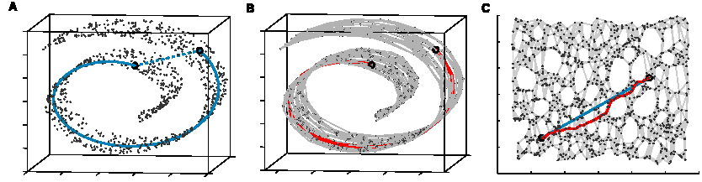
Manifold learning
A manifold is a topological space which is locally Euclidean.

Slide 3
Manifold learning
A global geometric framework for nonlinear dimensionality reduction
  Tenenbaum JB, de Silva V., and Langford JC
  Science, 290: 2319–2323, 2000
Nonlinear Dimensionality Reduction by Locally Linear Embedding
  Roweis and Saul
  Science, 2323-2326, 2000

Slide 4
Outline of lecture
Intuition
Linear method- PCA
Linear method- MDS
Nonlinear method- Isomap
Summary

Slide 5
Why Dimensionality Reduction
The curse of dimensionality
Number of potential features can be huge
  Image data: each pixel of an image
    A 64X64 image = 4096 features
  Genomic data: expression levels of the genes
    Several thousand features
  Text categorization: frequencies of phrases in a document or in a web page
    More than ten thousand features

Slide 6
Why Dimensionality Reduction
Data visualization and exploratory data analysis also need to reduce dimension
  Usually reduce to 2D or 3D
Two approaches to reduce number of features
  Feature selection: select the salient features by some criteria
  Feature extraction: obtain a reduced set of features by a transformation of all features (PCA)

Slide 7
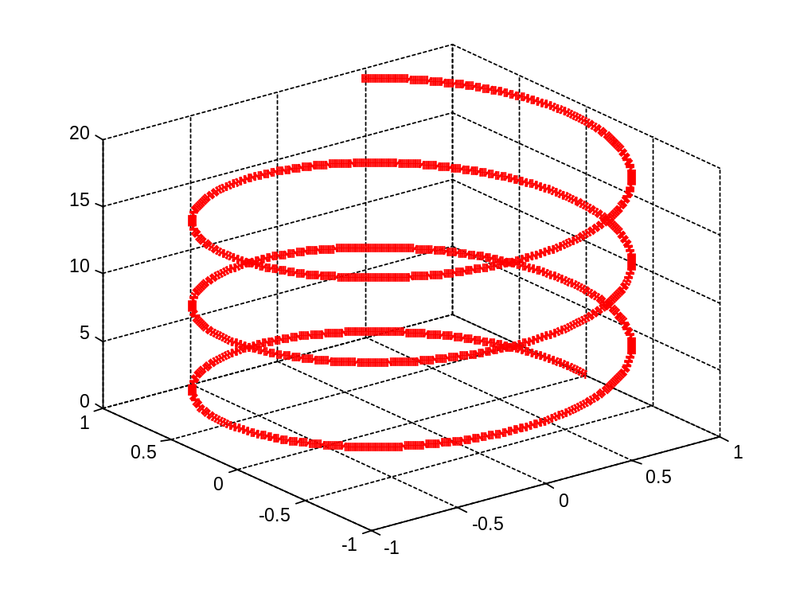
Deficiencies of Linear Methods
Data may not be best summarized by linear combination of features
  Example: PCA cannot discover 1D structure of a helix

Slide 8
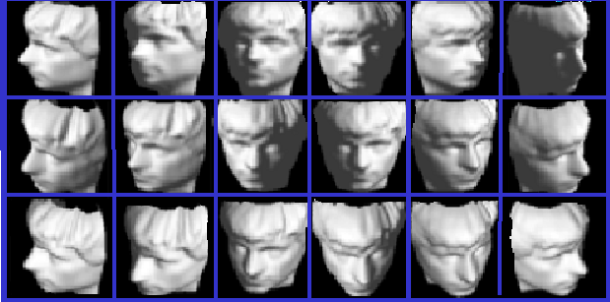
Intuition: how does your brain store these pictures?

Slide 9
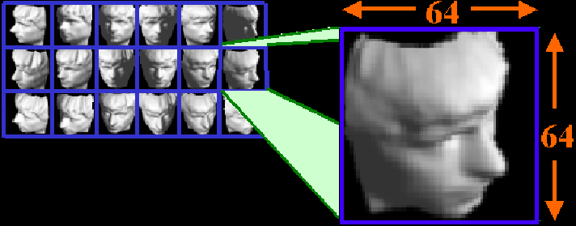
Brain Representation

Slide 10
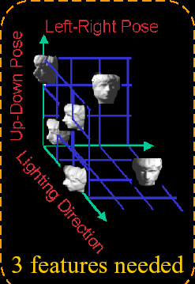
Brain Representation
Every pixel?
Or perceptually meaningful structure?
  Up-down pose
  Left-right pose
  Lighting direction
  So, your brain successfully reduced the high-dimensional inputs to an intrinsically 3-dimensional manifold!

Slide 11
Manifold Learning
A manifold is a topological space which is locally Euclidean
An example of nonlinear manifold:

Slide 12


Manifold Learning
latent
Discover low dimensional representations (smooth manifold) for data in high dimension.
Linear approaches(PCA, MDS)
Non-linear approaches (Isomap, LLE, others)
Y
X
observed

Slide 13
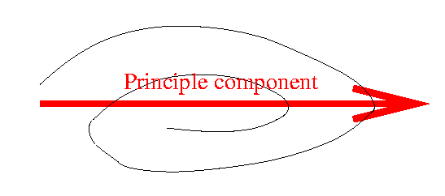
Linear Approach- PCA
PCA Finds subspace linear projections of input data.

Slide 14
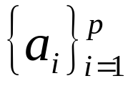
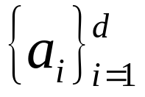
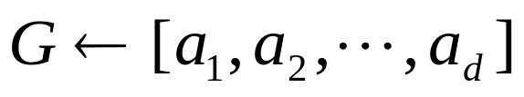
Linear approach- PCA
Main steps for computing PCs
  Form the covariance matrix S.
  Compute its eigenvectors:
  The first d eigenvectors form the d PCs.
  The transformation G consists of the p PCs.

Slide 15
Linear Approach- classical MDS
MDS: Multidimensional scaling
  Borg and Groenen, 1997
MDS takes a matrix of pair-wise distances and gives a mapping to R^{d}. It finds an embedding that preserves the interpoint distances, equivalent to PCA when those distance are Euclidean.
  Low dimensional data for visualization

Slide 16
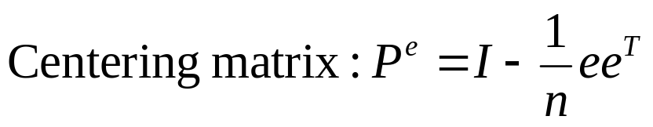
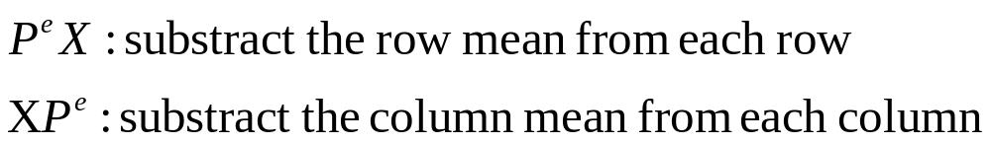
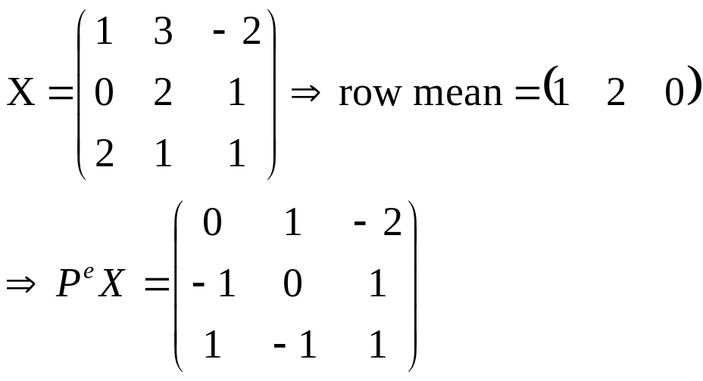
Linear Approach- classical MDS
Example:

Slide 17
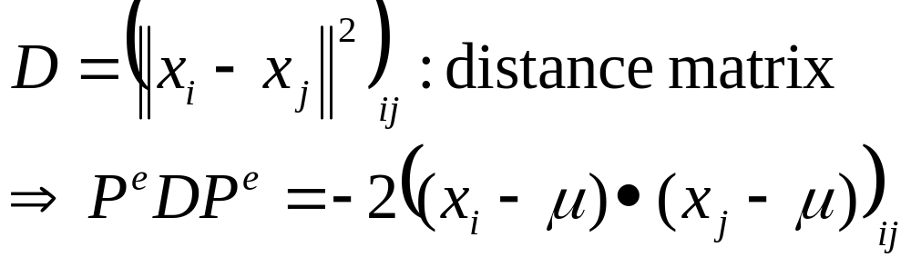
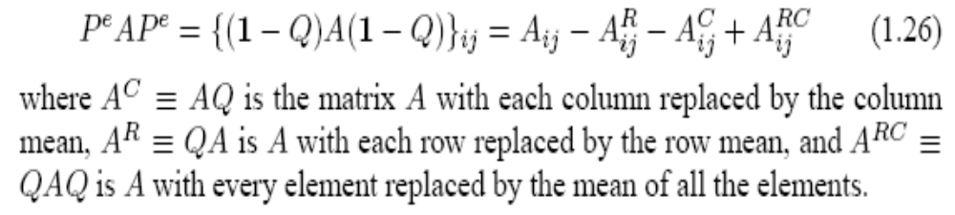
Linear Approach- classical MDS

Slide 18
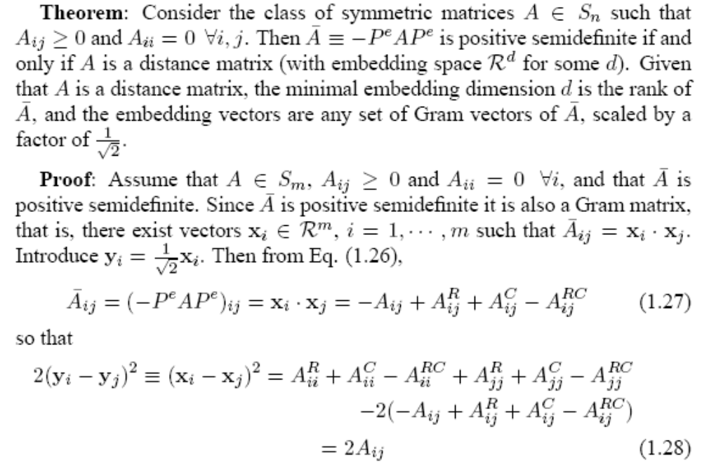
Linear Approach- classical MDS

Slide 19
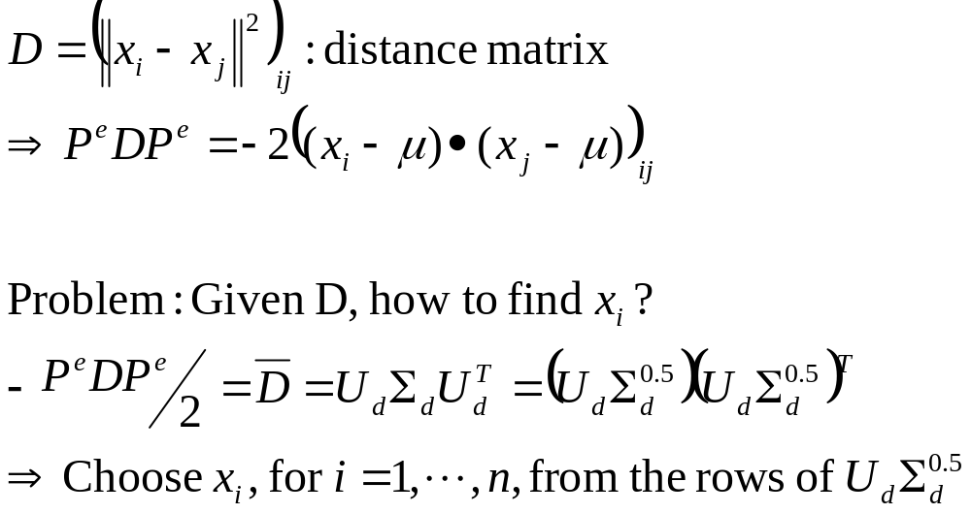
Linear Approach- classical MDS

Slide 20
Linear Approach- classical MDS
If Euclidean distance is used in constructing D, MDS is equivalent to PCA.
The dimension in the embedded space is d, if the rank equals to d.
If only the first p eigenvalues are important (in terms of magnitude), we can truncate the eigen-decomposition and keep the first p eigenvalues only.
  Approximation error

Slide 21
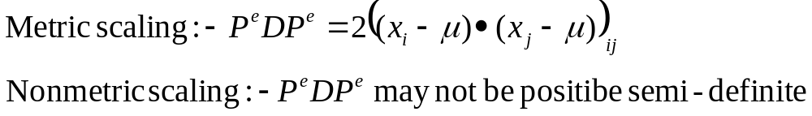
Linear Approach- classical MDS
So far, we focus on classical MDS, assuming D is the squared distance matrix.
  Metric scaling
How to deal with more general dissimilarity measures
  Non-metric scaling
Solutions: (1) Add a large constant to its diagonal.
(2) Find its nearest positive semi-definite matrix
by setting all negative eigenvalues to zero.

Slide 22
Nonlinear Dimensionality Reduction
Many data sets contain essential nonlinear structures that invisible to MDS
  MDS preserves all interpoint distances and may fail to capture inherent local geometric structure
Resorts to some nonlinear dimensionality reduction approaches.
  Kernel methods
    Depend on the kernels
    Most kernels are not data dependent
  Manifold learning
    Data dependent kernels

Slide 23
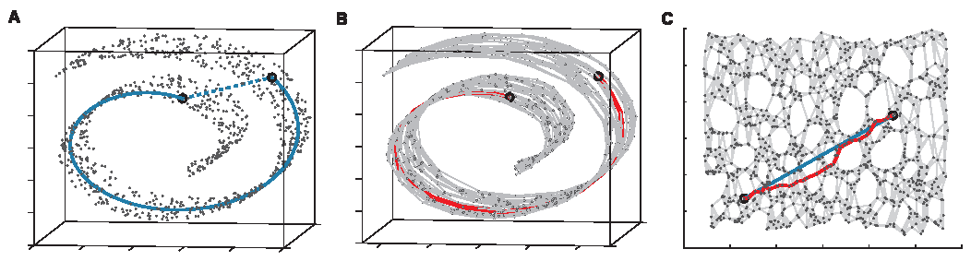
Nonlinear Approaches- Isomap
Josh. Tenenbaum, Vin de Silva, John langford 2000
Constructing neighbourhood graph G
For each pair of points in G, Computing shortest path distances ---- geodesic distances.
Use Classical MDS with geodesic distances.
Euclidean distance→ Geodesic distance

Slide 24
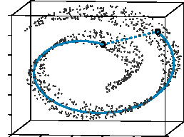
Sample points with Swiss Roll
Altogether there are 20,000 points in the “Swiss roll” data set. We sample 1000 out of 20,000.

Slide 25
Construct neighborhood graph G
  K- nearest neighborhood (K=7)
  D_{G} is 1000 by 1000 (Euclidean) distance matrix of two neighbors (figure A)

Slide 26
Compute all-points shortest path in G
  Now D_{G} is 1000 by 1000 geodesic distance matrix of two arbitrary points along the manifold (figure B)

Slide 27
Use MDS to embed graph in R^{d}
  Find a d-dimensional Euclidean space Y (Figure c) to preserve the pariwise diatances.

Slide 28
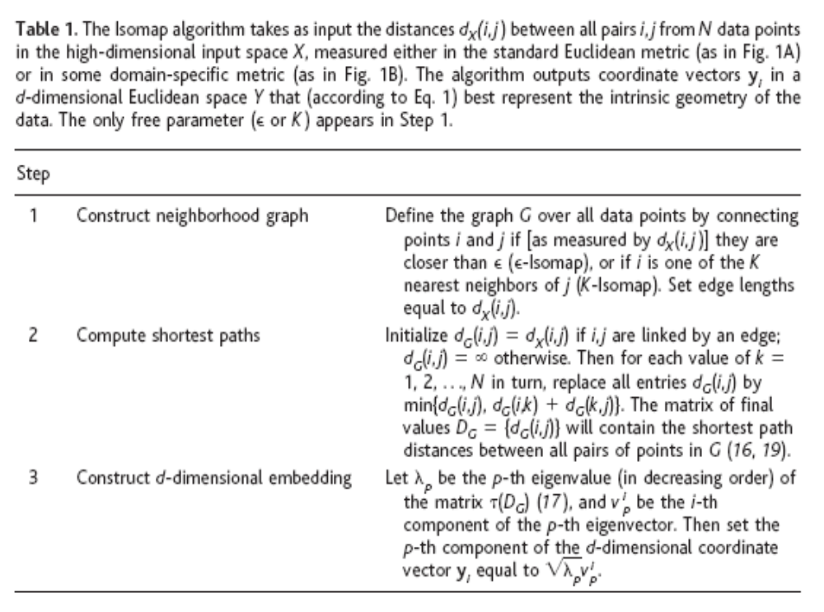
The Isomap algorithm

