Slide 1
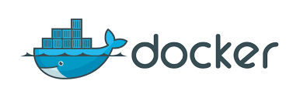
DOCKER
BY:MAYANK SHARMA

Slide 2
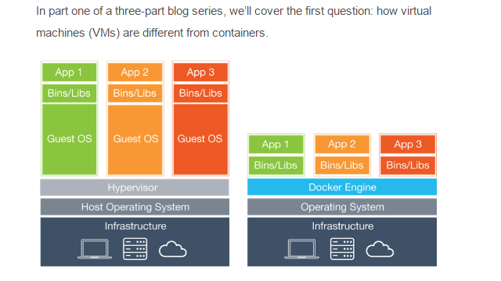

Slide 3
Install on centos 7
# yum update -y
# sudo yum-config-manager --add-repo https://download.docker.com/linux/centos/docker-ce.repo
# sudo yum-config-manager --enable docker-ce-edge
# yum install docker-ce
# service docker statsi
# service docker status
# service docker restart
# chkconfigdocker on
# chkconfig docker on
# service docker status
INSTALL DOCKER-COMPOSE ON CENTOS 7
# docker-compose
# curl -L "https://github.com/docker/compose/releases/download/1.11.2/docker-compose-$(uname -s)-$(uname -m)" -o /usr/local/bin/docker-compose
# chmod +x /usr/local/bin/docker-compose
# docker-compose --version

Slide 4
Basics commands
Docker images => to see all images
Docker pull image_name => to get images from online repos
Docker search => to search docker image from online repos
Docker stop => to stop running container
Docker start => to start stoped container
Docker attach => to attach and get shell of running container.
Docker rm => remove containers
Docker rmi => remove images
Docker rename => rename a container
Docker build => build custome docker images using Dockerfile
Docker commit => Create a new image from a container's changes
Docker cp =>Copy files/folders from a container's filesystem to the host path
Docker diff => to see difference from base image to container or see changes made in container.
Docker exec => execute command inside container
Docker inspect => to Return low-level information on a container or image

Slide 5
Docker port => Lookup the public-facing port that is NAT-ed to PRIVATE_PORT
ex:docker port <CONTAINER_ID>
Docker save => Save an image to a tar archive
ex:docker save –o /tmp/mydata <IMAGE_ID>
Docker stats => display cpu,mem,net usageg
ex: docker stats <container_id>

Slide 6
INSTALL APACHE ON UBUNTU CONTAINER

Slide 7
#docker images -> to see all downloaded images on system
#docker search ubuntu -> to search all docker ubuntu images
#docker pull ubuntu -> downloading image of ubuntu on local machine
#docker run -it –name “ubuntu_test” ubuntu /bin/bash
[container]#apt-get update -> to update container repos
[container]#apt-get install apache2
[container]#exit
#docker ps -a -> to see al container_id
#docker commit -m “installed apache” container_ID IMAGENAME:TAGS
#dockers images -> Now we can see comited image

Slide 8
NOW RUN THE COMMITED IMAGES
#docker run -it -p 80:80 --name “ubuntu_test” IMAGENAME:TAGS /bin/bash
[container]#service apache2 start -> now we hosted apache on container
NOTE:cnt+p,cnt+q to exit from container without stoping them
NOTE: exit to stop container and exit
If we stop it we need to start it
#docker start container_id and the attach with it to get shell
Or
If we container is running then we need to attach from it
#docker attach container_Id

Slide 9
INSTALL APACHE ON CENTOS7 CONTAINER

Slide 10
#docker images -> to see all downloaded images on system
#docker search centos -> to search all docker ubuntu images
#docker pull centos -> downloading image of ubuntu on local machine
#docker run -it –name “centos_test” centos /bin/bash
[container]#yum install httpd -> to update container repos
[container]#exit
#docker ps -a -> to see all container_id
#docker commit -m “installed apache” container_ID IMAGENAME:TAGS
#dockers images -> Now we can see comited image

Slide 11
NOW RUN THE COMMITED IMAGES
#docker run -it -p 80:80 --name “centos_test” IMAGENAME:TAGS /bin/bash
[container]#/usr/sbin/apachectl -DFOREGROUND & -> now we hosted apache on container
NOTE:cnt+p,cnt+q to exit from container without stoping them
NOTE: exit to stop container and exit
If we stop it we need to start it
#docker start container_id and the attach with it to get shell
Or
If we container is running then we need to attach from it
#docker attach container_Id

Slide 12
DIFF BETWEEN EXPOSE and P
Basically, you have three options:
Neither specify EXPOSE nor -p.
Only specify EXPOSE.
Specify EXPOSE and -p.
If you do not specify any of those, the service in the container will not be accessible from anywhere except from inside the container itself.
If you EXPOSE a port, the service in the container is not accessible from outside Docker, but from inside other Docker containers. So this is good for inter-container communication.
If you EXPOSE and -p a port, the service in the container is accessible from anywhere, even outside Docker.

Slide 13
Dockerfile

Slide 14
FROM centos
# File Author / Maintainer
MAINTAINER mayank sharma
#adding mongodb repo from base to container
ADD mongo-db.repo /etc/yum.repos.d/mongo-db.repo
#updating repos
RUN yum update all
#installing require packages
RUN yum install httpd mongodb-org python -y
# Create the default web file to be hosted
RUN echo "default website" > /var/www/html/index.html

Slide 15
FROM centos
# File Author / Maintainer
MAINTAINER mayank sharma
#adding mongodb repo from base to container
ADD mongo-db.repo /etc/yum.repos.d/mongo-db.repo
#updating repos
RUN yum update all
#installing require packages
RUN yum install httpd mongodb-org python -y
# Create the default web file to be hosted
RUN echo "default website" > /var/www/html/index.html

Slide 16
DOCKER RENAME
# docker rename <old name> <new name>

Slide 17
Docker file
CMD => when you run container then CMD command will run automaticlly
ENTRYPOINT
Create Dockerfile
Vim Dockerfile
FROM ubuntu
MAINTAINER MAYANK SHARMA
RUN apt-get update
RUN apt-get install -y wget
CMD df –h

Slide 18
Docker file
CMD => when you run container then CMD command will run automaticlly
ENTRYPOINT
#Vim Dockerfile
FROM ubuntu
MAINTAINER MAYANK SHARMA
RUN apt-get update
RUN apt-get install -y wget
CMD df –h
#docker build –t mycmdtest .
#docker run <image_id>
<output of df –h>

Slide 19
Docker file
CMD => when you run container then CMD command will run automaticlly
ENTRYPOINT => when container start where its located and where your command execute
#Vim Dockerfile
FROM ubuntu
MAINTAINER MAYANK SHARMA
RUN apt-get update
RUN apt-get install -y wget
ENTRYPOINT [ "ls" , "-l" ]
#docker build –t myentrypointtest .
#docker run <image_id> /root
<output of ls –l /root>

Slide 20
Docker file
CMD => when you run container then CMD command will run automaticlly
ENTRYPOINT => when container start where its located and where your command execute
#Vim Dockerfile
FROM ubuntu
MAINTAINER MAYANK SHARMA
RUN apt-get update
RUN apt-get install -y wget
ENTRYPOINT [ "ls" , "-l" ]
CMD /root
#docker build –t myentrypointcmdtest .
#docker run <image_id> /root
<output of ls –l /root>
NOTE:IF you pass any arg during container create it’ll overright /root (CMD)and pass .
IF you not pass any arg it’ll go to ls –l(ENTRYPOINT) and /root(CMD).

Slide 21
Docker networking
#docker run -d --publish-all jpetazzo/web
#docker inspect --format '{{.NetworkSettings.IPAddress}}' Container ID
So you’ll se ip a of container

Slide 22
Volumes
mkdir /data
cd /data
echo mayank > index.html
docker run -d -p 8080:80 -v /data:/var/www/html --name mywebsite_C1centos/httpd
docker run -d -p 8081:80 -v /data:/var/www/html --name mywebsite_sC2 centos/httpd
docker run -d -p 80:80 -v /data:/var/www/html --name mywebsite_C3 centos/httpd
GOTO browser and type localhost:8080, localhost:8081, localhost:80.
Now we have shared volume environment three container with same folder shared with them

Slide 23
docker run -d -p 9090:80 --name shared-volume1 --volumes-from mywebsite_sec2 centos/httpd

Slide 24
Docker inspect container_name
DOCKER-COMPOSE
yum install epel-release
yum install -y python-pip
pip install docker-compose
yum upgrade python*

