Slide 1
JENKINS INDEX 1).What is Devops. 2). What is CI/CD. 3).Installation Type BASE OS,CONTAINER 4). USE CASE (INCLUDE’s GIThub,shell script,,deploy on a system) 5). How To Setup Docker Containers As Build Slaves For Jenkins

Slide 2
Kohsuke Kawaguchi, who started the project as a hobby project under the name of Hudson in late 2004 whilst working at Sun. In 2009, Oracle purchased Sun. Towards the end of 2010. In January 2011, the Hudson developer community decisively voted to rename the project to Jenkins.

Slide 3
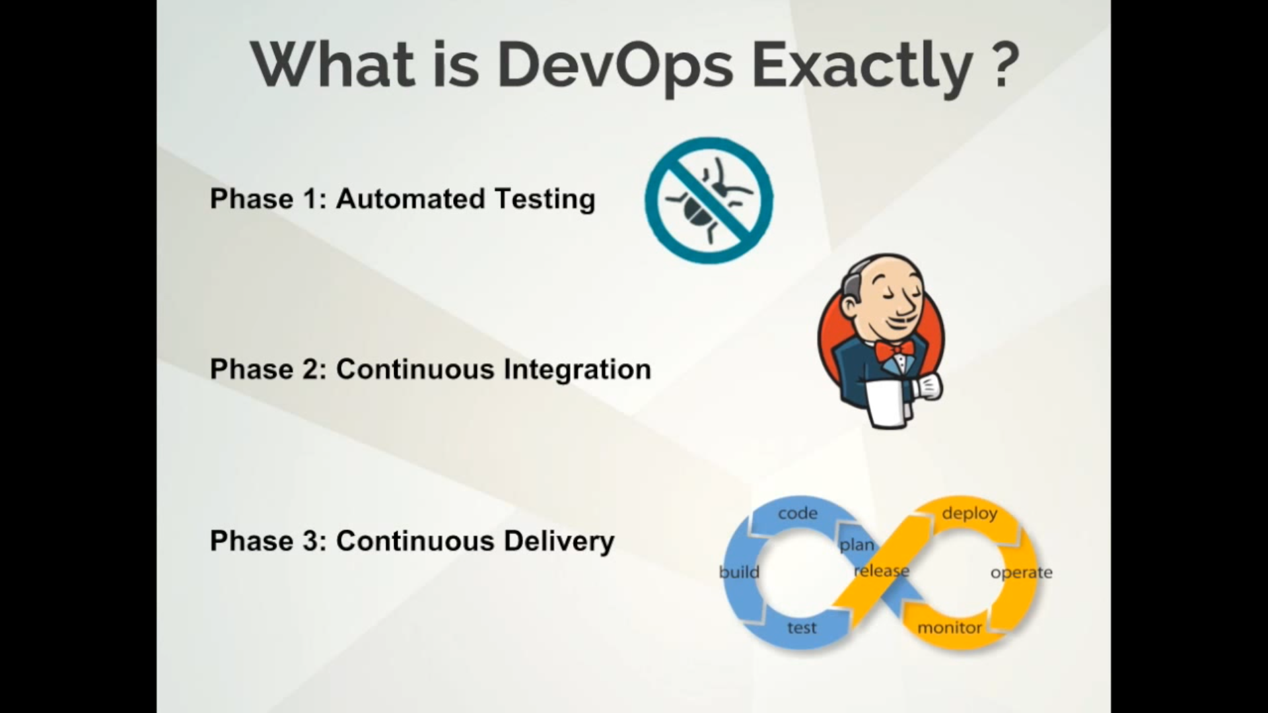

Slide 4
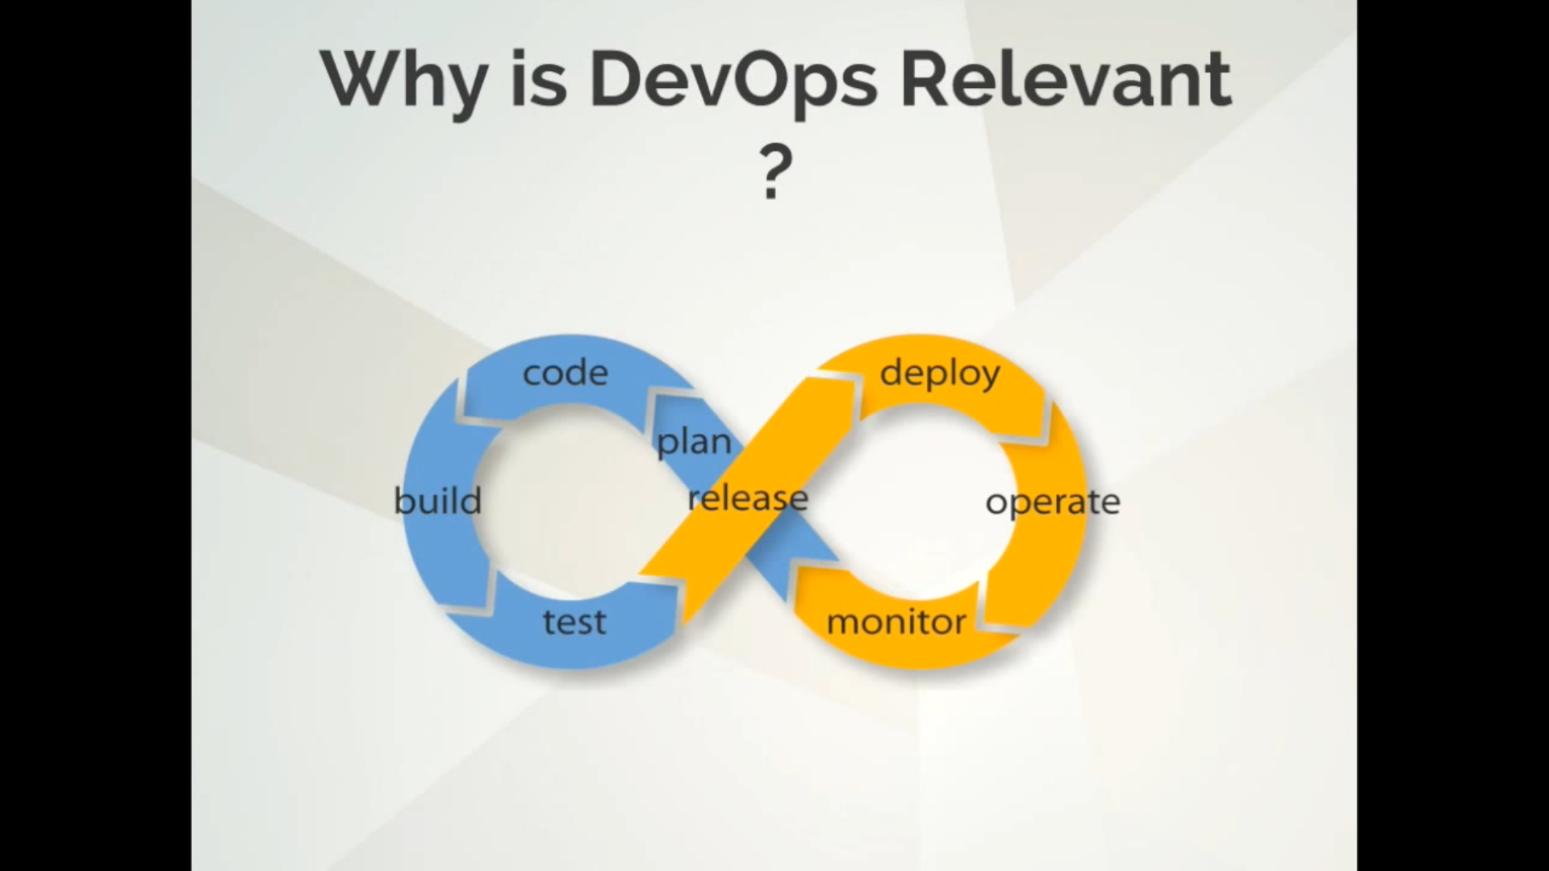

Slide 5
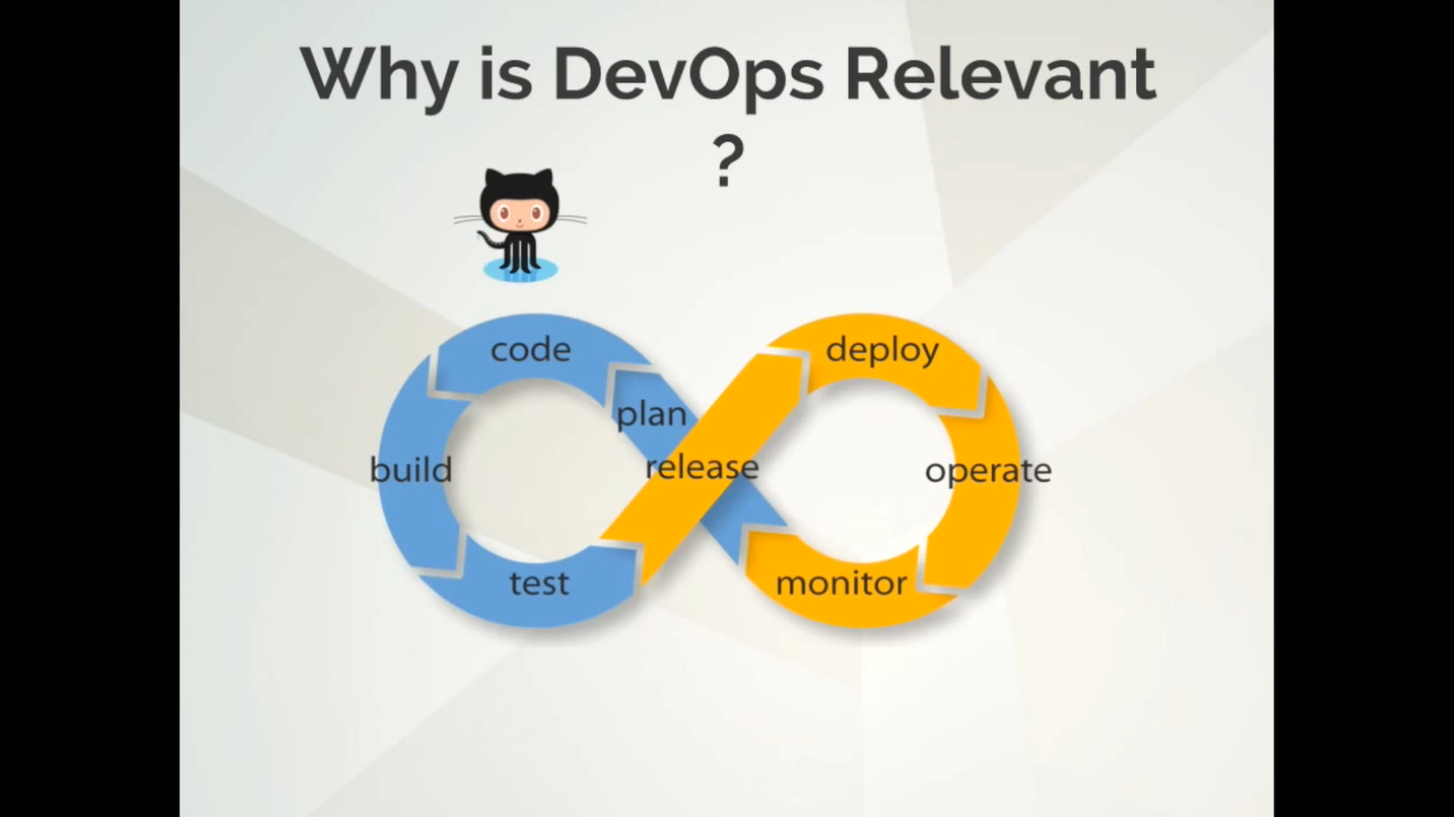

Slide 6
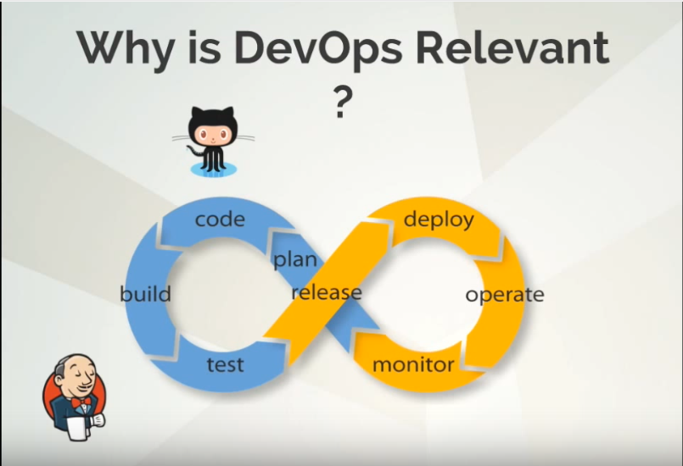

Slide 7
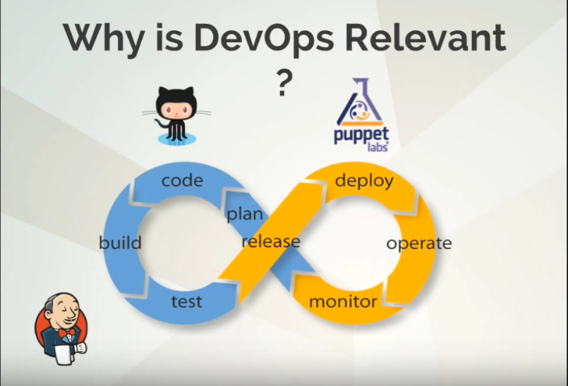

Slide 8
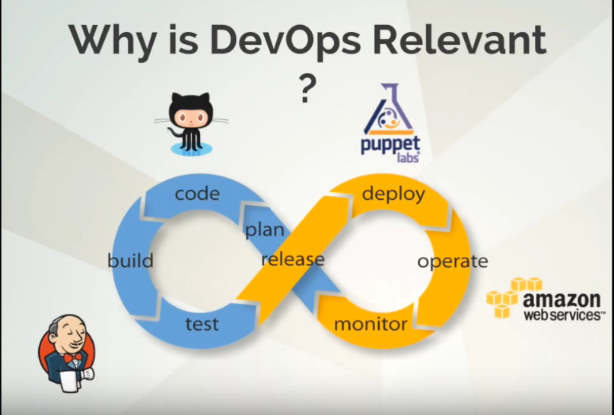

Slide 9
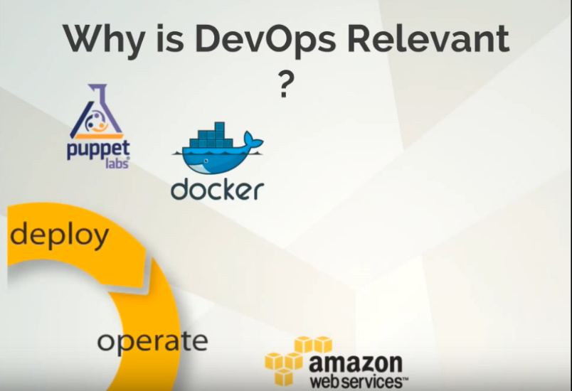

Slide 10
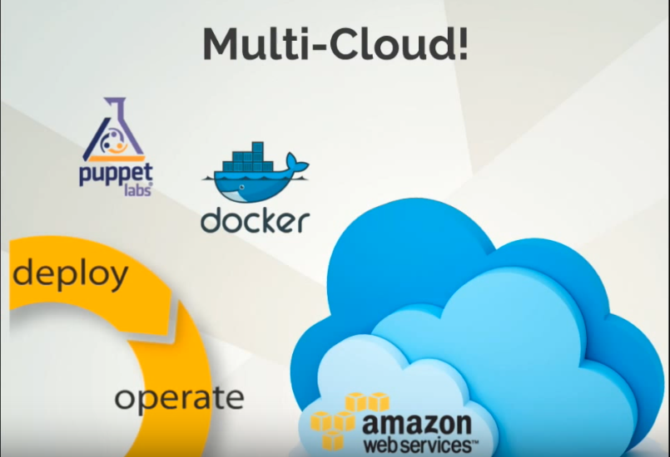

Slide 11
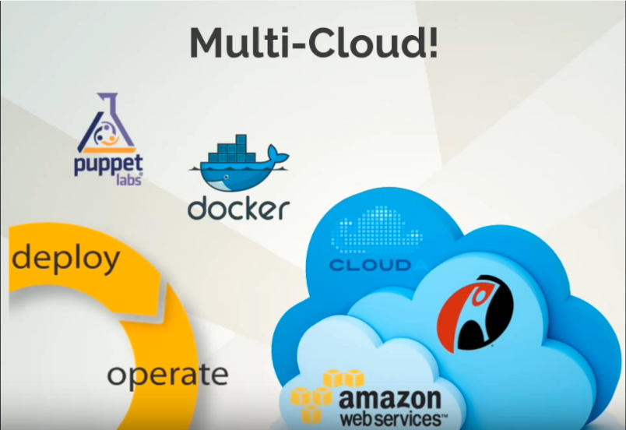

Slide 12
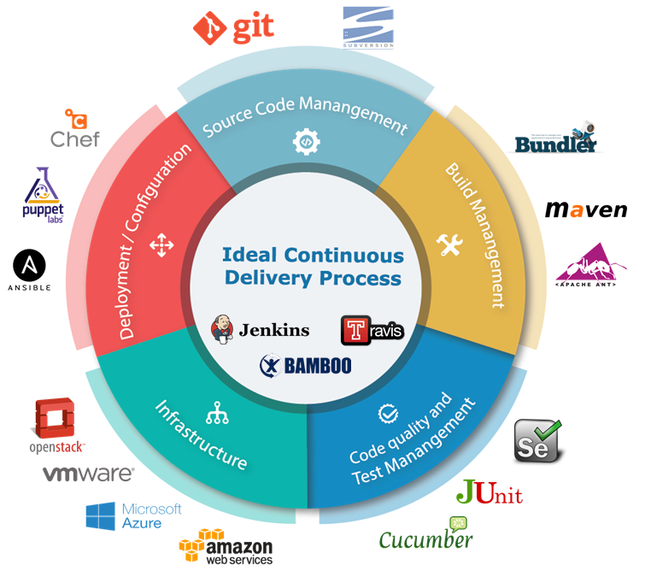
WHAT IS CI/CD

Slide 13
INSTALL JENKINS
Install on system itself
https://wiki.jenkins-ci.org/display/JENKINS/Installing+Jenkins+on+Red+Hat+distributions
Running Jenkins inside containers of docker
http://www.javaworld.com/article/3123117/development-tools/open-source-java-projects-jenkins-with-docker-part-1.html
------------------------------------------------------------------------------------------
After installation goto http://localhost:8080 then after it will ask you for admin token you can find it out in 2 difff location
/var/lib/jenkins/secrets/initialAdminPassword
more /var/log/Jenkins/Jenkins.log
Then it’ll ask you for 2 options
Install suggested plugins
Select plugins to install
NOTE we’ll go with 2 options

Slide 14
Goto configure global setting -> Enable security check it Security Realm: -> jenkin’s own user database |->allow user sign up NOTE: that sign up option must be tick because,I don’t after save button system will go into security mode and wont allow us to login. Now jus create a admin user for you NOTE :BY DEFAULT JENKINS ALLOW EVERY USER AS A ADMIN PRIVILAGE

Slide 15
Use case (INCLUDE’s GIThub,shell script,,deploy on a system ) STEP 1: INSTALL GITHUB PLUGIN Manage Jenkins -> Manage Plugins -> AVAILABLE -> search for “GIT plugin” and install it without restart or MANUAL PROCESS OF GETTING PLUGIN download plugin *.jpi or *.hpi extension and past it into plugins folder of Jenkins HOME_DIR=Manage Jenkins => configuration system. STEP 2: CONFIGURE GIT URL IN JENKINS goto => new item(upper left) => select(FREESTYLE PROJECT) => Source Code Management => select(GIT) => past github url here in Repository URL option STEP 3:SET THE TIMING ON WHAT TIME JENKINS WILL GET YOUR CODE FROM PROVIDED GITHUB URL BUILD TRIGGERS SECTION => POLL SCM(PLACE * * * * *) IN BLANK AREA. BUILD ENVIROMENT => TICK ON (ADD TIMESTAMP TO THE CONSOLE OUTPUT) STEP 4: BUILD => SELECT EXECUTE SHELL(PLACE YOUR COMMAND YOU WANT TO EXECUTE ON JENKINS SERVER OR DEPLOYMENT CODE) IF YOU WANT TO DEPLY YOUR CODE IN DIFF SYSTEM WE HAVE OTHER OPTIONS CODE: cd /tmp wget https://raw.githubusercontent.com/hackersdatabase007/mayank/master/script.sh chmod +x script.sh bash script.sh NOW just commit your git and see auto building of task.

Slide 16
FOLDER DECLERATIONS JENKINS_HOME_DIR/.ssh = user to store ssh keys of user Jenkins In system JENKINS_HOME_DIR/plugins = to store plugins in *.jpi format JENKINS_HOME_DIR/logs = to store logs of jenkins JENKINS_HOME_DIR/users= contain user home dir for jenkin and contain config.xml config.xml store user information email,password .etc

Slide 17
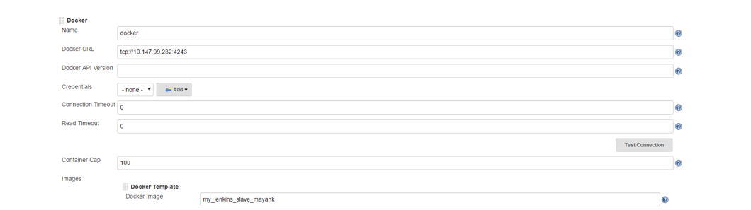
How To Setup Docker Containers As Build Slaves For Jenkins
1. Head over to Jenkins Dashboard –> Manage jenkins –> Manage Plugins.
2. Under available tab, search for “Docker Plugin” and install it.
3. Once installed, head over to jenkins Dashboard –> Manage jenkins –>Configure system.
4. Under “Configure System”, if you scroll down, there will be a section named “cloud” at the last. There you can fill out the docker host parameters for spinning up the slaves.
5. Under docker, you need to fill out the details as shown in the image below.
Note: Replace “Docker URL” with your docker host IP. You can use the “Test connection” to test if jenkins is able to connect to the docker host.
NOW IF you click on test connection and you get an error on it so please goto link below to know how toe expose docker url on specific port
LINK=> http://blog.tmtk.net/post/2014-01-16-expose_docker_remote_api_on_centos/

Slide 18
We came to install Docker on CentOS easily. Here is an instruction for the way to expose Docker remote API port on CentOS.
$ cat /etc/sysconfig/docker other_args=""
Edit the file /etc/sysconfig/docker as below.
other_args="-H tcp://0.0.0.0:4243 -H unix:///var/run/docker.sock"
After that, restart docker and try to access the host from another host.
$ sudo /etc/init.d/docker restart ... $ curl $hostname:4243/images/json ...
I think docker is almost practical for production environment since it cames to run on CentOS.

Slide 19
NOW to initiate a container as a slave for Jenkins we need a docker image so for creating a docker image here is a code FROM ubuntu MAINTAINER MAYANK SHARMA RUN apt-get update RUN apt-get install -y openssh-server RUN mkdir /var/run/sshd RUN echo 'root:root' |chpasswd RUN sed -ri 's/^PermitRootLogin\s+.*/PermitRootLogin yes/' /etc/ssh/sshd_config RUN sed -ri 's/UsePAM yes/#UsePAM yes/g' /etc/ssh/sshd_config RUN apt-get install -y default-jre RUN apt-get install -y default-jdk RUN apt-get install -y git EXPOSE 22 CMD ["/usr/sbin/sshd", "-D"] #docker build –t <name of this image you want to> . Or #docker pull sharmamayank6790/jenkins-slave

Slide 20
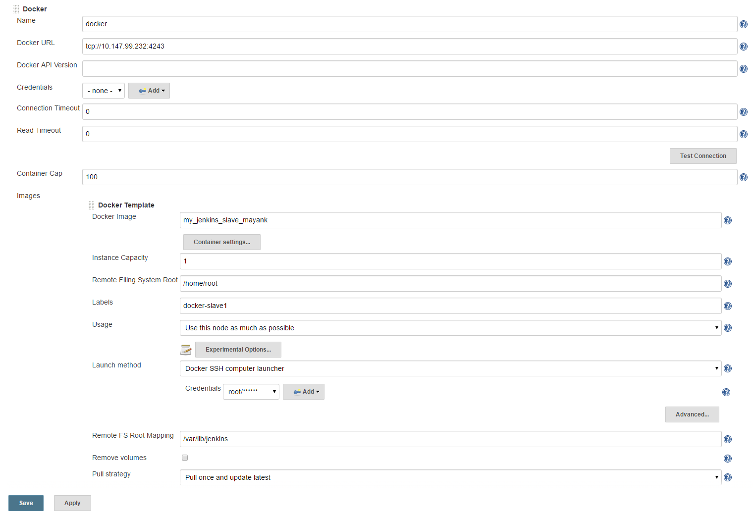
5. Now, from “Add Docker Template” dropdown, click “docker template” and fill in the details based on the explanation and the image given below.
Docker Image – Image that you created for the slave.
Remote Filing System Root – Home folder for the user you have created. In our case it’s jenkins.
Labels – Identification for the docker host. It will be used in the Job configuration.

Slide 21
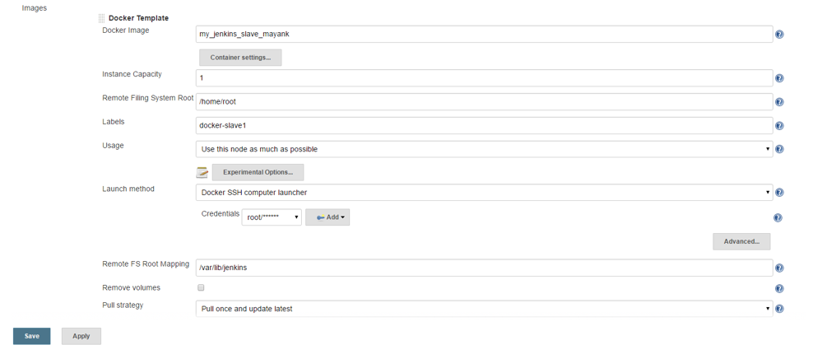
Credentials – click add and enter the username and password that you have created for the docker image. Leave the rest of the configuration as shown in the image below and click save. Find uname and pass in DockerFile.

Slide 22
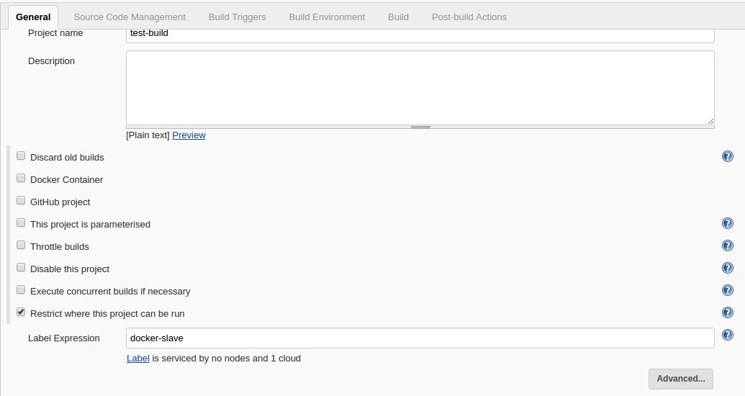
Building Jobs On Docker Slaves
Now that you have the slave configurations ready, you can create a job, select “Restrict where this project can be run” option and select the docker host as slave using the label as shown below.
If you have done all the configurations right, Jenkins will spin up a container, builds the project and destroys the container once the build is done. You can check the build logs in your jobs console output.

Slide 23
Vedio : Link -> https://www.youtube.com/watch?v=Lxd6JMMxuwo website : https://www.katacoda.com/courses/jenkins/build-docker-images

