Slide 1
GIT
Version Control System (VCS) is a software that helps software developers to work together and maintain a complete history of their work.
Listed below are the functions of a VCS:
Allows developers to work simultaneously.
Does not allow overwriting each other’s changes.
Maintains a history of every version.
Following are the types of VCS:
Centralized version control system (CVCS).
Distributed/Decentralized version control system (DVCS).
Note Git falls under distributed version control system.

Slide 2
GIT
Centralized version control system(CVCS):
A central server to store all files and enables team collaboration. But the major drawback of CVCS is its single point of failure,
If the disk of the central server gets corrupted and proper backup has not been taken, then you will lose the entire history of the project. Here, distributed version control system (DVCS) comes into picture.
Distributed Version Control System(DVCS):
DVCS clients not only check out the latest snapshot of the directory but they also fully mirror the repository.
If the server goes down, then the repository from any client can be copied back to the server to restore it.
Git does not rely on the central server and that is why you can perform many operations when you are offline.
You can commit changes, create branches, view logs, and perform other operations when you are offline.

Slide 3
ADVATAGES GIT
Free and open source:Git is released under GPL’s open source license. It is available freely over the internet. You can use Git to manage property projects without paying a single penny. As it is an open source, you can download its source code and also perform changes according to your requirements.
Fast and small
Implicit backup
Security:Git uses a common cryptographic hash function called secure hash function (SHA1), to name and identify objects within its database. Every file and commit is check-summed and retrieved by its checksum at the time of checkout. It implies that, it is impossible to change file, date, and commit message and any other data from the Git database without knowing Git.
No need of powerful hardware
Easier branching

Slide 4
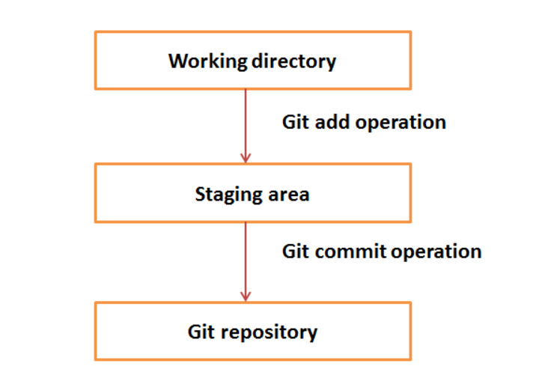
WORKFLOW GIT

Slide 5
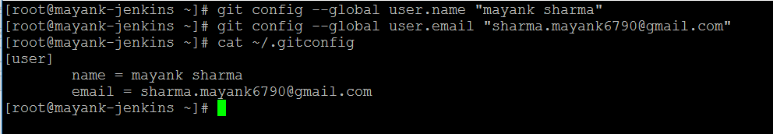
INSTALL GIT IN SYSTEM
Yum install git
Or
Apt-get install git
Customize Git Environment
NOTE:Git stores all global configurations in .gitconfig file, which is located in your home directory. To set these configuration values as global, add the --global option, and if you omit --global option, then your configurations are specific for the current Git repository.
Setting username:this used by git for each commit .

Slide 6
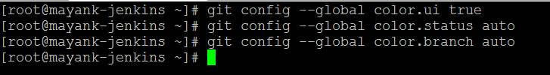
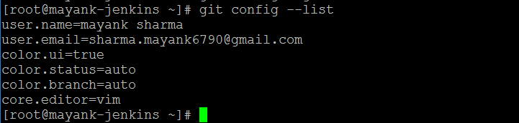
Color highlighting
Setting default editor
Listing git setting

Slide 7
GIT-Life Cycle
General workflow is as follows:
You clone the Git repository as a working copy.
You modify the working copy by adding/editing files.
If necessary, you also update the working copy by taking other developer's changes.
You review the changes before commit.
You commit changes. If everything is fine, then you push the changes to the repository.
After committing, if you realize something is wrong, then you correct the last commit and push the changes to the repository.

Slide 8
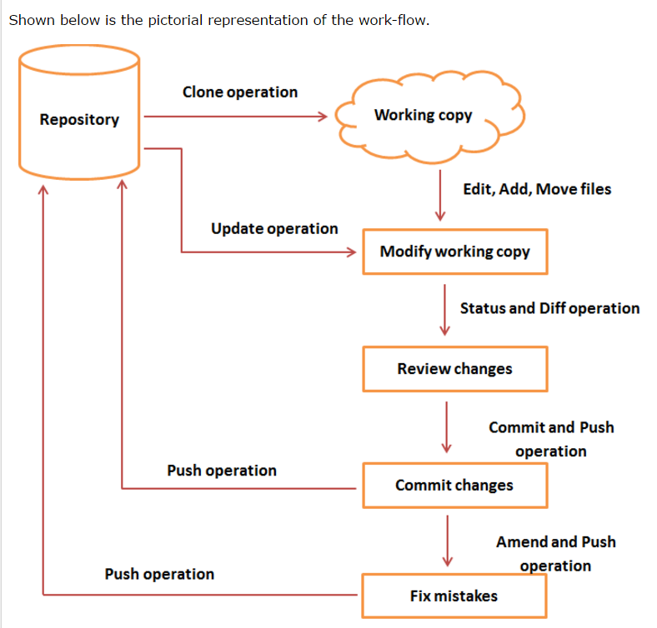
GIT-Life Cycle

Slide 9
GIT-Life Cycle
We have created a bare repository on the server and allowed access for two users. From now on, Tom and Jerry can push their changes to the repository by adding it as a remote.
Admin user=gituser for local repo

Slide 10
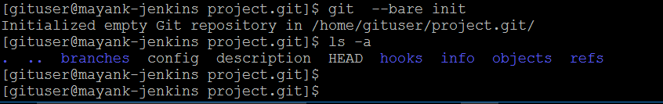
Now create admin user for local git repo’s
# groupadd dev
# useradd –G dev gituser(admi for local repo’s)
Create a bare repository/main repo/local master repo
Now create 2 user’s as a developer’s
# groupadd dev
# useradd –G dev gituser(admi for local repo’s)
# useradd –G dev tom
# useradd –G dev jerry

Slide 11
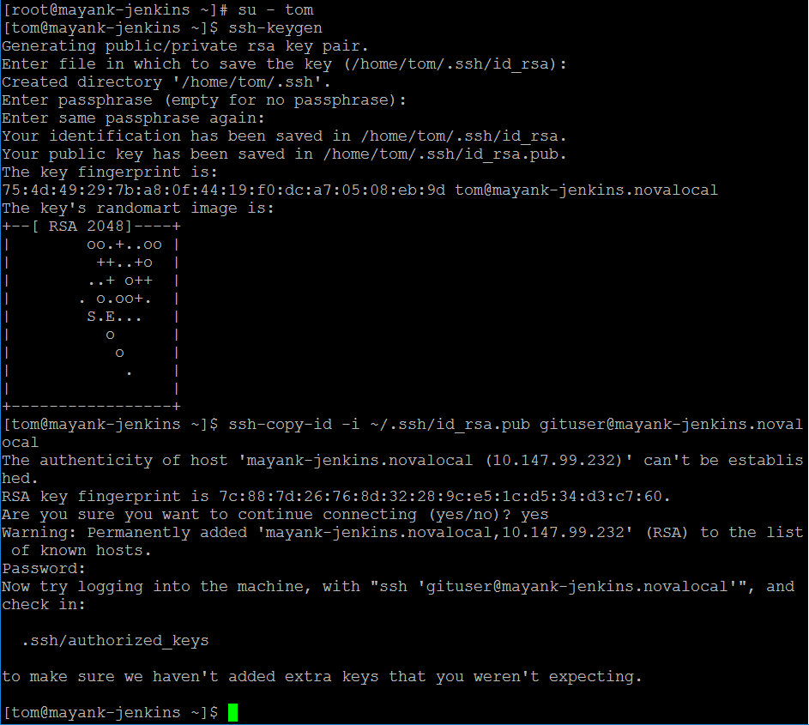
Now login with tom and copy ssh key to gituser bco’z git user is admin of local git

Slide 12
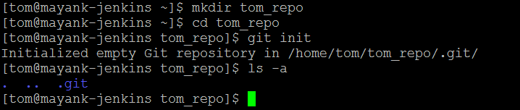
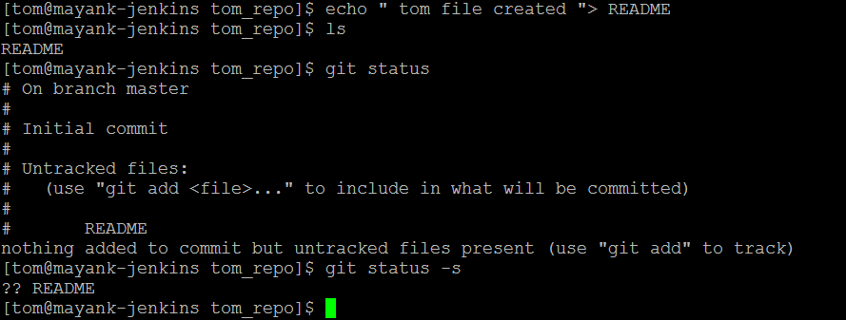
Similer jerry add his public key to gituser account
NOW Push Changes to the Repository
First create tom local repo
Create a file and commit it

Slide 13
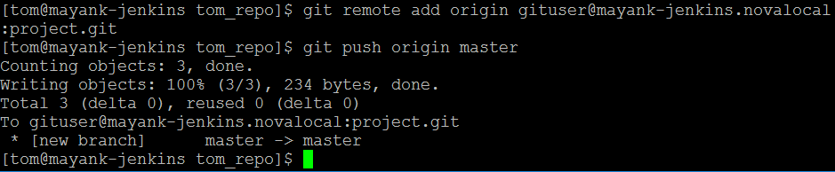
Commit tom’s README file
#git add .
#git commit –m “Initial commit”
Tom committed his changes to the local repository. Now, it’s time to push the changes to the remote repository.
But before that, we have to add the repository as a remote, this is a one-time operation. After this, he can safely push the changes to the remote repository.

Slide 14
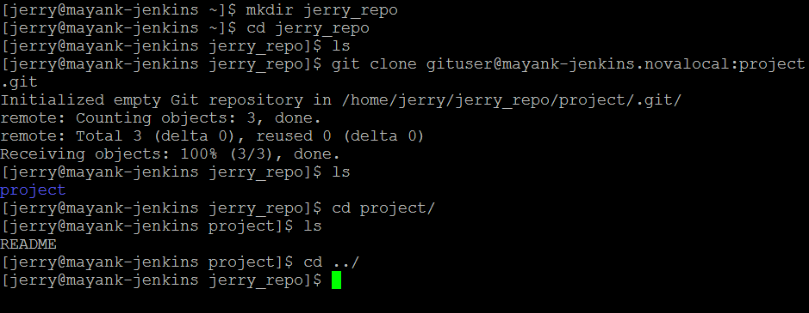
CLONING We have a bare repository on the Git server and Tom also pushed his first version. Now, Jerry can view his changes. The Clone operation creates an instance of the remote repository.
Jerry creates a new directory in his home directory and performs the clone operation.
#git clone gituser@serverip:project.git

Slide 15
Jerry clones the repository and decides to implement basic string operations. So he creates string.c file. After adding the contents, string.c will look like as follows: Now jerry create a file in jerry_repo [jerry]$echo “jerry code”> string.c [jerry]$git status –s ?? string.c [jerry]$git add string.c [jerry]$git status –s A string.c [jerry]$git commit –m “create my code” [jerry]$git status –s [jerry]$git log

Slide 16
What is you want to change your last commit for this we have amend option used with commit [jerry]$echo “new change” > string.c [jerry]$git add string.c [jerry]$git status –s [jerry]$git add string.c [jerry]$git commit –amend –m “new changed made” [jerry]$git log now jerry need to push there changes to master repo so [jerry]$git push origin master to get changes tom will fire clone command [tom]$git clone gituser@mayank-jenkins.novalocal:project.git NOTE:The Clone operation will create a new directory inside the current working directory. He changes the directory to newly created directory and executes the git log command. To sync your repo with remote [tom]$git pull

Slide 17
Stash Suppose you are implementing a new feature for your product. Your code is in progress and suddenly a customer escalation comes. Because of this, you have to keep aside your new feature work for a few hours. You cannot commit your partial code and also cannot throw away your changes. So you need some temporary space, where you can store your partial changes and later on commit it. In Git, the stash operation takes your modified tracked files, stages changes, and saves them on a stack of unfinished changes that you can reapply at any time. For reuse it $git stash pop.
[jerry@CentOS project]$ git status –s
M string.c
?? string
[jerry@CentOS project]$ git stash
Saved working directory and index state WIP on master: e86f062 Added my_strcpy function
HEAD is now at e86f062 Added my_strcpy function

Slide 18
GIT
INSTALL GIT IN SYSTEM
Yum install git
Or
Apt-get install git
NOTE:Git stores all global configurations in .gitconfig file, which is located in your home directory. To set these configuration values as global, add the --global option, and if you omit --global option, then your configurations are specific for the current Git repository.
Now just create a folder
# Mkdir ~/desktop/myapp
# Cd ~/desktop/myapp
# echo “my web” > index.html
#git init . => this’ll create .git folder in your PWD(~/desktop/myapp).
Now add user email to git
# git config --global user.email 'hackersdatabase007@gmail.com'
# git config --global user.name 'hackersdatabase007'

Slide 19
GIT
To add file present in folder tolocal repo
# git add .
# git status => show added file
# gir rm --cached index.html => remove indexing
# git commit -m "changed appjs“
IMPORTANT BRANCH all branches are isolated from each other
# git branch login => create a “login” branch
# git checkout login => log into “login “ branch
Echo “123455”> index.html
# git add .
# git commet –m “sdf”
# git checkout master
# cat index.html => now you cant se any update of this file which we have made in login branch becoz all branches are isolated

Slide 20
GIT
How to ignore any file or directory in git
Create .gitignore file in folder
Place file or dir name line by line in that to be egnored by git add command.
Now post it on github
# git remote add origin https://github.com/hackersdatabase007/mayank.git
# git push -u origin master
# git clone url of github.com to be cloned

Slide 21
GLOBAL CONFIG
Git config --list => to see all global options
credential.helper=manager
user.name=MAYANK SHARMA
user.email=mayank.sharma@amdocs.com
core.editor=notepad
core.repositoryformatversion=0
core.filemode=false
core.bare=false
core.logallrefupdates=true
core.symlinks=false
core.ignorecase=true
Git config –global user.name “XXXX”
Git config –global user.email XXXX@xxx.xxx

Slide 22
git init .
git remote add repo https://github.com/hackersdatabase007/mayank.git =>
git remote show
git remote show
git pull repo
touch mayank
git add .
git commit -m "my new"
git push -u repo master
git commit -m "my new"
git push -u repo master
git push -u repo master
history
git show
git repo show
git remote show
git remote -v
vim script.sh
git diff
git add .
git commit -u "updatesd
git commit -m "updatesd"
git push repo maste
git push repo master

