Slide 1
Credence — Credit Card Management System
Gajula Sathish
07 August 2026
Grad-hire Project | Angular + Spring Boot Microservices

Slide 2
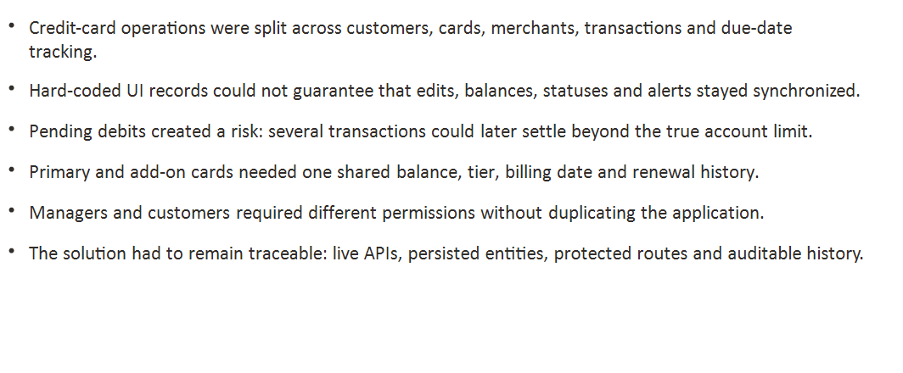

The project turns requirements into measurable controls

Slide 3
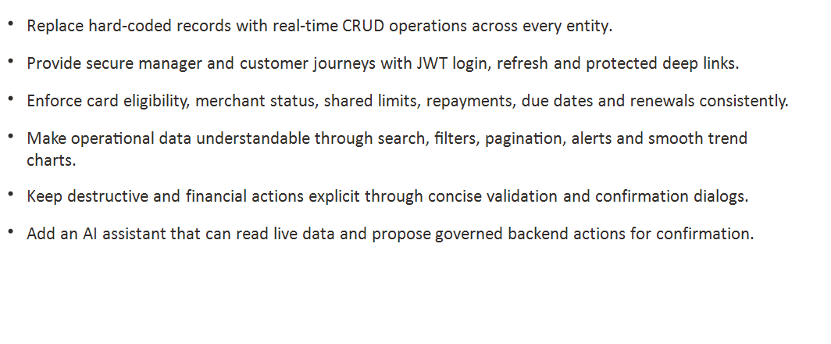
Live APIs keep every role on one source of truth

Slide 4
Each service owns one business capability

Slide 5
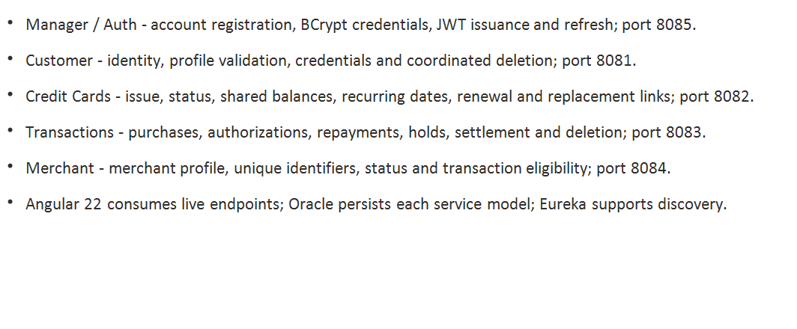
JWT and role boundaries protect every experience

Slide 6
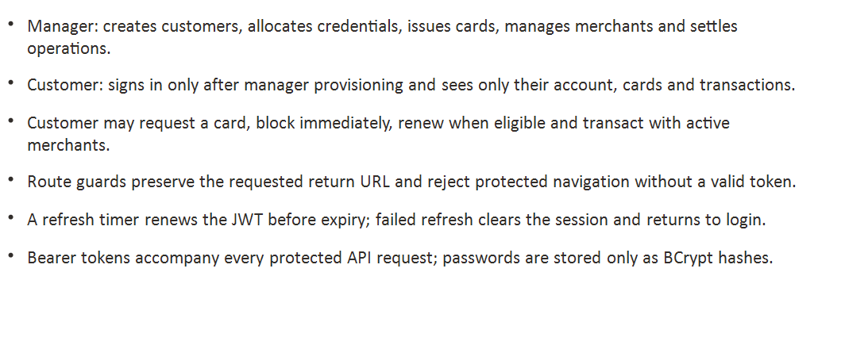
A card account is more than a physical card

Slide 7
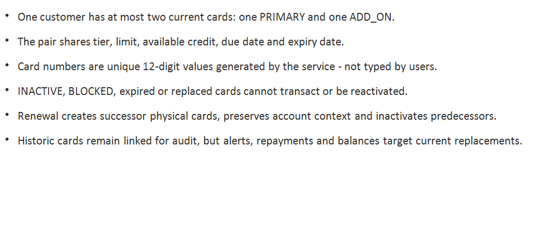
Credit is reserved before settlement—not after

Slide 8
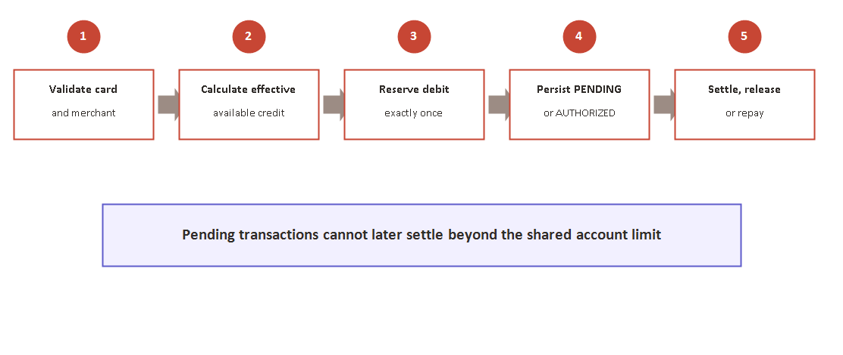
Validation is enforced where the business rule lives

Slide 9
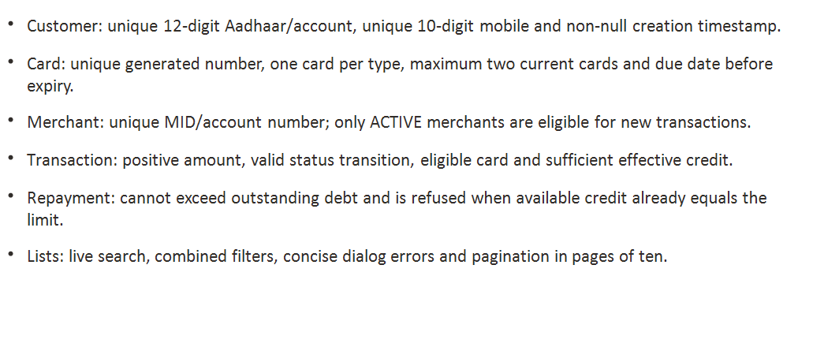
The dashboard turns live activity into action

Slide 10
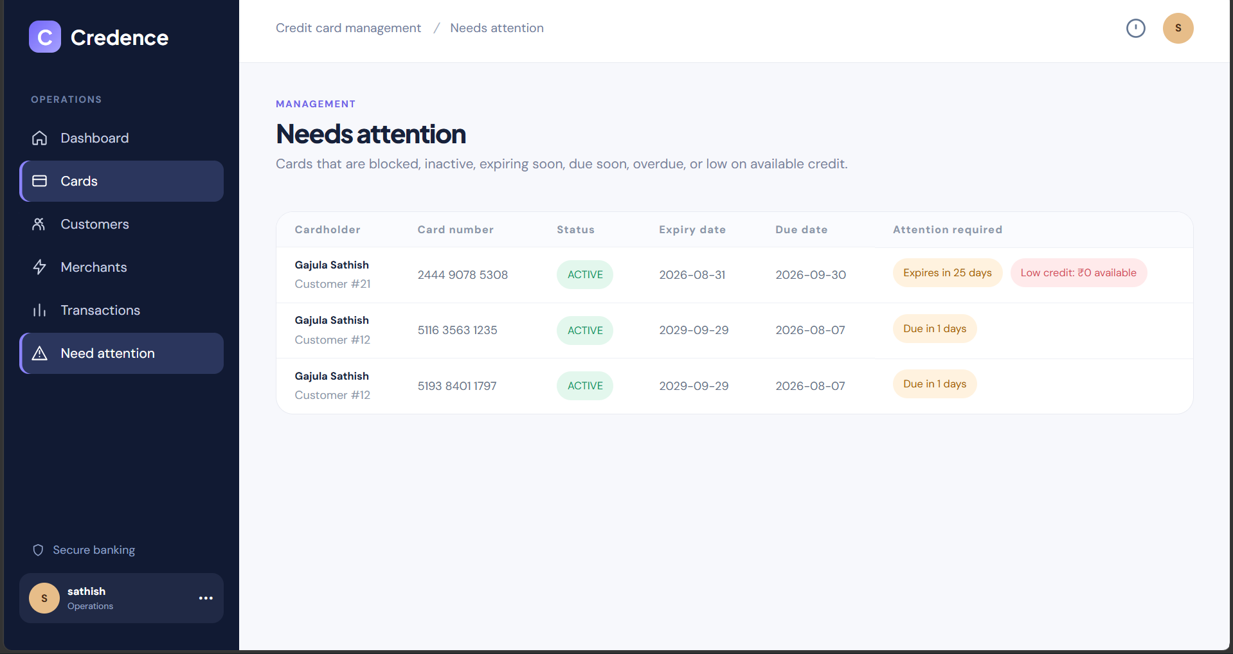
Card operations stay searchable, governed and auditable

Slide 11
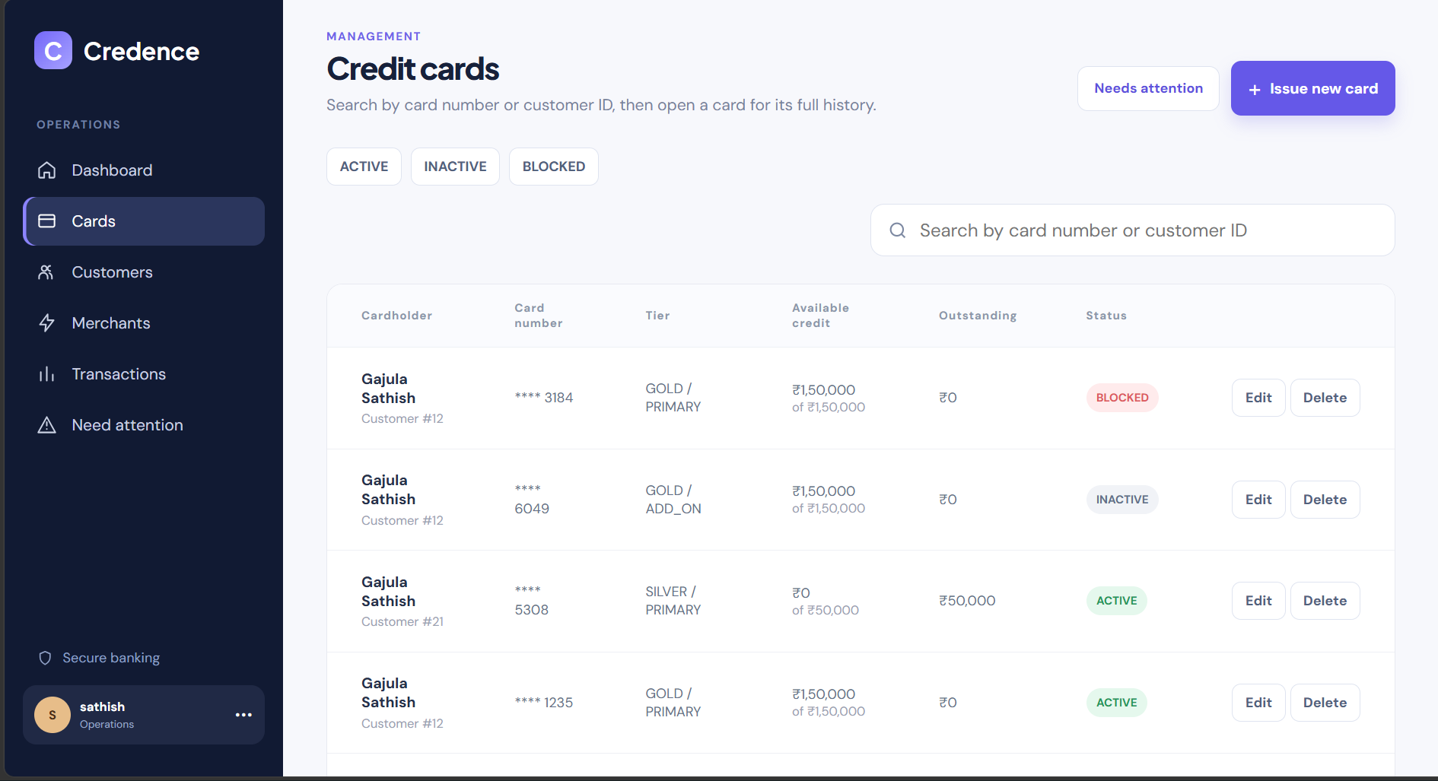
Customer details connect identity, cards and alerts

Slide 12
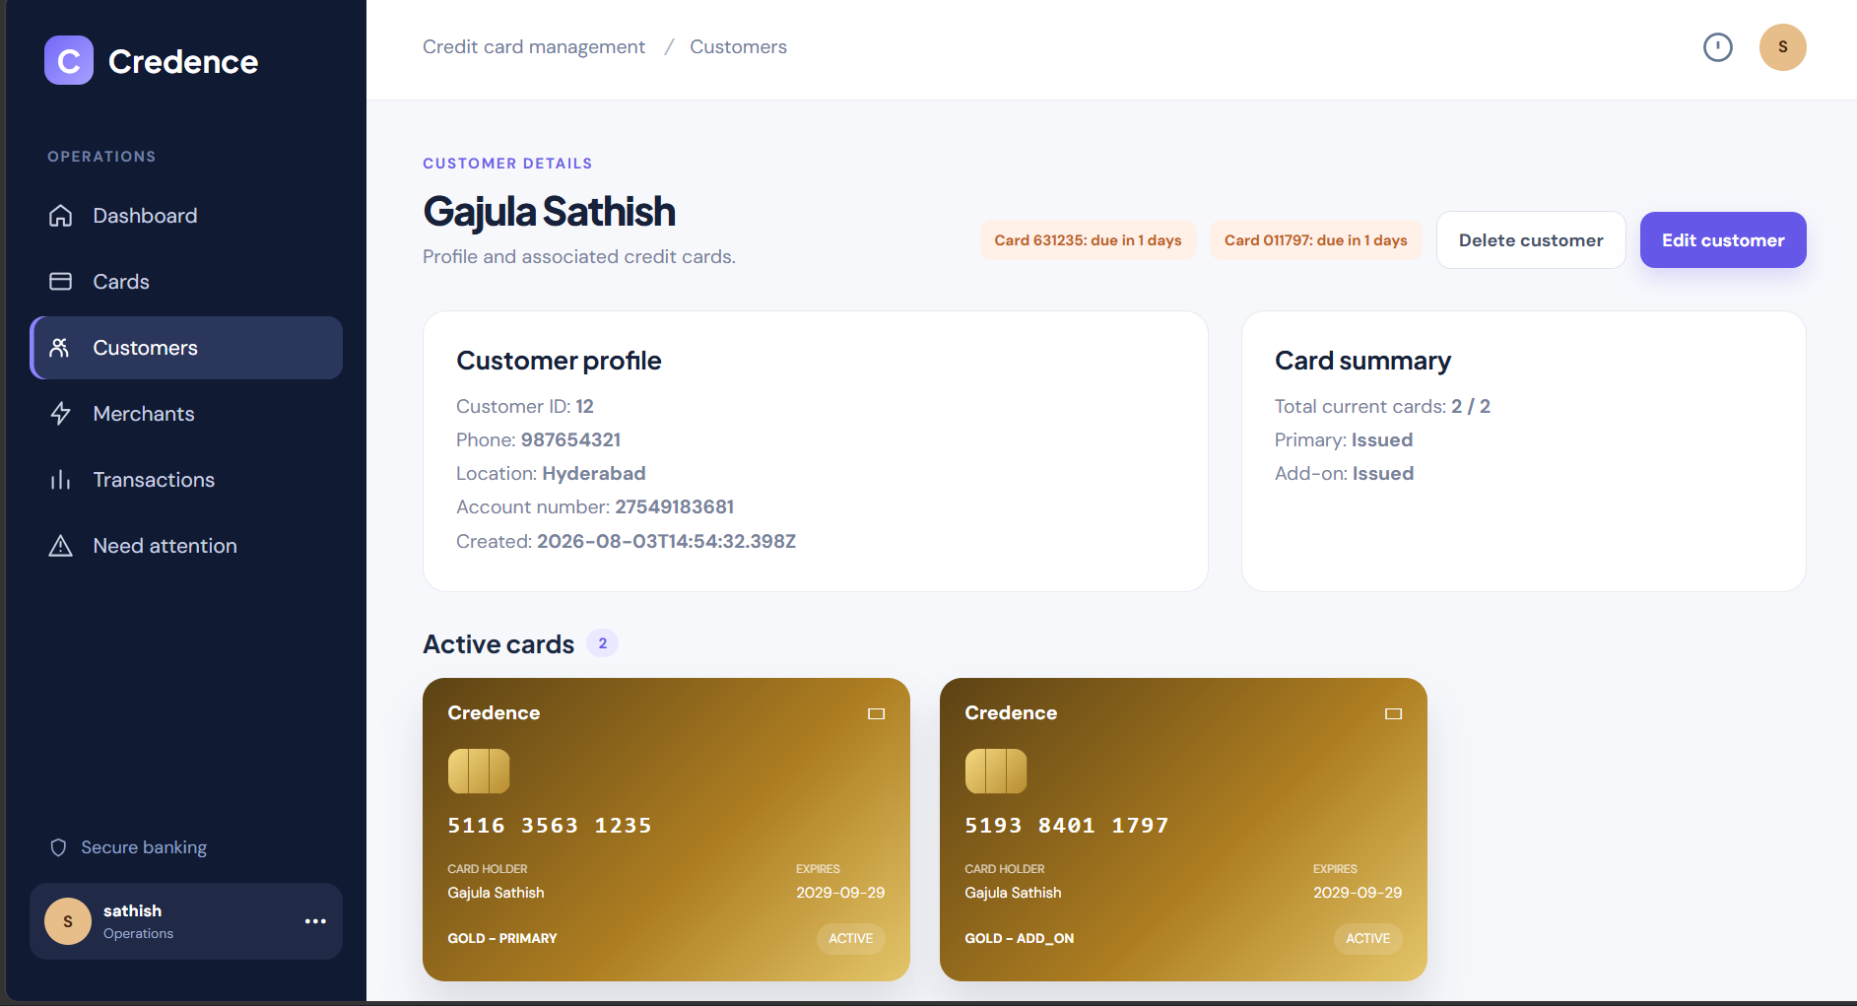
Merchant details expose eligible cards and transaction history

Slide 13
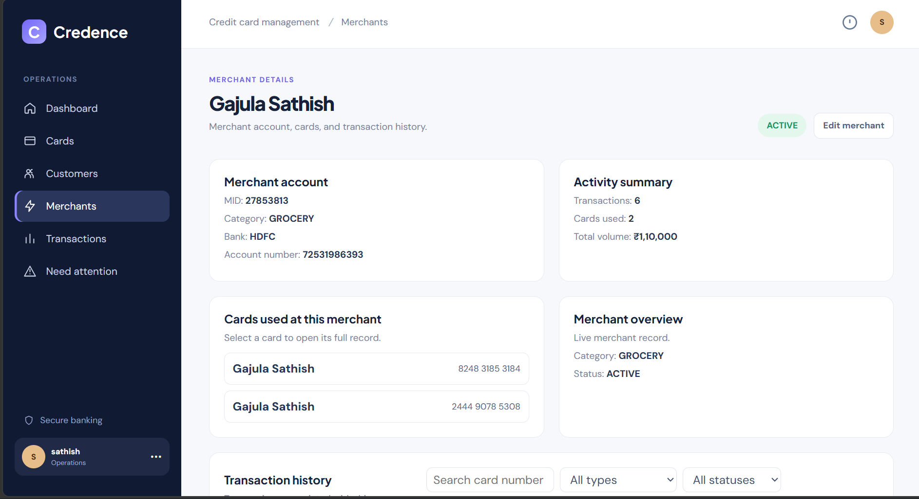
Card details bring status, balance and lifecycle controls together

Slide 14
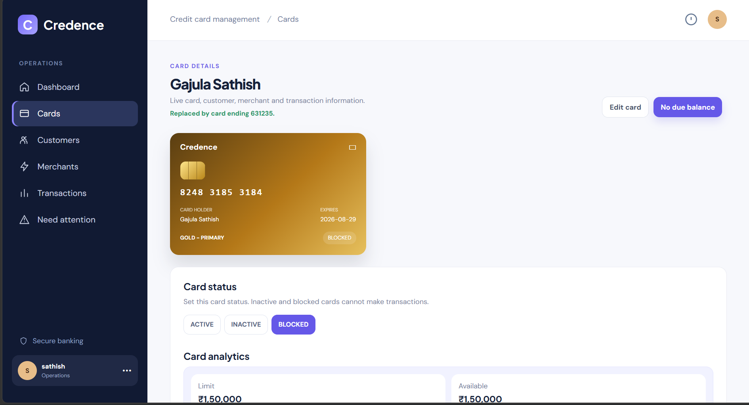
A complete transaction record supports investigation

Slide 15
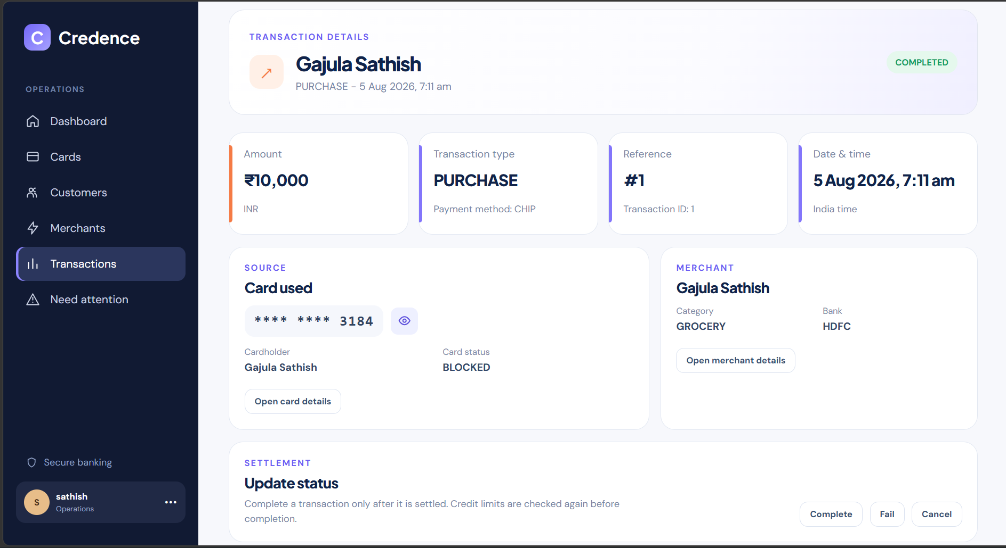
The AI assistant adds governed natural-language operations

Slide 16
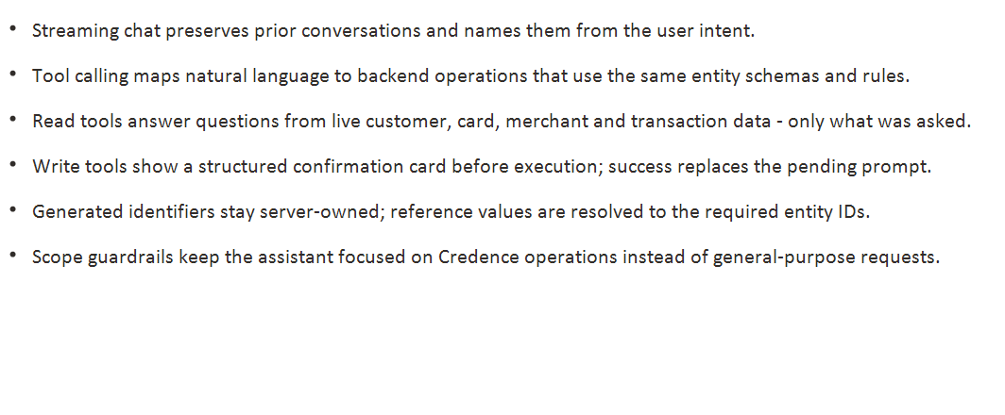
The hardest issues became reusable engineering safeguards

Slide 17
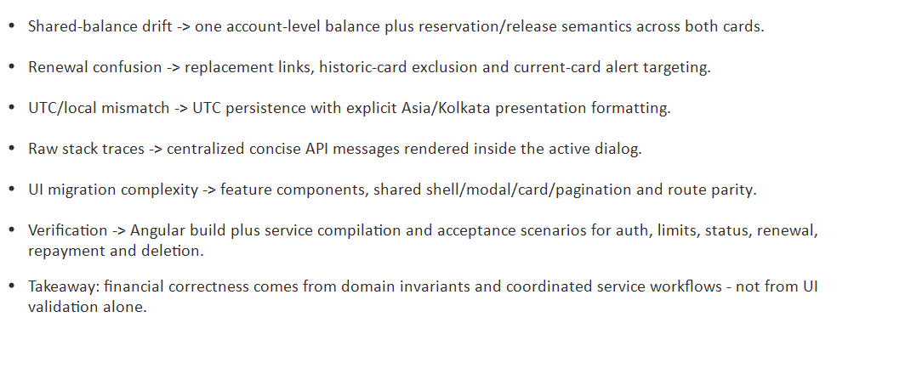

Slide 18

Credence demonstrates how secure domain rules, live microservices and a role-aware Angular experience can manage the complete credit-card lifecycle.
Questions & comments

