Slide 1
Weather Forecasting

Slide 2
Introduction
Play essential role in fields like weather control, agriculture and other business.
Weather forecasting is application of science and technology to predict the condition of atmosphere.
Weather Forecasting using Machine Learning Algorithms

Slide 3
Objectives
Weather forecasting
Comparing different classifiers for best prediction
Prediction Accuracy

Slide 4
Dataset
Kaggle dataset
US weather events (2016-2020)
Collected from 2071 airport-based weather stations
6.3 millions samples
Covers 49 states of US

Slide 5
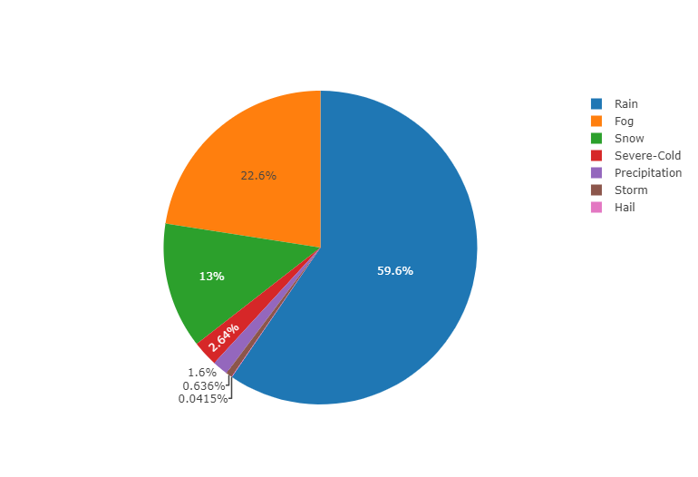
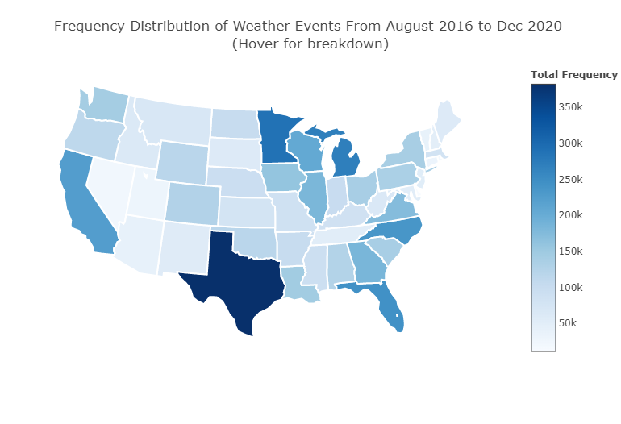
Dataset
Freq. Distribution of weather events
Distribution of weather events

Slide 6
Flowchart
Data Cleansing
Data Preprocessing
Visualization
Model Training/Testing
Results

Slide 7
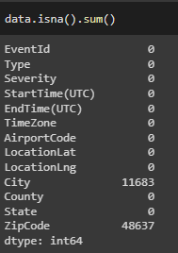
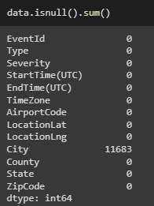

Methodology
Data Cleaning
Filling all missing ‘numeric’ values with their medians

Slide 8
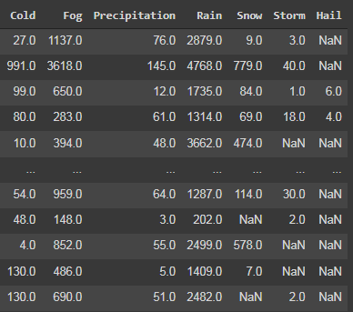
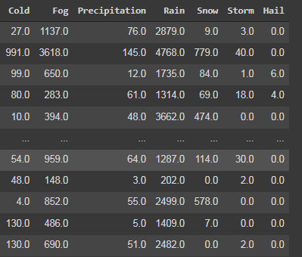

Methodology
Data Cleaning

Slide 9
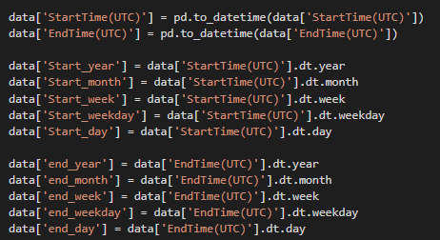
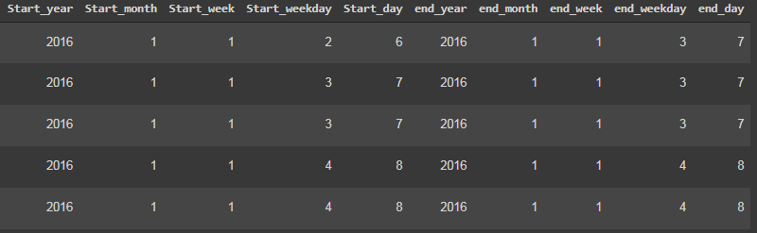
Methodology
Data Preprocessing

Slide 10
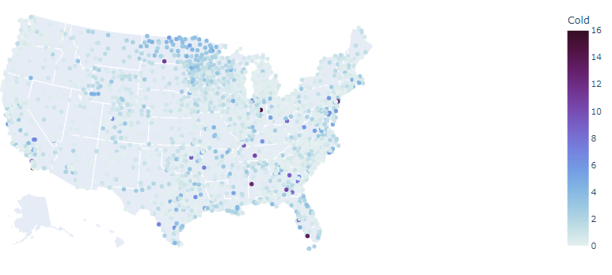
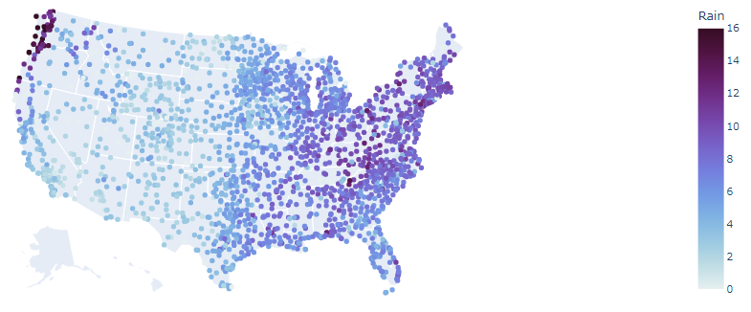
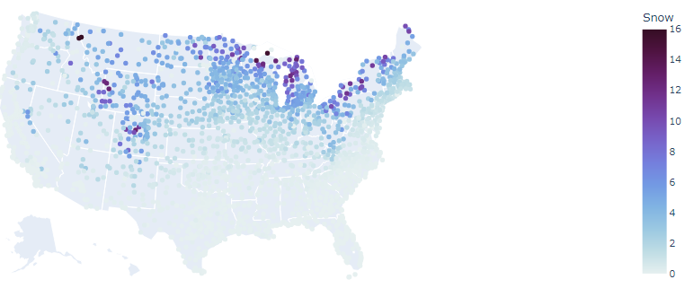
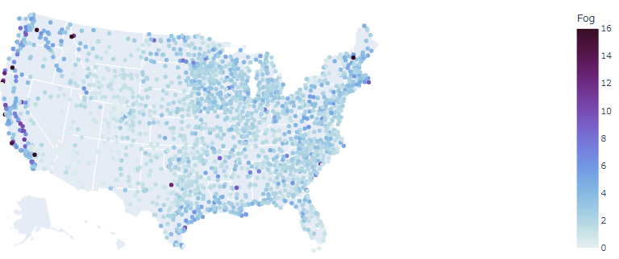
Data Visualization
Snow:
Cold:
Fog:
Rain:

Slide 11
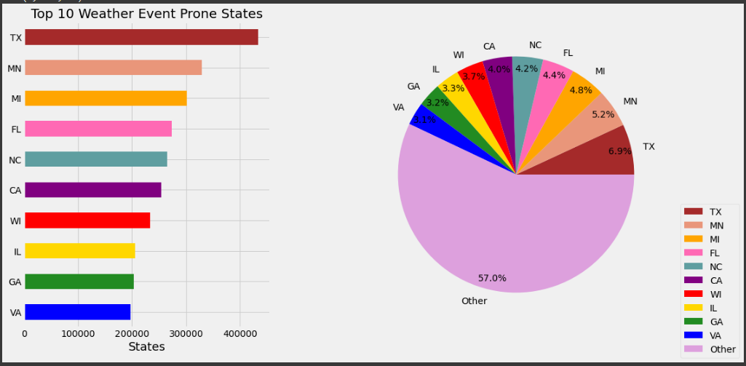
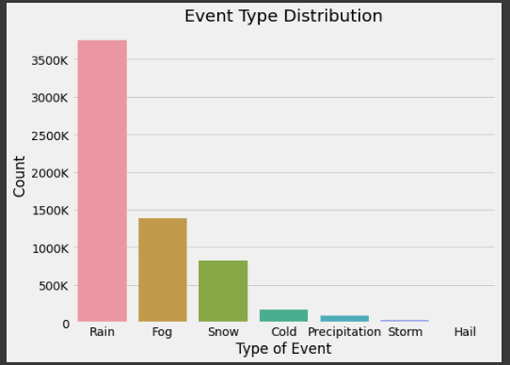

Slide 12
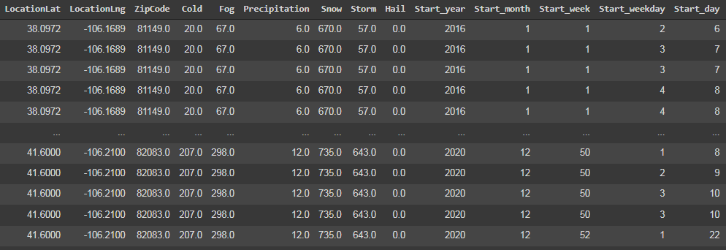
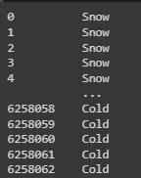
Experimentation
Feature Space ‘X’ =
Class Labels ‘y’=
Notes:
What is ‘X’ and ‘y’ ?

Slide 13
Results
Algorithm | Accuracy
Random Forest Classifier | 90.72
Decision Tree | 89.27
KNN | 78.78
SVM | 54.66
Logistic Regression | 59.84

Slide 14
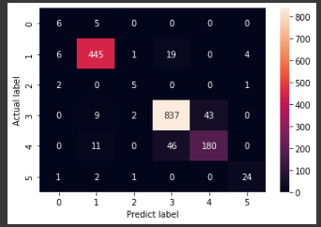
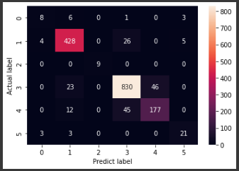
Random Forest:
Decision Tree:
0=Cold
1=Fog
2=Precipitation
3=Rain
4=Snow
5=Storm

Slide 15
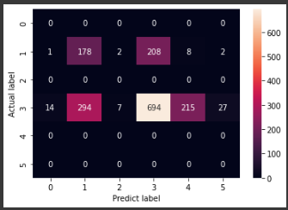
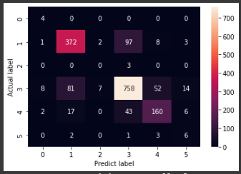
Logistic Regression:
K-NN

Slide 16
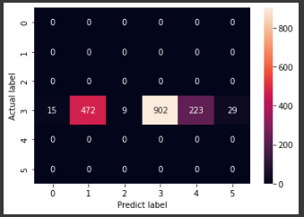
SVM:

Slide 17
Reference
Moosavi, Sobhan, Mohammad Hossein Samavatian, Arnab Nandi, Srinivasan Parthasarathy, and Rajiv Ramnath. “Short and Long-term Pattern Discovery Over Large-Scale Geo-Spatiotemporal Data.” In proceedings of the 25th ACM SIGKDD International Conference on Knowledge Discovery & Data Mining, ACM, 2019.

Slide 18
Thanks

