Slide 1

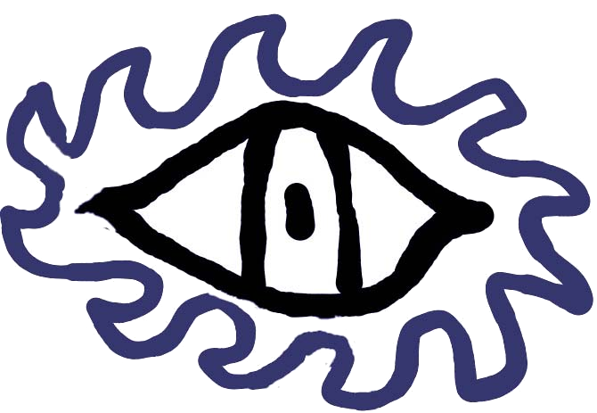
Satellite Image Retrieval and Pre-processing
A.K.A. SatelitoVido
Designed By:
Clayton Kern, Eric Brown, Rhianon Brown, & Tim Burbank

Slide 2
Problems:
Analyzing massive databases of many years worth of Sat. Images is labor intensive and extremely difficult by hand.
Researchers, scientists, and policy makers do not have the ability to get the data they need from Satellite images.
Solution: Develop software and utilize algorithms that have the abilities to “weed” out the majority of what you DON’T want and/or provide a small percentage of what you DO want

Slide 3
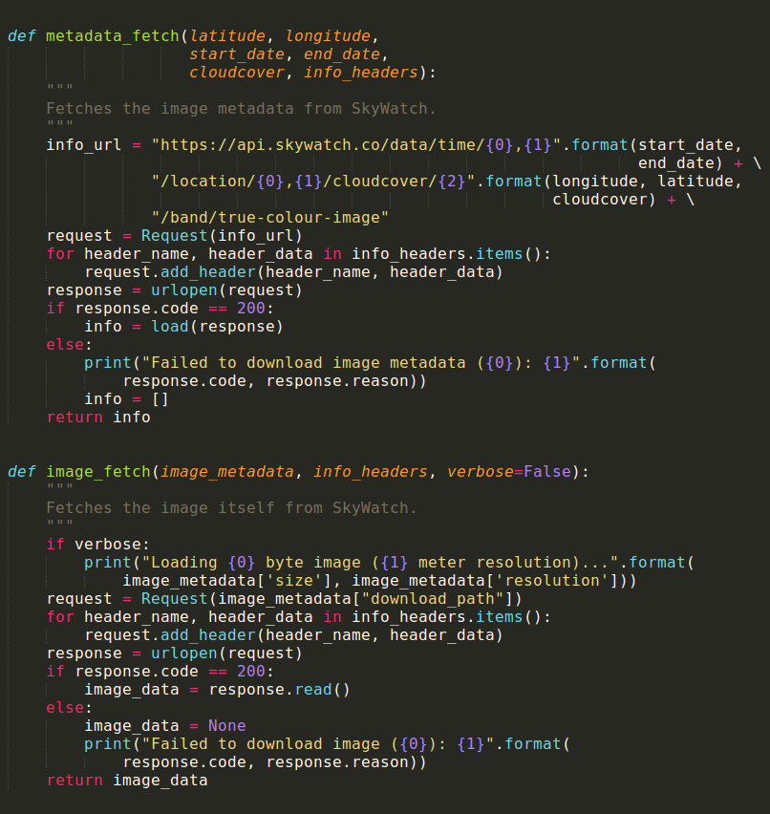
Step One: Get the Images
We developed a Python script that enables retrieval of specific sets of images, for example, a specific time span, a specific location, or a certain % of cloud cover using metadata already included with the images.
Depending on the variables selected this enables a large percentage to be removed from the dataset (probably more than 75%)

Slide 4
Step 2: Enable Object Classification
Potential Objects to Avoid
Potential Objects of Interest
Boats/boat wakes
Land masses/islands
Waves
Clouds
Ice masses
Satellite Apparitions
Algal Blooms
Marine Mammals
Ocean Currents / Gyres
Floating Debris

Slide 5
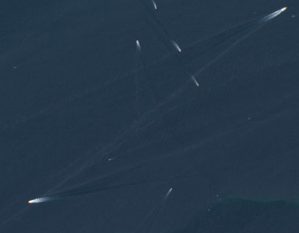
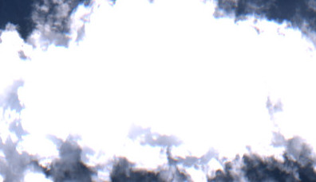
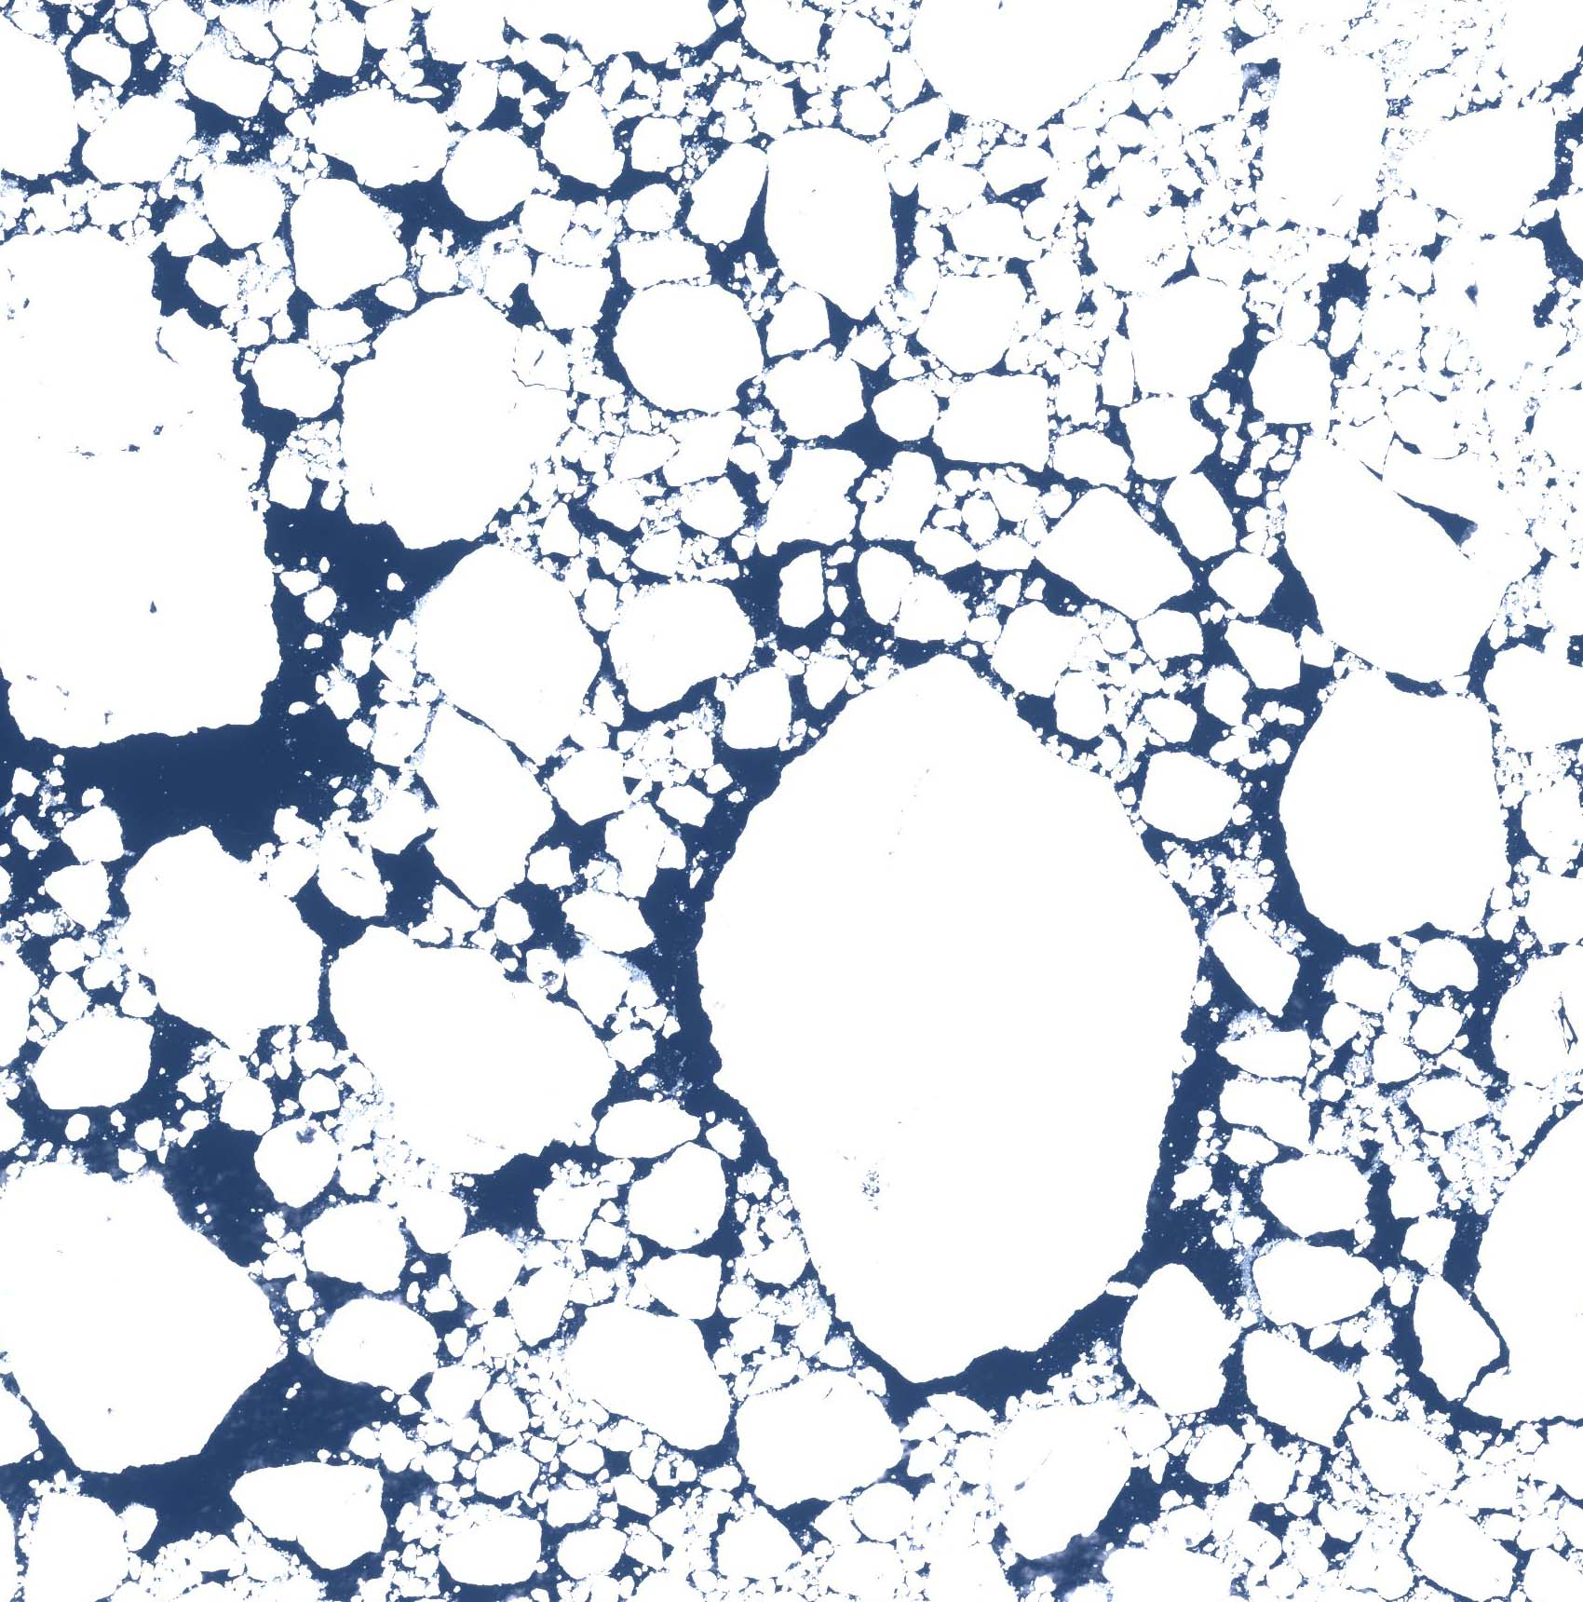
Examples of Objects
Boats
Clouds
Ice Masses

Slide 6
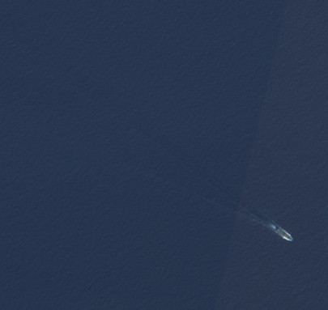
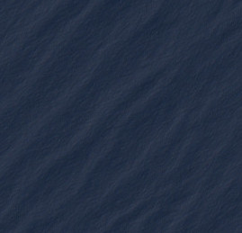
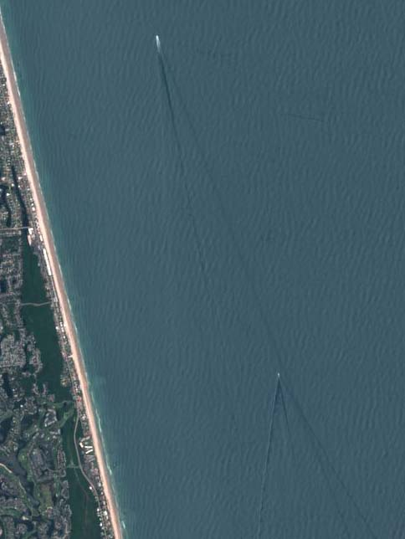
More Examples
Satellite Apparitions
Waves
Land Masses

Slide 7
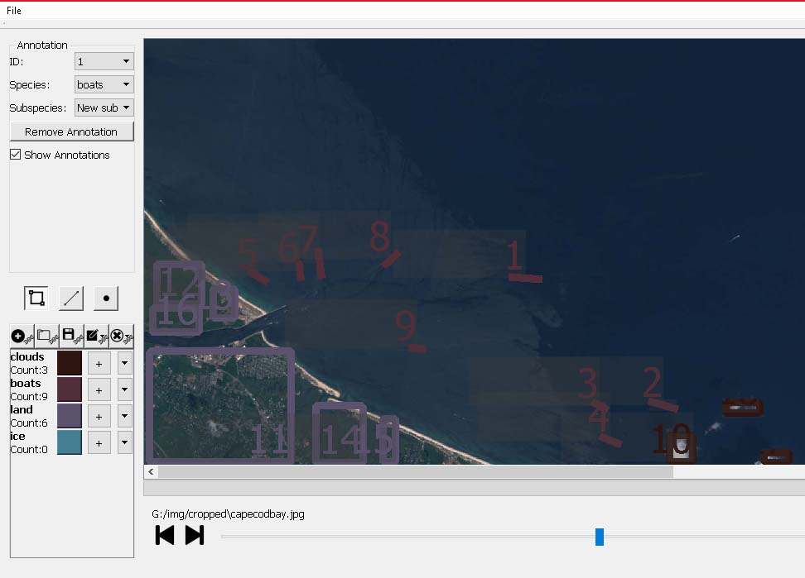
Step 3 Develop data set for either Image avoidance or retrieval
Utilizing Cvision Consulting LLC’s Image Annotator Software we were able to develop a JSON file and CSV file that annotates where specific objects of interest are located within an image for further analysis and characterization.
This could be utilized for any types of objects

Slide 8
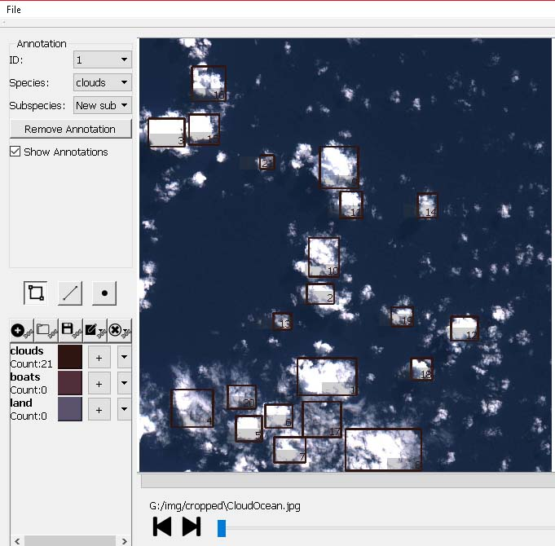
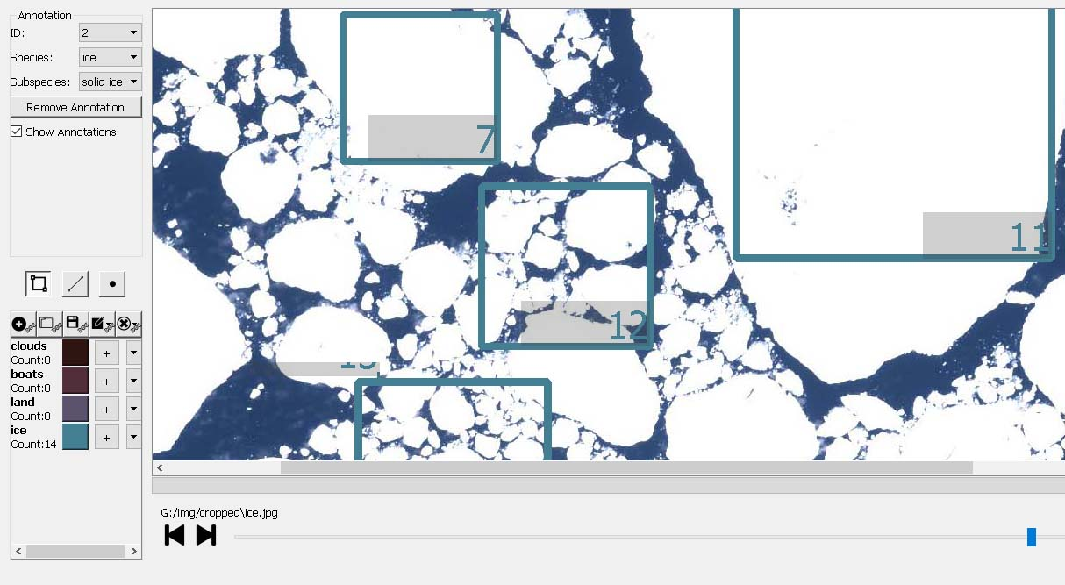
Further Characterization of Objects

Slide 9
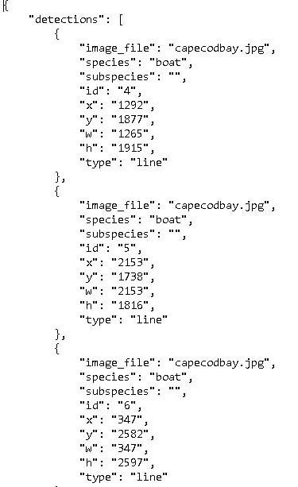
JSON output from ImageAnnotator software ready to be imported

Slide 10
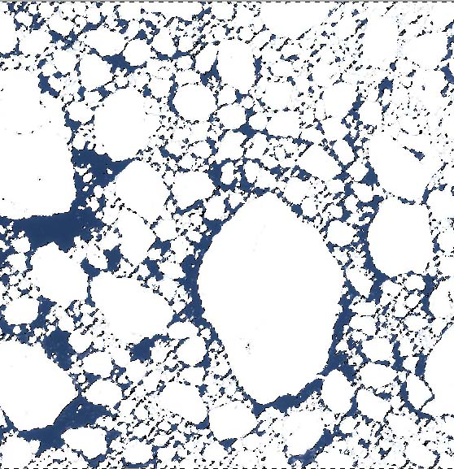
Image Analysis Example to Detect Color Variance
Pre
Post

Slide 11
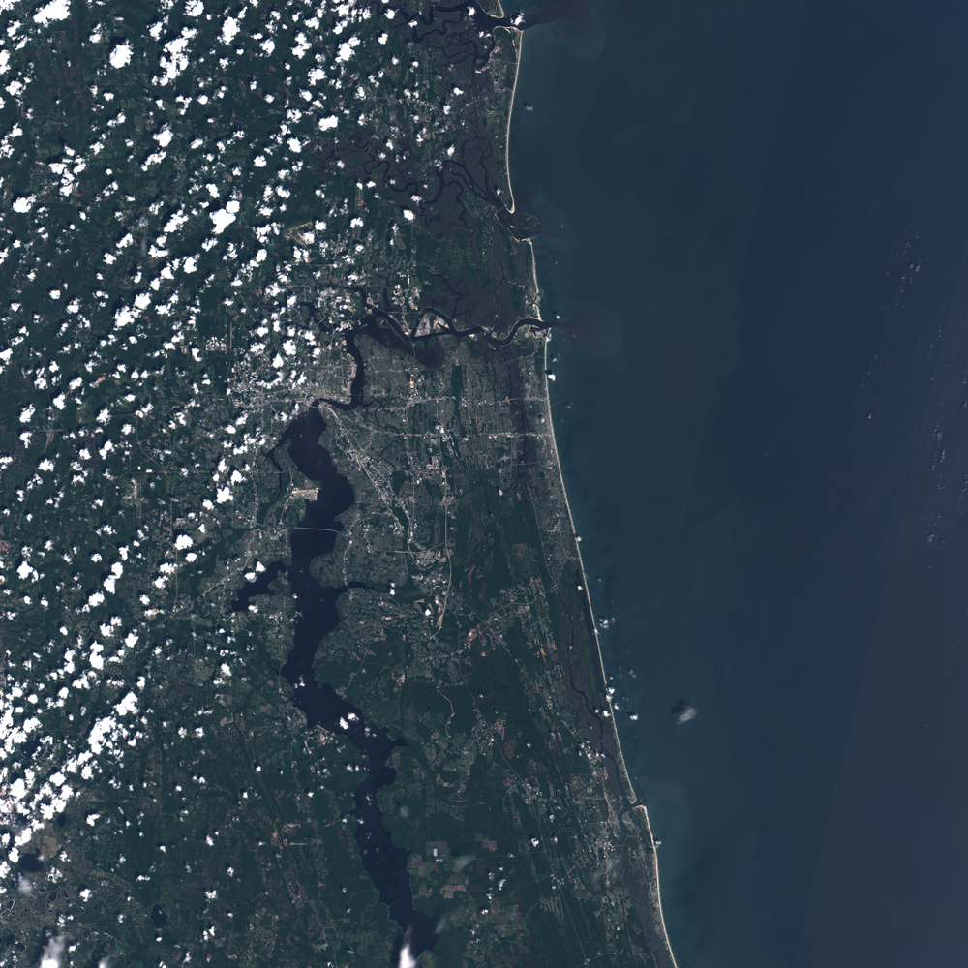
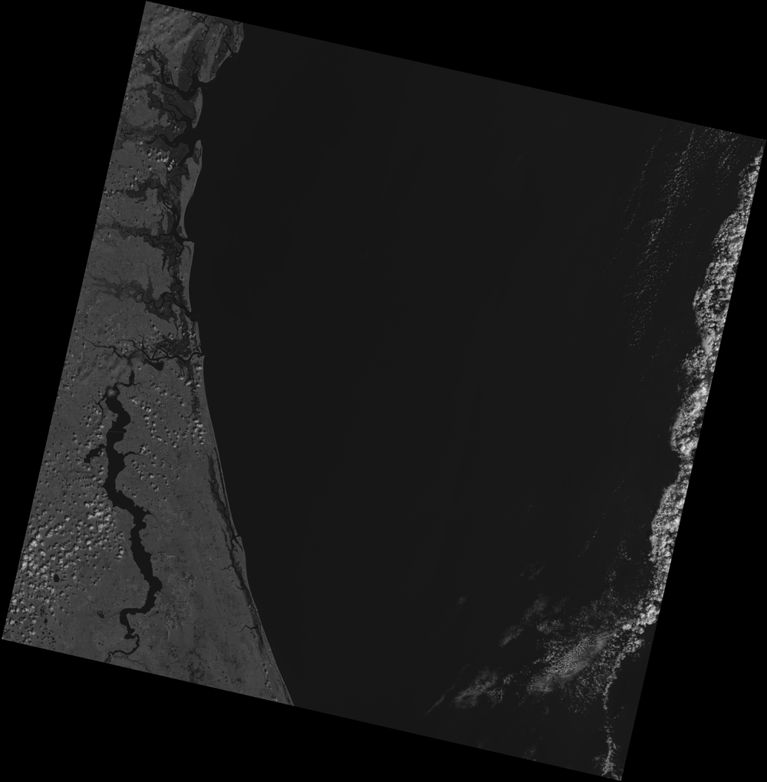
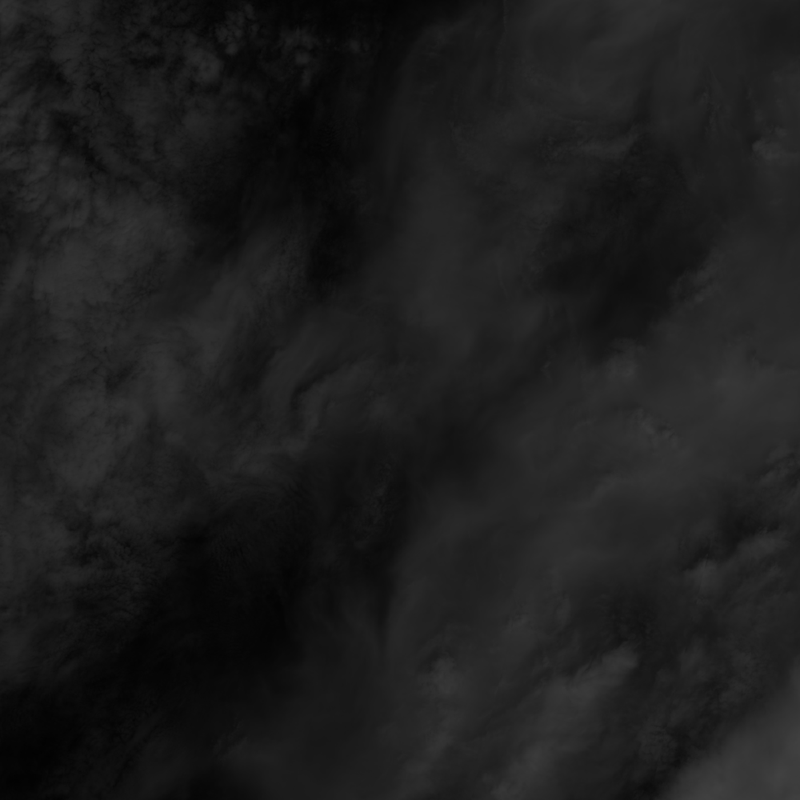
Additional Data Bands
Visible
Near-Infrared
Water Vapor

Slide 12
Thank you!

