Slide 1
WhaleMatch
A Hack-for-the-Sea project
September 2018

Slide 2
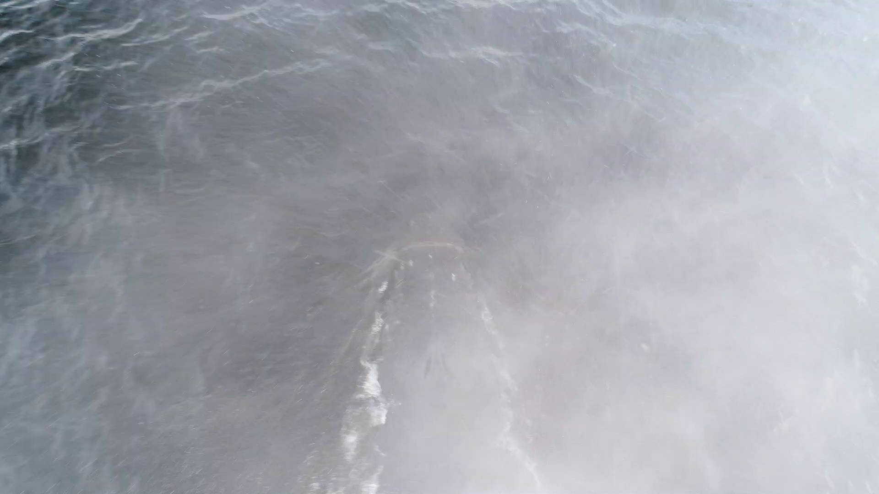
The Problem
The “SnotBot” is a drone that follows whales and collects samples from the blowhole
Whale identification is traditionally done visually using the tail, but not all whales show their tails when surfacing
The “SnotBot” should be able to identify whales in order to more easily match DNA data with visual imagery

Slide 3
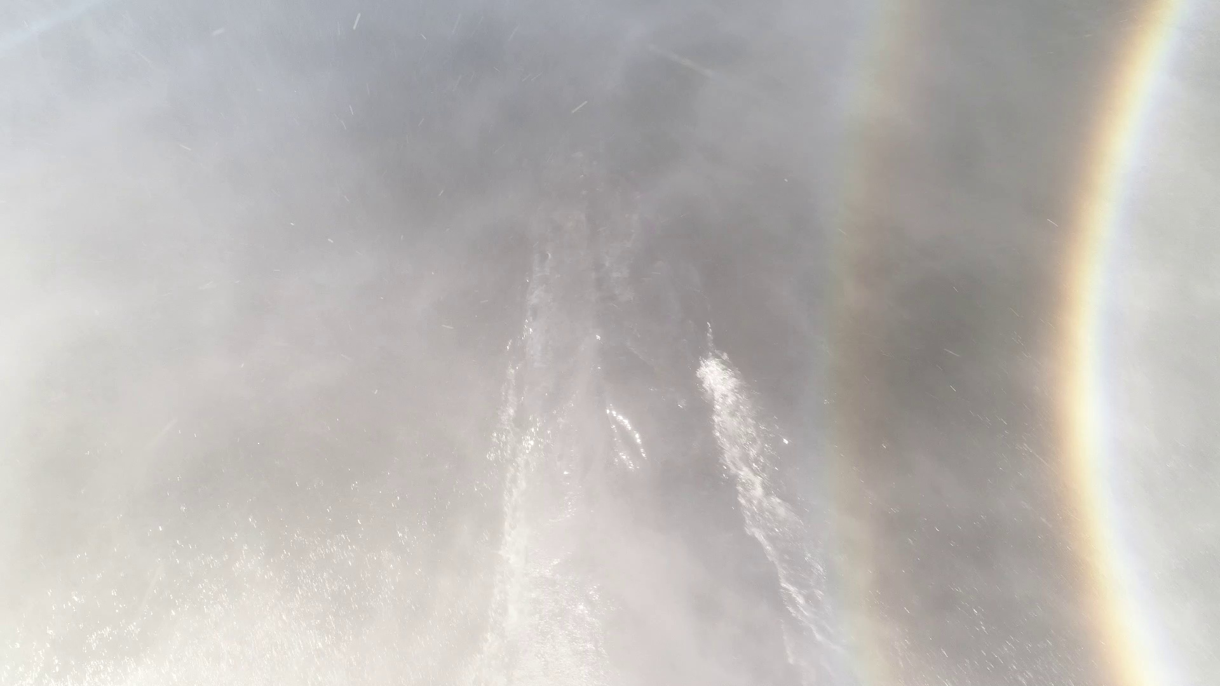
Possible Solution
Whales have to show their blowholes
The SnotBot collects video directly above these blowholes
Is it possible to use this for identification?
  It’s like identifying a person using only nostrils

Slide 4
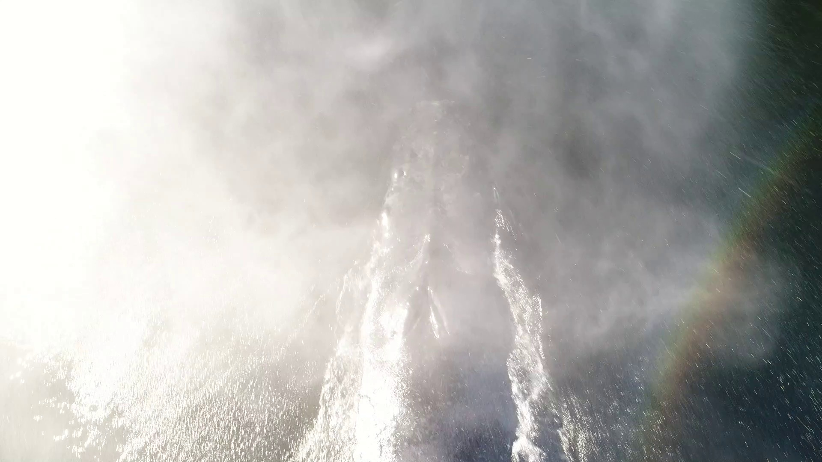
Possible Solution Breakdown
We can extract stills from the video
We can manually go through images
  We can get positive images
  We can get negative images
We can feed this data into CV/ML algorithms
  We can do detection
  We can (maybe) do classification

Slide 5
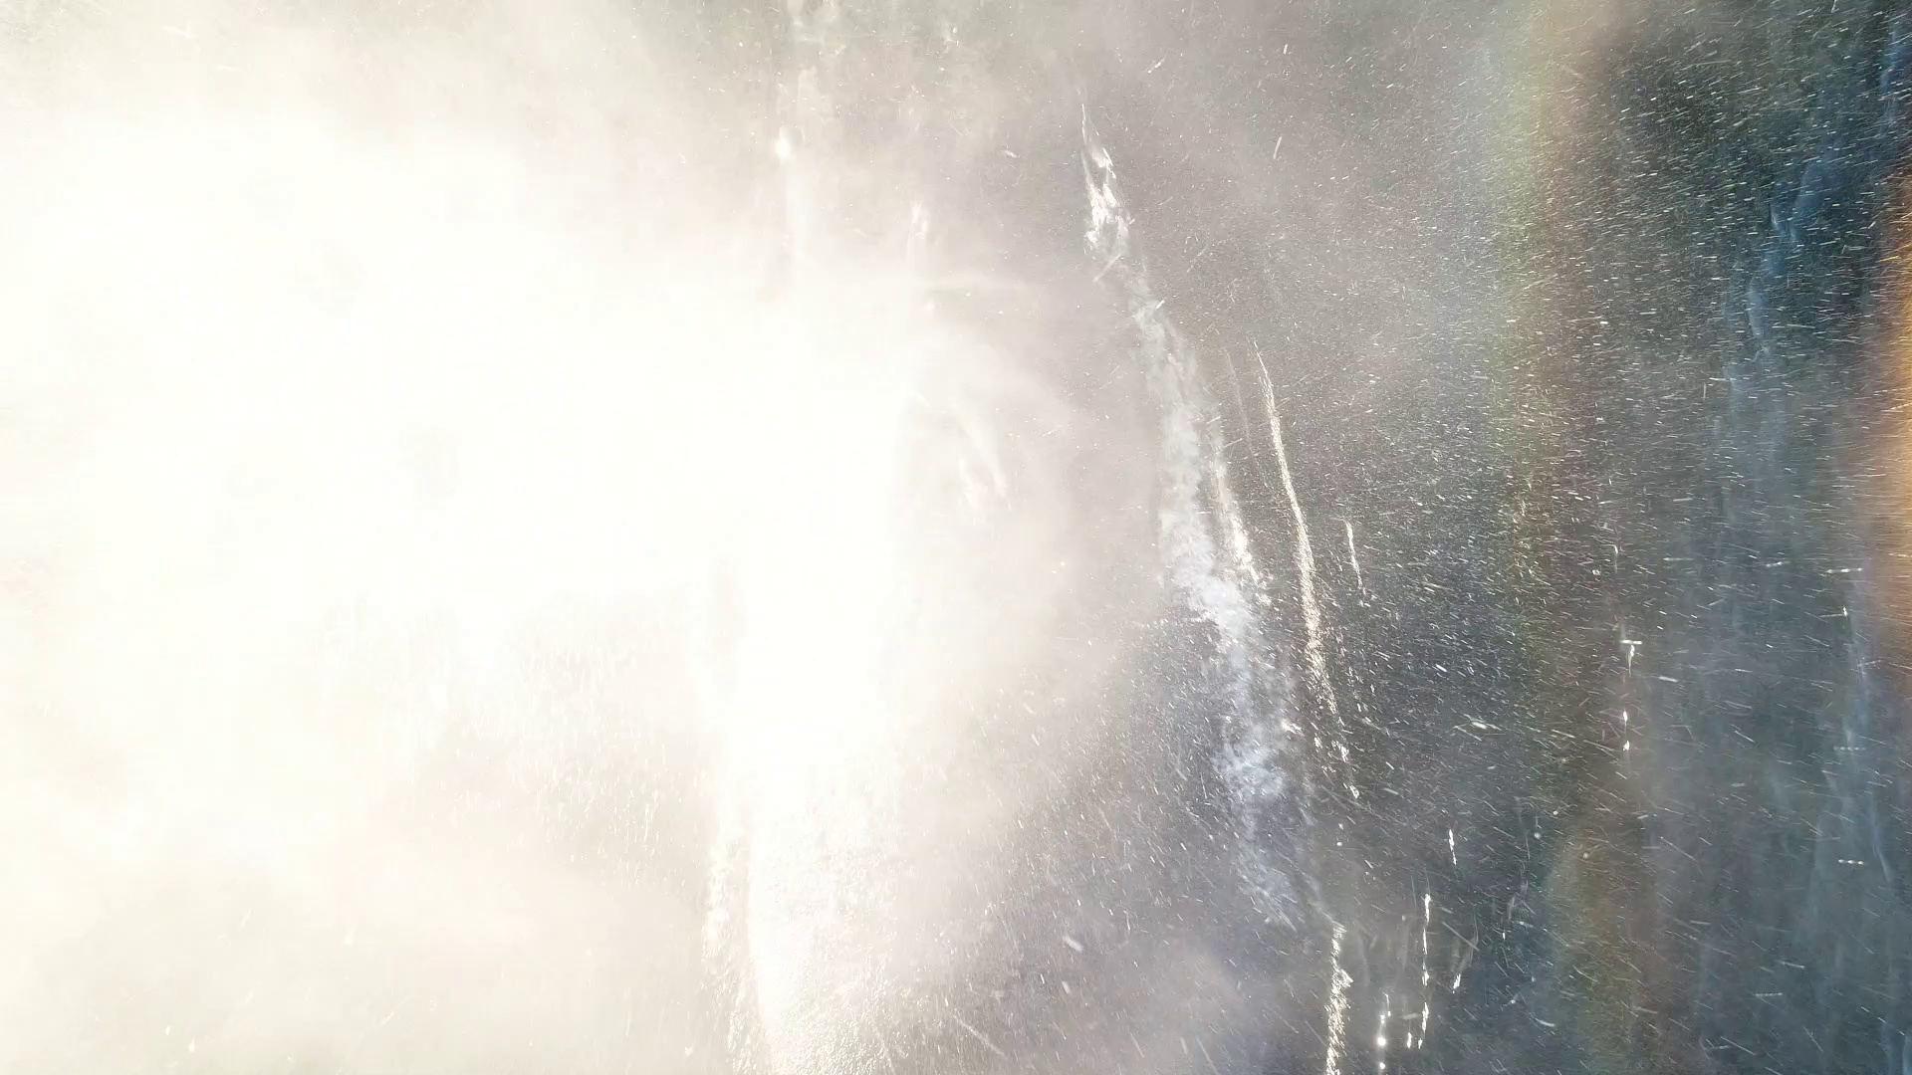
Challenges
Whales are moving targets
Spray from blowholes kills visibility
Blowholes open and close
  They need to keep water out
They change a lot per individual whale
They may not differ that much across whales
They are not that visually different from the surrounding ocean

Slide 6
Work Breakdown
We need to convert video to still images
We need to manually get some blowhole images
We can semi-automatically get negative images
We can train a detector
We can (maybe) train a classifier

Slide 7
Video Processing
The raw data is video
We need to convert first to still images
We can use OpenCV to extract images
We got around 100K images

Slide 8
Training
We tried three different techniques for detection
  Two using OpenCV
  One using Keras

Slide 9
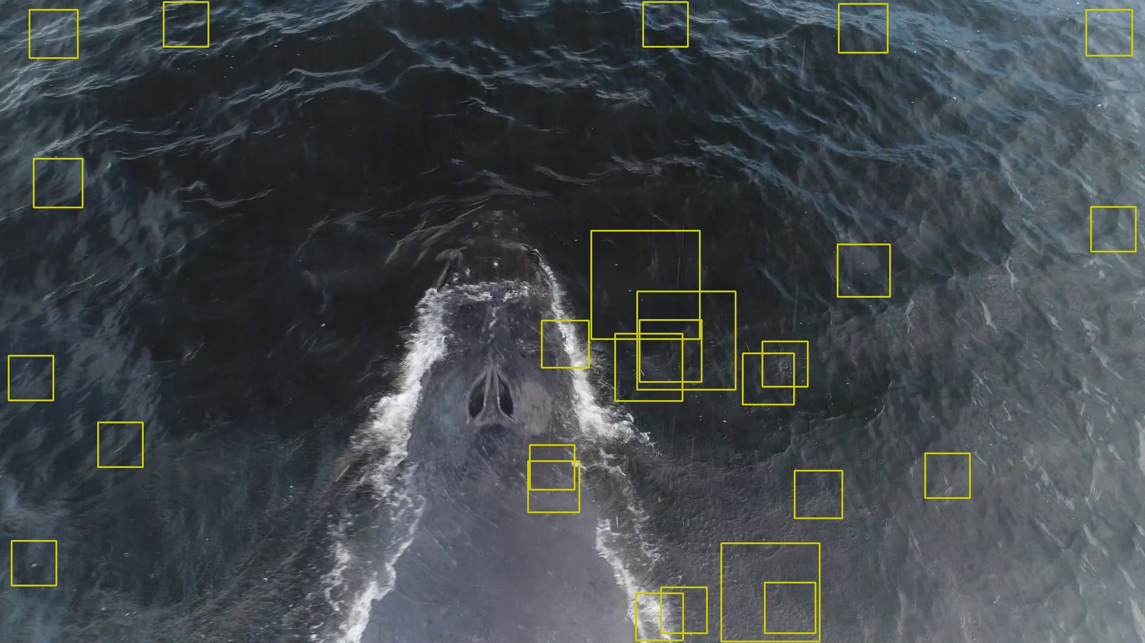
Training Almosts
Training doesn’t always work

Slide 10


Training Failures Details
Close ups of the failures help explain them

Slide 11

















Blowholes

Slide 12
The Machine Learning Approach
Without doing much pre-processing, can we train a machine learning model to recognize and classify blowholes?
A similar, but harder, problem to common ML examples like Iris detection, cats vs. dogs detection etc.
Decided on a convolutional neural network approach to recognize and classify images

Slide 13
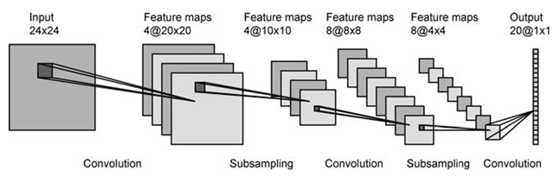
Convolutional Neural Networks
Feature matching across a set of training data to inform recognition of images in the testing data
Very useful for image recognition since you can do multiple types of recognition as layers

Slide 14






Our Dataset (non-representative)
Training Data
Testing Data

Slide 15
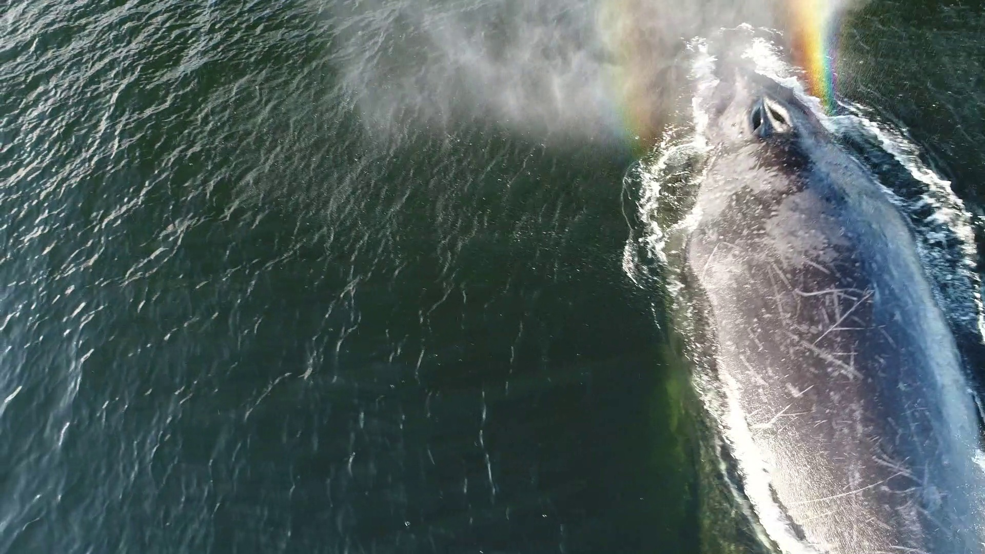
Output

Slide 16
The Road Ahead
A larger dataset of blowhole images and non-blowhole images
Tuning the ML model
A database mapping blowhole images to whale names

