Slide 1

WhaleMatch
A Hack-for-the-Sea project
September 2018
Rich Bean, Eric and Rhianon Brown,
Ted Greene, Isaac Vandor, Chris Zadra

Slide 2
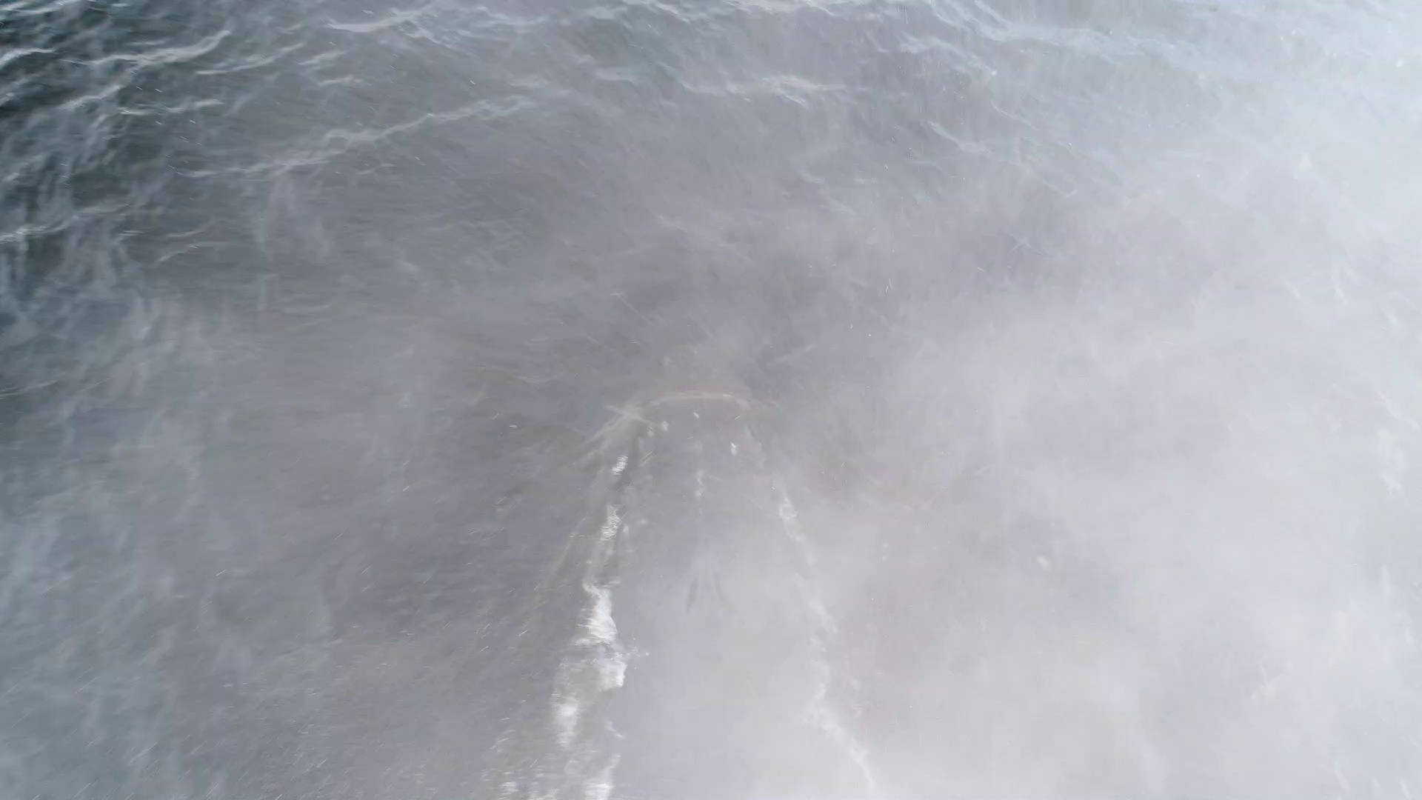
The Problem
The “SnotBot” is a drone that follows whales and collects samples from the blowhole
Whale identification is traditionally done visually using the tail, but not all whales show their tails when surfacing
The “SnotBot” should be able to identify whales in order to more easily match DNA data with visual imagery

Slide 3
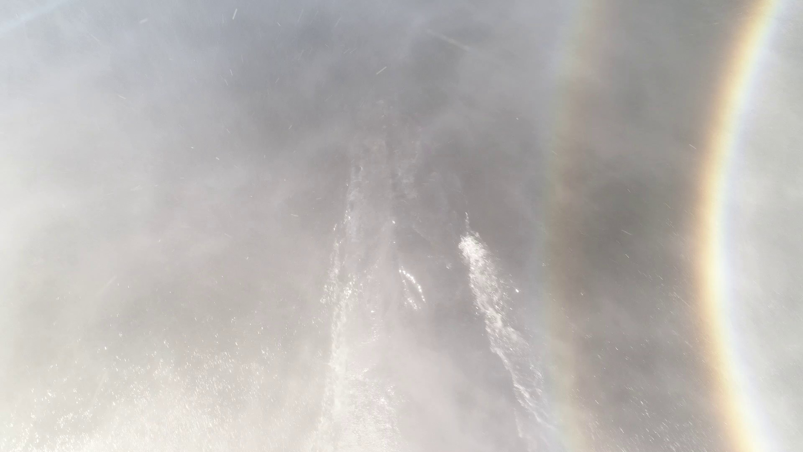
Possible Solution
Whales have to show their blowholes
The SnotBot collects video directly above these blowholes
Is it possible to use this for identification?
  It’s like identifying a person using only nostrils

Slide 4
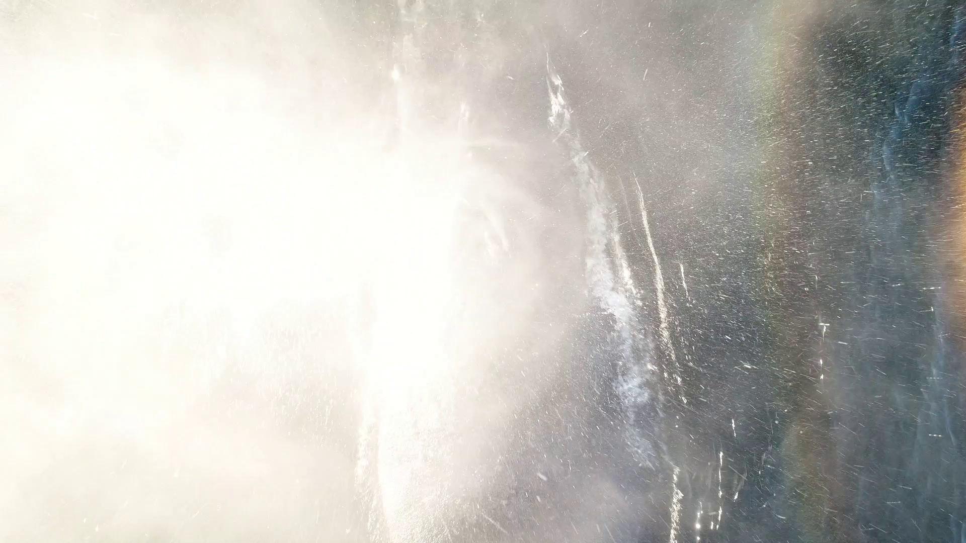
Challenges
Whales are moving targets
Spray from blowholes kills visibility
Blowholes open and close (to keep water out)
Skin color very similar to surrounding ocean
Self and cross-subject variability of blowhole shape

Slide 5
Varying Shape Causes Errors
Whale A’s distinct blowhole remains distinct over the course of the video clip, always matching Whale A
Whale A’s blowhole across frames matches other whales better than itself or no whales
Other whale’s blowholes are different enough to never match Whale A’s

Slide 6
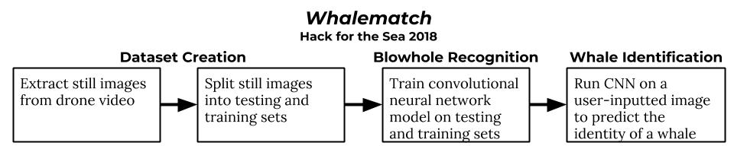
Whalematch Block Diagram

Slide 7
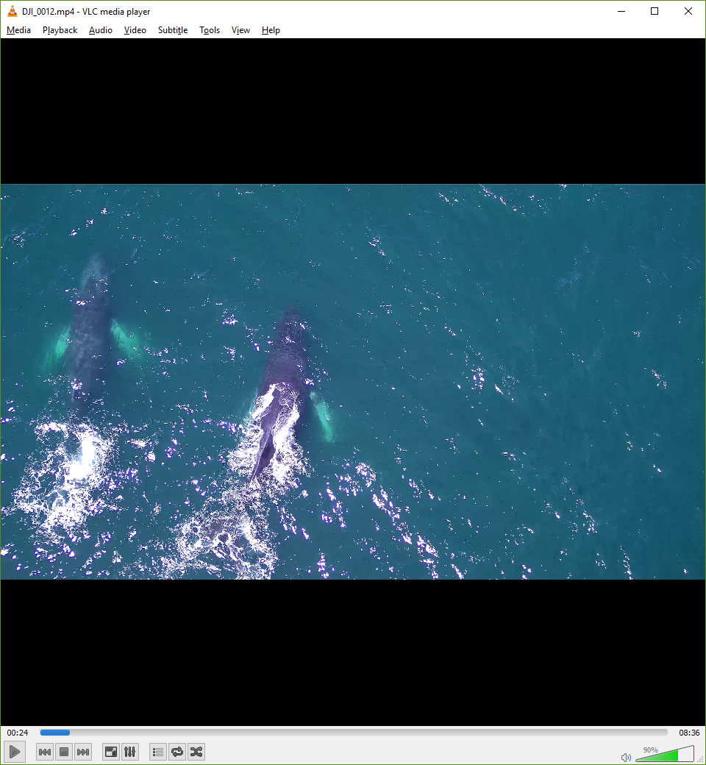
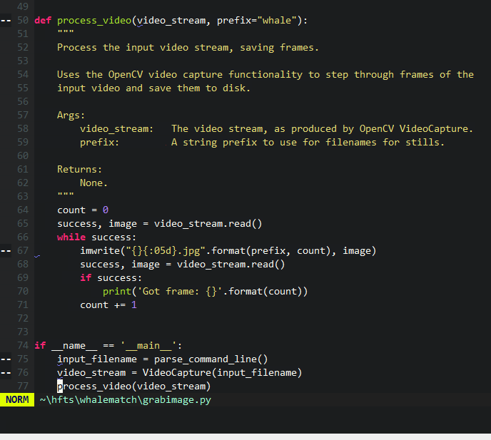
Video Processing
3-8 minute long HD videos
Extract and convert frames
We got around 100K images!

Slide 8














Our (non-representative) Dataset
Training Data (Negatives)
Testing Data (Blow Holes!)
Took random 200x200px samples from video stills, resized to 75x75
Negative sample creation was semi-automated (hand reviewed)
Blowholes were manually created
Total Count: 727 negatives, 14 blowholes

Slide 9
The Machine Learning Approach
Without doing much pre-processing, can we train a machine learning model to recognize and classify blowholes?
A similar, but harder, problem to common ML examples like Iris detection, cats vs. dogs detection etc.
Decided on a convolutional neural network approach to recognize and classify images

Slide 10
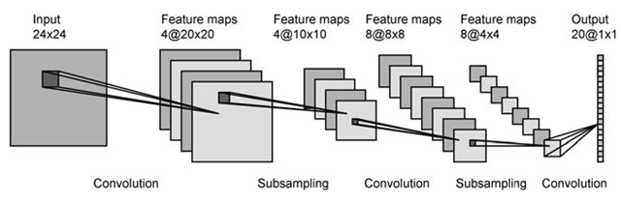
Convolutional Neural Networks
Feature matching across a set of training data to inform recognition of images in the testing data
Very useful for image recognition since you can do multiple types of recognition as layers

Slide 11


Training
We tried three different techniques for detection
  Two using OpenCV
  One using Keras

Slide 12
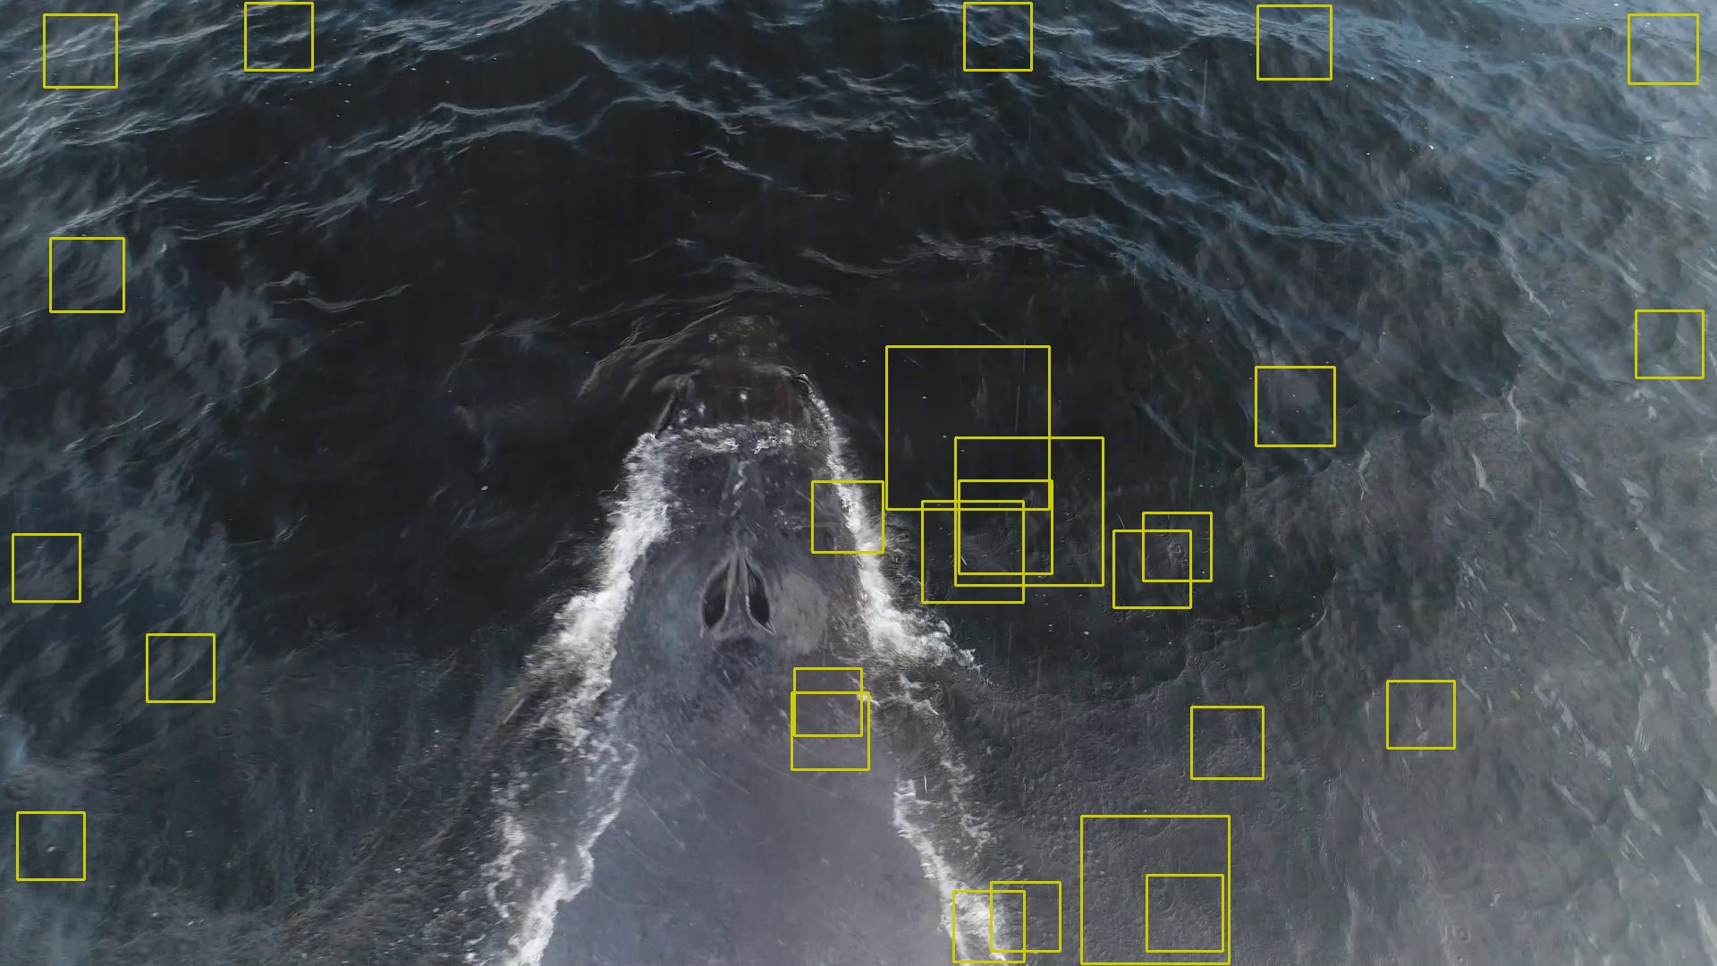
OpenCV False Positives
Training doesn’t always work

Slide 13


But Not Unreasonable Either!
Close ups of the failures help explain them

Slide 14
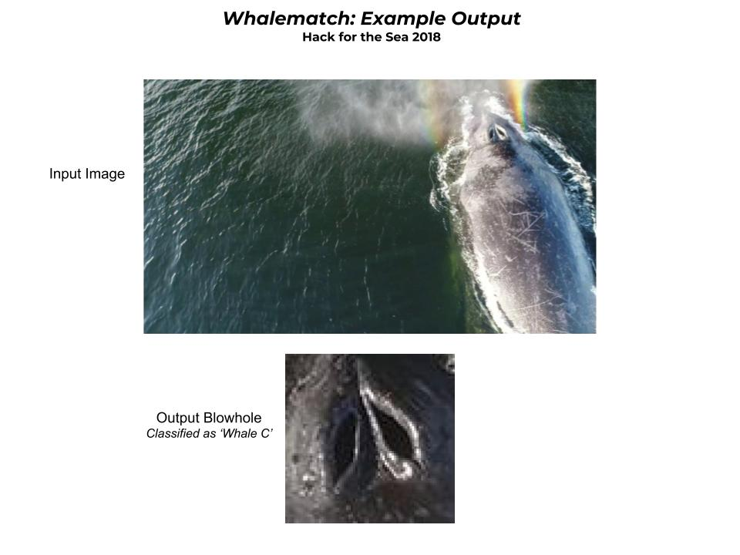
Keras Results

Slide 15
The Road Ahead
A larger dataset of blowhole images and non-blowhole images
Tuning the ML model
A database mapping blowhole images to whale names

