Slide 1


Slide 2
So…
The Challenge
The Process
The Solution
Next Steps

Slide 3



The Challenge
An app with location-based capabilities that provides a virtual tour of
Public Art
Historical Places
Cultural Events

Slide 4
The Process

Slide 5


Requirements
?
We met with our stake holders and gathered requirements
?
?
?
?
Holyoke
Northampton

Slide 6




Assessment
+
+
Responsive Application
Geo-location API
Landmarks/Events
Notes:
We Assessed that they needed a responsive applications that uses a geo-location API, to retrieve cultural landmarks and events that are near where the user is using the application on a mobile device.
Because it is responsive it can simply be used on a tablet or a computer as well.

Slide 7



Data
+
An administrative interface to login and provide descriptions and the locations of various landmarks or events
Notes:
We wanted to make it easy to update the data for the app so we created an administrative interface for them to login to and be able to provide descriptions and the locations of various landmarks.

Slide 8
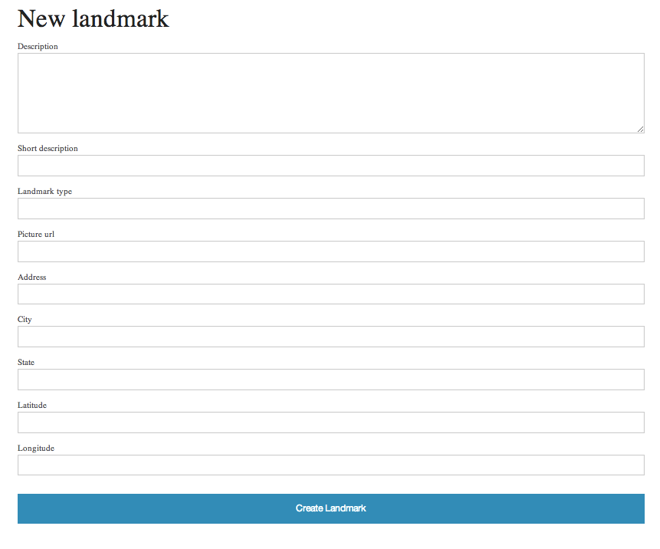

Slide 9
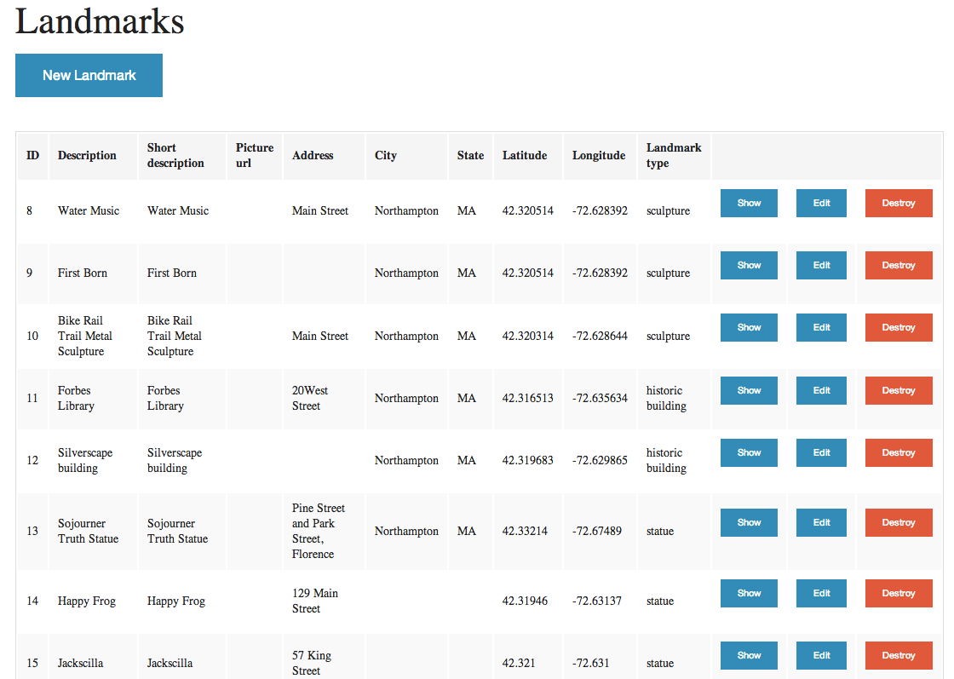

Slide 10
The Solution

Slide 11

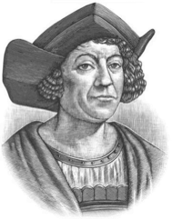



Existing Solutions?
We did research!
and…
We found America!
Notes:
Within our process, we researched existing solutions, and we found one that was already done by Code for America and some of us spent time to get that solution up and running to see if we could build upon it.
We thought that we could leverage the existing infrastructure that they had there like use their mobile UI, but we never really got it running.

Slide 12

Existing Solutions?
We did research!
and…
We found Code for America!
Notes:
Within our process, we researched existing solutions, and we found one that was already done by Code for America and some of us spent time to get that solution up and running to see if we could build upon it.
We thought that we could leverage the existing infrastructure that they had there like use their mobile UI, but we never really got it running.

Slide 13

Our Solution
Postgres
Geo-location Info
Landmark Info
Notes:
Java Script - Geo-location Info
Ruby on RAILS - Landmark Info
Postgres Database - Store data
A REST interface for Java Script and RAILS to talk to each other
Deployed it to Heroku which has a free solution for deploying applications

Slide 14



Our Solution
Hi
Hi
Postgres
Geo-location Info
Landmark Info

Slide 15
Our Solution
Postgres
Geo-location Info
Landmark Info

Slide 16
Demo

Slide 17
Next Steps
Finish this presentation! :-P
Customize site based on the needs of Holyoke and Northampton individually
Add social capabilities

Slide 18
Thanks!

Slide 19
Credits
Location by Ricardo Moreira from The Noun Project
Indifference by Paul F. from The Noun Project
Brainstorming by Icons8 from The Noun Project
Statistics by Scott Lewis from The Noun Project
Web Search by Alexandria Eddings from The Noun Project
Smartphone by George Agpoon from The Noun Project
Monument by Creatorid'immagine from The Noun Project
Theater by Björn Andersson from The Noun Project

Slide 20

Credits
Form by Arslan Shahid from The Noun Project
Thrilled by Paul F. from The Noun Project
Database by Javier Cabezas from The Noun Project
Computer by Edward Boatman from The Noun Project

