Slide 1
Black Forest Hackathon
DRAWING
2
CAD
CAD
The Novice Ninjas
From 2D technical drawings to 3D STEP models, automatically.
Notes:
Welcome. We are The Novice Ninjas, and this is Drawing2CAD: we turn 2D technical drawings into 3D CAD models automatically.

Slide 2
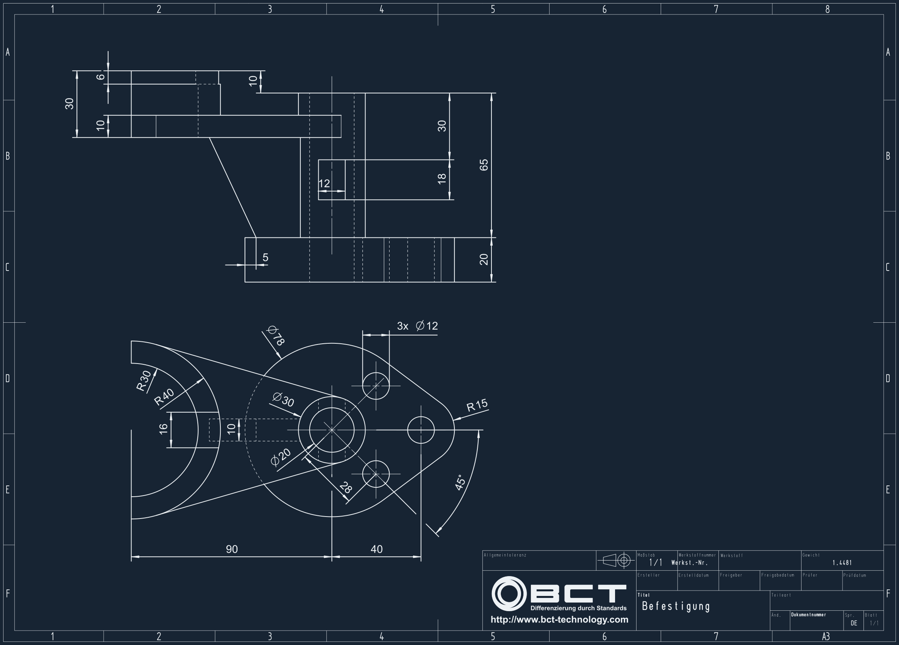
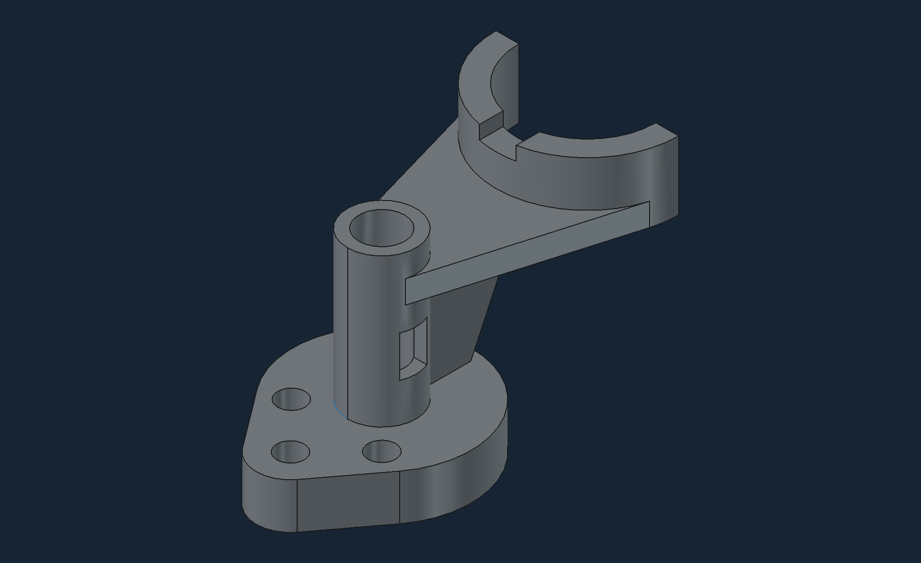

01 — Problem
The problem
3D model
2D drawings only
…in countless different formats.
Drawing2CAD · The Novice Ninjas
02
Notes:
Today, parts mostly exist as 2D drawings like this one, in countless different formats. What we need is the 3D model of the same part.

Slide 3



02 — Goal
The goal: Drawing2CAD
Accurate output
Automated workflow
Using average,
low-cost AI models
Dimension-true 3D models, exported as STEP.
PDF in, STEP file out. No manual remodelling.
Works with everyday, off-the-shelf models.
Drawing2CAD · The Novice Ninjas
03
Notes:
Our goal is Drawing2CAD: accurate output, a fully automated workflow, and it runs on average AI models rather than specialised ones.

Slide 4




03 — Architecture
The idea
PDF
PDF
User
UI
3D Creation MCP Server
STEP file
STEP file
Skill & tooling set
Drawing2CAD · The Novice Ninjas
04
Notes:
The user uploads a PDF in the UI. The UI hands it to our 3D Creation MCP Server, which is backed by a skill and tooling set. The server returns a STEP file, which the UI hands back to the user.

Slide 5
03 — Architecture
Inside the MCP server
3D Creation MCP Server
PDF
01
02
03
STEP file
Features extraction
3D Model
Creator
Validator
feedback loop
Drawing2CAD · The Novice Ninjas
05
Notes:
Inside the server, three stages: features are extracted from the PDF, the 3D Model Creator builds the model, and the Validator checks it. If the check fails, it loops back to the Model Creator. What comes out is a STEP file.

Slide 6

04 — Business Value
How much is the fish?
3 h
€50
€150
average per drawing
personnel cost per hour
manual cost per drawing
500 drawings
2,000 drawings
5,000 drawings
€75,000
€300,000
€750,000
Saved
Saved
Saved
Drawing2CAD · The Novice Ninjas
06
Notes:
A drawing takes three hours on average to remodel by hand. At €50 per hour personnel cost, that is €150 per drawing. For 500 drawings, that is €75,000 saved; for 2,000 drawings, €300,000; for 5,000 drawings, €750,000.

Slide 7
05 — Live
DEMO
From PDF to STEP file, live.
Notes:
Switch to the live demo now.

Slide 8
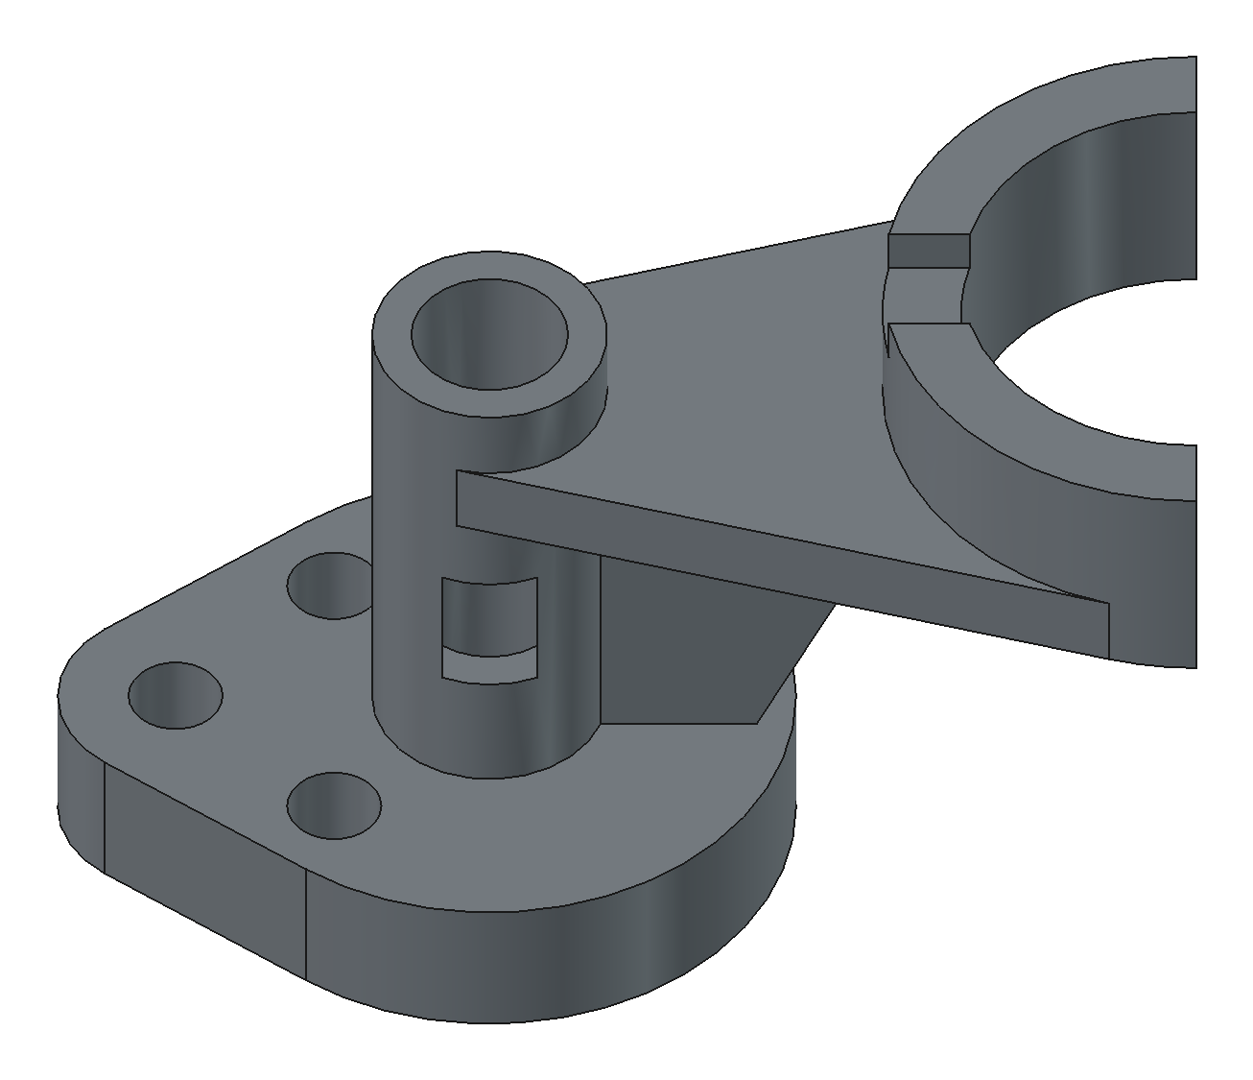
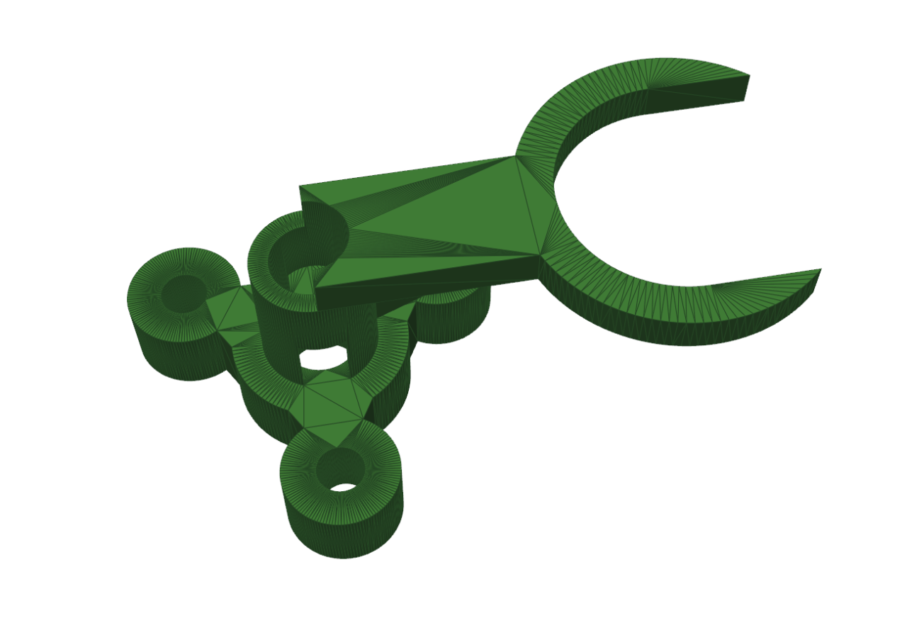
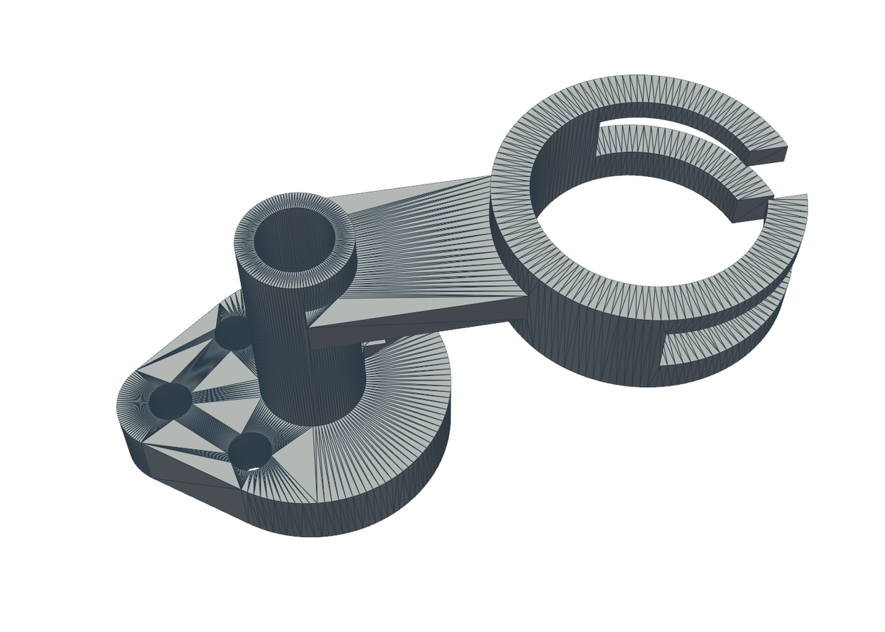
06 — Results
Evolution
V1 · First model
V2 · Refined
V3 · Current
Rough mesh geometry, open clamp
Base plate with holes, tube boss, split-ring clamp
Clean solid model: slotted boss, split clamp
Drawing2CAD · The Novice Ninjas
08
Notes:
How our output evolved. V1 had rough mesh geometry and an open clamp. V2 captured the base plate, the holes, the tube boss and the split-ring clamp. V3, our current result, is a clean solid model with smooth faces, the slotted boss and the split clamp.

Slide 9
THANK YOU
Questions?
The Novice Ninjas · Drawing2CAD
Notes:
Thank you. Happy to take questions.

