Slide 1
UnBoundEd ET-5 Designing an online education system that functions effectively on low-resource devices and networks.
UnBoundEd (Unbounded Education) – Learning without limits. In today’s world, access to quality education remains a challenge for students in areas with low-resource devices and limited network connectivity. Our solution is a lightweight, AI- powered online education platform designed to function seamlessly in such environments.

Slide 2
Key Features:
AI-Powered Assistance – Smart AI tutors provide personalized learning recommendations and instant Q&A support.
Lightweight UI & Optimized Performance – Minimalist design ensures smooth operation on low-end devices and slow networks.
Micro-Certifications & Leaderboard – Learners earn digital certifications and compete in a gamified ranking system.
Community Support – discussion forums enhance collaboration.
Our platform ensures inclusive and scalable learning, empowering students with minimal data consumption and maximum engagement. 🚀

Slide 3
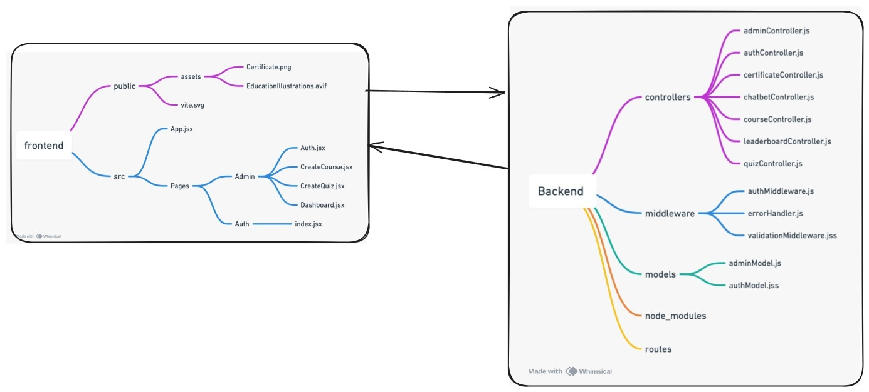
Project Structure

Slide 4

Landing Page

Slide 5
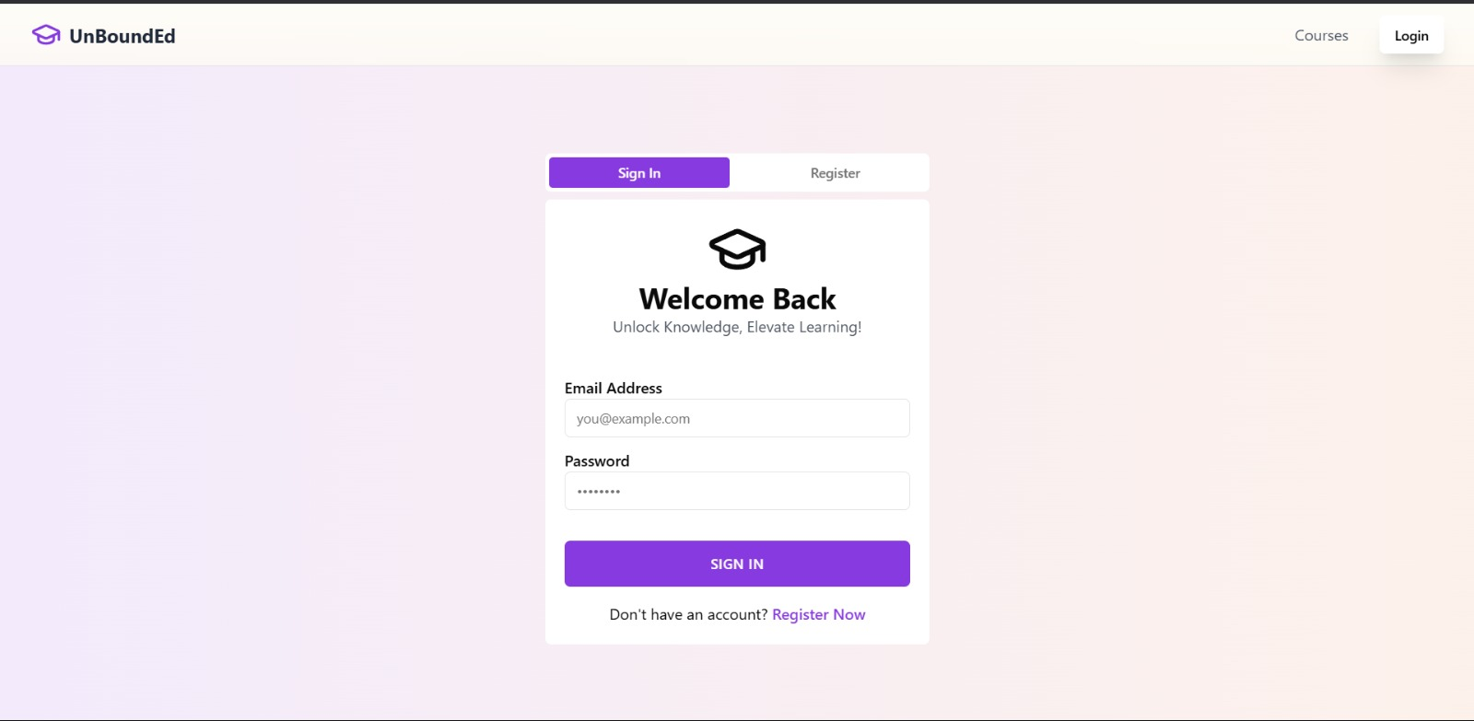
Authentication

Slide 6
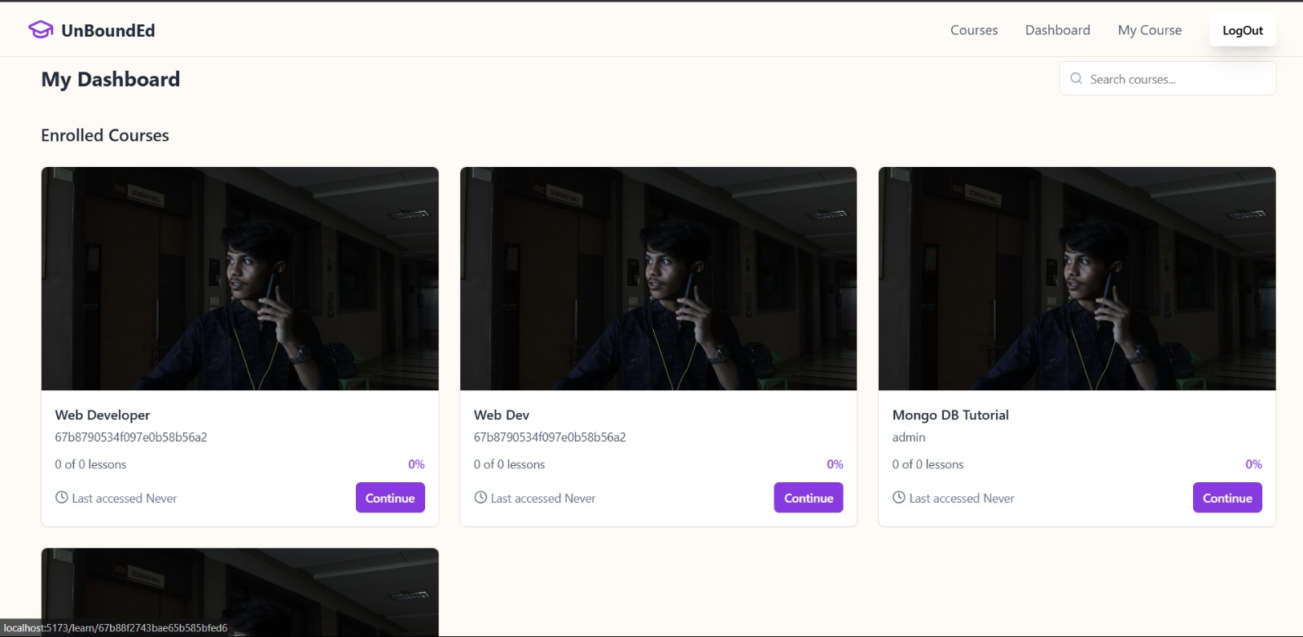
User Dashboard

Slide 7
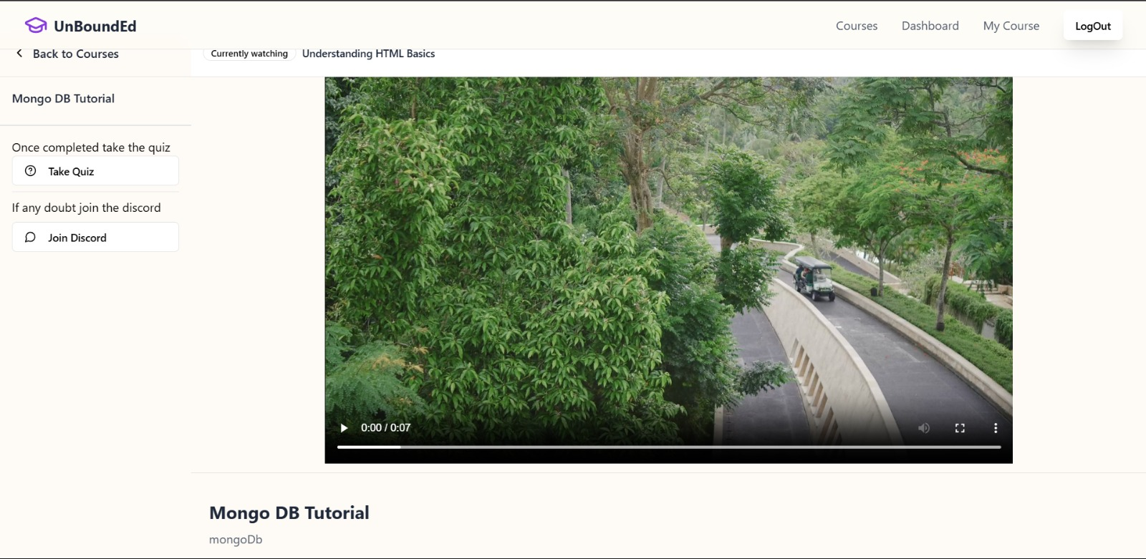
Learn Page

Slide 8
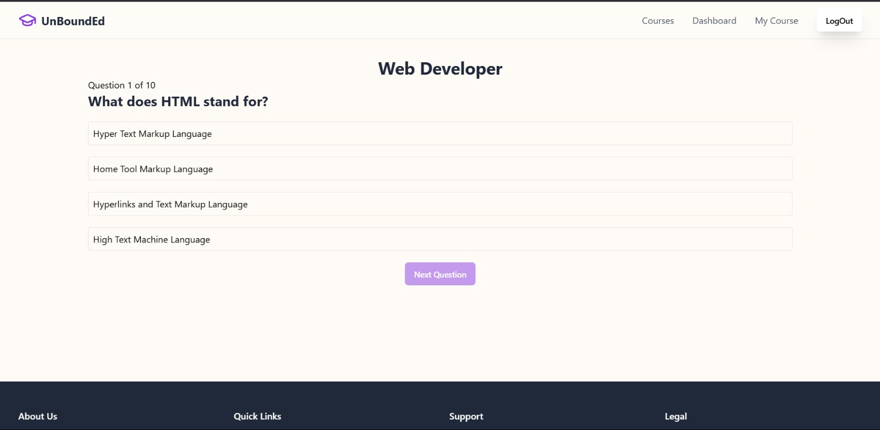
Quiz Page

Slide 9
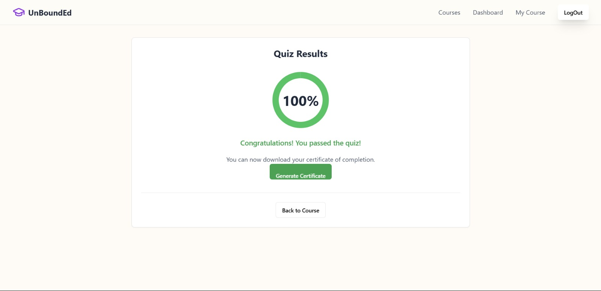
Quiz Review

Slide 10

Certification

Slide 11
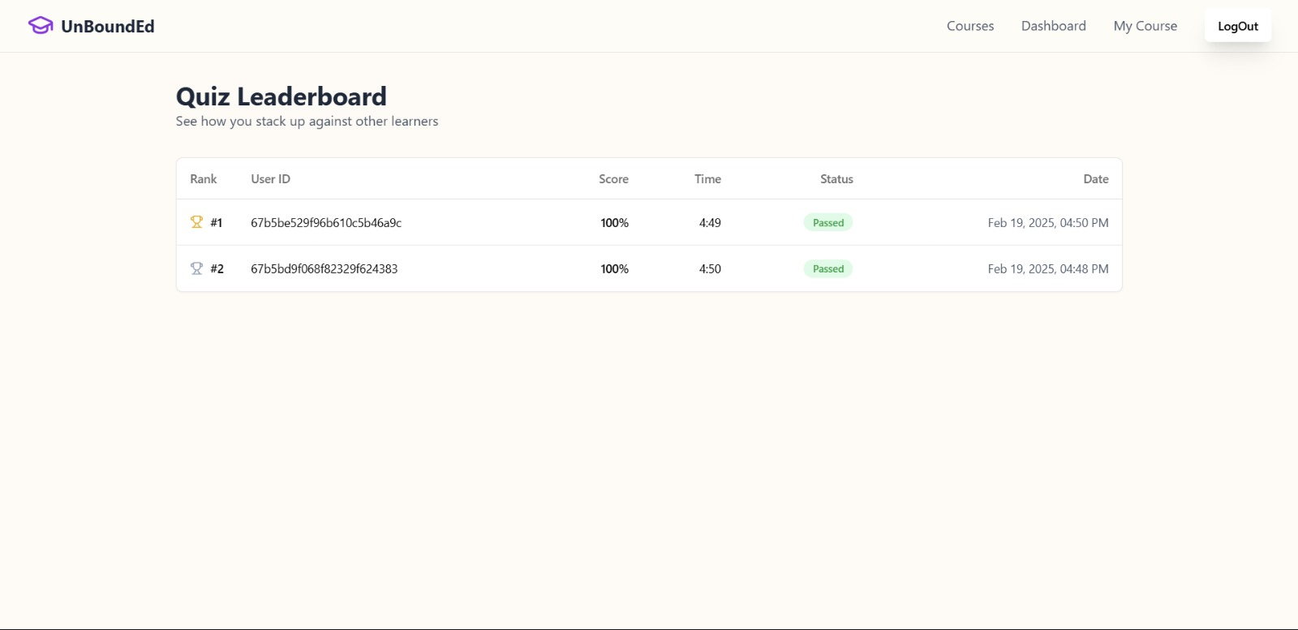
LeaderBoard

Slide 12
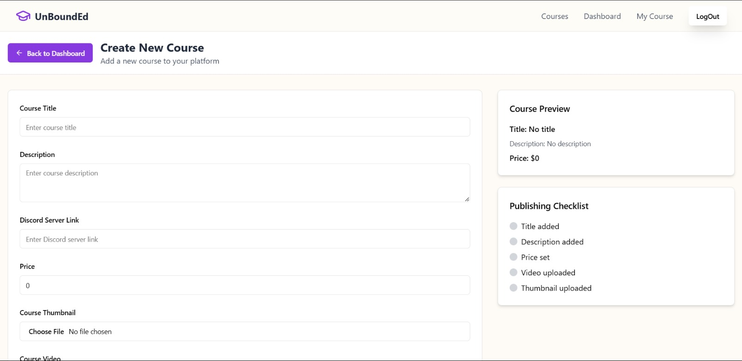
Create Course

Slide 13
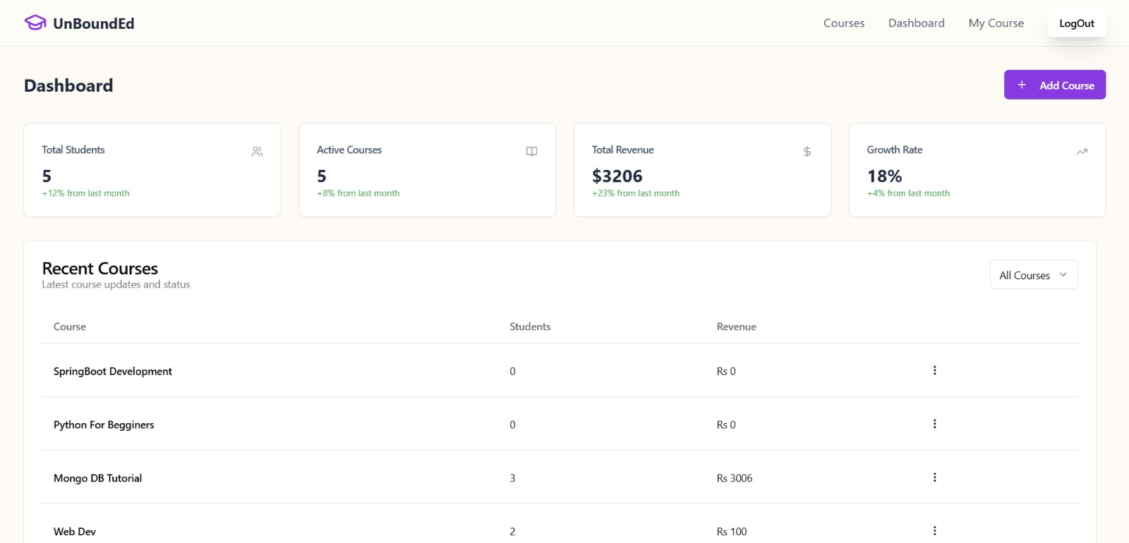
Admin Dashboard

Slide 14
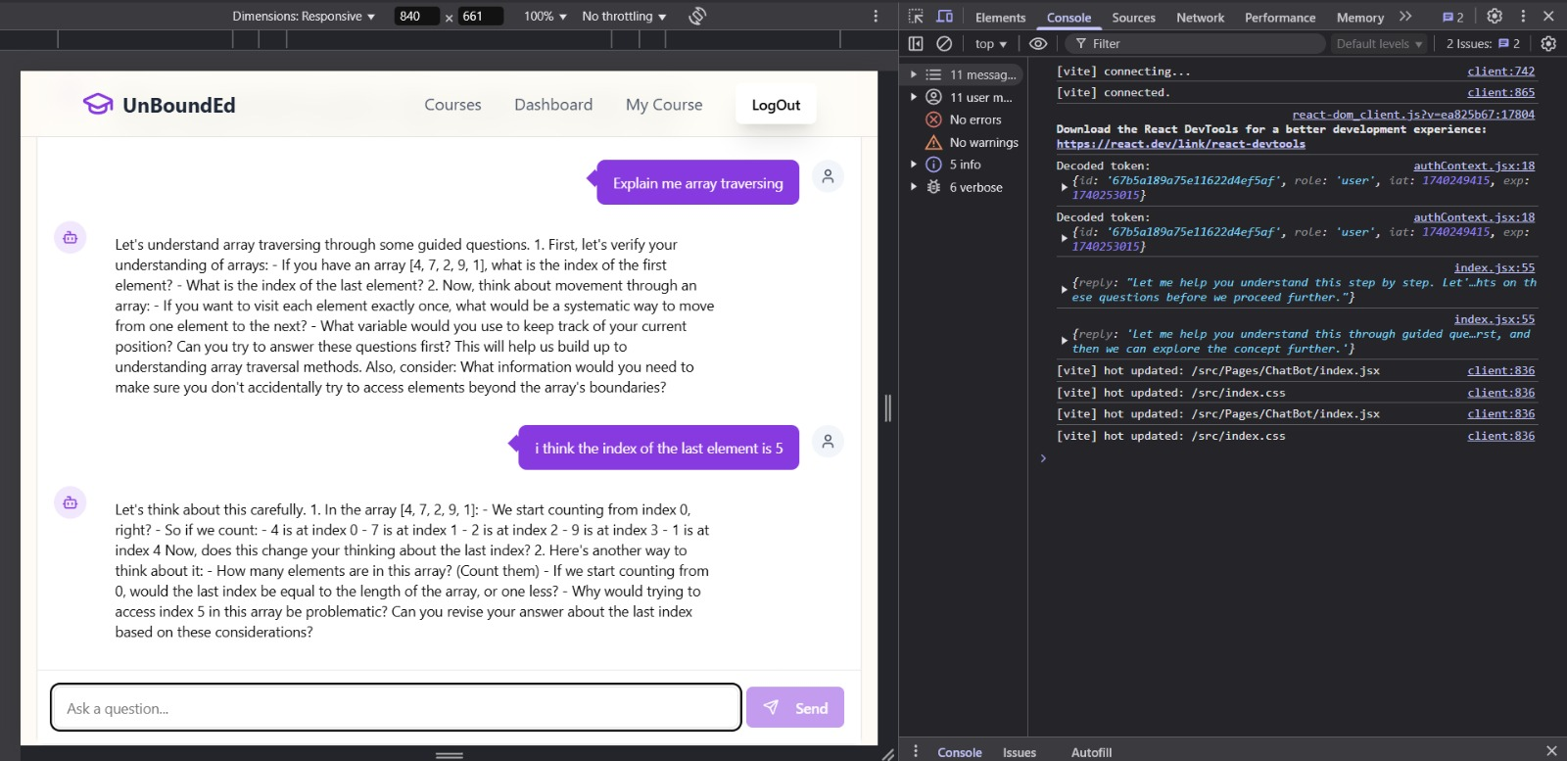
AI Chatbot

Slide 15
Lazy Load

Slide 16
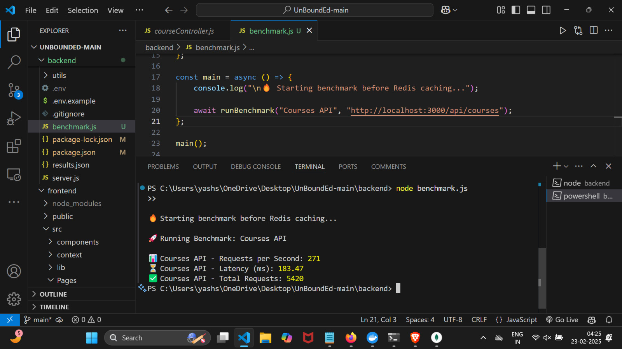
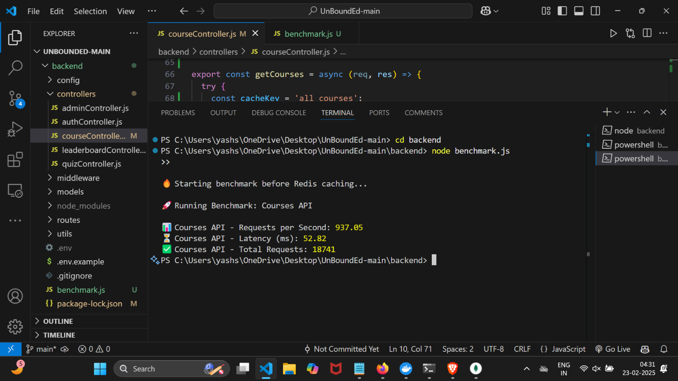
Caching
Before Caching
After Caching

Slide 17
Future Scope
Learn-to-Earn Model – Students receive discounts or rewards for course completions, making education more affordable.
Peer-to-peer learning, mentor matching.
Offline Support – Students can download lessons (text & video) and sync progress when online.

Slide 18
Thank You!

