Slide 1
Goals and Objectives
Explain what TF-IDF weighting is and why TF transformation and document length normalization are necessary for the design of an effective ranking function.
Explain what an inverted index is and how to construct it for a large set of text documents that do not fit into the memory.
Explain how variable-length encoding can be used to compress integers and how unary coding and gamma-coding work.
Explain how scoring of documents in response to a query can be done quickly by using an inverted index.
Explain Zipf’s law.
Guiding Questions
What are some different ways to place a document as a vector in the vector space?
What is term frequency (TF)?
What is TF transformation?
What is document frequency (DF)?
What is inverse document frequency (IDF)?
What is TF-IDF weighting?
Why do we need to penalize long documents in text retrieval?
What is pivoted document length normalization?
What are the main ideas behind the retrieval function BM25?
What is the typical architecture of a text retrieval system?
What is an inverted index?
Why is it desirable to compress an inverted index?
How can we create an inverted index when the collection of documents does not fit into the memory?
How can we leverage an inverted index to score documents quickly?

Slide 2
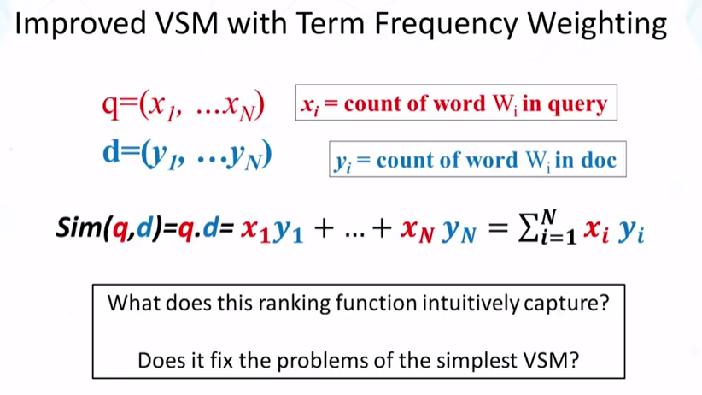
2.1 Vector Space Model – Improved Instantiation

Slide 3
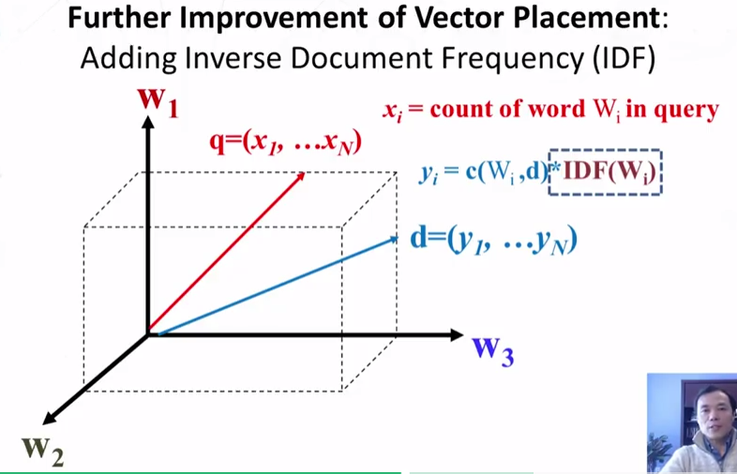
2.1 Vector Space Model – Improved Instantiation

Slide 4
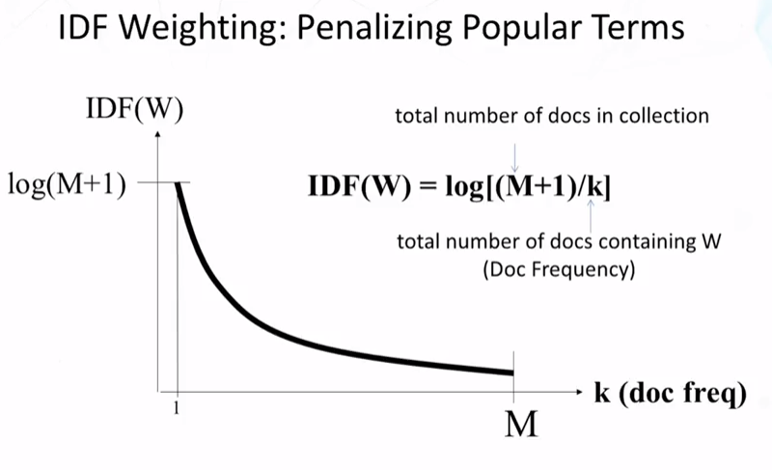
2.1 Vector Space Model – Improved Instantiation

Slide 5
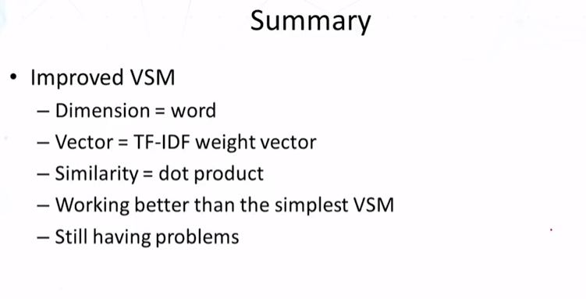
2.1 Vector Space Model – Improved Instantiation

Slide 6
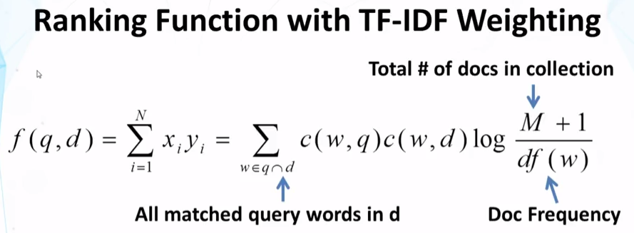
2.2 TF Transformation

Slide 7
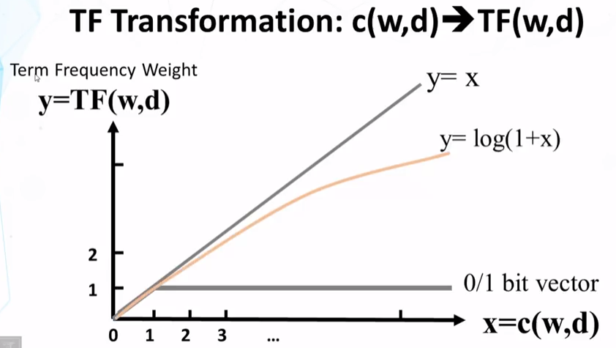
2.2 TF Transformation

Slide 8
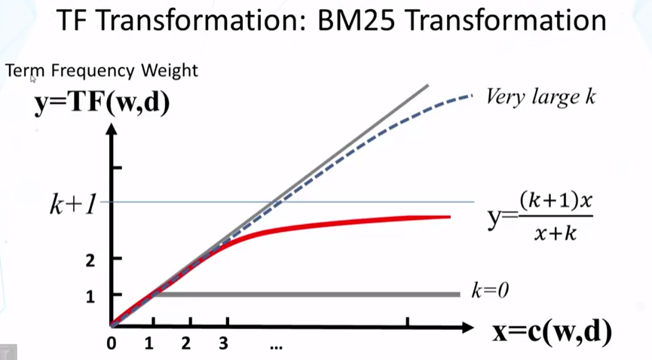
2.2 TF Transformation

Slide 9
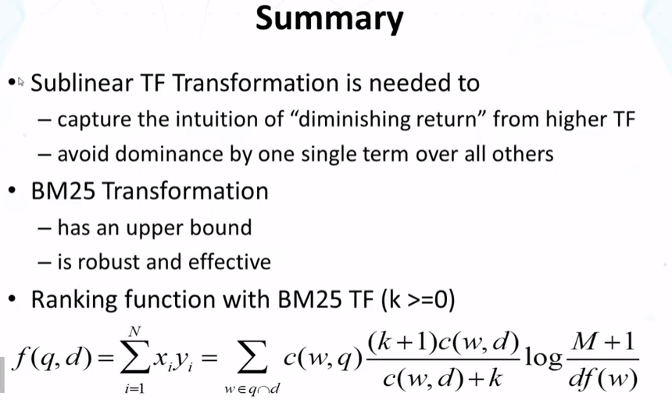
2.2 TF Transformation

Slide 10
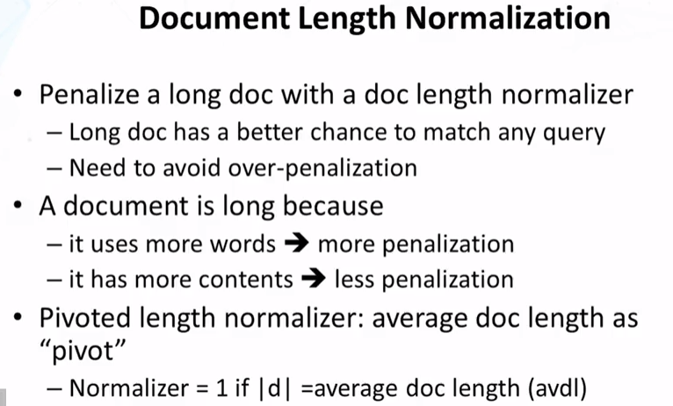
2.3 Doc Length Normalization

Slide 11
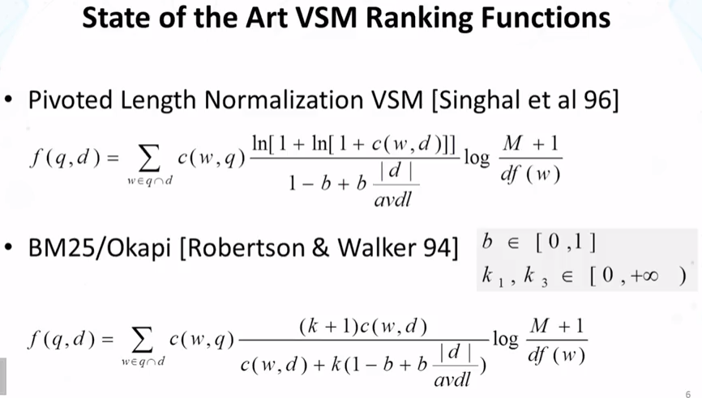
2.3 Doc Length Normalization

Slide 12
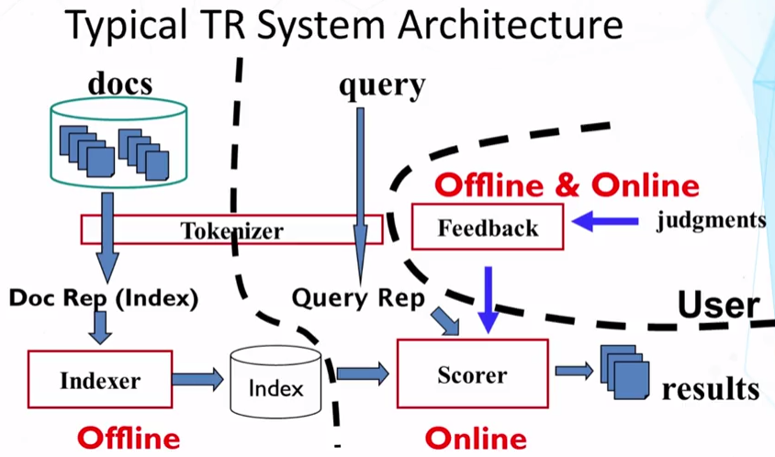
2.4 Implementation of TR Systems

Slide 13
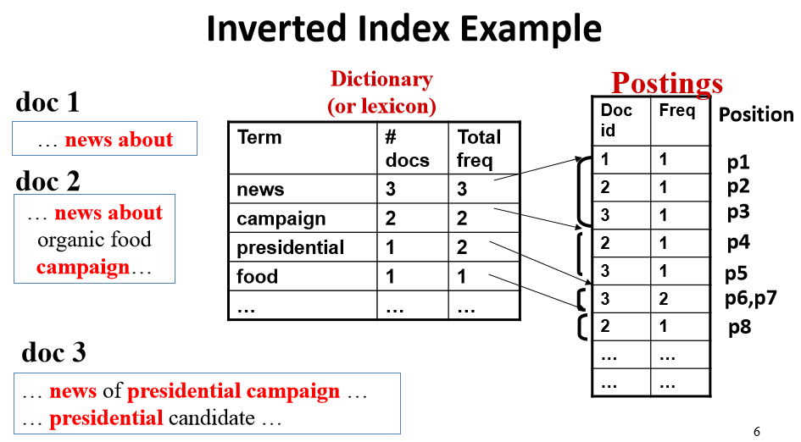
2.4 Implementation of TR Systems

Slide 14
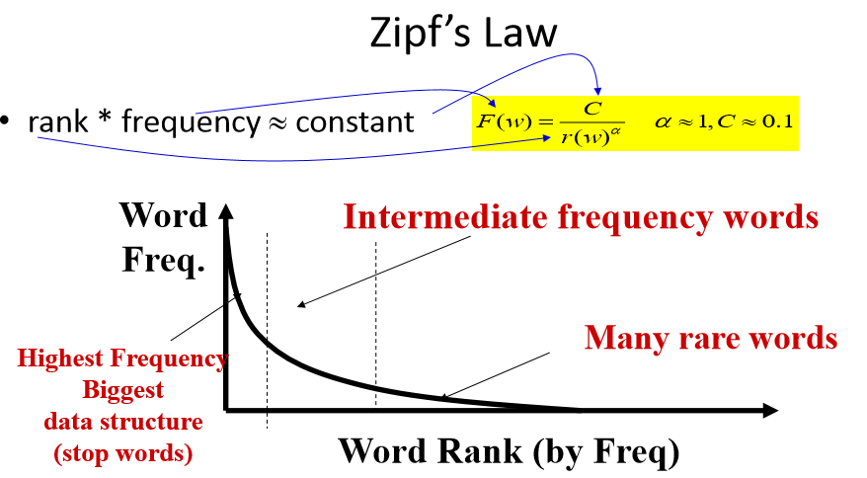
2.4 Implementation of TR Systems

Slide 15
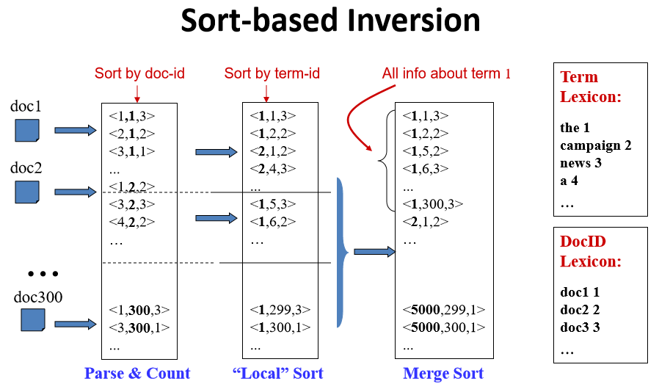
2.5 System Implementation – Inverted Index Construction

Slide 16
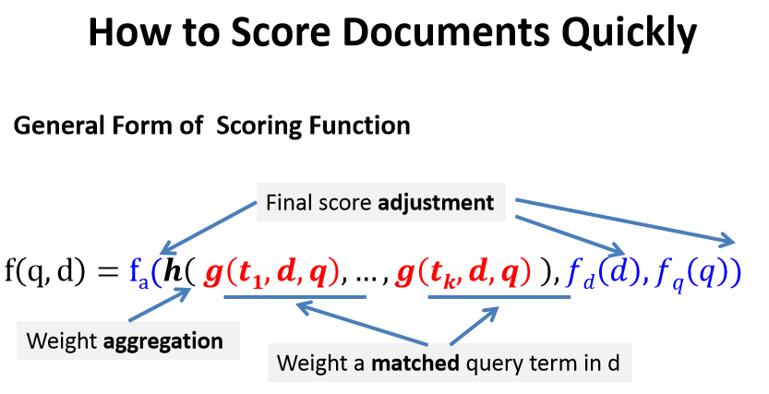
2.6 System Implementation –Fast Search

Slide 17
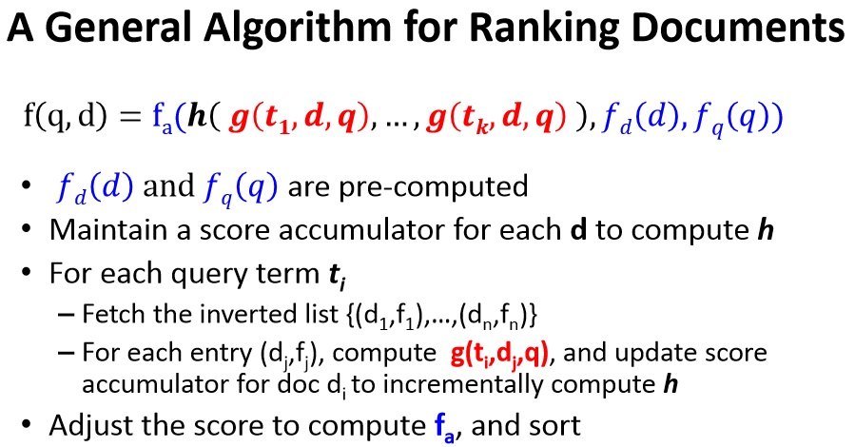
2.6 System Implementation –Fast Search

Slide 18
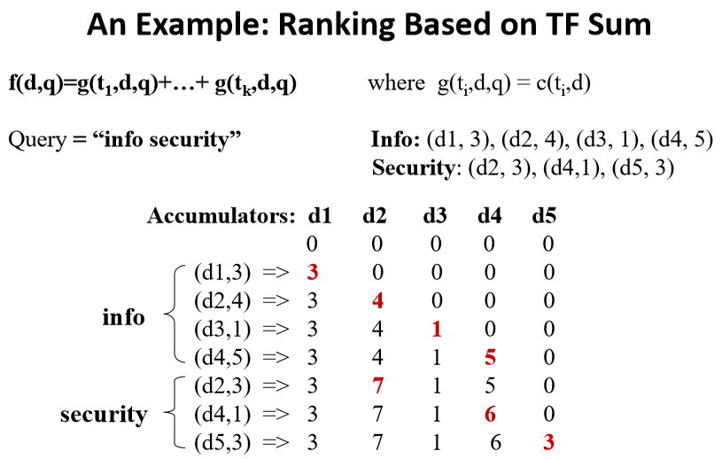
2.6 System Implementation –Fast Search

Slide 19
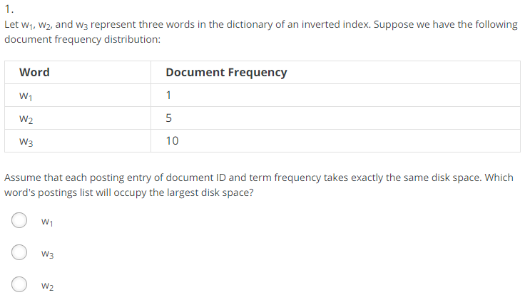
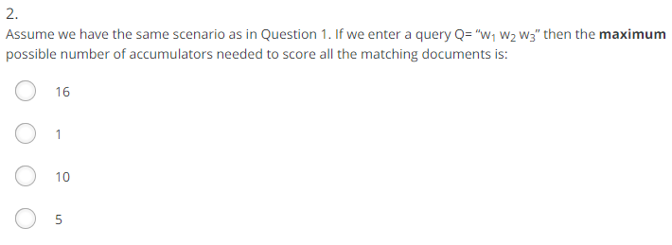
Practice Quiz
2
1

Slide 20
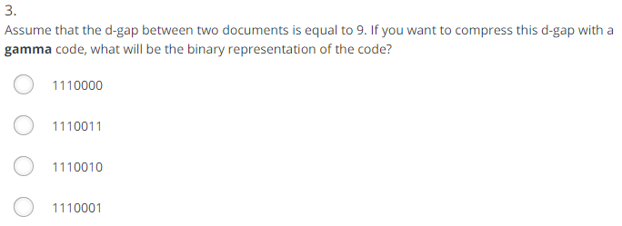


Practice Quiz
4
1+floor(log(9)) = 4, which can be represented as 1110 in unary code. 9 – 2^(floor(log(9))) = 1, which can be represented as 001 in a uniform code with 3 bits. The gamma code is the concatenation of the unary and uniform codes.
1
2

Slide 21





Practice Quiz
1
3
1
1
3

Slide 22
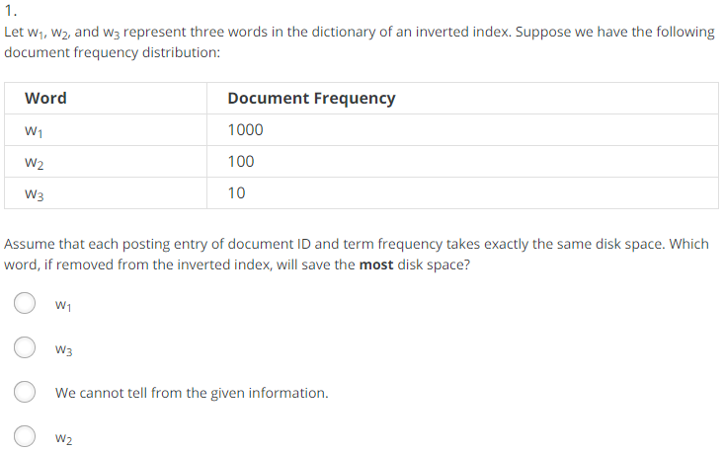
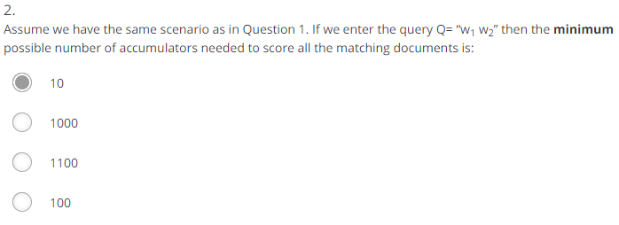
Quiz

Slide 23
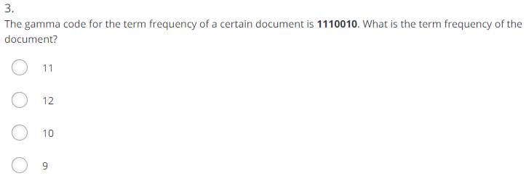
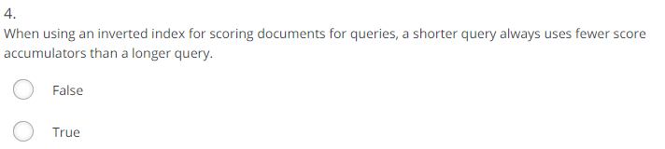
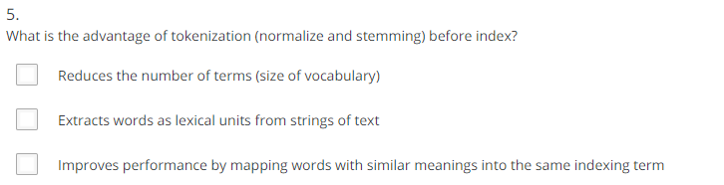
Quiz

Slide 24
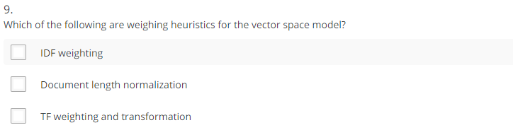




Quiz

