Slide 1

THE 7TH TIMEPIE LONGEVITY FORUM · BIOHACKER TRACK
BIOHACK.IT
Turn self-experimentation into evidence.
Open infrastructure for structured human self-experimentation.
PRESENTED AT
September 12–13, 2026 · Shanghai
Open source · AGPL-3.0 · Non-profit — Hacking Biology

Slide 2
THE GAP
Longevity intervention is running far ahead of longevity measurement.
People already adopt off-label drugs, peptides, HBOT, plasmapheresis. But the protocol lives in spreadsheets, forum posts and chat prompts — not comparable, not followable, not readable by a physician.
130+
N = 1
0
biomarkers a serious protocol tracks — blood, DNA methylation, DEXA
an isolated self-experiment carries almost no statistical power
shared representation layer for protocol & biomarker across people and labs
Bryan Johnson has a lab and a team. Everyone else has a spreadsheet. A thousand N-of-1 on the same protocol, made comparable, are a different scientific object — and it doesn't exist yet.

Slide 3
WHO IS EXPOSED
The beginner who copies is the person most at risk.
PRIMARY USER
HIGHEST RISK
RECIPIENT, NOT USER
The experienced biohacker
The beginner who copies
The treating physician
Designs, self-administers, iterates — but the results today are just anecdotes: claimed, not measured, impossible to compare.
Reads a forum thread or an influencer hyping a compound and starts taking it — no baseline, no safety markers, no measurement.
Today receives, at best, a handwritten sheet. Deserves a legible, complete view of what is taken and why.
The person who copies an off-label compound off a forum thread — without knowing to monitor kidney and liver — is exactly the case where the platform protects health.

Slide 4
WHAT MAKES IT COMPUTABLE
The same protocol, written three ways, is one entity.
This is the whole project in three lines. Our real asset is not an app — it is standardising something nobody has standardised.
"rapamycin 6mg weekly" "sirolimus 6 mg every Sunday" "Rapa 6 mg q7d"
──▶
RxNorm 35302 · 6 mg · every 7 days · pulsed
human-readable, research-useless
one computable entity, linked to your biomarkers over time
Do this ten thousand times and a forum's worth of prose becomes a dataset.

Slide 5
HOW IT WORKS
From one intervention to shared evidence.
Intervention
→
Measurement
→
Individual effect
→
Cohort
→
Evidence
Intervention what you take and do — dose, timing, real cycle schema, versioned with every change.
Measurement standards-coded biomarkers (LOINC/UCUM) with lab, method and provenance attached.
Individual effect your own before/after, bound to the protocol version that was active at the time.
Cohort everyone running the same protocol, weighted by adherence and data completeness.
Evidence an open dataset the community — and researchers — can actually interrogate.

Slide 6
THE PLATFORM
Document your protocol. Measure it. Share it.
01 — DOCUMENT
02 — MEASURE
03 — SHARE
What you take & do
Efficacy & safety
Open by default
Substances, therapies, exercise, nutrition — with dose, timing and real cycle schemas. Create from scratch, or copy any public protocol with one click.
Biomarkers with reference, optimal and safety ranges, plus biological clocks (PhenoAge, epigenetic, glycation). Upload past lab reports, get your history in graphs.
Publish your protocol and its outcomes. Quality comes from three layers: deterministic validation, community review, expert oversight.
Open source, free, non-profit — built on the community that already exists, not a forum rebuilt from scratch.

Slide 7
FOR HACKERS
GitHub for biological self-experimentation.
If you have ever used version control, you already know how this works.
repository
a protocol
issues
a contested claim, discussed in public
fork
copying someone's protocol
telemetry
your biomarkers over time
commit
a dose change, with its reason
README
the doctor sheet
release
a protocol version
dataset
the open research output
CI
safety monitoring — baseline, inherited markers, overdue

Slide 8
DATA MODEL
Three questions, deliberately kept apart.
TestingProtocol
TreatmentPlan
Goal
What I measure, and when. A versioned set of measures and timepoints.
What I take and do. Versioned interventions — self-managed or physician-assigned.
What I want to change. Mapped onto the Hallmarks of Aging.
Substance → SafetyRule → Biomarker → Measurement → Dashboard
“What you take” and “how you are” are the same data structure, read from two sides.

Slide 9
HARM REDUCTION
Follow a protocol — inherit its safety.
Mandatory baseline before you can follow a protocol at all — plus an explicit risk acknowledgment.
Safety markers inherited automatically from every active compound — safety is never opt-in.
Dose sanity check catches the extra zero — plausibility validation of a number, not clinical advice.
Overdue is a safety gap “rapamycin active for 94 days, liver panel overdue by 34.”
This is the module that justifies the project. Biohackers already take the risk today — without any of it.

Slide 10
THE MVP · WHAT SHIPS FIRST
Upload your past lab reports. Get your clinical history in graphs. Free.
A HARD BOUNDARY
BUILT FOR AGGREGATION
The LLM writes words, never numbers
LOINC + UCUM + method, every value
Extraction, mapping and thresholds are deterministic and reproducible. The model only produces the plain-language narration — generated once and cached.
The only architecture compatible with releasing open data. Three ranges per analyte: laboratory reference, longevity-optimal, safety — each with its source.
A sentence you can say on television without pronouncing the word “biohacking”, with no regulatory exposure — and it works with a single user and no community.

Slide 11
WHAT THIS IS — AND WHAT IT IS NOT
We are not a clinical trial, and we say so first.
This is self-managed, self-declared, self-selected experimentation. No randomisation, no blinding, no controlled conditions. People change protocol halfway, measure irregularly, and drop out.
The honest comparison is not biohack.it versus a clinical trial — we lose that one, and we are not trying to win it. It is biohack.it versus what exists today: a dose written in prose, a screenshot of a lab report, a spreadsheet nobody else can open.
Every number carries its confidence value, uncertainty, provenance and evidence level — or it is not shown.
Observed, never caused “among qualifying users exposed to X, the observed change was Y.”
Negative results are welcome “I tried X. Nothing happened.” — the data biohacking always loses.

Slide 12
WHAT NO ONE ELSE CAN BUILD
What the literature predicts, beside what practitioners actually show.
THE ORIGINALITY
Outcome ↔ Biomarker
Anyone can draw the first line — it is in the literature. Only a platform with a living community and shared, standards-coded biomarkers can draw the second, and put them side by side.
Illustrative. We report what was observed in a self-selected group — never that the intervention caused it.

Slide 13
OPEN BY DEFAULT
Open data first, linked data second, API third.
SELF-GENERATED
THEN
BY CONSTRUCTION
Open & linked data
Research API
Impossible to enclose
Everything public — profiles, protocols, treatments, measurements — is released as a clonable snapshot, coded and linked, sufficient to seed an independent instance.
A documented endpoint returning de-identified, methodologically annotated cohort data. Ask for an intervention and a biomarker, get an answer with its caveats attached.
AGPL-3.0: anyone running it as a service must open the source. Fork it, self-host it, keep the community's data in the community's hands.
Standards, not silos: HL7 FHIR internally, OMOP for research export, LOINC/UCUM for analytes — so what you produce is research data, not another wellness silo.

Slide 14
BUILT IN THE OPEN
The whole specification is public before the first line of product.
24 capabilities, 140+ requirements — protocols, biomarkers, safety, community, evidence and open data — browsable at biohack.it/specs, growing with community review.
Protocols
Blood Layer
Safety guardrails
create · copy · import · versioned
biomarkers · clocks · deterministic
baseline · inheritance · dose check
Community & Studies
Open Data & Standards
AI, Evidence & Provenance
follow/copy · cohorts · N-of-1
LOINC/UCUM · FHIR/OMOP · clonable
AI4L · Evipedia · attribution
Specifying broadly costs little. Building broadly costs everything — so what we build first is deliberately narrow.

Slide 15
MVP FIRST
Breadth in thinking, discipline in shipping.
NOW
MVP
NEXT
THEN
THEN
DESTINATION
Foundations
Useful to one
Adherence
Useful to many
Open data
Distributed trials
Domain model, biomarker registry, coded catalogue, safety rules.
Protocol · Blood Layer · Safety · Doctor sheet.
Daily log — thirty seconds a day.
Public protocols, follow & copy, pre-registered N-of-1.
Cohorts, open & linked data, then a research API.
Shared protocols, endpoints declared in advance.
Deferred without regret: procurement, advanced nutrition, therapeutics scheduling, genomics beyond import, agent access.

Slide 16
JOIN US
Build this with us.
This is open infrastructure, and it is early. Every one of these roles is genuinely open — and each one changes what the project becomes.
Biohackers
Software hackers
Researchers & scientists
Longevity enthusiasts
Fundraisers & philanthropy
Bring your experience into the specification, and your protocols and measurements into the software.
Build it. AGPL, public specification, open issues — written down before it is written in code.
Keep us honest on validity, uncertainty and evidence — while keeping it usable by a beginner.
Volunteer to spread it: community, translation, events. A tool nobody knows about produces no data.
Build the funding pipeline — grants and philanthropy — so it never has to become commercial.
Tell us which of the five you are — and what you would like to work on.

Slide 17

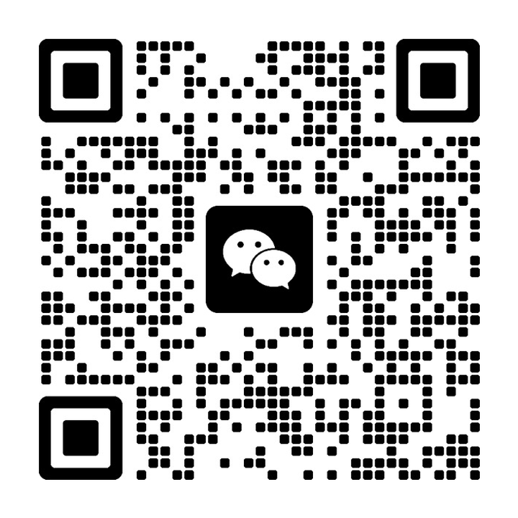
GET IN TOUCH
Contacts & references.
Telegram Group Chat
WeChat 微信
EMAIL
research@hackingbiology.com
WEBSITE
biohack.it
SOURCE
github.com/hackingbiology/biohackit
Scan, or open t.me/+0qg9-HC4Nx45OTI8 — project updates and open discussion.
Scan to add Fabio — he will add you to the biohack.it group chat.
COMMUNITY
rapamycin.news

Slide 18
THE INVITATION
Everyone buys anti-aging. Almost no one measures it.
Let's measure it — together, in the open.
Open infrastructure for structured human self-experimentation — fork it, self-host it, own your data. The community already exists; now it gets its instrument.
BIOHACK.IT
AN OPEN LABORATORY FOR LONGEVITY · NON-PROFIT · AGPL-3.0

