Slide 1
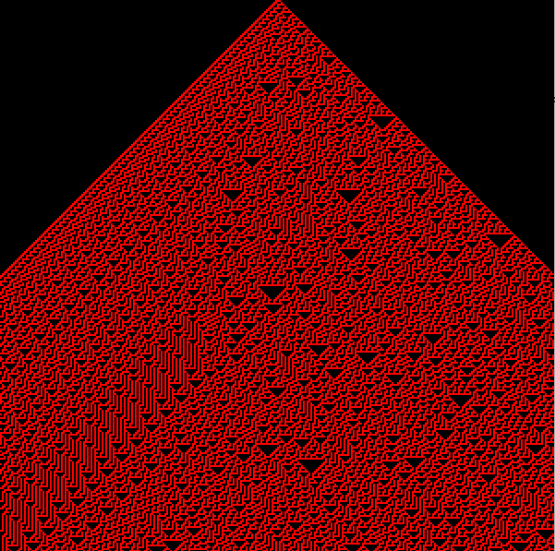
Hacking Math Class
BAy PIGgies
July 21, 2016

Slide 2
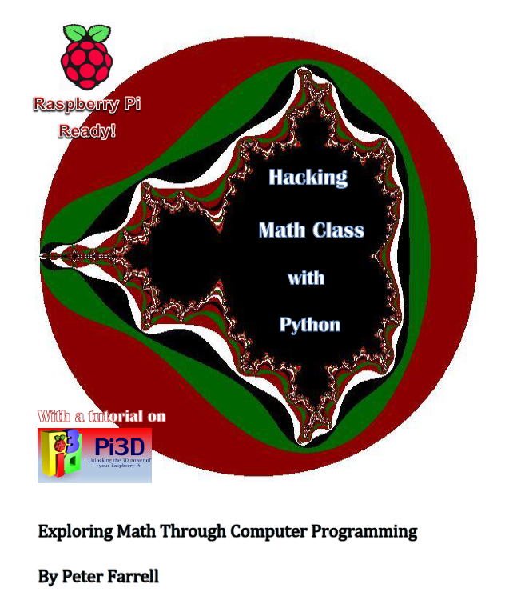
Another Math Book

Slide 3
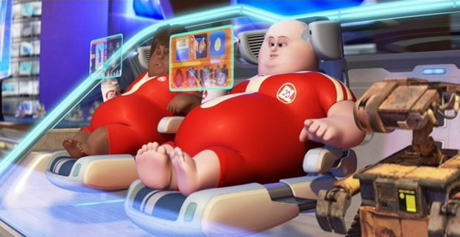
Computer Aided?

Slide 4
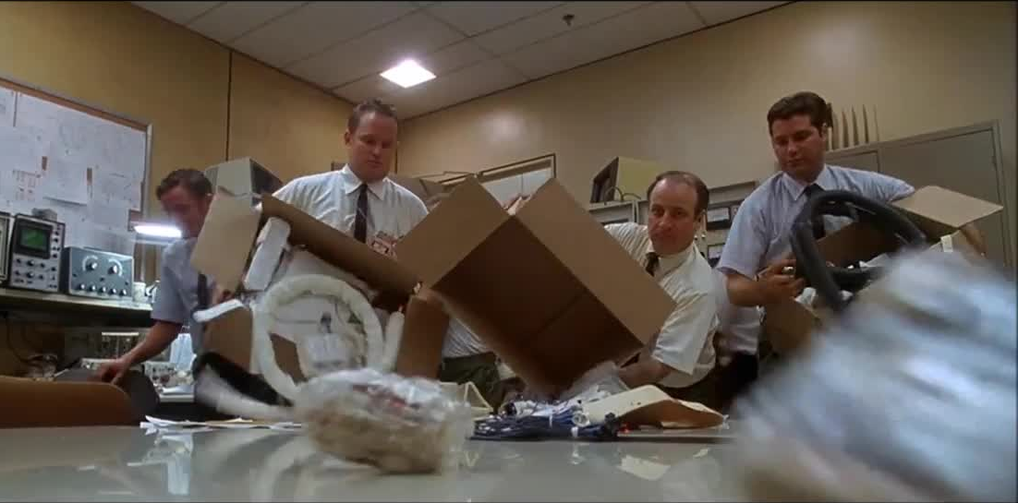
Just These Tools

Slide 5
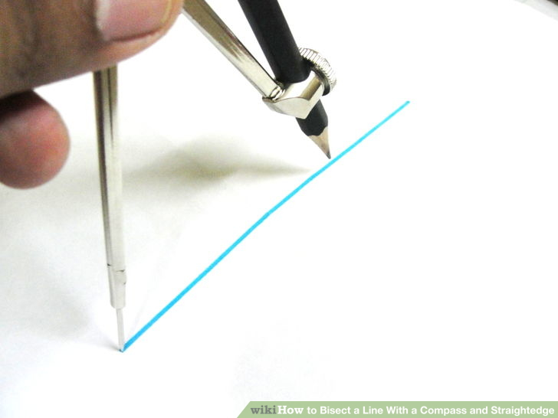
Compass and Straightedge

Slide 6
Programming Tools
Loops
Functions
Variables
Conditionals
Lists

Slide 7
DIY
Computers should make it harder
But:
  The computer can do the arithmetic
  Code can be reused
  Extending patterns is possible
  You're learning to program
  You're doing something interesting

Slide 8
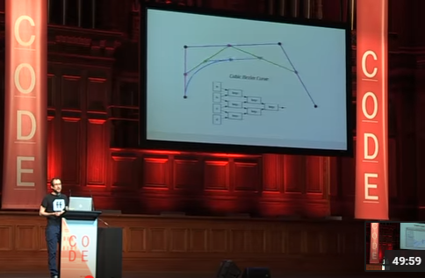
Do What's Interesting
“When you’re playing with math, you don’t need to do anything right, you can just do what’s interesting.” - Steven Wittens

Slide 9

Turtles

Slide 10
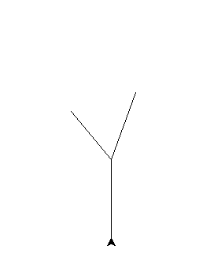
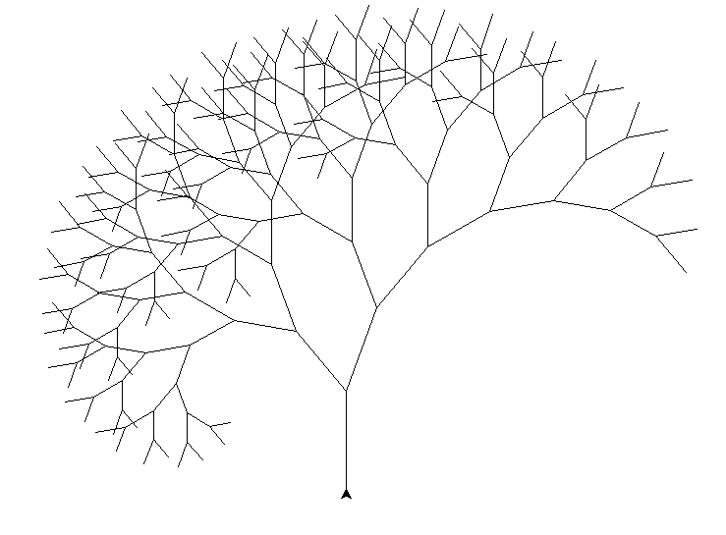
Fractals

Slide 11
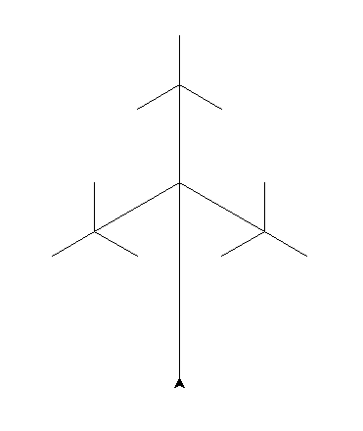
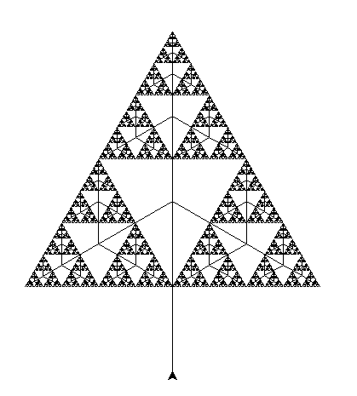
Fractals

Slide 12
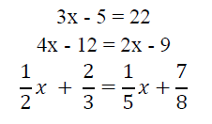
Code a Solver

Slide 13
Code a Solver

Slide 14
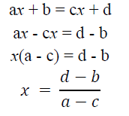
Abstract It

Slide 15
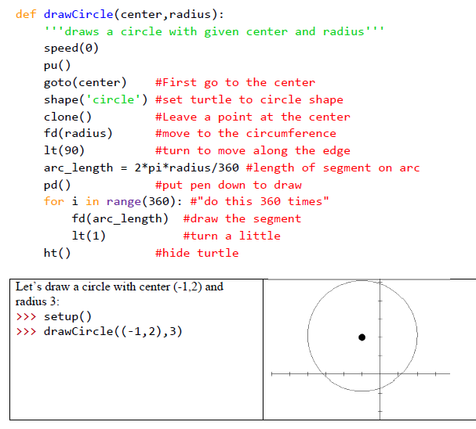
Geometry

Slide 16
Calculus
Derivatives: Don't You Mean Slope?
Integrals: Drawing Lots of Rectangles

Slide 17
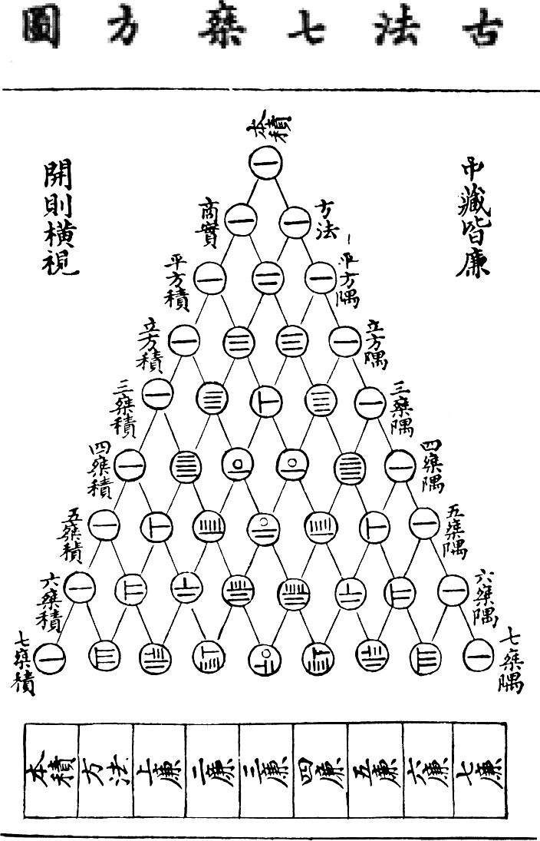
Patterns

Slide 18
Cellular Automata (CA's)
Teach your computer a rule
Have it repeat the rule a bunch of times

Slide 19


Slide 20
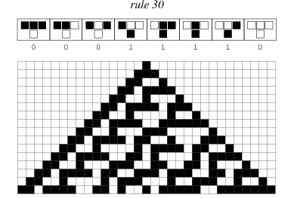
Simple Rule

Slide 21
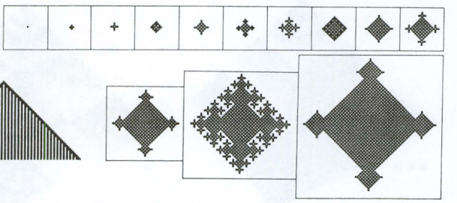
2D CA

Slide 22
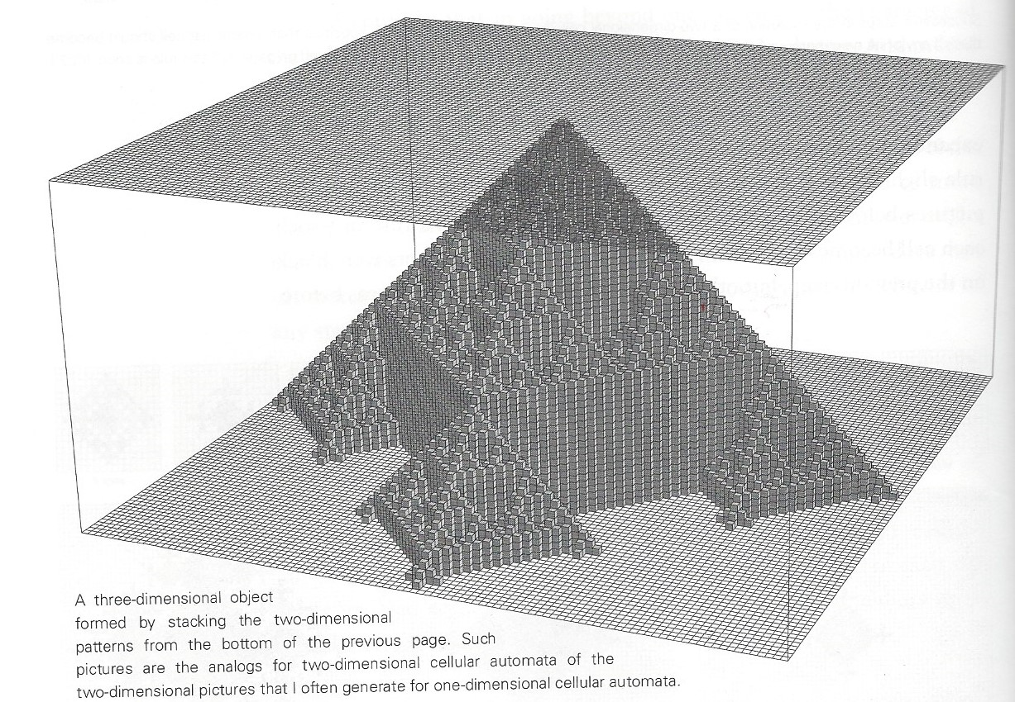
Made into a Pyramid!

Slide 23
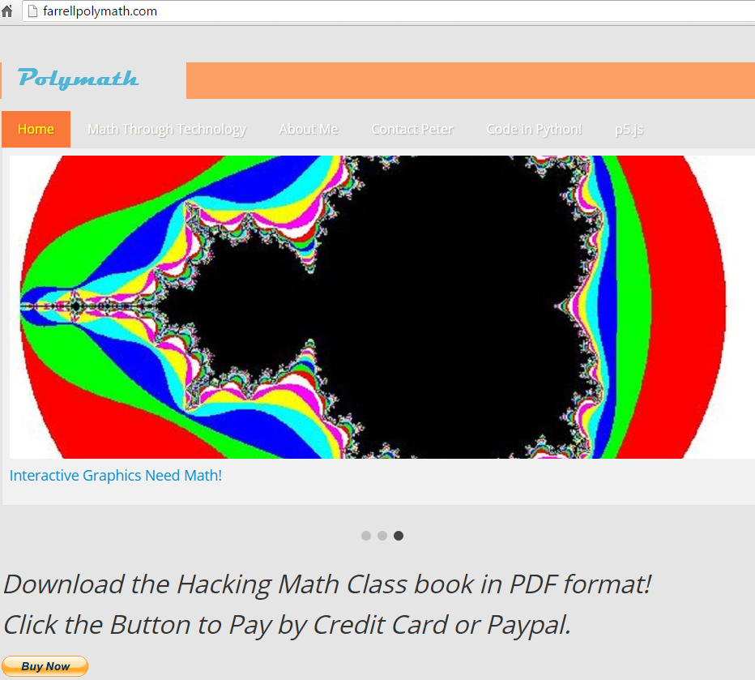
farrellpolymath.com

Slide 24
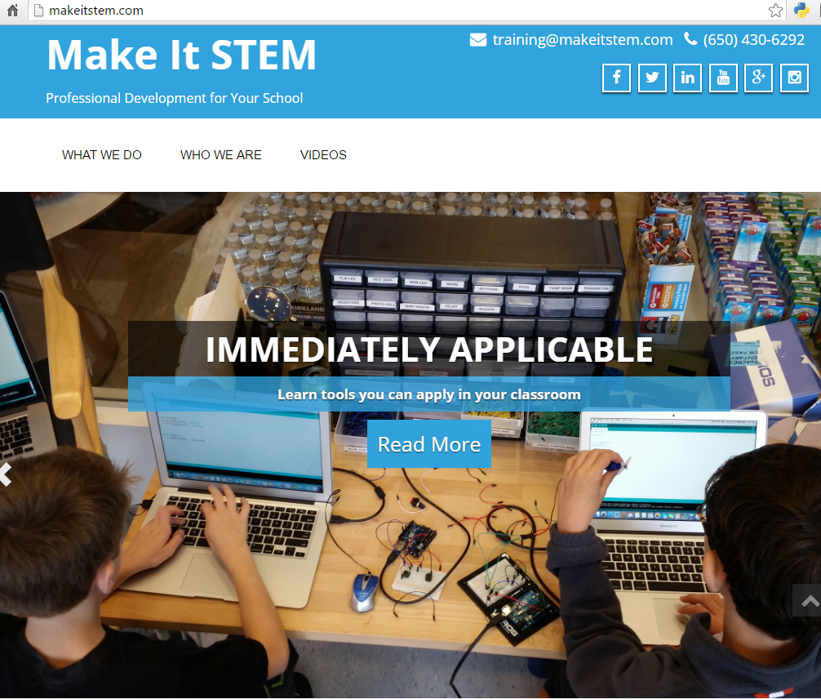
Makeitstem.com

Slide 25
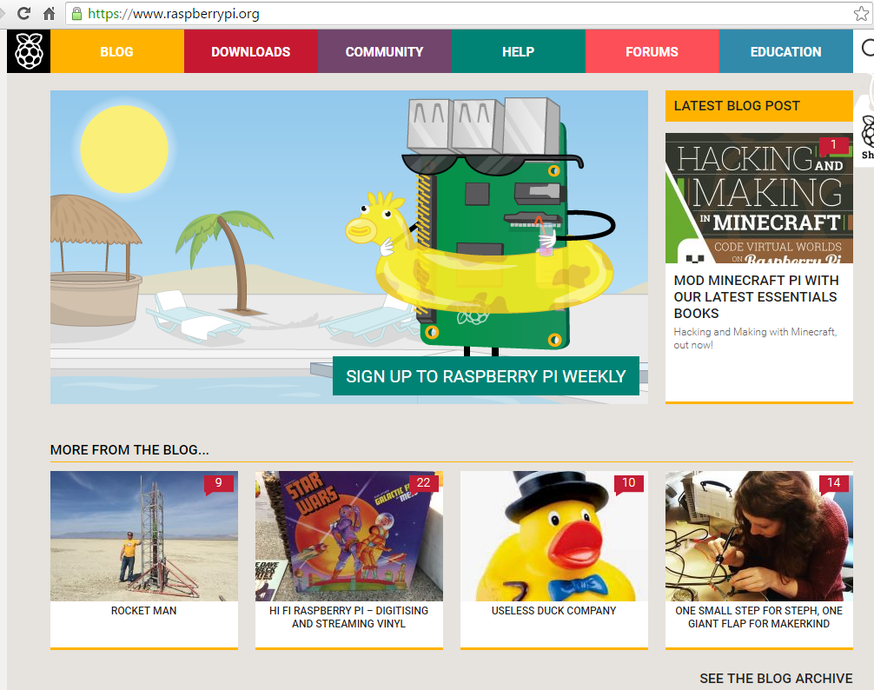
raspberrypi.org

Slide 26
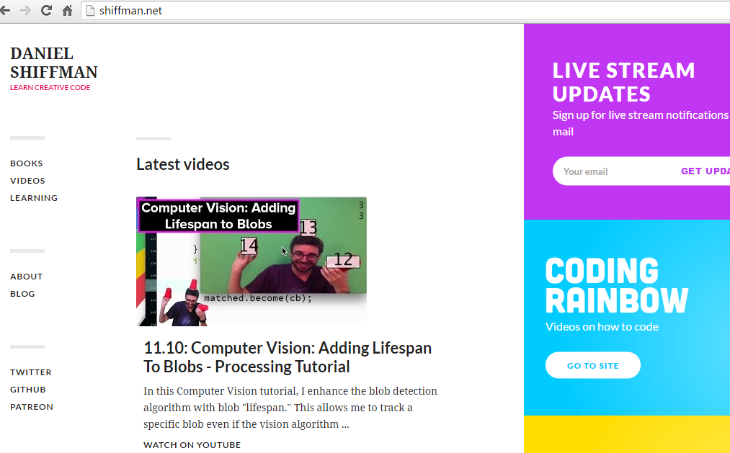
Dan Shiffman

Slide 27
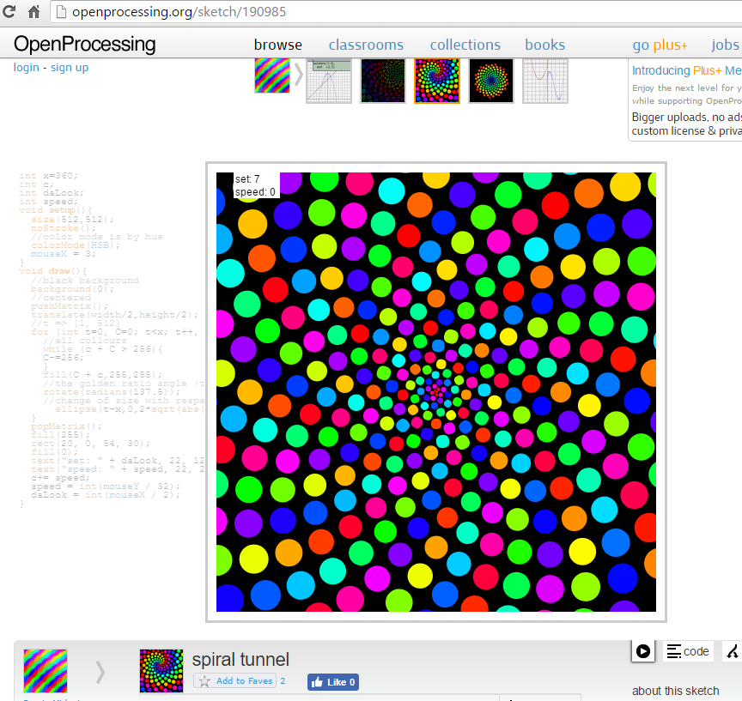
Openprocessing.org

