Slide 1
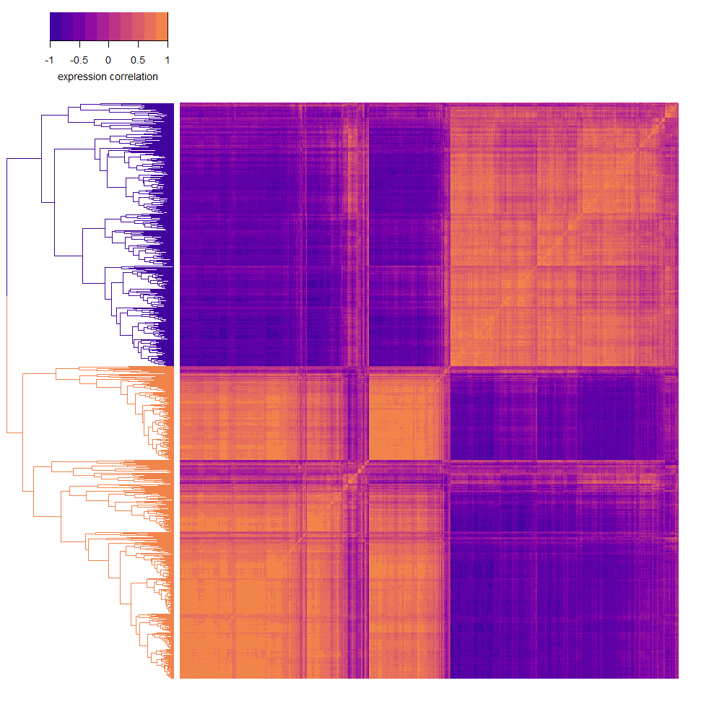
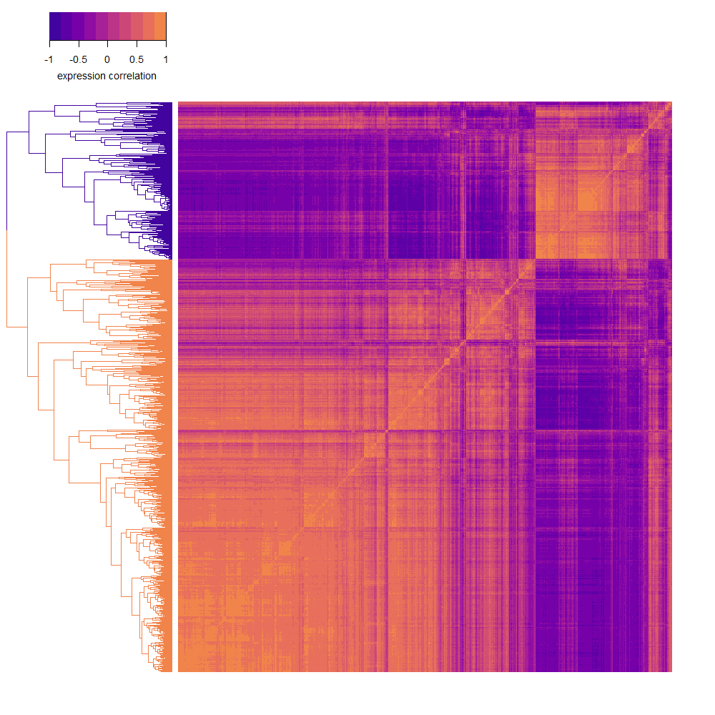
(a)
(b)
S. cerevisiae
(c)
(d)
Hbt. salinarum

Slide 2
(a)
S. cerevisiae
(b)
Hbt. salinarum

Slide 3
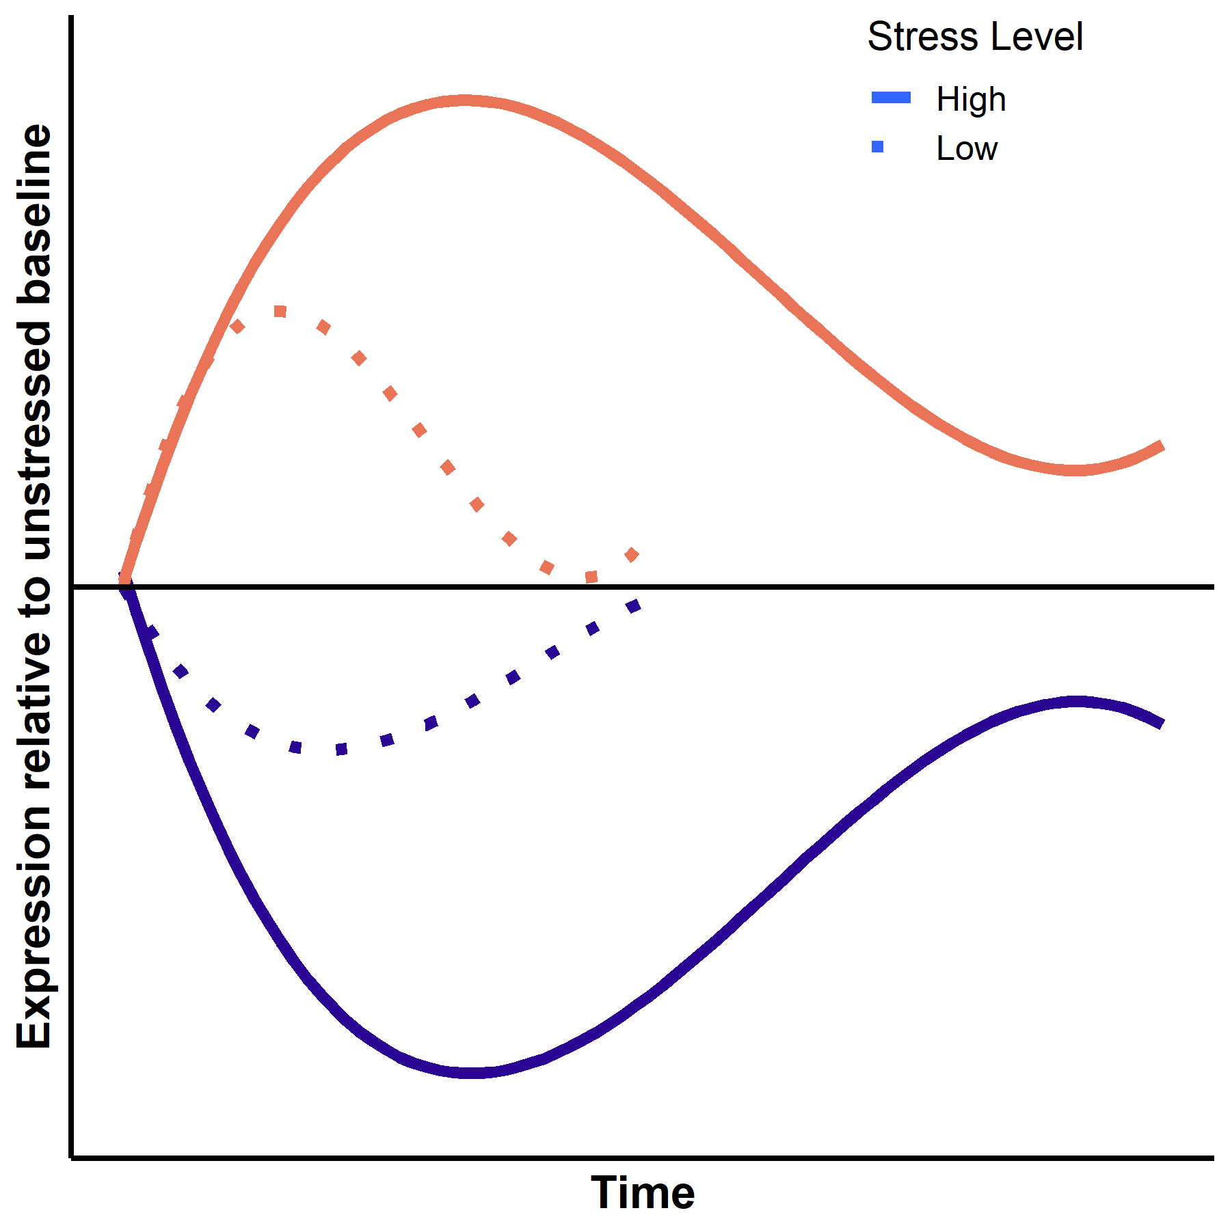



Eukarya
S. cerevisiae
stress
ESR
Archaea
induced genes
repressed genes
induced genes
repressed genes
H. salinarum
induced genes
repressed genes
induced genes
repressed genes
Archaea respond to diverse stresses using a coordinated genome-wide transcriptional program similar to the ESR in yeast

