Slide 1
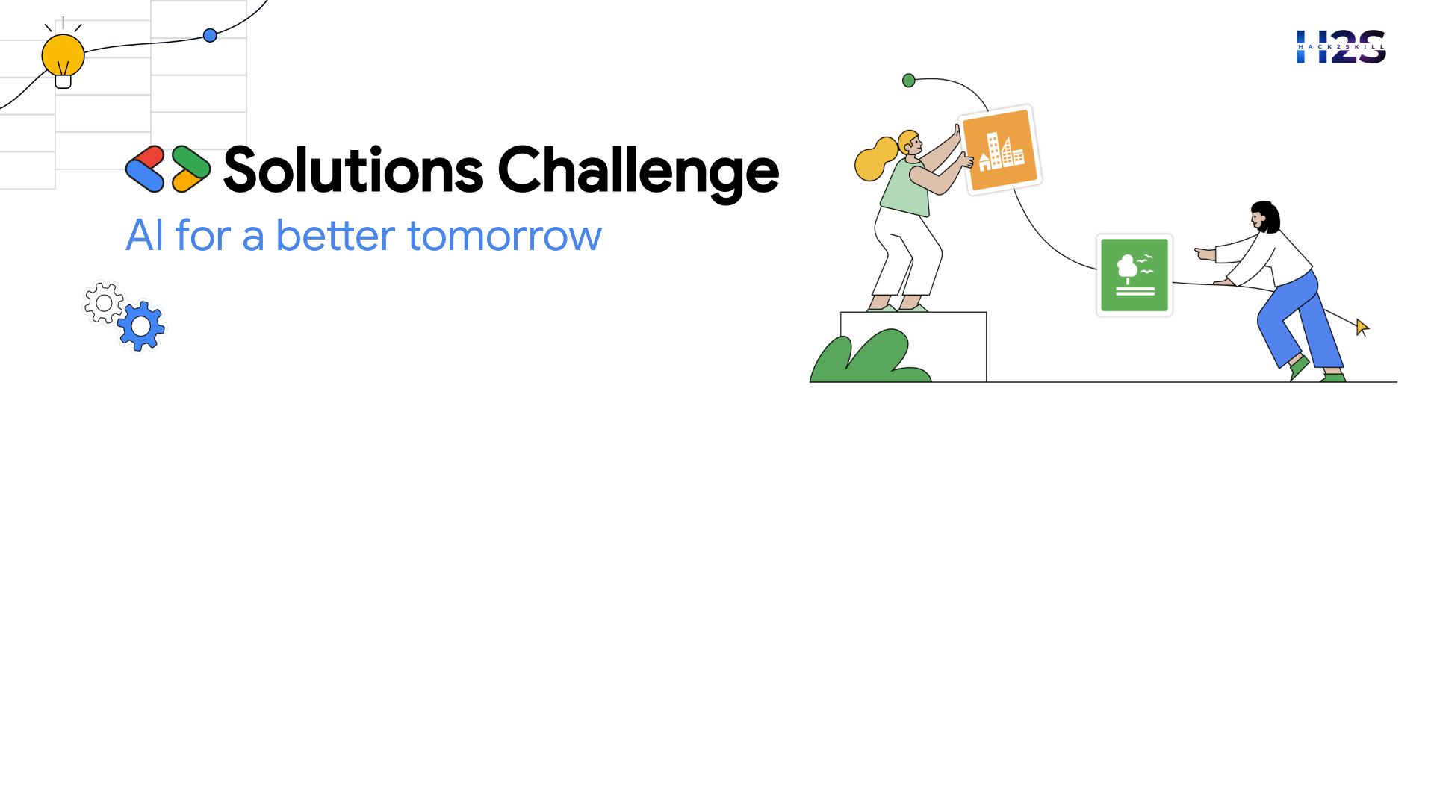
Idea Submission for Bootcamps
Team Details
Team name: VISION HUB
Team leader name: CHAHAT MADHU
Problem Statement: Industry, Innovation and Infrastructure

Slide 2

Brief about the idea
Our Computer Vision API Platform is an AI-powered solution designed to help businesses and developers seamlessly integrate content moderation, image analysis, and media processing into their applications. With just a simple input, users can customize their API behavior—whether it's detecting duplicate images, blocking specific objects or faces, moderating inappropriate content, or optimizing media files. Powered by a smart NLP-based recommendation system, users don’t need technical expertise; they simply describe their needs, and the platform suggests the best API for them.
Built for e-commerce, social media platforms, security, and branding, our system ensures efficient automation and high customization, allowing users to define rules like restricting logos, weapons, or other sensitive content. Though we currently offer five core features, our platform is designed for continuous expansion based on real user demand. This makes it not just a tool for today but a future-ready AI ecosystem, growing alongside industry needs.

Slide 3
Opportunities
How different it is from existing solutions?
Unlike rigid, predefined APIs, our platform offers a customizable, NLP-powered system that adapts to user-specific needs rather than forcing users to fit into fixed models.
How will it solve the problem?
By allowing users to define their own content moderation, image analysis, and face recognition rules, it ensures precise, automated decision-making tailored to individual business needs.
USP (Unique Selling Proposition) of the proposed solution?
A flexible, AI-driven API generation system that evolves based on user requests, making it scalable, adaptable, and future-ready for diverse industries.

Slide 4
List of features offered by the solution
1. Image Duplication Detection – Identifies duplicate or near-duplicate images using similarity thresholds.
2. Content Moderation – Detects and blocks restricted objects (e.g., weapons, NSFW content, logos) based on user-defined filters.
3. Face Recognition & Filtering – Allows users to permit or restrict specific faces in images or videos.
4. Media Processing & Optimization – Provides tools for file size reduction, resolution control, and frame sampling in videos.
5. NLP-Based API Recommendation – Users describe their needs in text, and the system suggests the best-suited API.

Slide 5
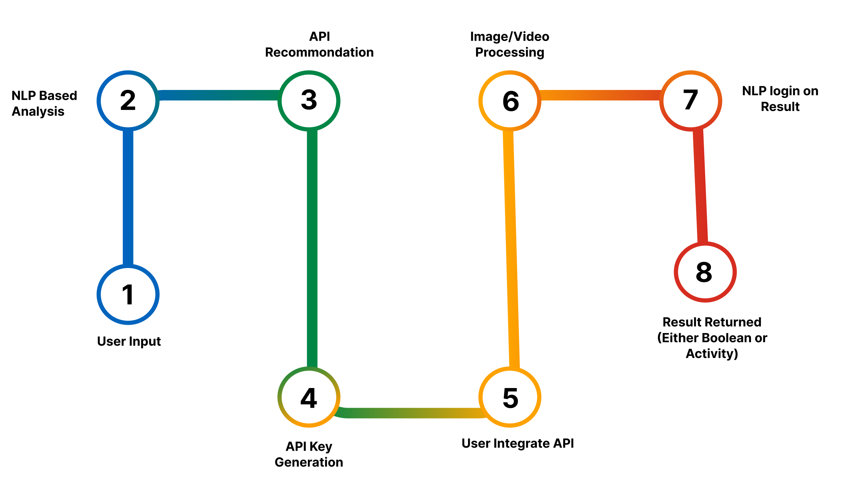
Process flow diagram or Use-case diagram

Slide 6
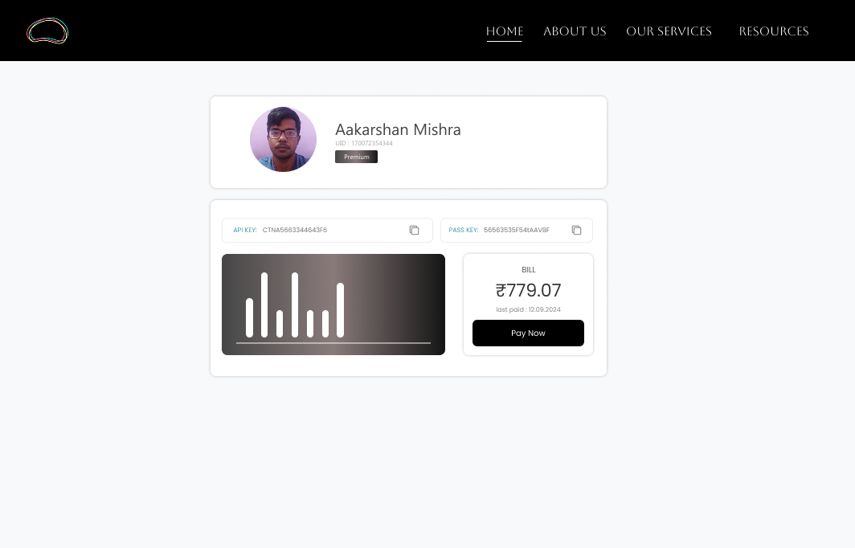
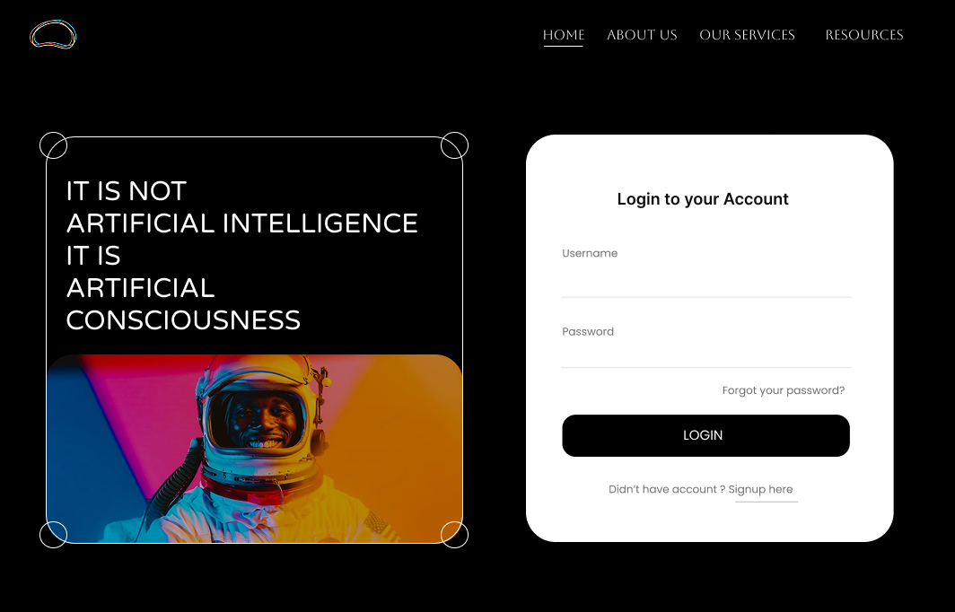
Wireframes/Mock diagrams of the proposed solution (optional)

Slide 7
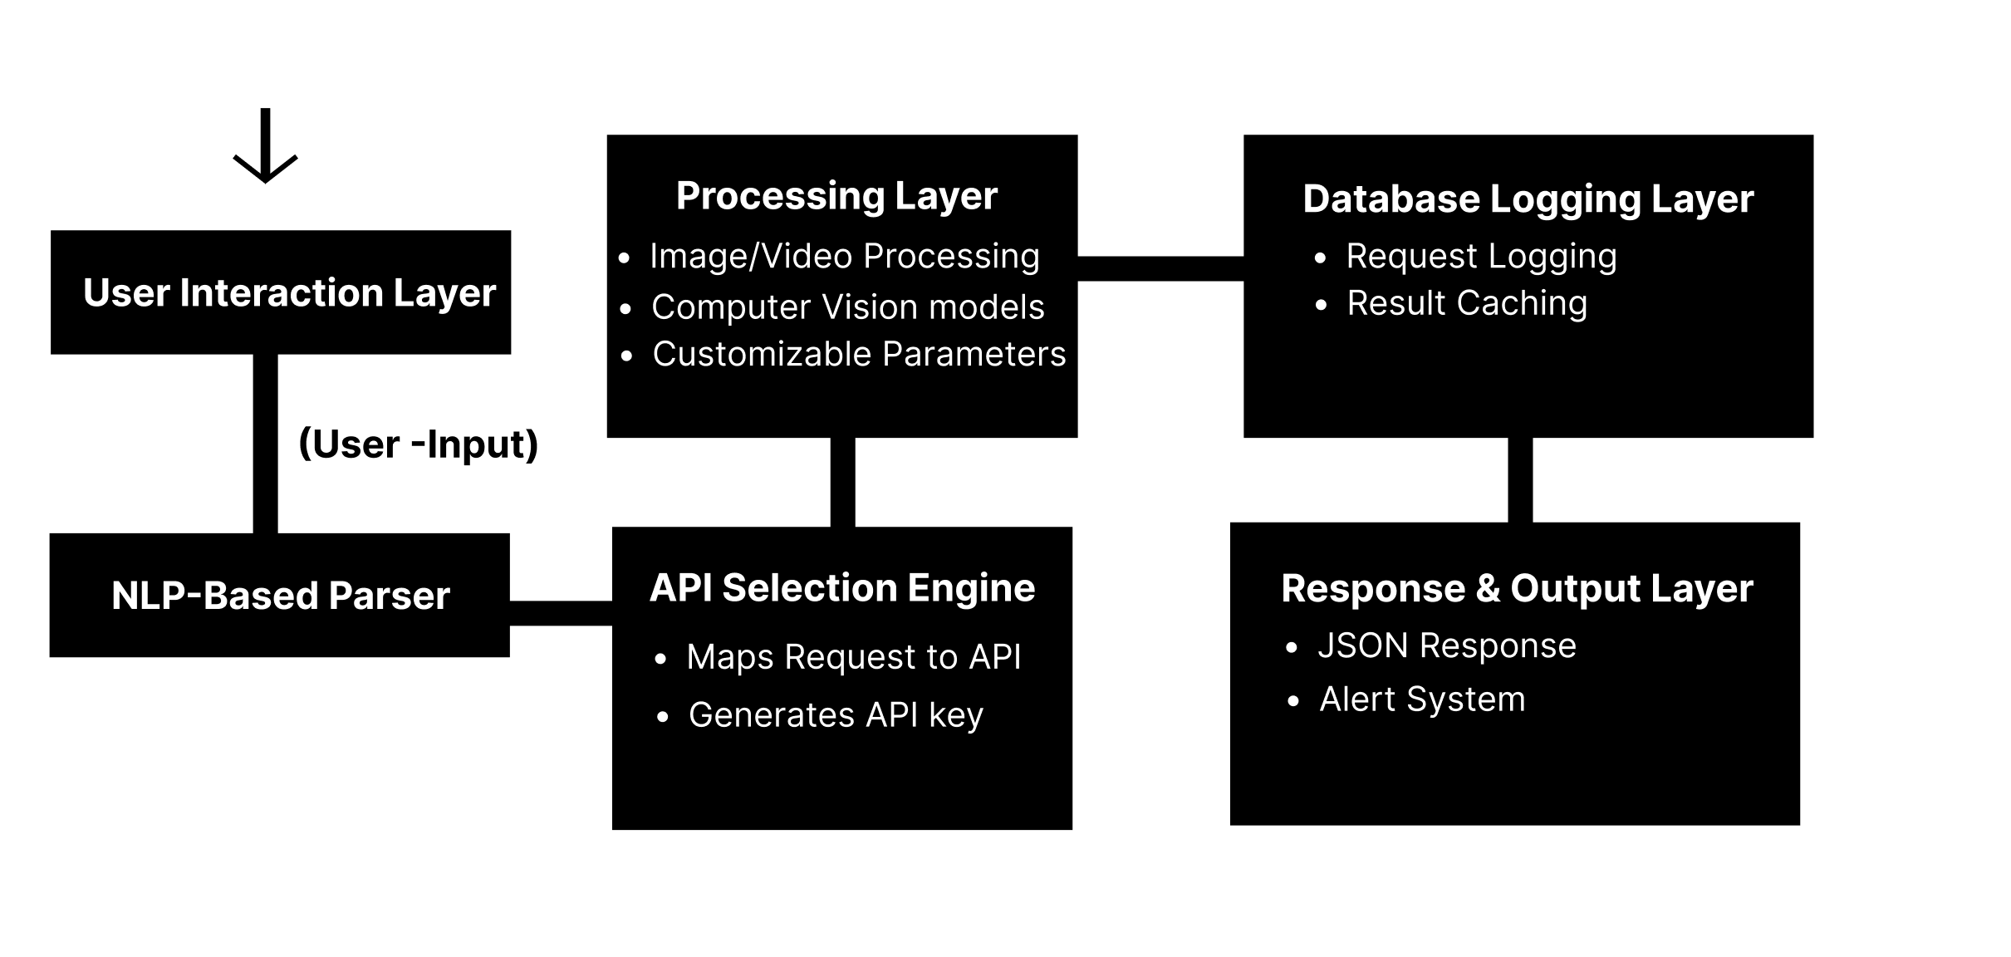
Architecture diagram of the proposed solution

Slide 8
t
Technologies that are being used/planning use during prototype development
1. Backend & API Development
Python (FastAPI / Flask) – For building lightweight and scalable APIs.
2. Computer Vision & AI/ML
OpenCV – For image and video preprocessing.
TensorFlow / PyTorch – For deep learning models (e.g., object detection, facial recognition).
YOLOv8 / EfficientNet – For real-time object detection and classification.
3. NLP for API Recommendation
LLAMA 3.2 : 1b Model for Better nlp operations
4. Database & Storage
PostgreSQL / MySQL – For storing user data, API keys, and logs.
5. Authentication & Security
JWT (JSON Web Tokens) – For secure API authentication.
6. Cloud & Deployment
NGINX
7. Frontent.
HTML,CSS AND JS

Slide 9
Estimated implementation cost (optional)
Estimated cost to implement it with given set of features along with major chunk of GPU and hosting is atleast ₹2.5lacs excluding all the fixed costs
Its still early to judge final costing because of Irregular market price of GPU which affects these AI solution

Slide 10
Additional Details/Future Development (if any)
1. Custom Object Detection – Users can define their own restricted objects beyond preset categories. 2. Real-Time & Streaming Support – Enable live video moderation and webcam feed analysis. 3. LLaVA + Object Detection Fusion – Integrate LLaVA with YOLO/DETR for accurate bounding boxes. 4. Edge AI Deployment – Run models on low-power devices for offline processing. 5. User Dashboard & API Analytics – Track API usage, flagged content, and model performance. 6. Privacy & Security – Encrypted API communication and federated learning for data privacy. 7. AI Model Marketplace – Allow developers to deploy and sell custom AI models.

Slide 11
Provide links to your:
GitHub Public Repository : https://github.com/AKM-dv/

Slide 13


