Slide 1
Configure Linux Servers (On-Prem and in the Cloud) with Windows PowerShell DSC
Tim Warner
timothy-warner@pluralsight.com

Slide 2

Our Agenda
Why PowerShell and DSC are important
Especially for Windows sysadmins who work with Linux
How to configure a Linux VM for PowerShell DSC
This is a (heavily) volatile subject
Where Azure Automation DSC fits in
A fascinating subject in itself
What is Microsoft's vision for PowerShell on Linux

Slide 3
Session Web Site
timw.info/linux

Slide 4


PowerShell and DSC Importance to Linux Systems Administration

Slide 5

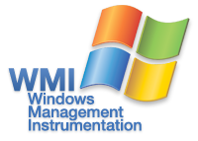


Common Information Model

Slide 6
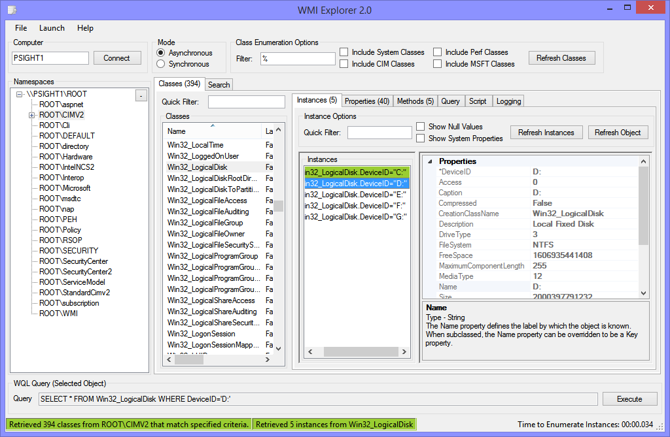

CIM Repository

Slide 7
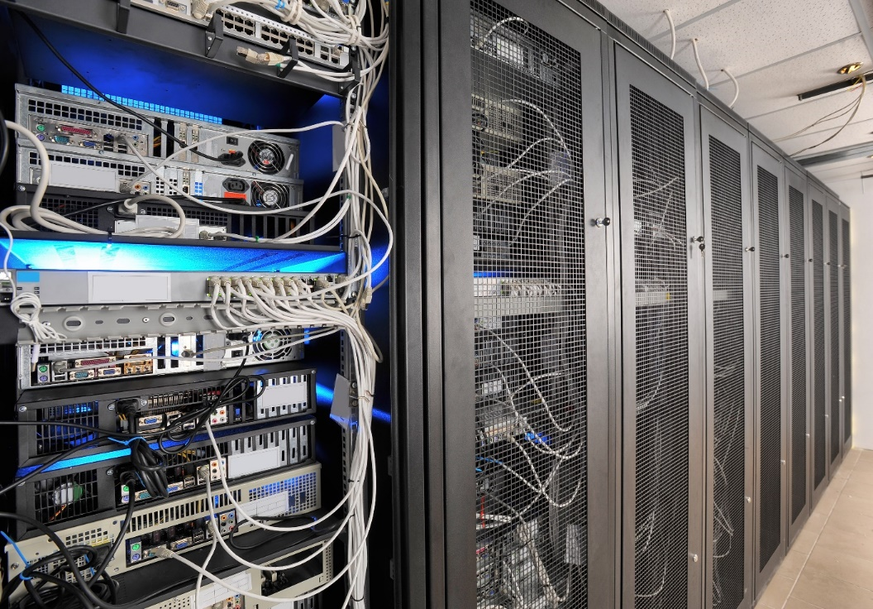

Configuration Drift Ramifications
Reduced security
Compliance failures
Reduced performance
Reduced availability
SLA impacts
High cost of manual management labor
http://timw.info/linux

Slide 8
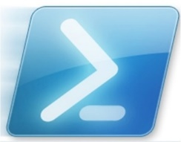





Configuration Management Solutions
Windows PowerShell DSC
http://timw.info/linux

Slide 9
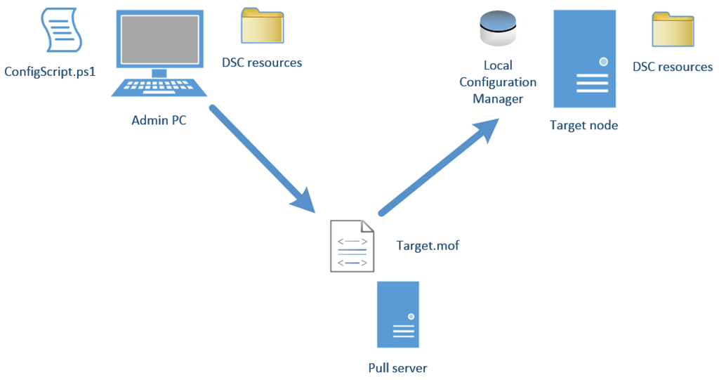

DSC High-Level Architecture
It doesn't matter how you create your configuration MOF documents; PowerShell is simply an easier way to do so
DSC pull servers are flexible (IIS, SMB, Azure Automation)

Slide 10
Let's Talk Vision...
DSC is Microsoft's CM vision
Open-source, standards-based protocols
DSC is not tooling
Azure Automation; "cloud first" strategy
Don't forget
PowerShell is an admin-friendly "wrapper" to .NET (Core), CIM

Slide 11

Prepare a Linux VM for PowerShell 6 and DSC

Slide 12
The High-Level Workflow
Meet OS dependency
See next slide
Open port TCP 5986 on each server node
Install software dependencies
apt, yum, rpm, etc.
Deploy OMI CIM server
Install DSC for Linux
LCM bits, developed in C (not .NET) by Microsoft's UNIX development team
Verify node configuration
/opt/Microsoft/dsc/Scripts
*.py

Slide 13
Supported Linux Distributions (All x64/x86)
CentOS 5,6,7
RHEL Server 5,6,7
Oracle Linux 5,6,7
SUSE ELSE 5,6,7
Debian GNU/Linux 6,7
Ubuntu Server 12.04, 14.04 LTS

Slide 14
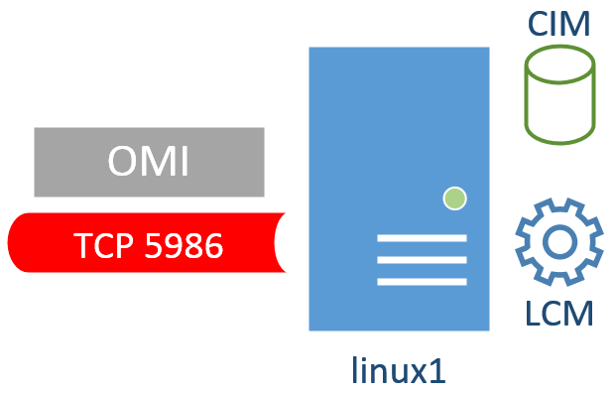
Demo
http://timw.info/linux

Slide 15

Remotely Administer a Linux VM from Windows

Slide 16
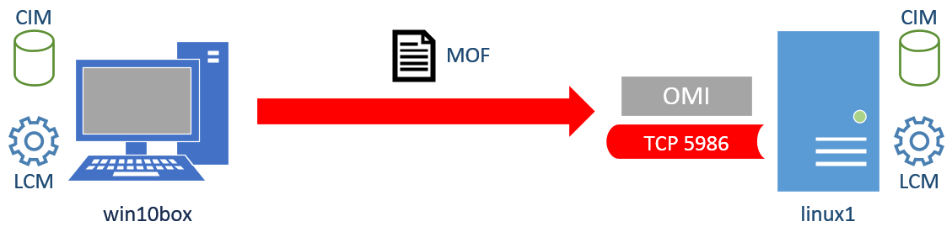
Demo
http://timw.info/linux

Slide 17
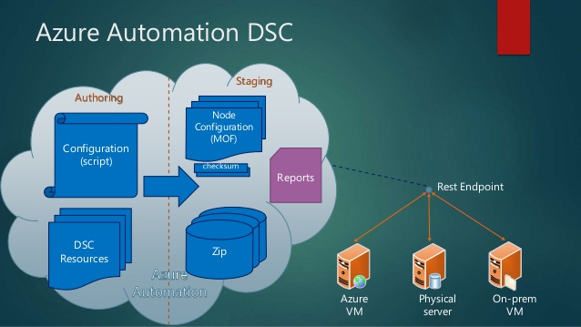
Azure Automation DSC
timw.info/dsc2

Slide 18
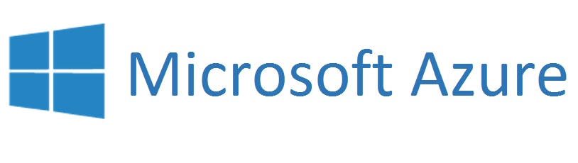
Demo
http://timw.info/linux

Slide 19
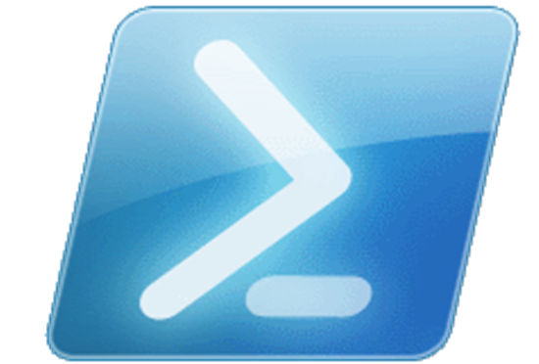
PowerShell on Linux

Slide 20
Let's Talk Vision Again...
PowerShell is a wrapper
Admin-friendly interface to .NET, CIM, REST API endpoints
Linux workloads are popular
PowerShell wraps bash commands
Don't forget
PowerShell brings objects to the table instead of straight text

Slide 21
Questions?
Please use Event Board to fill out a session evaluation.
Thank you!
Tim Warner
timothy-warner@pluralsight.com
@TechTrainerTim
timwarnertech.com
timw.info/linux
http://timw.info/linux

